Slide 1
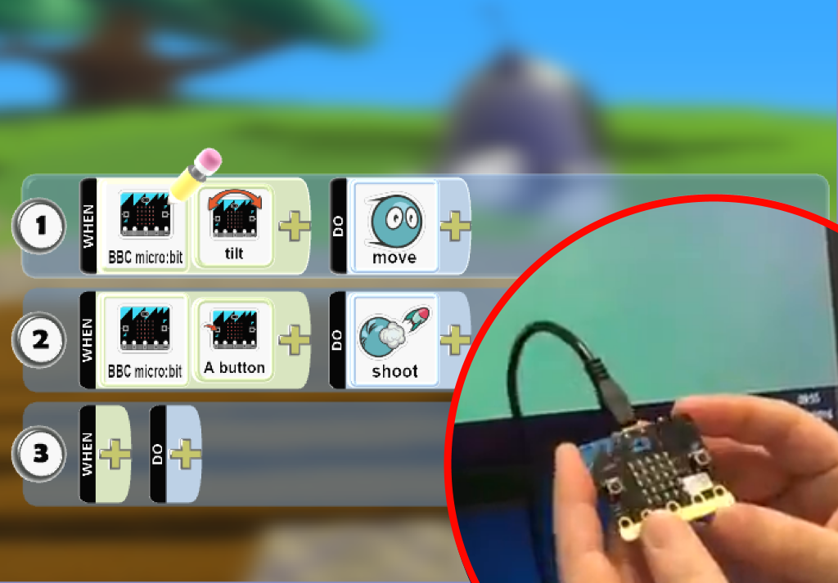
Kodu Game Lab Using the mbit as a Game Controller
mbit programming tiles added to Kodu’s language.
Alternative way to explore mbit capabilities.
Program characters in game to:
Move with the mbit accelerometer.
Jump or shoot on a button press.
Display animations on the LED screen.

