Slide 1
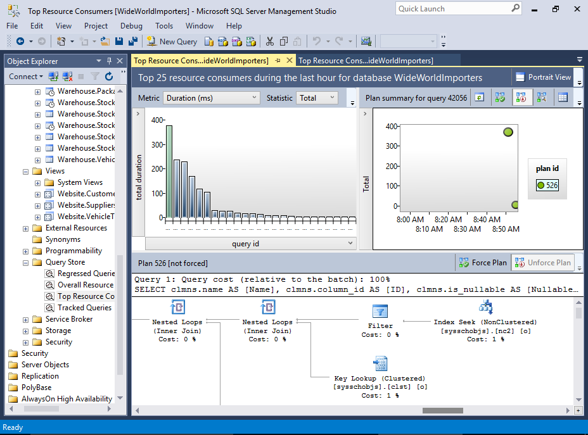
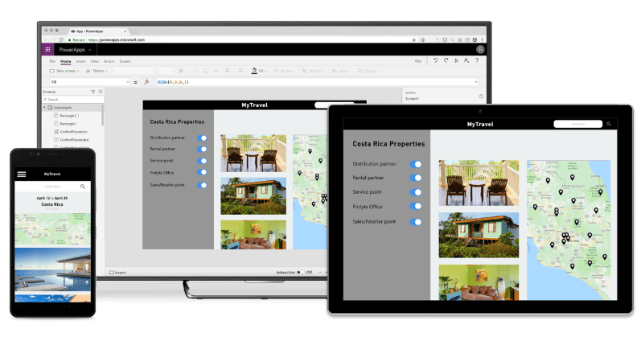


Slide 2
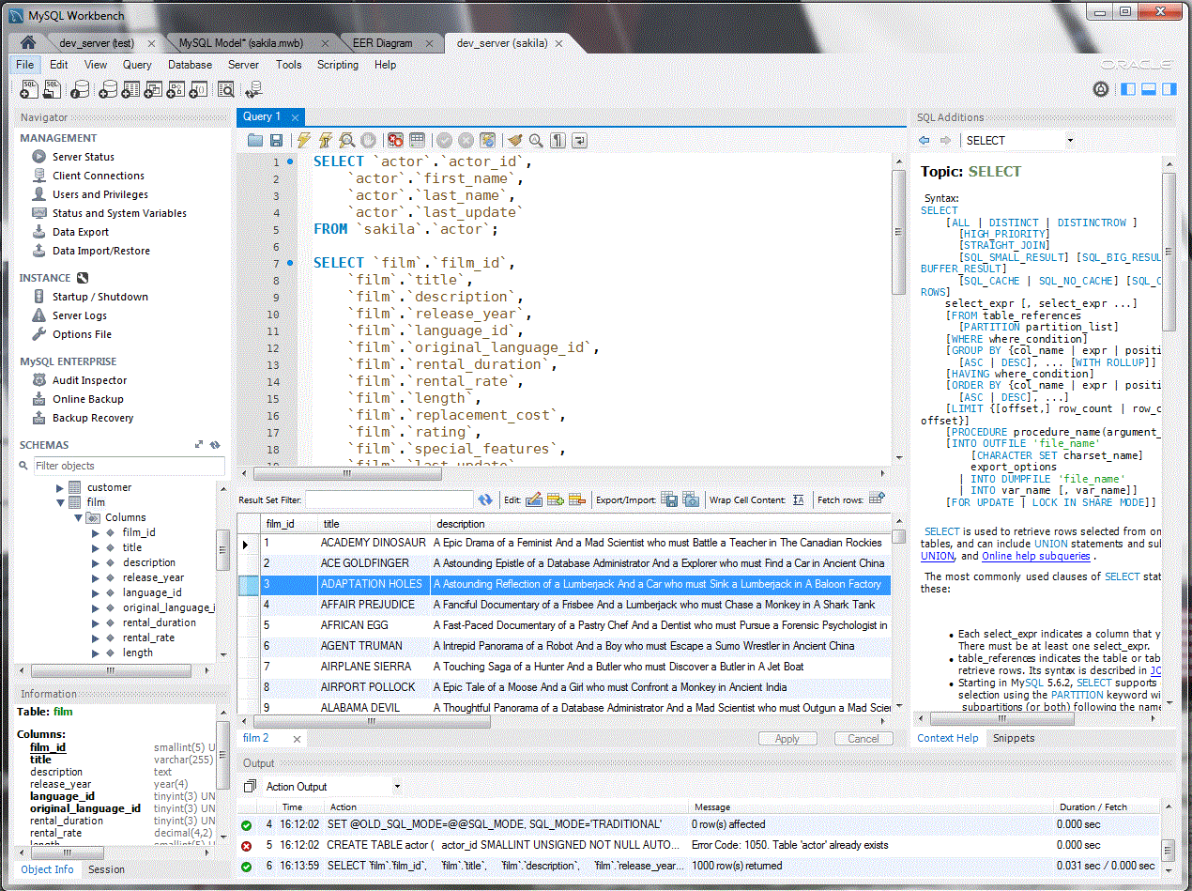
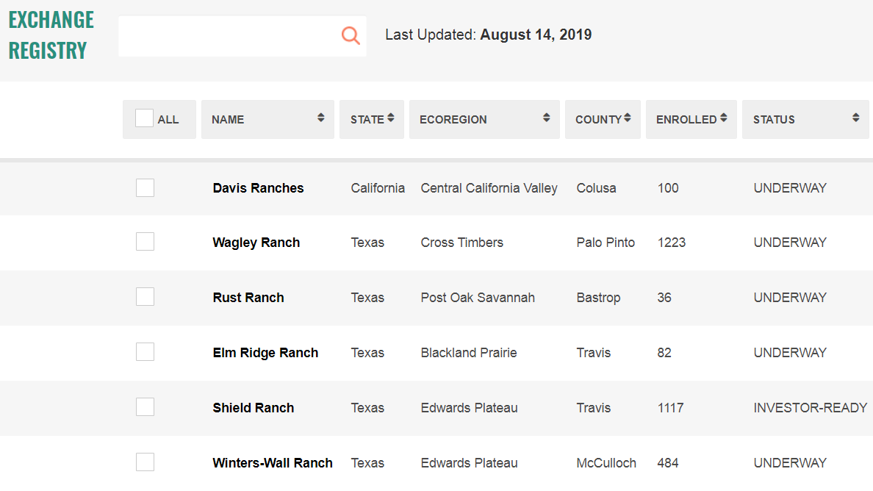


Slide 3
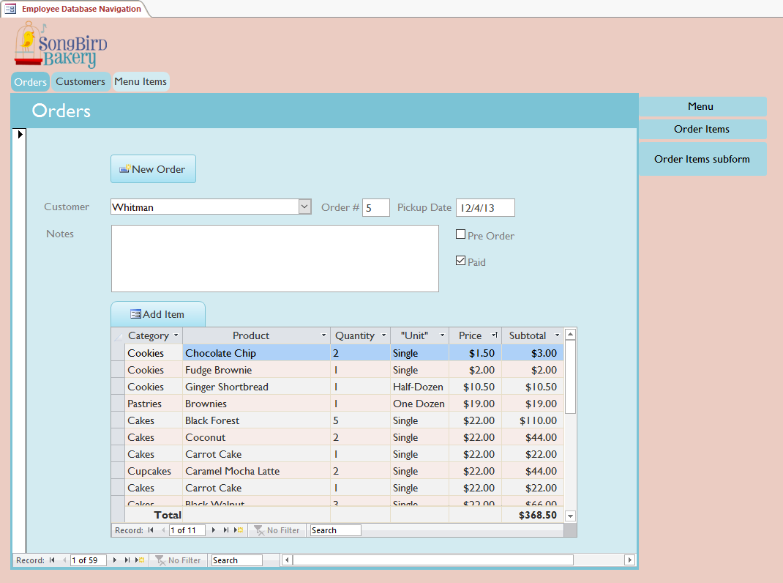

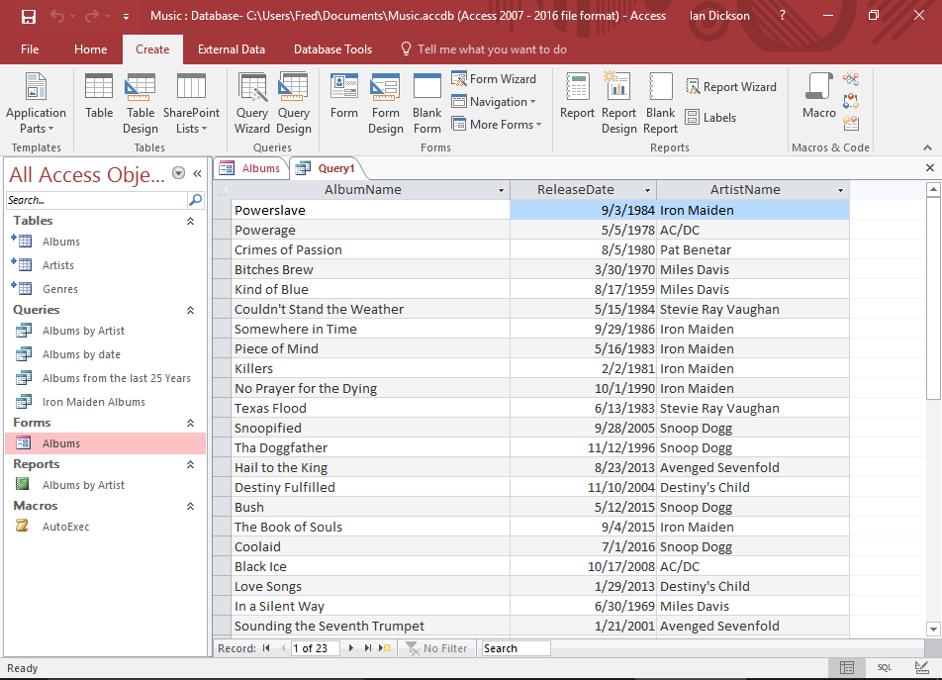

Slide 4
Vision
Scope
Map it!
Stakeholders
Underline boundary partners
Problems
Alternatives
How Might We?
Considerations/Constraints
Research Questions

Slide 5
Vision
Scope
Problems
Map It!
Stakeholders
Alternatives
Considerations/
Constraints
Research Questions
How Might We?

Slide 6
Vision
Scope
Situation Model & Interventions
Circle key intervention point(s)
Stakeholders
Underline boundary partners
Problems
Alternatives
How Might We?
Considerations/Constraints
Research Questions

