Slide 1
Modeling Earthquakes and the Gutenberg-Richter Law with Partial Success
Eric Anderson
University of Rochester
PHYS 256

Slide 2
References
[1] N. J. Giordano and H. Nakanishi, 2005, Computational Physics, Addison-Wesley, New York.
[2] P. Bak and C. Tang, "Earthquakes as a Self-Organized Critical Phenomenon,“ J. Geophys. Res. 94, 15635 (1989).
[3] R. Burridge and L. Knopoff, "Model and Theoretical Seismicity," Bull. Seismol. Soc. Am. 57, 341 (1967).
[4] J. M. Carlson, "Two-Dimensional Model of a Fault," Phys. Rev. A 44, 6226 (1991).
[5] J. M. Carlson and J. S. Langer, "Properties of Earthquakes Generated by Fault Dynamics," Phys. Rev. Lett. 62, 2632 (1989); "Mechanical Model of an Earthquake Fault," Phys. Rev. A 40, 6470 (1989).
[6] B. Gutenberg and C F. Richter, "Earthquake Magnitude, Intensity, Energy,
and Acceleration," Bull. Seismol. Soc. Am. 46, 105 (1956).
[7] B. Gutenberg and C. F. Richter, "Magnitude and Energy of Earthquakes,“ Ann. Geofis. 9, 1 (1956).

Slide 3
Earthquakes
Big
Result of sudden movement of one plate relative to another
Involves Newton’s second law
Connection to the Ising model

Slide 4

Gutenberg-Richter Law
$P\left(ℳ\right)=AM^{−b}=Ae^{−bℳ}$ where $ℳ ≡\ln{M}$ is the magnitude
Probability of having a quake of a given magnitude
A is a constant
b is a factor somewhere between 0.8 and 1.5

Slide 5

Gutenberg-Richter connection to Ising model
$E_{average}=\int_{0}^{∞}{EAe^{−bℳ}dℳ}∼ \int_{0}^{∞}{Me^{−bℳ}dℳ}$
Integral diverges
Power law singularities at a critical point

Slide 6
Goal
Determine properties to model a power law distribution

Slide 7
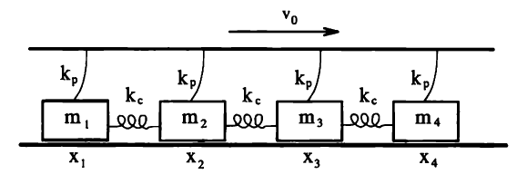
Model

Slide 8
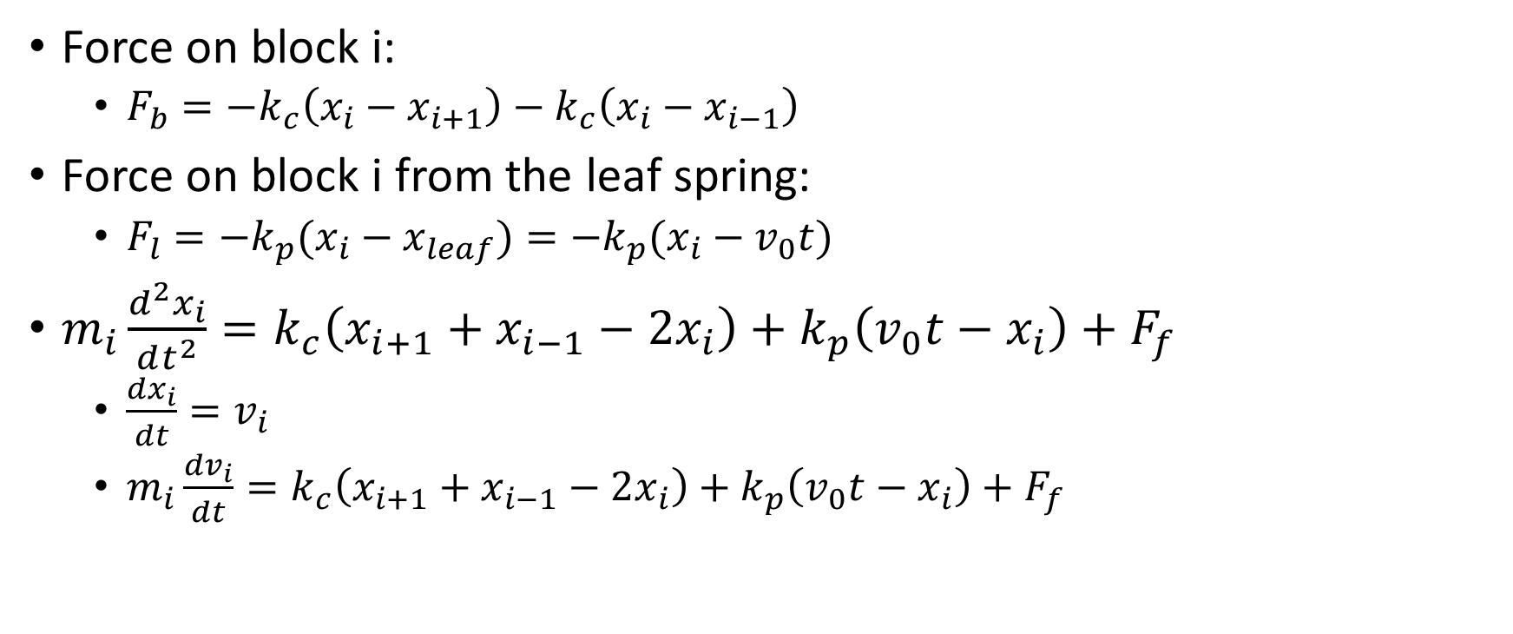
Model equations
Force on block i:
$F_{b}=−k_{c}\left(x_{i}−x_{i+1}\right)−k_{c}\left(x_{i}−x_{i−1}\right)$
Force on block i from the leaf spring:
$F_{l}=−k_{p}(x_{i}−x_{leaf})=−k_{p}(x_{i}−v_{0}t)$
$m_{i}\frac{d^{2}x_{i}}{dt^{2}}=k_{c}\left(x_{i+1}+x_{i−1}−2x_{i}\right)+k_{p}\left(v_{0}t−x_{i}\right)+F_{f}$
$\frac{dx_{i}}{dt}=v_{i}$
$m_{i}\frac{dv_{i}}{dt}=k_{c}\left(x_{i+1}+x_{i−1}−2x_{i}\right)+k_{p}\left(v_{0}t−x_{i}\right)+F_{f}$

Slide 9
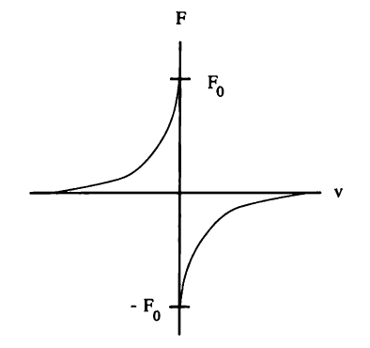
Friction
Decreases with increasing |v|
Lack fundamental understanding

Slide 10
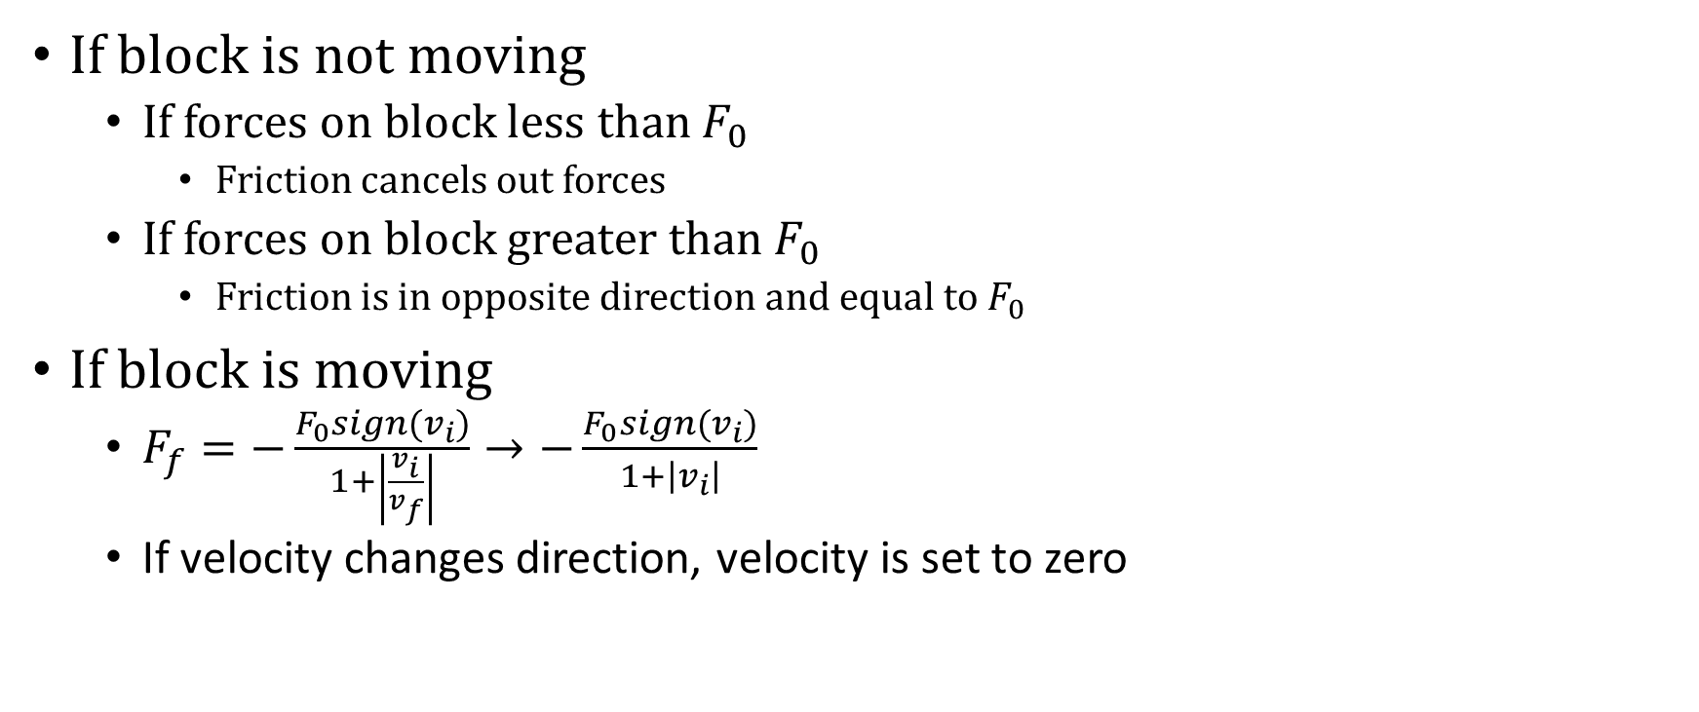
Friction modeling
If block is not moving
If forces on block less than $F_{0}$
Friction cancels out forces
If forces on block greater than $F_{0}$
Friction is in opposite direction and equal to $F_{0}$
If block is moving
$F_{f}=−\frac{F_{0}sign(v_{i})}{1+\left|\frac{v_{i}}{v_{f}}\right|}→−\frac{F_{0}sign(v_{i})}{1+\left|v_{i}\right|}$
If velocity changes direction, velocity is set to zero

Slide 11

Parameters
$m=1$
$k_{p}=40$
$k_{c}=250$
$F_{0}=50$
$v_{0}=0.01$
Assume all initial velocities are zero

Slide 12

Consideration of timestep
Switch timestep when an event starts to occur
${dt}_{1}=0.03$
${dt}_{2}=0.003$

Slide 13
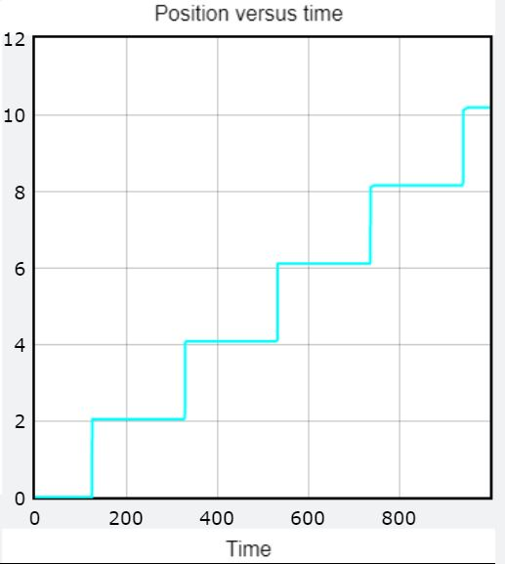
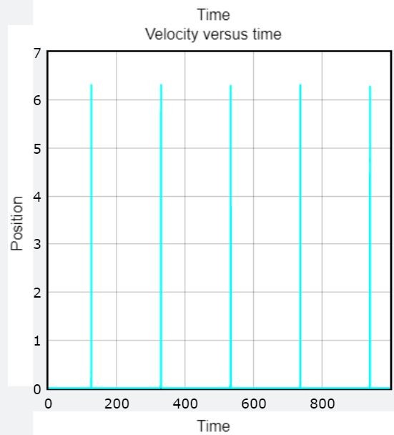
Uniformly distributed start

Slide 14
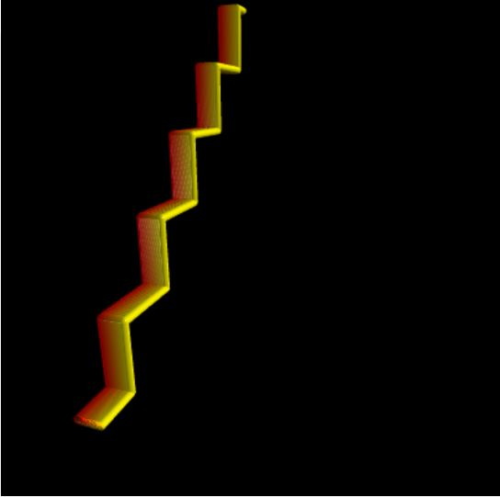
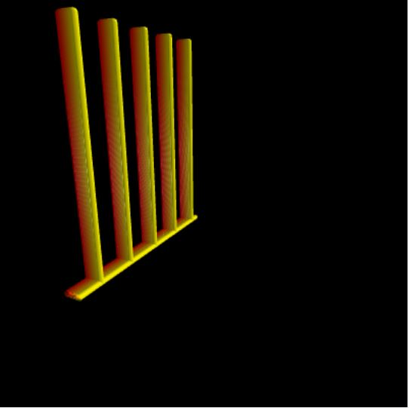
Uniformly distributed start

Slide 15
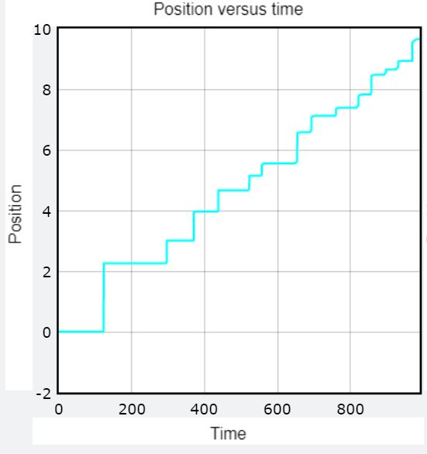
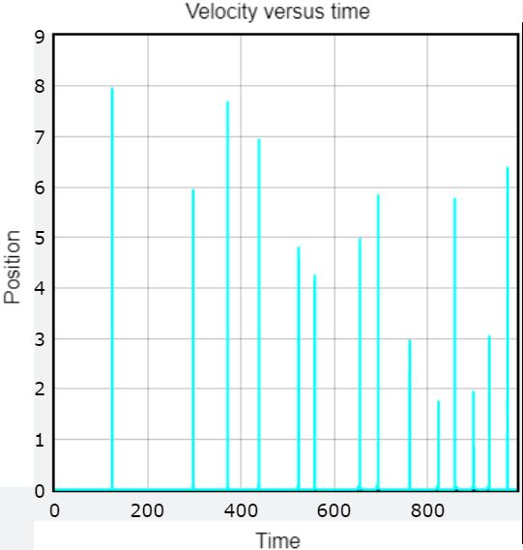
Randomly distributed start

Slide 16
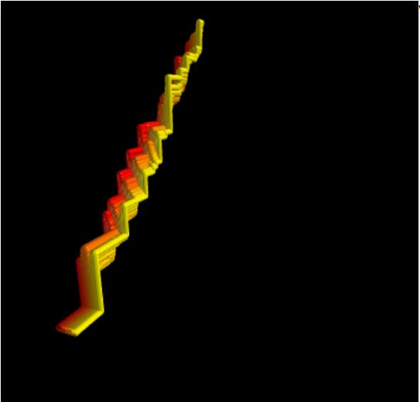
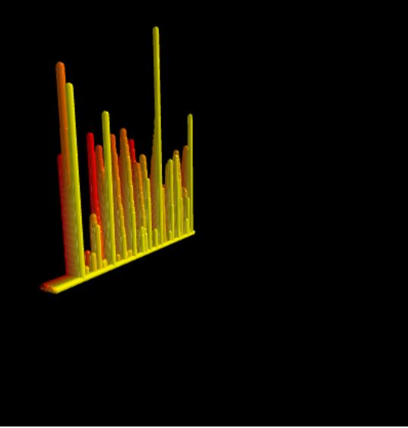
Randomly distributed start

Slide 17

Moment
$$M=\sum_{n=time}{(\sum_{i=blocks}{v_{i}t)}}$$

Slide 18
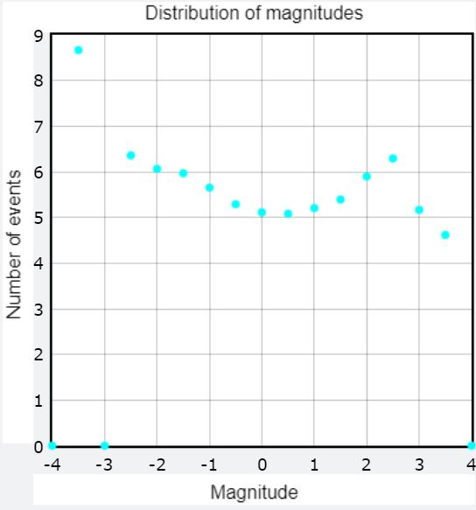
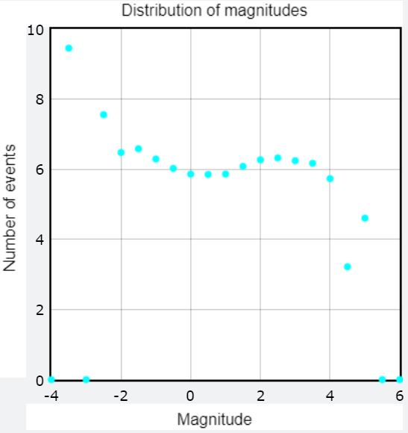
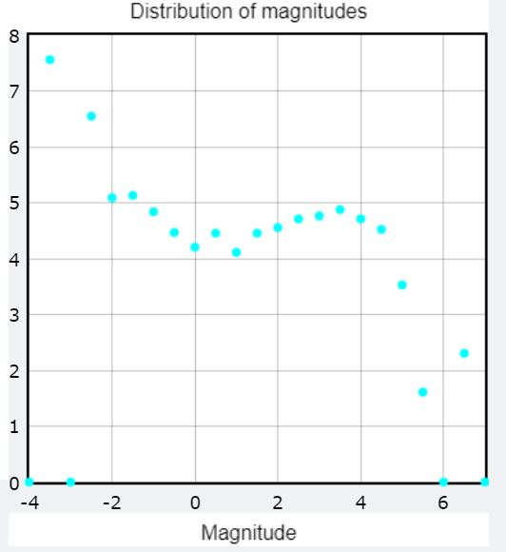
Distribution of magnitudes

Slide 19
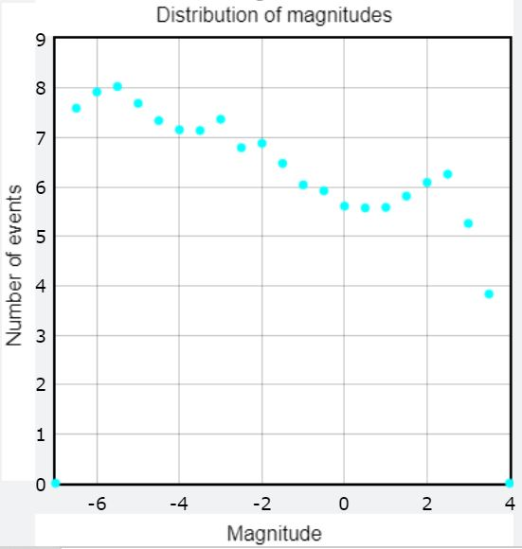
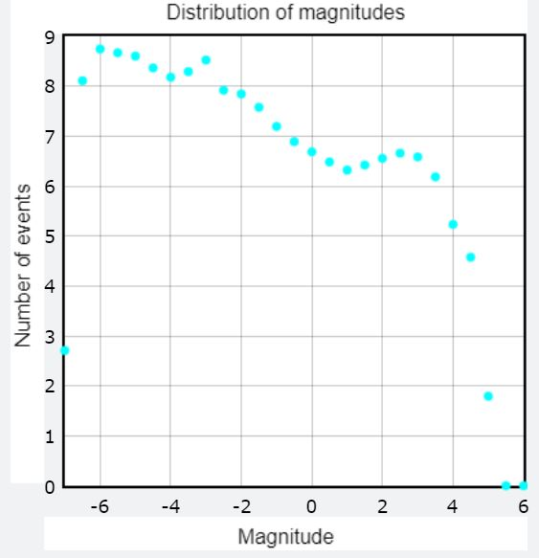
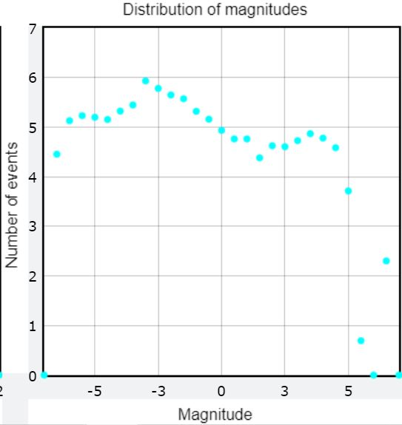
Distribution of magnitudes with varying parameters

Slide 20
Evaluation of success
Partially successful in modeling power law
Gutenberg-Richter law could fail at large magnitudes
Model alterations
Dimensionality
Parameter variation
Friction

Slide 21

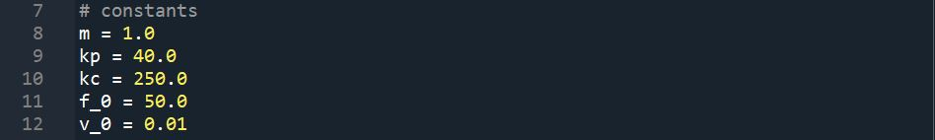

Slide 22
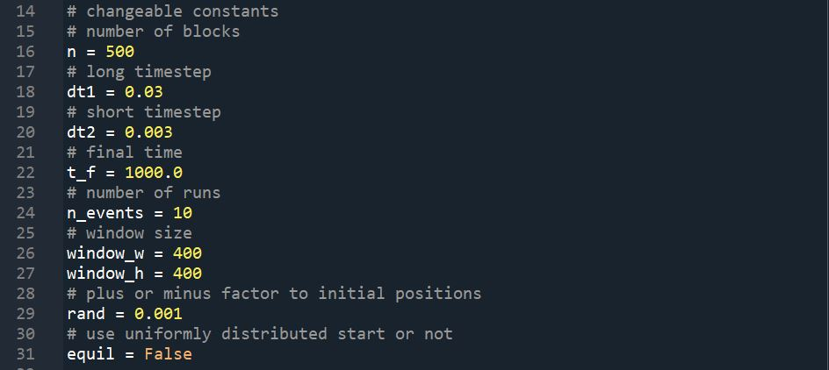

Slide 23
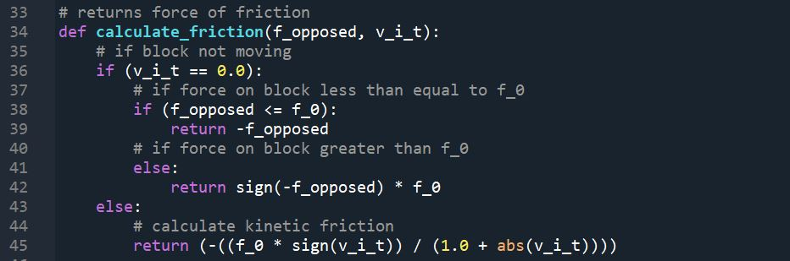

Slide 24
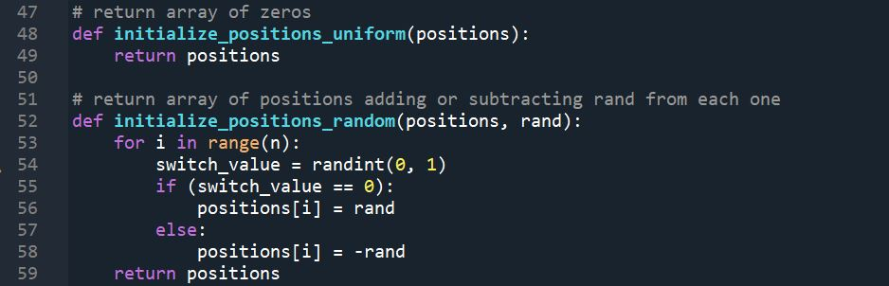

Slide 25
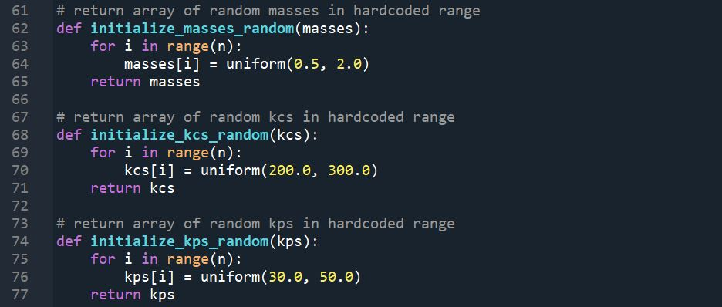

Slide 26
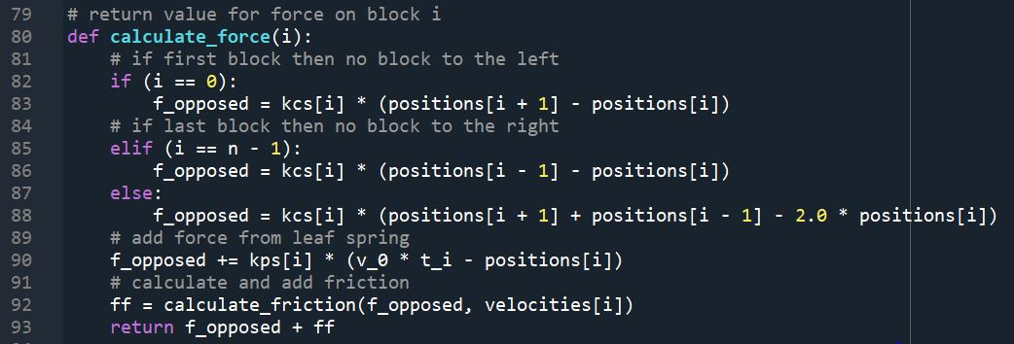

Slide 27
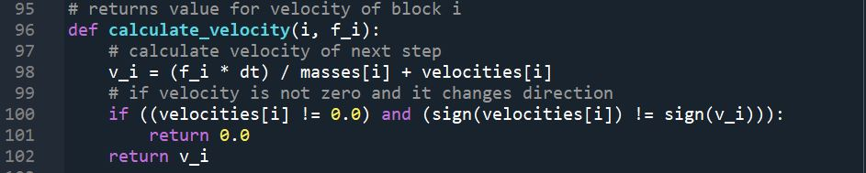

Slide 28
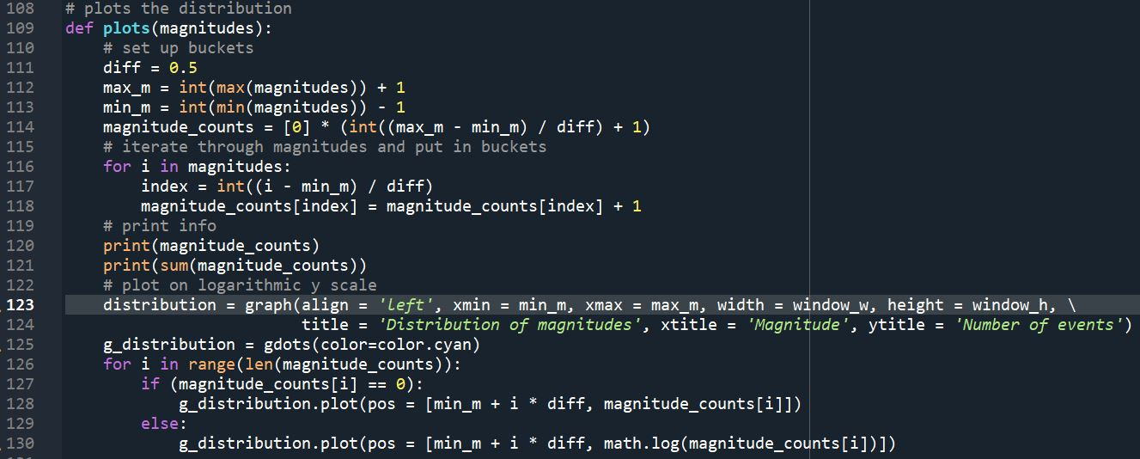

Slide 29
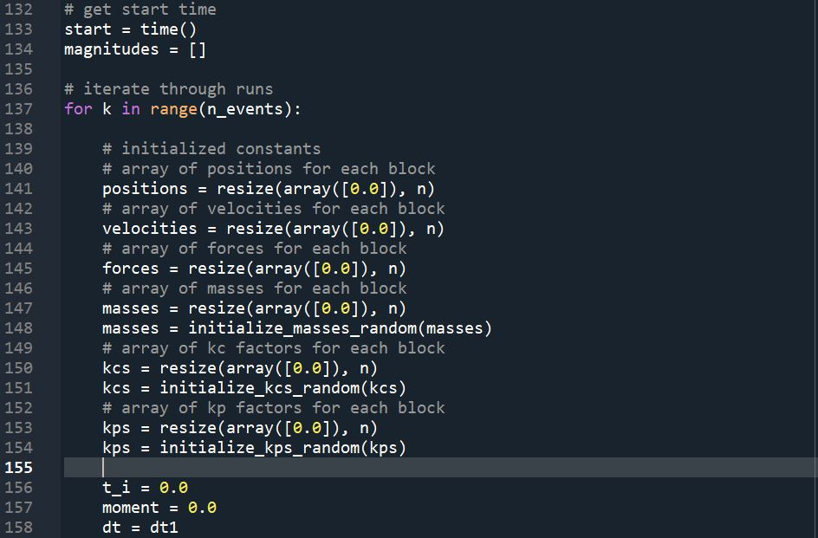

Slide 30

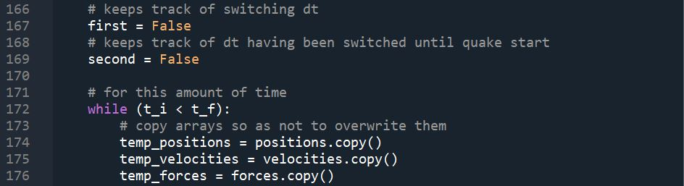

Slide 31

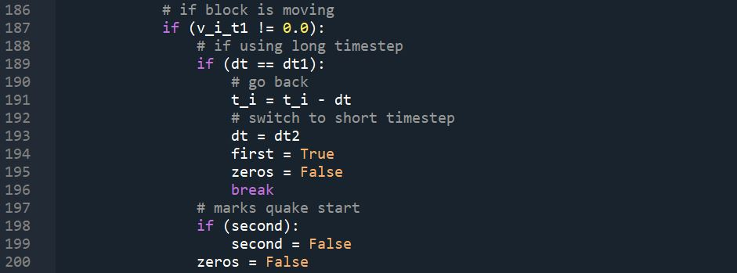

Slide 32


Slide 33
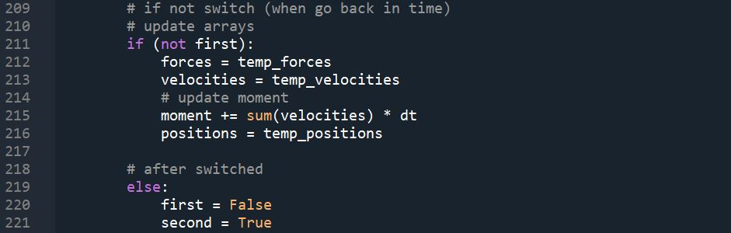
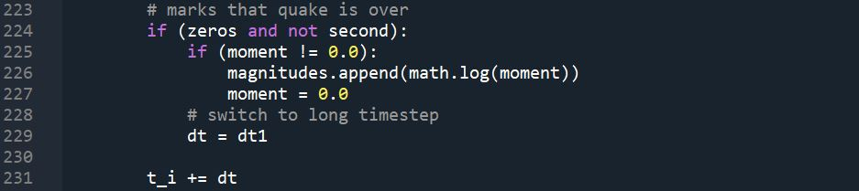

Slide 34
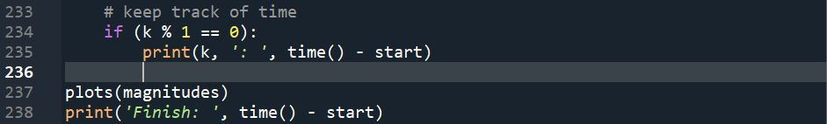

Slide 35
References
[1] N. J. Giordano and H. Nakanishi, 2005, Computational Physics, Addison-Wesley, New York.
[2] P. Bak and C. Tang, "Earthquakes as a Self-Organized Critical Phenomenon,“ J. Geophys. Res. 94, 15635 (1989).
[3] R. Burridge and L. Knopoff, "Model and Theoretical Seismicity," Bull. Seismol. Soc. Am. 57, 341 (1967).
[4] J. M. Carlson, "Two-Dimensional Model of a Fault," Phys. Rev. A 44, 6226 (1991).
[5] J. M. Carlson and J. S. Langer, "Properties of Earthquakes Generated by Fault Dynamics," Phys. Rev. Lett. 62, 2632 (1989); "Mechanical Model of an Earthquake Fault," Phys. Rev. A 40, 6470 (1989).
[6] B. Gutenberg and C F. Richter, "Earthquake Magnitude, Intensity, Energy,
and Acceleration," Bull. Seismol. Soc. Am. 46, 105 (1956).
[7] B. Gutenberg and C. F. Richter, "Magnitude and Energy of Earthquakes,“ Ann. Geofis. 9, 1 (1956).

