Slide 1
Mobile Patient Monitor Suite
Brain Cefail, Karman Chu, Will Lenk, and Ryan Dougherty

Slide 2
Mission Statement
Our mission is to implement a proof-of- concept patient monitoring suite for Jumbo Medical which wirelessly displays vital signs on an iPad to provide medical practitioners a more intuitive, highly mobile patient monitor.

Slide 3
Key Customer Requests
“Simple, one-touch commands”
“Customized viewing options”
“Graphical and Numerical Data Displays”

Slide 4
Features
Uses iPad as display platform
Customizable alarms for each sensor
Customizable visual display
Real time graphical displays
Real time data transmission
Works on any WiFi capable network

Slide 5
What’s New
Wireless data transmission to display on iPad
Display interface resembles current devices but interfaces are simple and intuitive like those in current smart phones and tablets
Highly customizable display and alarm features

Slide 6
What’s the Advantage
Wireless telemetry makes for easier setup, improved patient comfort. Allows for mobility of display
iPad app updates can be instantly downloaded. Potential to sync data with electronic medical records
Simple and intuitive interface will encourage more doctors to interact with monitor. No need for training
Customizability allows each caregiver to optimize their use of the product

Slide 7
Block Diagram
Sensor Package
Arduino
iPad
ECG
Sensor Data
Information over WiFi
Visual
Information
Patient
Pulse
Nurse/
Doctor
Temp
User input

Slide 8
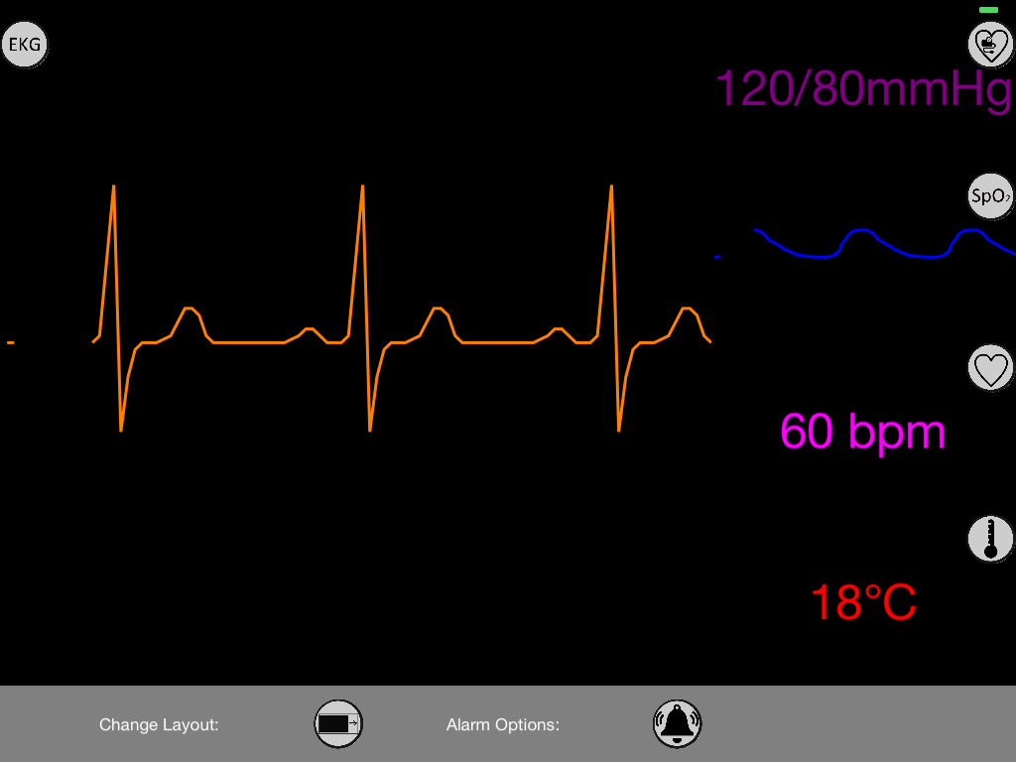

Slide 9
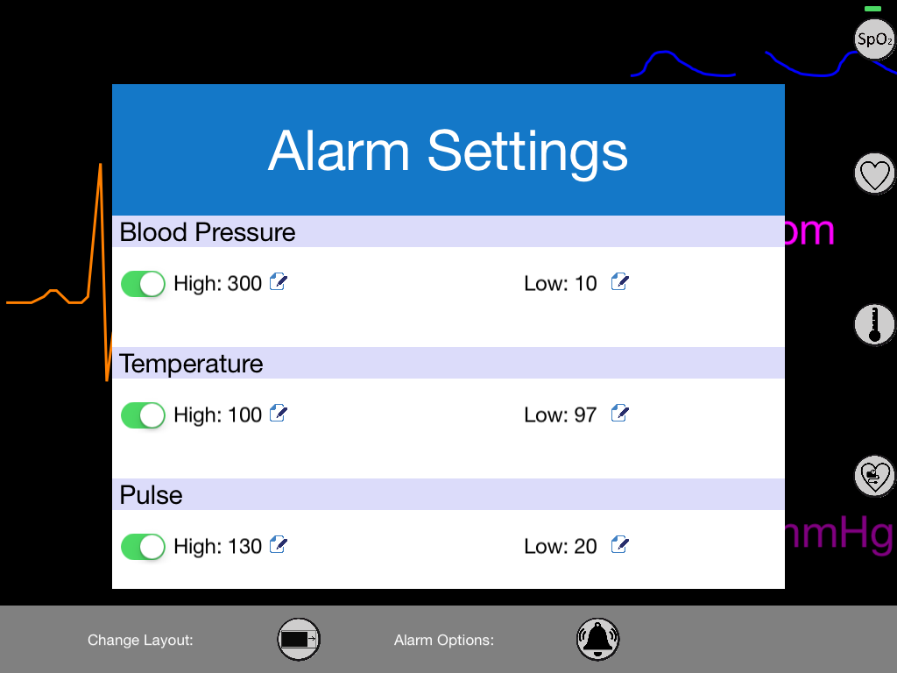

Slide 10
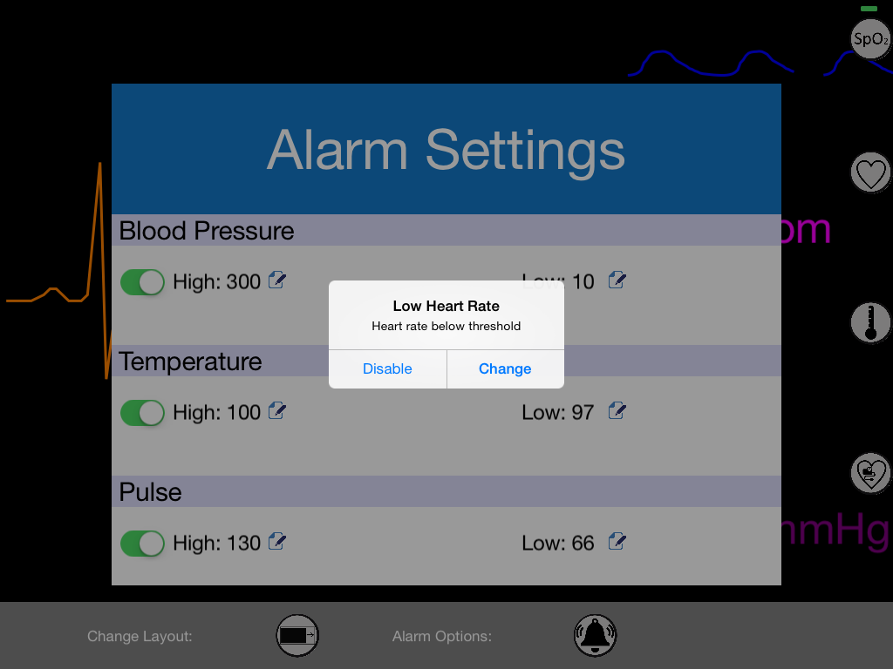

Slide 11
Trajectory
Add data histories in addition to real time displays
Replace Arduino and WiFi shield with another product that is faster and can transmit more data
Integrate and miniaturize sensor and wireless circuitry onto a single printed circuit board with 3V operation
Construct a palm-sized packaging for sensor housing and circuitry powered by a single coin cell

Slide 12
Lessons Learned
The customer guides the technology, not the other way around
System integration is just as difficult to implement as the individual modules
There are trade-offs in each design choice
Development is an iterative process
Feedback and advice from professionals is crucial to guide development

Slide 13
Demo!

