Slide 1
Patient Monitor Demonstration
Jumbo Medical
EE93/COMP50, Mobile Medical Devices and Apps
S. Broner, B. Frizzell, A. Henry, D. Wiegard and E. Wong
December 2, 2014

Slide 2
Mission Statement
“Our goal is to ship a mobile patient monitoring device and app for Jumbo Medical on June 1st, 2015.
Our patient monitor will address the most common use cases of doctors and nurses by providing configurable alarms and displaying current vital signs in the context of historical trends.”
Notes:
Our goal is to make a mobile patient monitoring system to move Jumbo Medical into the mobile medical device and app market that will ship on June 1st.
The system addresses the most common needs of doctors by displaying current vital signs in the context of historical trends.
Our patient monitor will address the most common use cases of doctors and nurses by providing configurable alarms and displaying current vital signs in the context of historical trends.”
Our goal is to ship a mobile patient monitoring device and app for Jumbo Medical on June 1st, 2015.

Slide 3
Customer Requirements
Don’t rest on your heritage, but make the interface recognizable
Display trending and historical information
Reduce training
Configurable
Integrate into hospital infrastructure
Security and privacy
Confidence in information
Notes:
“Don’t rest on your heritage” - Michael Blum
“Don’t rest on your heritage” - Jumbo Medical

Slide 4
“Most doctors don’t spend much time interacting with the patient monitor … current monitors are too complicated.”
- Dr. Michael Blum

Slide 5
Value Proposition
Reduced training time
Simplified feature set
Resembles legacy interface
Focus on streamlining common use cases
Faster access to trending and historical data
Faster access to alarms
Notes:
Evidence
Trends - 3 clicks vs 1
data still visible
Alarms - 3 clicks vs 2
data still visible

Slide 6

Block Diagram
Patient
Doctor/
Nurse
Vital signs
(electrical, IR, heat)
Physical contact
Visual cues
Touch
Physical contact
(attach device)
Transducers
Vital Sign
Monitor
Power
Analog voltage
Power Unit
Processor Unit
Server connect
Power
JSON data
Touch
(on/off)
Notes:
tie back to environments, clear info in hectic setting is important
Alex or Brad

Slide 7
Features
Updated legacy interface for iOS HIG
Focus configurability to core functionality
Accessible, overlaid help interface
Notes:
Updated legacy interface for iOS HIG
One touch historical data
Low training time, maximum clicks from default screen is 2
Modern design while still recognizable - the default view resembles current competitor patient monitors, with HIG compliance
Integrate into existing hospital infrastructure
Easily display trending and historical information - One touch to display historical data
Low training time
fewest clicks to navigate
reduce max clicks / low avg clicks
Max clicks for any operation is 3, from the default screen is 2. Majority of operations take 1 click.
Configurable
Can minimize and exit vital sign views
Security / Privacy
Unaddressed
Confidence in Information

Slide 8
Features (continued)
One touch historical and trended data
Low training time
Actions take maximum of 2 touches from default view
Majority of actions require 1 touch
Minimize and close vital signs
Notes:
Updated legacy interface for iOS HIG
One touch historical data
Low training time, maximum clicks from default screen is 2
Modern design while still recognizable - the default view resembles current competitor patient monitors, with HIG compliance
Integrate into existing hospital infrastructure
Easily display trending and historical information - One touch to display historical data
Low training time
fewest clicks to navigate
reduce max clicks / low avg clicks
Max clicks for any operation is 3, from the default screen is 2. Majority of operations take 1 click.
Configurable
Can minimize and exit vital sign views
Security / Privacy
Unaddressed
Confidence in Information

Slide 9
User Interface
“The most important thing is that a user’s path through the content is logical, predictable, and easy to follow.”
-Apple Human Interface Guidelines

Slide 10
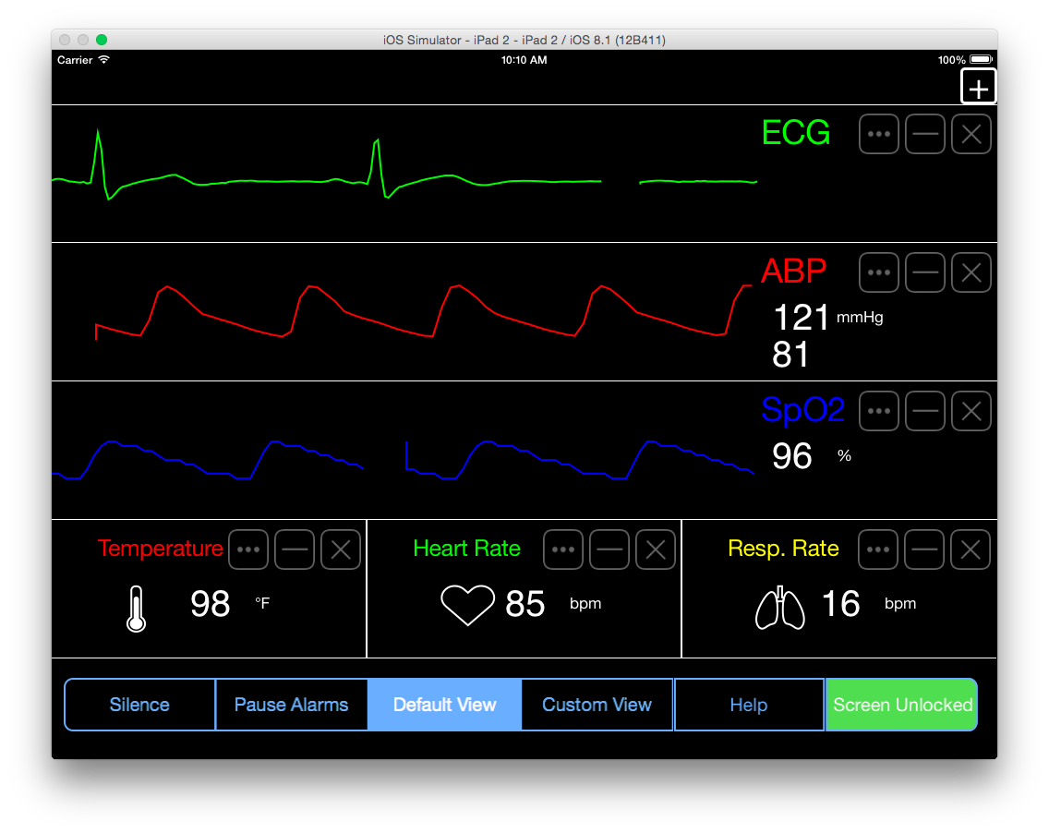

Slide 11
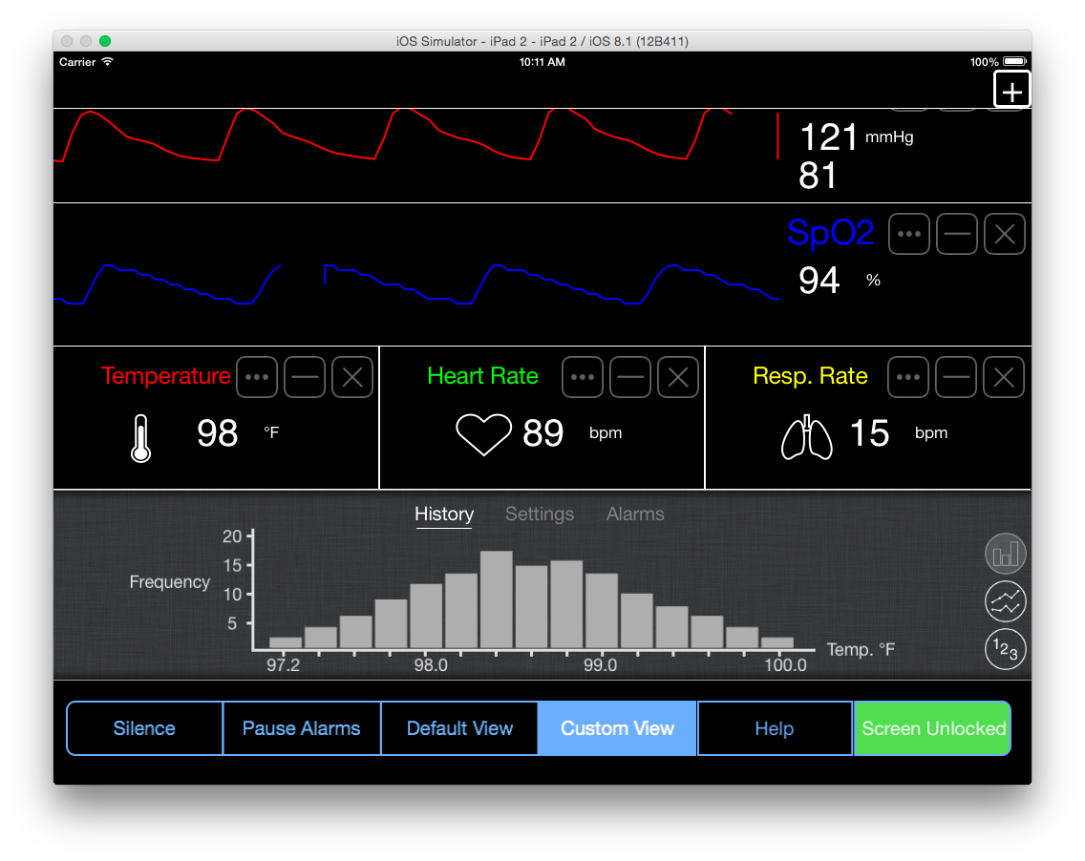

Slide 12
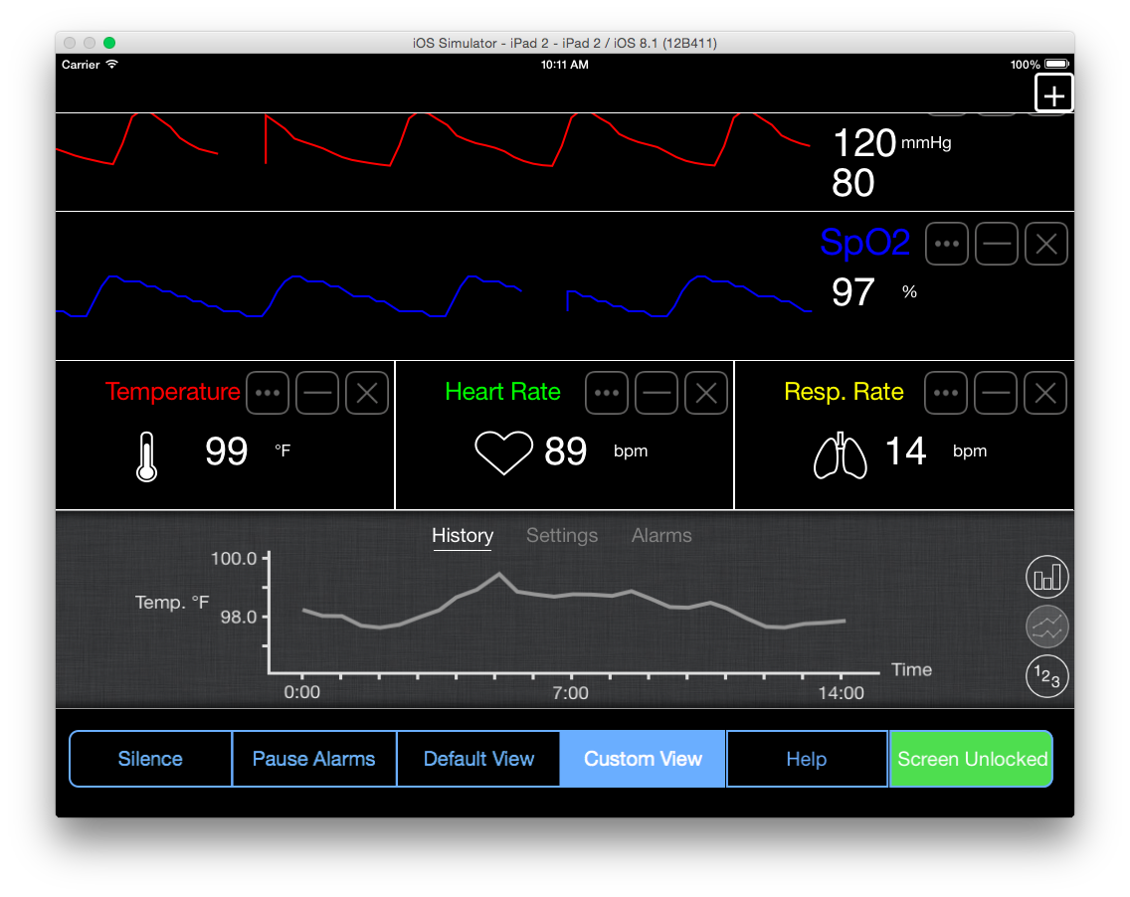

Slide 13
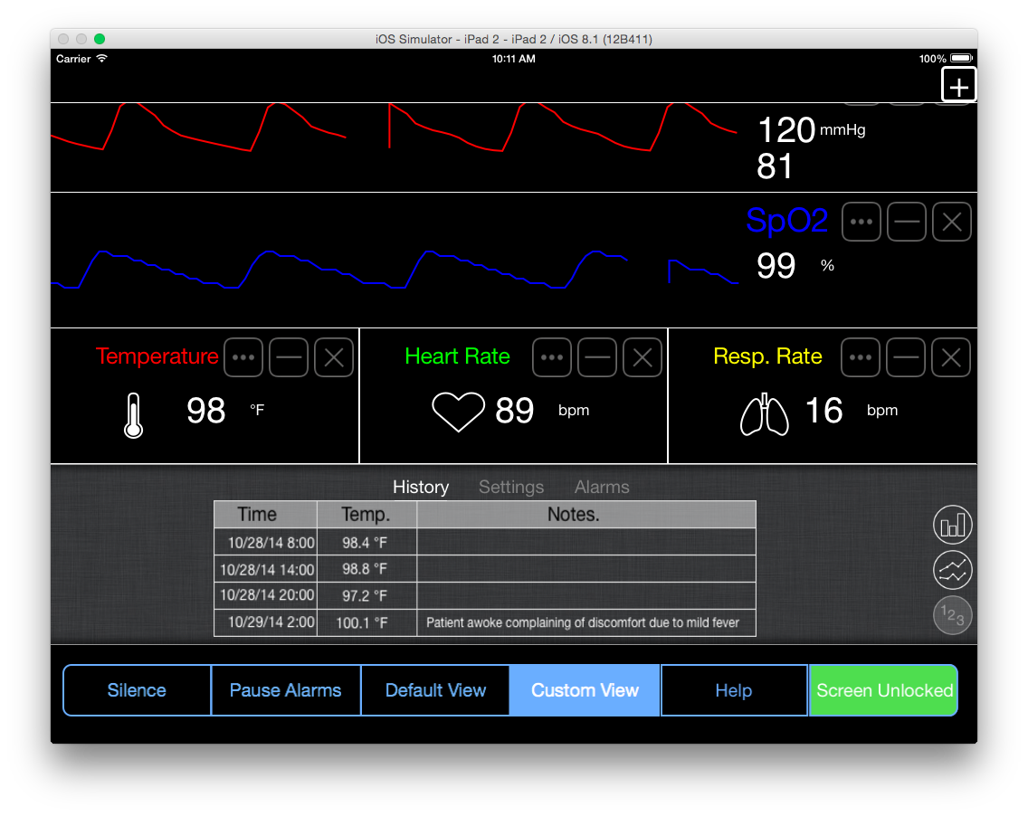

Slide 14
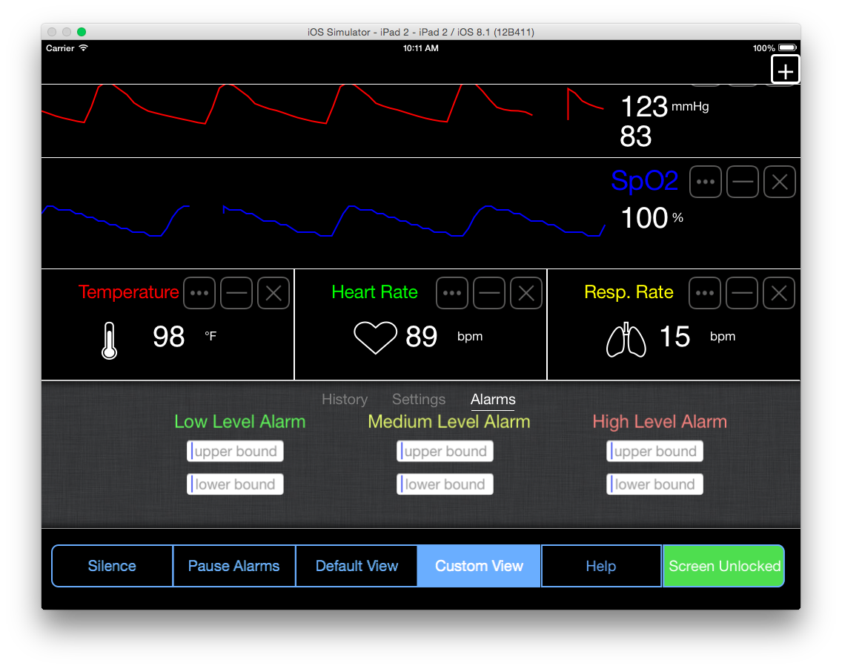

Slide 15
Ideal Product
Integration with EMR
Historical data
Data logging
Alarms with messaging
Integration with hospital infrastructure
Monitor multiple patients
Track hospital metadata as required
Security
Data encryption

Slide 16
Lessons Learned
Customers are most in touch with the problem but do not know what the solution looks like
Consistent communication and testing with the users leads to iterative improvements in design
Mobile medical space has many challenges that other areas of product development do not
FDA/HIPAA compliance
Security
Notes:
FDA/HIPAA Compliance
Difficulty of Security
How inconsistently the user understand their own needs
usability testing is hard
Iteration is critical to success

Slide 17
Demonstration

Slide 18
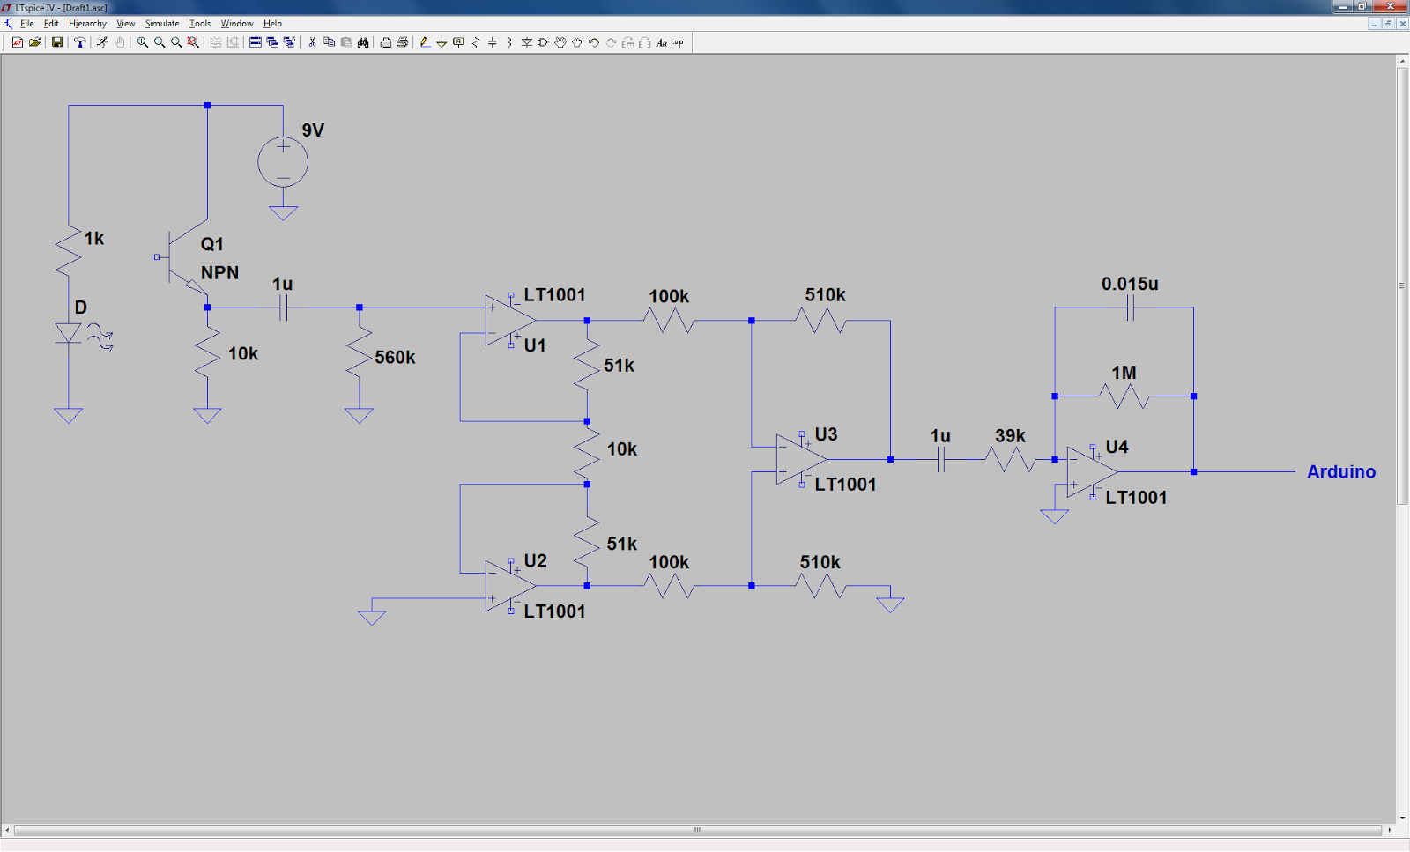
Pulse Detector Schematic

Slide 19
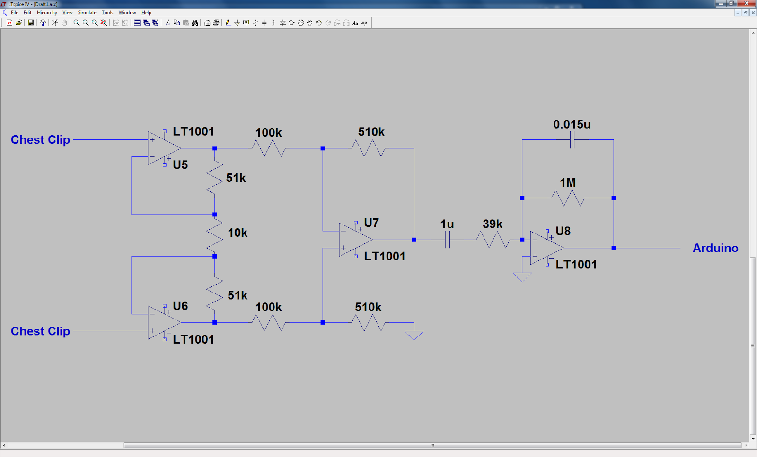
Electrocardiogram (ECG) Schematic

