Slide 1

Demonstration
EE93/COMP50, Mobile Medical Devices
S. Broner, B. Frizzell, A. Henry, D. Wiegard and E. Wong
October 2, 2014
TexPoint fonts used in EMF.
Read the TexPoint manual before you delete this box.: AAAAAA

Slide 2


Slide 3
Mission Statement
“Our goal is to develop a passive patient temperature monitoring system that displays on an iPad app to help alert parents to their child’s temperature by October 2, 2014.”

Slide 4
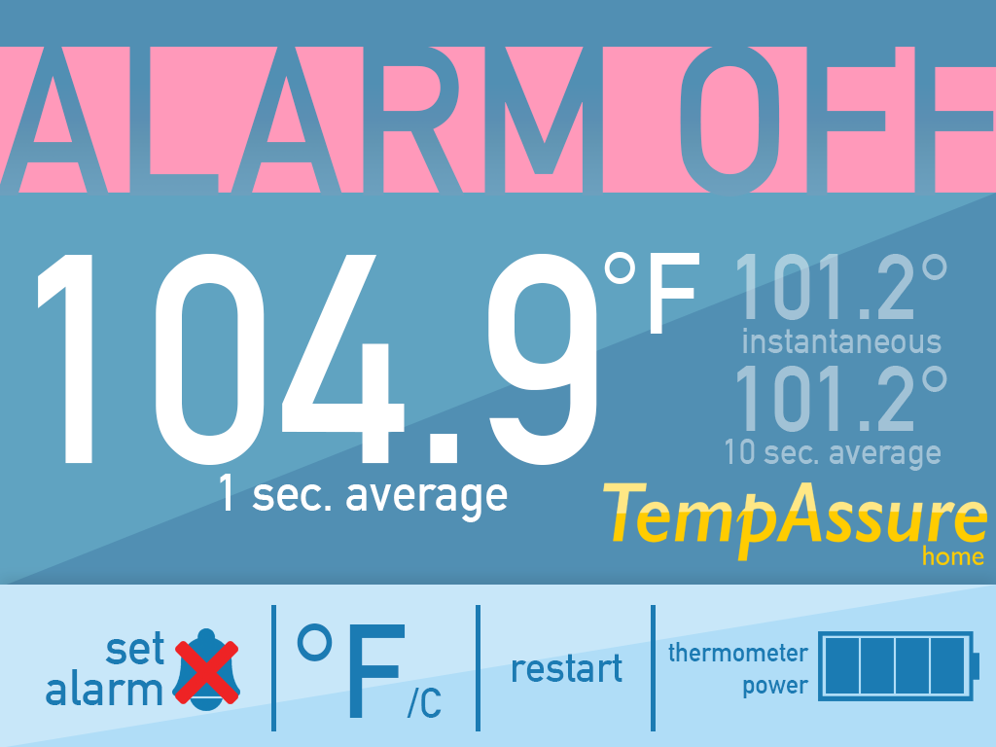

Slide 5
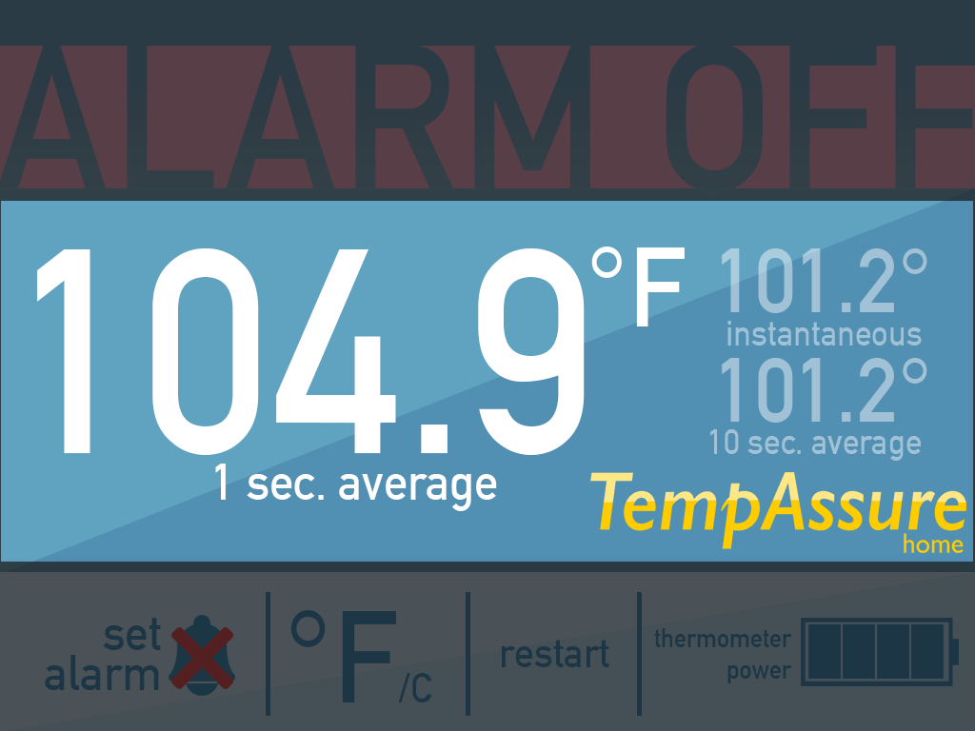

Slide 6
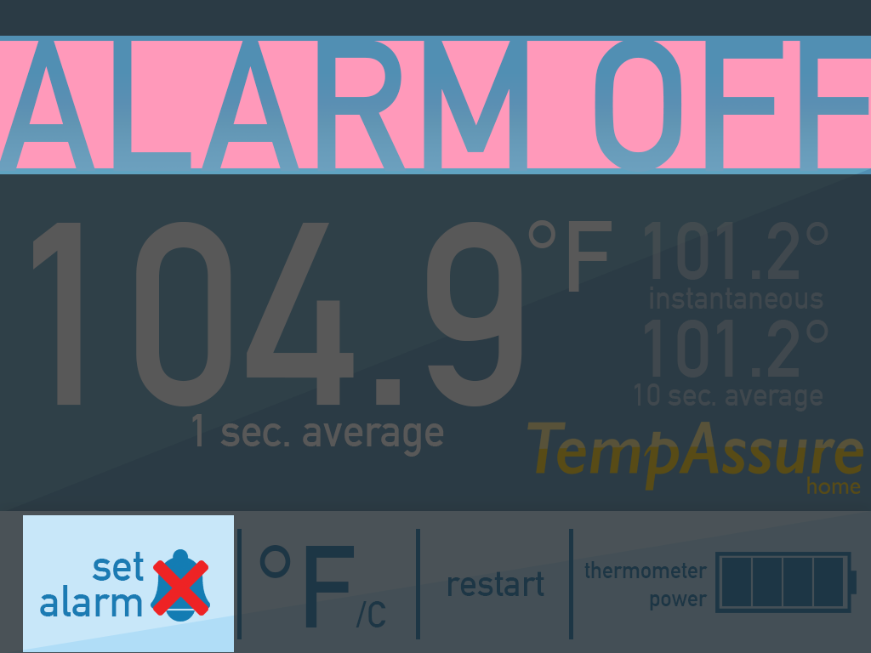

Slide 7
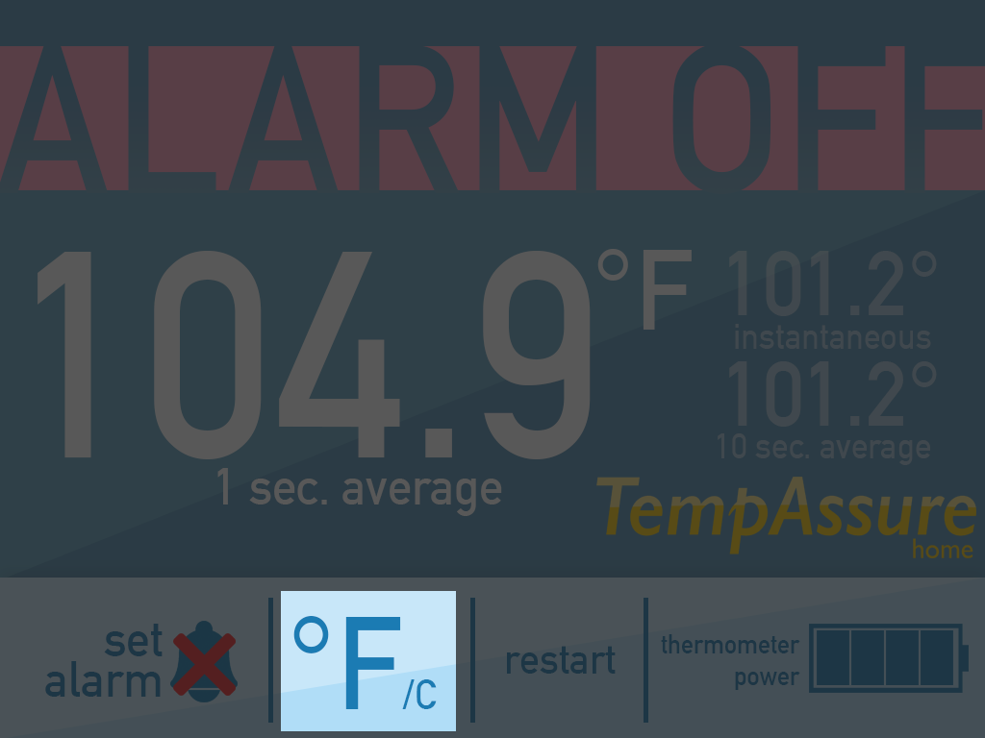

Slide 8
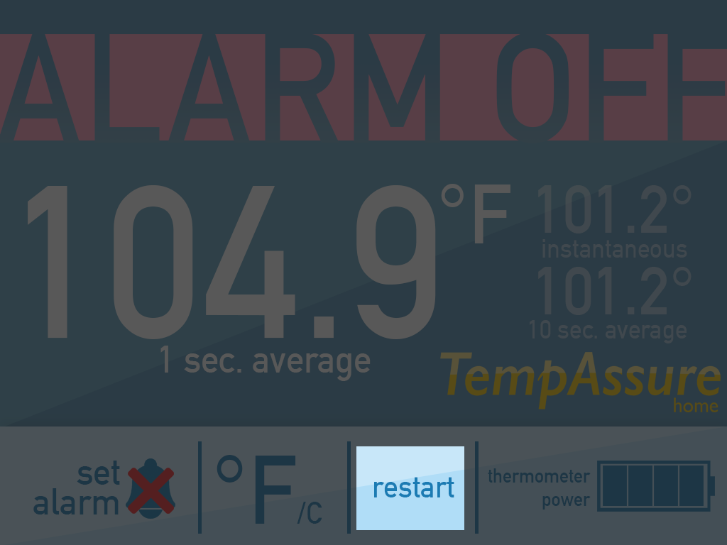

Slide 9
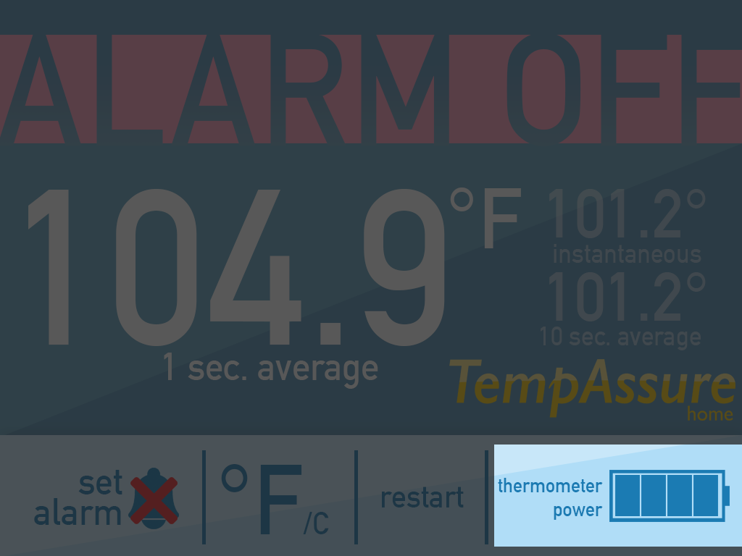

Slide 11
Financials
Item | Cost ($)
MicroController | 10.00
Resistors | 0.20
Battery Snap | 0.20
Enclosure | 5.00
Production Costs Housing | 15.00
Total Housing Cost | 30.00
Production Costs Thermistor | 0.10
Production Costs Probe | 5.00
Total Probe Cost | ~5.00
Total Cost | ~35.00

Slide 12
Financial Sources
Battery Snap
Resistors
Microcontroller
Enclosure
Thermistor
Production Costs

