Slide 1
Task List & Block Diagrams
Team 2

Slide 2
Task List
Device
Application

Slide 3
Device Task List
Temperature Sensor (4-5h)
Getting any reading
(Voltage Divider)
Software (2-3h)
Wi-Fi Shield
Packaging (10h)
Device, thermistor
Battery casing

Slide 4
Application Task List
UI (5-7h)
Mockup
Functional buttons
Assets
UI Methods
Backend (6-8h)
Data readings from device
UI integration

Slide 5
Block Diagram
Temperature (°F/°C)
Temperature Sensor
Reads in temperature
Thermistor converts temperature to voltage reading
Arduino System
Reads in voltage
A/D conversion of voltage input
Convert from voltage reading (0-1023) to temperature (°F/°C)
Transmit temperature via WiFi to iPad/iPhone
iPad/iPhone App
Reads in temperature from Arduino
Reads in inputs from user
Displays temperature readings and graph to user
Temperature Sensor
Voltage across thermistor
(V)
Arduino System
Temperature in °F/°C
(string or floating point via WiFi)
iPad/iPhone App
User Inputs
(Button Presses / “Gestures”)
Temperature Display (values shown on screen)

Slide 6
Arduino System
Voltage across thermistor
(V)
A/D Converter
Reads in voltage
A/D conversion of voltage input
Convert from voltage reading (0-1023) to temperature (°F/°C)
Can calculate averages here
Transmit temperature via WiFi to iPad/iPhone
Digital Reading
(0-1023)
Temperature Conversion
Temperature in °F/°C (string or floating point)
WiFi Shield
Temperature in °F/°C
(string or floating point via WiFi)

Slide 7
iPad/iPhone App
Temperature in °F/°C
(string or floating point via WiFi)
Reads in temperature from Arduino
Reads in inputs from user
Displays temperature readings and graph to user
WiFi
Interface
Temperature in °F/°C
(string or floating point)
User Interface
User Inputs
(Button Presses / “Gestures”)
Temperature Display (values shown on screen)

Slide 8
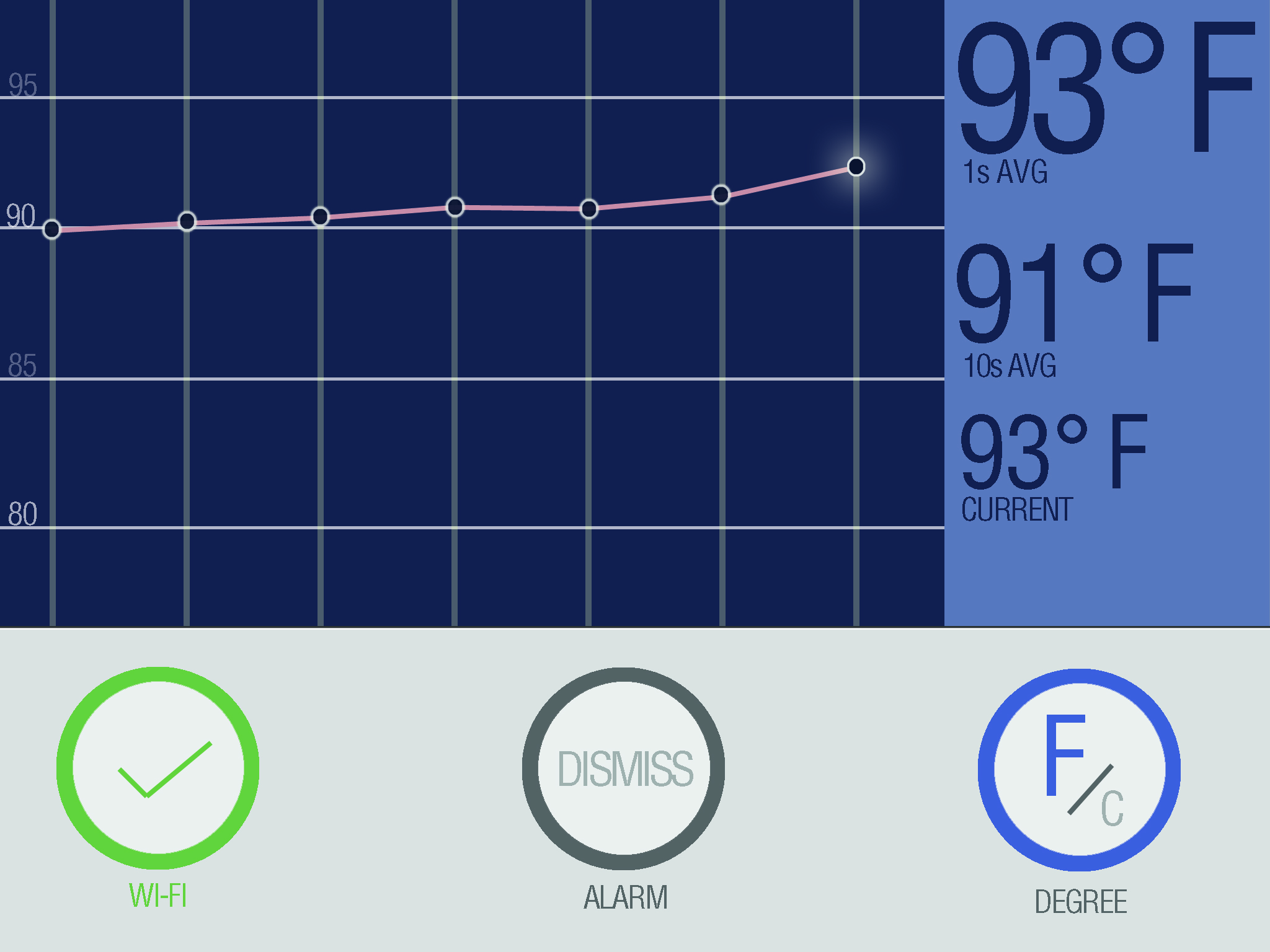

Slide 9
Questions

