Slide 1
EE93/Comp50 Mobile Medical Devices and Apps Patient Monitor
Team 2
Mr. Carranza, Mr. Rosenberg, Mr. Park,
Mr. Tran, Mr. Roseman

Slide 2
Mission statement
Our vision is to create a mobile patient medical monitor device that will be as unobtrusive as possible for the patient wearing it; also, it will be quick and simple to set up for the technician. We plan to have this delivered by December 2nd 2014
Notes:
About 9 weeks ago we were asked by Jumbo Medical to build a medical monitoring measurement equipment, a mobile medical monitoring measurement equipment to show a demo prototype at a medical trade show in coming January.

Slide 3
Customer Needs
Automate simple tasks for health care providers/
Provide easy access to information related to health conditions or treatments
“Easy to use. What does that mean to me? It means this; in less than five steps, I can
turn the thing on, and immediately know what to do. I don’t have to waste my time
learning. It is just obvious.”
“I need to see the monitor from close where I set it on a table or desk, to across the room – a hospital room is fine.”
“Make it automatically adjust in size depending on the number of waves or data
being configured and viewed.”
Notes:
Two discretion points from FDA about mobile medical app
Very focusing on easiness, mobility part of the product

Slide 4
Customer requirements
3-lead EKG
Pulse detector
Underarm temperature
Prevent eavesdropping of patient data
Real-time—Dropped data +/- 2 data cycles
Alarm
Notes:
Alarm -> alerting nurse / hardware failure

Slide 5
Value proposition
Portable Hardware
Easily replaceable parts
Easily learnable
Flexible User Interface
Familiarity
Notes:
Portable hardware for patients’ comfort
Easily replaceable parts to save care providers’ time
Short learning time due to very simple instructions to use the app and very exposed to IOS app
Flexible UI -> changeable graph size
Familiar screen from the previous patient monitors

Slide 6
Block diagram
Patient
Hardware Sensor Array
iPad App
Care Provider
Visual/
Audio
Data
Temp.
Pulse
Wi-Fi
(JSON)
ECG
Touch
Input

Slide 7
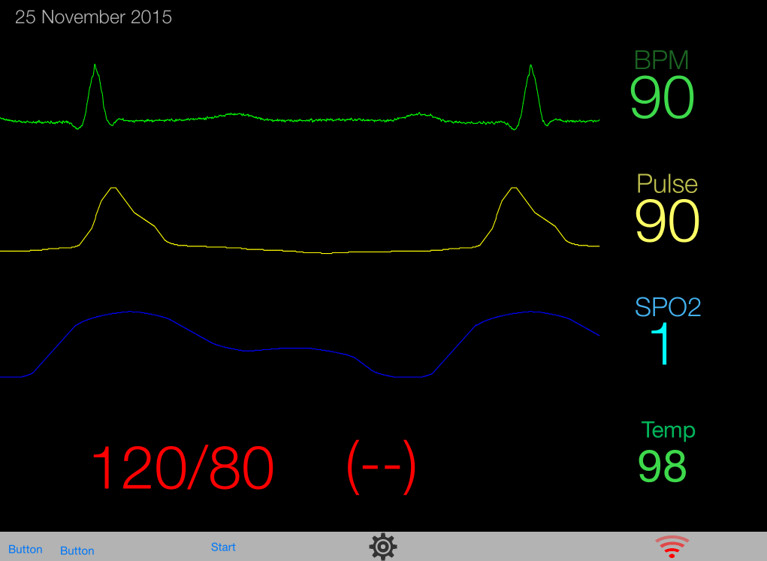
User Interface

Slide 8
Major features
Data Display
Heart Rate
SpO2 Monitor
Temperature
Additional Features
Alarm
Hardware Status
Wi-Fi connectivity

Slide 9
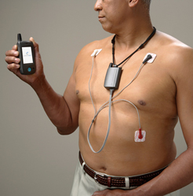
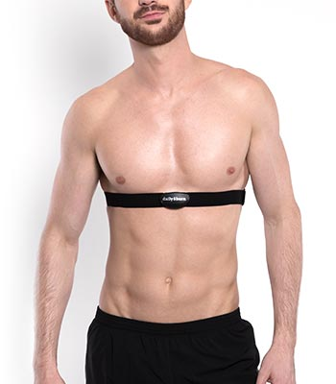
Future
Customized CPU
Handling multiple patients’ data
Security
Packaging
Notes:
CPU -> instead of Arduino, faster processing unit, lighter, and smaller
Instead of a device for a patient, collecting data from multiple mobile devices and sharing it on a phone app

Slide 10
Lessons learned
Focus on the Customer
Mobile Development Strategies
Challenges of Medical Technology
Care Provider Inertia
FDA Regulation

Slide 11
Demonstration

Slide 12
Hardware Proof-of-concept

Slide 13
Questions?

