Slide 1

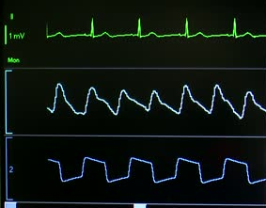
EE93 – Medical Mobile Devices and Apps
60
98
30
bpm
%
rpm
Lecture: Instrumentation & DSP

Slide 2
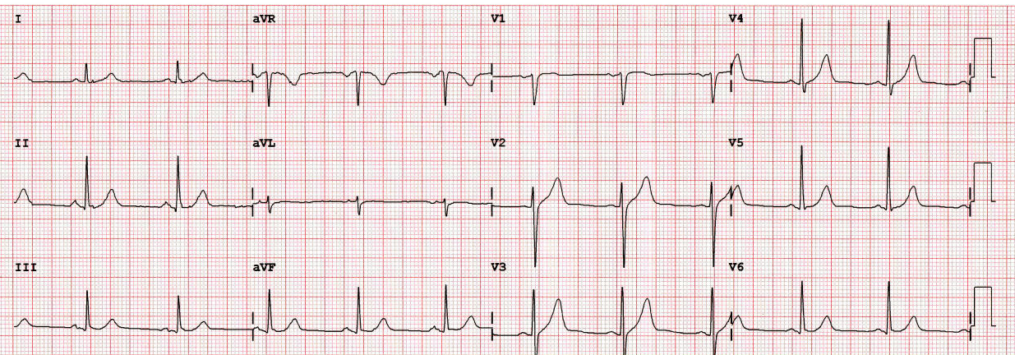
ECG Waveform on Strip Chart
12-lead – showing in 4 columns by 3 rows
One heartbeat cycle
5 mm by 5 mm reference square
0,200 s duration by 0.5 mV amplitude
1 mm by 1 mm reference square
0,040 s duration by 0.1 mV amplitude
1 mV, 10 mm high reference pulse
Length: 0.200 s

Slide 3
Measuring ECG (3-Lead)
3-lead ECG uses right arm (or chest), left arm (or chest) and left foot
Able to obtain PQRST wave
Unable to obtain other leads and heart angle
60
98
30
bpm
%
rpm
Source for ECG slides: Computing the Electrical Activity in the Heart: 1 (Monographs in Computational Science and Engineering) by Joakim Sundnes, Glenn Terje Lines, Xing Cai and Bjørn Frederik Nielsen (2007)

Slide 4
Common Frequencies for ECG
Heart rate: 0.67 to 5 Hz (40 to 300 bpm)
P-wave: 0.67 to 5 Hz
QRS Complex: 10 to 50 Hz
T-wave: 1 to 7 Hz
High frequency potentials: 100 to 500 Hz

Slide 5
Common Frequencies for ECG Artifacts & Noise
Muscle: 5 Hz to 50 Hz
Respiratory: 0.12 to 0.5 Hz (8 to 30 bpm)
External Electric: 50 Hz or 60 Hz (AC Line)
Other Electrical: > 10 Hz (muscle stimulators, magnetic fields, pacemakers with impedance monitoring)

Slide 6
ECG Special Notes
Skin-electrode interface – largest source of interference – produces 200 to 300 mV
Skin-electrode interference is magnified by motion (patient movement, respiratory variation)
Electrical activity of heart – 0.1 to 2 mV

Slide 7
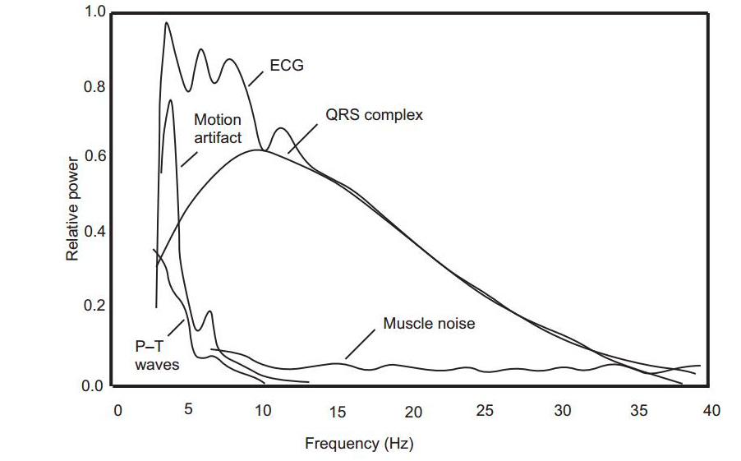
Power Spectra of ECG
Relative power spectra of QRS complex, P and T waves, muscle noise and motion artifacts based upon an average of 150 bpm
Source: http://www.ems12lead.com/wp-content/uploads/sites/42/2014/03/ecg-component-frequencies.jpg

Slide 8
ECG Amplifier
+
+
V₁
V₂

Slide 9
Signal & Noise Model
V_{noise}
+
V_{signal} + V_{noise}
V_{signal}
-

Slide 10
Instrumentation Amplifier
V₁
–
+
R₄
R₃
R₂
–
R₁
V_{out}
+
R₂
R₃
R₄
–
V₂
+

Slide 11
Instrumentation Amplifier (IA)
Provides capability to:
Reject common-mode signal components (noise & interference, undesired DC offsets)
Amplifies differential-mode signal
In practice, rejection of common-mode signal is not complete → common-mode rejection ration (CMRR)

Slide 12
Instrumentation Amplifier (IA)
Provides impedance isolation between bridge transducers and differential amplifier stage
Signals V1 and V2 are amplified separately
Conditions the signals
Provide high CMRR if implemented with diligence

Slide 13
Instrumentation Amplifier
V₁
–
+
R₄
R₃
R₂
–
R₁
V_{out}
+
R₂
R₃
R₄
–
V₂
+

Slide 14
Level Shifter
R_{F}
Wide spread use in medical applications
Adds or subtracts a DC offset to or from signal
R_{s}
V₊
–
+
V_{out}
+
V_{ref}
-

Slide 15
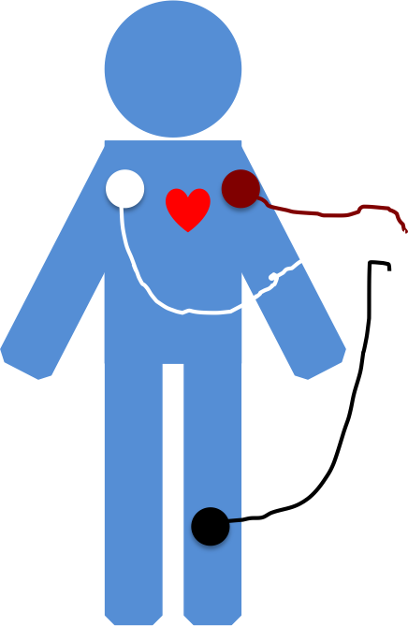
Signal Processing
Pulse Indicator
Instrumentation Amplifier
High Pass Filter
Signal Processing
WiFi
Patient Monitor
ECG with Noise
Stop Band
Filter
Square Signal
Pulse Detect

Slide 16
DSP
→ IIR Filter
→ FIR Filter

Slide 17
Filter Specification
“Ripple”
“Effective edge of the filter”
“Ripple”

Slide 18
DSP Notes
IIR filter – has infinite impulse response → need to limit
FIR filter – has finite impulse response → h_{f}[n] = 0, n ≥ 0
FIR filter advantages:
Can have exact linear phase
Always stable (even under quantization)
Design methods are reasonable linear
Realize efficiently in hardware or software
Transients have finite duration
Disadvantages
Requires higher filter order that IIR to achieve similar performance
Delay is typically greater in FIR than IIR counterpart

Slide 19
FIR Filter Design Notes
IIR: H[Ω] = desired IIR filter with impulse h[n]
FIR:
Transfer function:
DTFT:

Slide 20
DSP – Analytically
h_{d}[n] = w[n]•h[n]
Where w[n] is a window function → truncates the signal
Rectangular window causes abrupt transitions
Other windows allow gradual transitions

Slide 21
DSP – Other Windows
Hanning:
Hamming:

Slide 22
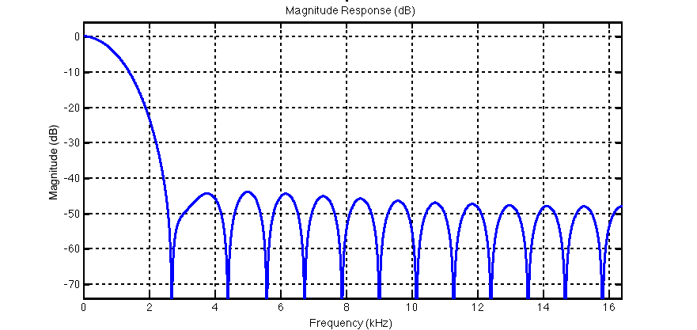
DSP – Windows
H_{d}(Ω) better approximates H(Ω) when main lobe of filter is narrow in bandwidth and side lobes are small in value
Hanning and Hamming, in general have much smaller sidelobes than rectangular window → less ripple in frequency response of FIR filter

Slide 23
DSP – Procedure
→ signal that needs to be filtered
Design the filter
Normalize the Nyquist rate across the spectrum
Generate the filter coefficients in MatLab
Use MatLab command fir1
Iterate until you “get an acceptable response”
Use MatLab command filter on signal
→ signal filter in iPad
Set up difference equation
Use filter coefficients from fir1
Compute filtered signal in code using add/multiply via difference equation
Program filter in Objective-C – rather than vDSP framework

