Slide 1
TEAM: No Show
Siddharth Gupta and Esther Wolf

Slide 2
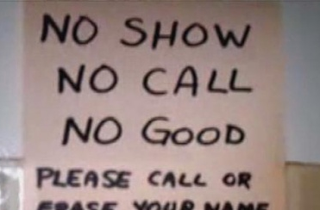
The Problem: Patients often do not show up for their scheduled doctor’s appointments

Slide 3
Why is it a problem?
For Patients:
Do not receive regular medical care
Incurs no-show fees
Increased risk for health problems
For Doctors, Practices, and Hospitals:
Wastes time
Loses money
Reduces clinic efficiency

Slide 4
The Numbers
With group practices accounting for 47 percent of the approximately 230,000 physician practices in the United States, clinics risk losing more than $100 billion annually due to patient no-shows.
~40% of missed appointments are due to lack of transportation

Slide 5
Why does it happen?
Our Focus:
Forgetfulness
Lack of Transportation
Potential Other Reasons:
Changes to personal schedule
Problems had been resolved prior to appointment
Too sick to attend
Cancelling process was unsuccessful

Slide 6
Our Solution
Forgetfulness:
Automatic text reminder system
Text Reminder sent 1-2 days before scheduled appointment
Option to Cancel, Reschedule, or Attend
Ability to send additional reminders if no response is given
Lack of Transportation:
Uber integration
Intelligent conversations about need
Demographic analysis
Custom tailored solutions using machine learning

Slide 7
Potential Customers
Directly to providers
Sell technology to call centers or other services (already connected to providers)

Slide 8
We need help!
No Show (Group 15):
Located: Ryder Room 217

