Slide 1
Lecture 7
Introduction to Distributed Programming
System V IPC:
Message Queues, Shared Memory, Semaphores

Slide 2
Introduction to Distributed Programming

Slide 3
Definitions
“Distributed programming is the spreading of a computational task across several programs, processes or processors.” – Chris Brown, Unix Distributed Programming
“A distributed system is one in which the failure of a computer you didn’t even know existed can render your own computer unusable.” – Leslie Lamport
“A parallel computer is a set of processors that are able to work cooperatively to solve a computational problem.” – Ian Foster, Designing and Building Parallel Programs
“A distributed system is a system in which multiple processes coordinate in solving a problem and, in the process of solving that problem, create other problems.” – Mark Shacklette

Slide 4
Benefits of Distributed Programming
Divide and Conquer
Concurrency
Parallelism
Component Reuse via pipelines (Modularity)
Location Independence
Scalability
Resource Sharing

Slide 5
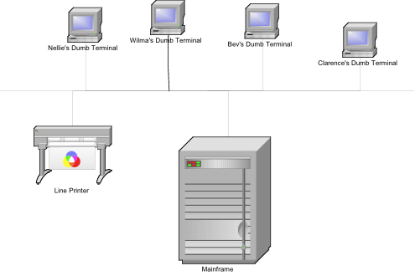
Mainframe Topology

Slide 6
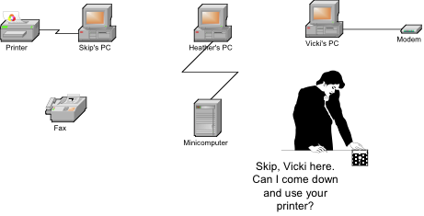
Sneaker Net

Slide 7
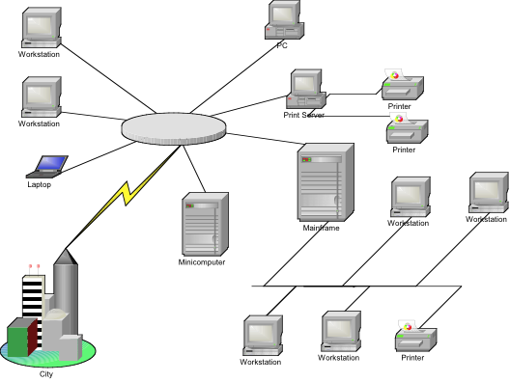
Modern Network

Slide 8
Problem Space
Problem 1
You have 1 hour to peel 1000 potatoes
You have 10 people available
Problem 2
You have 1 hour to do the dishes after a dinner for 1000 guests
You have 10 people available
Problem 3
You have 1 hour to lay the brick around a 5’ square dog house
You have 10 people available

Slide 9
Facilitating Division of Labor: Work and Communication
Single Machine Inter-process Communication
(Signals)
Pipes (named and unnamed)
System V and POSIX IPC
Multiple Machine Inter-process Communication
Sockets
Remote Procedure Calls (Sun ONC, OSF DCE, Xerox Courier (4.3BSD))
Distributed Shared Memory (Berkeley mmap)
Single Machine Division of Labor:
Processes
Threads

Slide 10
Methods of Solution Distribution: Input Distribution (Division of Labor)
Workload Decomposition
Potato Peelers aboard the USS Enterprise
loosely coupled (little coordination)
Roofers or Bricklayers
tightly coupled (high coordination)
Software: large database query of all records with a given characteristic
Strategy: Divide and Conquer
Key: Exact same code is operating on different sets of input data
Software: large matrix multiplication
Strategy: Divide and Conquer
Key: Exact same code is operating on different parts of the matrices

Slide 11
Methods of Solution Distribution: Process Decomposition (Inter-process Communication)
Divide not the work, but the process of conducting the work
Factory Production Line:
Identical widgets are coming along the converyor belt, but several things have to be done to each widget
Dish Washing Example
collector, washer, dryer, cabinet deployer
multiple washers and dryers can be employed (using Input Distribution)
Software: A Trade Clearing System
Each trade must be entered, validated, reported, notified
Each task can run within a different process on a different processor
Strategy: divide the work to be done for each trade into separate processes, thus increasing overall system throughput

Slide 12
Problems in Distributed Solutions
Data access must be synchronized among multiple processes
Multiple processes must be able to communicate among themselves in order to coordinate activities
Multiple coordinating processes must be able to locate one another

Slide 13
Interprocess Communication and Synchronization using System V IPC
Message Queues
Shared Memory
Semaphores

Slide 14
System V IPC
System V IPC was first introduced in SVR2, but is available now in most versions of unix
Message Queues represent linked lists of messages, which can be written to and read from
Shared memory allows two or more processes to share a region of memory, so that they may each read from and write to that memory region
Semaphores synchronize access to shared resources by providing synchronized access among multiple processes trying to access those critical resources.

Slide 15
Message Queues
A Message Queue is a linked list of message structures stored inside the kernel’s memory space and accessible by multiple processes
Synchronization is provided automatically by the kernel
New messages are added at the end of the queue
Each message structure has a long message type
Messages may be obtained from the queue either in a FIFO manner (default) or by requesting a specific type of message (based on message type)

Slide 16
Message Structs
Each message structure must start with a long message type: struct mymsg { long msg_type; char mytext[512]; /* rest of message */ int somethingelse; float dollarval; };

Slide 17
Message Queue Limits
Each message queue is limited in terms of both the maximum number of messages it can contain and the maximum number of bytes it may contain
New messages cannot be added if either limit is hit (new writes will normally block)
On linux, these limits are defined as (in /usr/include/linux/msg.h):
MSGMAX 8192 /*total number of messages */
MSBMNB 16384 /* max bytes in a queue */

Slide 18
Obtaining a Message Queue
#include <sys/types.h> #include <sys/ipc.h> #include <sys/msg.h> int msgget(key_t key, int msgflg);
key is either a number or the constant IPC_PRIVATE
a msgid is returned
key_t ftok(const char * path, int id) will return a key value for IPC usage
The key parameter is either a non-zero identifier for the queue to be created or the value IPC_PRIVATE, which guarantees that a new queue is created.
The msgflg parameter is the read-write permissions for the queue OR’d with one of two flags:
IPC_CREAT will create a new queue or return an existing one
IPC_EXCL added will force the creation of a new queue, or return an error

Slide 19
Writing to a Message Queue
int msgsnd(int msqid, const void * msg_ptr, size_t msg_size, int msgflags);
msgqid is the id returned from the msgget call
msg_ptr is a pointer to the message structure
msg_size is the size of that structure
msgflags defines what happens when the queue is full, and can be set to the following:
IPC_NOWAIT (non-blocking, return –1 immediately if queue is full)

Slide 20
Reading from a Message Queue
int msgrcv(int msqid, const void * msg_ptr, size_t msg_size, long msgtype, int msgflags);
msgqid is the id returned from the msgget call
msg_ptr is a pointer to the message structure
msg_size is the size of that structure
msgtype is set to:
= 0 first message available in FIFO stack
> 0 first message on queue whose type equals type
< 0 first message on queue whose type is the lowest value less than or equal to the absolute value of msgtype
msgflags defines what happens when no message of the appropriate type is waiting, and can be set to the following:
IPC_NOWAIT (non-blocking, return –1 immediately if queue is empty)
example: ~mark/pub/51081/message.queues/potato.*.c

Slide 21
Message Queue Control
struct msqid_ds {
... /* pointers to first and last messages on queue */
__time_t msg_stime; /* time of last msgsnd command */
__time_t msg_rtime; /* time of last msgrcv command */
...
unsigned short int __msg_cbytes; /* current number of bytes on queue */
msgqnum_t msg_qnum; /* number of messages currently on queue */
msglen_t msg_qbytes; /* max number of bytes allowed on queue */
... /* pids of last msgsnd() and msgrcv() */
};
int msgctl(int msqid, int cmd, struct msqid_ds * buf);
cmd can be one of:
IPC_RMID destroy the queue specified by msqid
IPC_SET set the uid, gid, mode, and qbytes for the queue, if adequate permission is available
IPC_STAT get the current msqid_ds struct for the queue
example: query.c

Slide 22
Shared Memory
Normally, the Unix kernel prohibits one process from accessing (reading, writing) memory belonging to another process
Sometimes, however, this restriction is inconvenient
At such times, System V IPC Shared Memory can be created to specifically allow one process to read and/or write to memory created by another process

Slide 23
Advantages of Shared Memory
Random Access
you can update a small piece in the middle of a data structure, rather than the entire structure
Efficiency
unlike message queues and pipes, which copy data from the process into memory within the kernel, shared memory is directly accessed
Shared memory resides in the user process memory, and is then shared among other processes

Slide 24
Disadvantages of Shared Memory
No automatic synchronization as in pipes or message queues (you have to provide any synchronization). Synchronize with semaphores or signals.
You must remember that pointers are only valid within a given process. Thus, pointer offsets cannot be assumed to be valid across inter-process boundaries. This complicates the sharing of linked lists or binary trees.

Slide 25
Creating Shared Memory
int shmget(key_t key, size_t size, int shmflg);
key is either a number or the constant IPC_PRIVATE (man ftok)
a shmid is returned
key_t ftok(const char * path, int id) will return a key value for IPC usage
size is the size of the shared memory data
shmflg is a rights mask (0666) OR’d with one of the following:
IPC_CREAT will create or attach
IPC_EXCL creates new or it will error if it exists

Slide 26
Attaching to Shared Memory
After obtaining a shmid from shmget(), you need to attach or map the shared memory segment to your data reference:
void * shmat(int shmid, void * shmaddr, int shmflg)
shmid is the id returned from shmget()
shmaddr is the shared memory segment address. Set this to NULL and let the system handle it.
shmflg is one of the following (usually 0):
SHM_RDONLY sets the segment readonly
SHM_RND sets page boundary access
SHM_SHARE_MMU set first available aligned address

Slide 27
Shared Memory Control
struct shmid_ds {
int shm_segsz; /* size of segment in bytes */
__time_t shm_atime; /* time of last shmat command */
__time_t shm_dtime; /* time of last shmdt command */
...
unsigned short int __shm_npages; /* size of segment in pages */
msgqnum_t shm_nattach; /* number of current attaches */
... /* pids of creator and last shmop */
};
int shmctl(int shmid, int cmd, struct shmid_ds * buf);
cmd can be one of:
IPC_RMID destroy the memory specified by shmid
IPC_SET set the uid, gid, and mode of the shared mem
IPC_STAT get the current shmid_ds struct for the queue
example: ~mark/pub/51081/shared.memory/linux/*

Slide 28
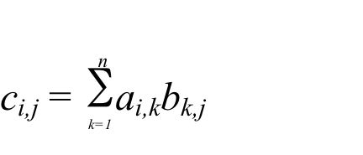

Matrix Multiplication
Multiply two n x n matrices, a and b
One each iteration, a row of A multiplies a column of b, such that:

Slide 29
Semaphores
Shared memory is not access controlled by the kernel
This means critical sections must be protected from potential conflicts with multiple writers
A critical section is a section of code that would prove problematic if two or more separate processes wrote to it simultaneously
Semaphores were invented to provide such locking protection on shared memory segments

Slide 30
System V Semaphores
You can create an array of semaphores that can be controlled as a group
Semaphores (Dijkstra, 1965) may be binary (0/1), or counting
1 == unlocked (available resource)
0 == locked
Thus:
To unlock a semaphore, you +INCREMENT it
To lock a semaphore, you -DECREMENT it
Spinlocks are busy waiting semaphores that constantly poll to see if they may proceed (Dekker’s Algorithm)

Slide 31
How Semaphores Work
A critical section is defined
A semaphore is created to protect it
The first process into the critical section locks the critical section
All subsequent processes wait on the semaphore, and they are added to the semaphore’s “waiting list”
When the first process is out of the critical section, it signals the semaphore that it is done
The semaphore then wakes up one of its waiting processes to proceed into the critical section
All waiting and signaling are done atomically

Slide 32
How Semaphores “Don’t” Work: Deadlocks and Starvation
When two processes (p,q) are both waiting on a semaphore, and p cannot proceed until q signals, and q cannot continue until p signals. They are both asleep, waiting. Neither can signal the other, wake the other up. This is called a deadlock.
P1 locks a which succeeds, then waits on b
P2 locks b which succeeds, then waits on a
Indefinite blocking, or starvation, occurs when one process is constantly in a wait state, and is never signaled. This often occurs in LIFO situations.
example: ~mark/pub/51081/semaphores/linux/shmem.matrix.multiplier2.c

