Slide 1
Lecture 8
Berkeley Socket Programming

Slide 2
Berkeley Sockets
Unix Socket Programming FAQ
Beej's Guide to Network Programming

Slide 3
Metaphors
Postal Service
Address
Name, Street, City, State, Zip Code
Return Address
Network of Post Offices
Local Post Offices
Lost Mail
Indeterminacy of Order
No confirmation of delivery for regular mail
No failed delivery notification

Slide 4
Metaphors (continued)
Toll call from one hotel room to another (circa 1945), (or, London today)
call down to local hotel operator
tell her the area code and number to call of the remote hotel
hotel operator calls long distance operator, who is listening for incoming calls
long distance operator calls remote hotel
remote hotel operator picks up, as she has been listening for calls, and routes the call to your friend’s room
You and your friend are now talking directly

Slide 5
You Already Use Sockets
echo (7), smtp (25), ftp (21), ssh (22)
telnet time.mit.edu 13
cat /etc/services | grep [telnet | ssh | ftp | echo | etc.]
daytime (13) (telnet time.mit.edu 13)
email (SMTP) (port 25): (telnet direct to SMTP server)
mark@sheik:~$ telnet smpt.cs.uchicago.edu 25
HELO sheik.cs.uchicago.edu
MAIL FROM: <soner@cs.uchicago.edu>
RCPT TO: <cspp51081@mailman.cs.uchicago.edu>
DATA
Hello, this is talking directly to Postfix.
.
QUIT

Slide 6
The Fundamentals
The Computer Systems Research Group (CSRG) at the University of California Berkeley gave birth to the Berkeley Socket API (along with its use of the TCP/IP protocol) with the 4.2BSD release in 1983.
A Socket is comprised of:
a 32-bit node address (IP address or FQDN)
a 16-bit port number (like 7, 21, 13242)
Example: 192.168.31.52:1051
The 192.168.31.52 host address is in “IPv4 dotted-quad” format, and is a decimal representation of the hex network address 0xc0a81f34

Slide 7
Port Assignments (less /etc/services)
Ports 0 through 1023 are reserved, privileged ports, defined by TCP and UDP well known port assignments (telnet, ssh, http, ftp, etc.)
Ports 1024 through 49151 are ports registered by the IANA (Internet Assigned Numbers Authority), and represent second tier common ports (socks (1080), WINS (1512), kermit (1649), Java RMI Registry (1099)), Microsoft SQL Server (1433), Oracle (1529)
Ports 49152 through 65535 are ephemeral ports, available for temporary client usage

Slide 8
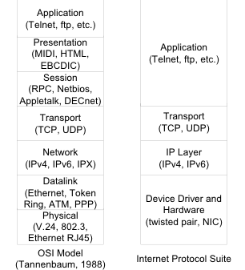
Protocol Stacks

Slide 9
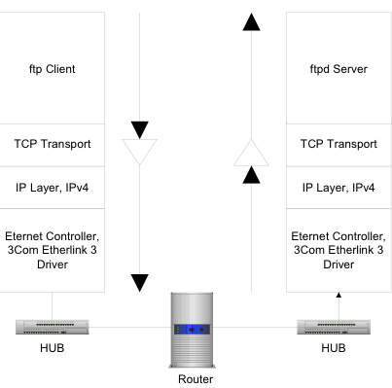
Protocol Communication

Slide 10
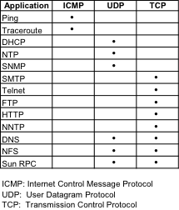
Common Protocols

Slide 11
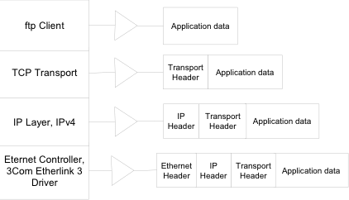
Data Encapsulation
Application puts data out through a socket
Each successive layer wraps the received data with its own header:

Slide 12
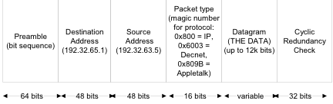
The Hardware (Ethernet) Layer
Responsible for transfering frames (units of data) between machines on the same physical network

Slide 13
The IP Layer
The IP layer allows packets to be sent over gateways to machines not on the physical network
Addresses used are IP addresses, 32-bit numbers divided into a network address (used for routing) and a host address
The IP protocol is connectionless, implying:
gateways route discrete packets independently and irrespective of other packets
packets from one host to another may be routed differently (and may arrive at different times)
non-guaranteed delivery

Slide 14
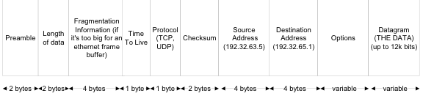
IP Datagram Format
Packets may be broken up, or fragmented, if original data is too large for a single packet (Maximum Transmission Unit is currently 12k bits, or 1500 Bytes)
Packets have a Time To Live, number of seconds/rounds it can bounce around aimlessly among routers until it’s killed

Slide 15
The Transport Layer
Unix has two common transports
User Datagram Protocol
record protocol
connectionless, broadcast
Metaphor: Postal Service
Transmission Control Protocol
byte stream protocol
direct connection-oriented
Metaphor: Phone Service circa 1945
“Sarah, this is Andy, get me Barney please.”

Slide 16
The Transport Layer: UDP Protocol
Connectionless, in that no long term connection exists between the client and server. A connection exists only long enough to deliver a single packet and then the connection is severed.
No guaranteed delivery (“best effort”)
Fixed size boundaries, sent as a single “fire and forget message”. Think announcement.
No built-in acknowledgement of receipt

Slide 17
The Transport Layer: UDP Protocol
No built-in order of delivery, random delivery
Unreliable, since there is no acknowledgement of receipt, there is no way to know to resend a lost packet
Does provide checksum to guarantee integrity of packet data
Fast and Efficient

Slide 18
The Transport Layer: TCP Protocol
TCP guarantees delivery of packets in order of transmission by offering acknowledgement and retransmission: it will automatically resend after a certain time if it does not receive an ACK
TCP promises sequenced delivery to the application layer, by adding a sequence number to every packet. Packets are reordered by the receiving TCP layer before handing off to the application layer. This also aides in handling “duplicate” packets.

Slide 19
The Transport Layer: TCP Protocol
Pure stream-oriented connection, it does not care about message boundaries
A TCP connection is full duplex (bidirectional), so the same socket can be read and written to (cf. half duplex pipes)
Provides a checksum that guarantees packet integrity

Slide 20
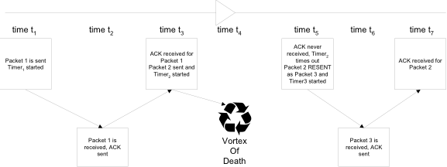
TCP’s Positive Acknowledgement with Retransmission
TCP offers acknowledgement and retransmission: it will automatically resend after a certain time if it does not receive an ACK
TCP offers flow control, which uses a “sliding window” (in the TCP header) will allow a limited number of non-ACKs on the net during a given interval of time. This increases the overall bandwidth efficiency. This window is dynamically manged by the recipient TCP layer.

Slide 21
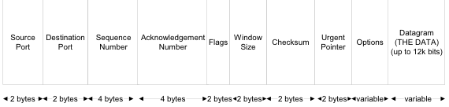
TCP Datagram Format
Source and Destination addresses
Sequence Number tells what byte offset within the overall data stream this segment applies
Acknowledgement number lets the recipient set what packet in the sequence was received ok.

Slide 22
Socket Domain Families
There are several significant socket domain families:
Internet Domain Sockets (AF_INET)
implemented via IP addresses and port numbers
Unix Domain Sockets (AF_UNIX)
implemented via filenames (think “named pipe”)
Novell IPX (AF_IPX)
AppleTalk DDS (AF_APPLETALK)
Example: ~mark/pub/51081/sockets/linux/socketpairs.c

Slide 23
Creating a Socket
#include <sys/types.h>
#include <sys/socket.h>
int socket(int domain, int type, int protocol);
domain is one of the Address Families (AF_INET, AF_UNIX, etc.)
type defines the communication protocol semantics, usually defines either:
SOCK_STREAM: connection-oriented stream (TCP)
SOCK_DGRAM: connectionless, unreliable (UDP)
protocol specifies a particular protocol, just set this to 0 to accept the default (PF_INET, PF_UNIX) based on the domain

Slide 24
Connection-oriented socket connections
Client-Server view

Slide 25
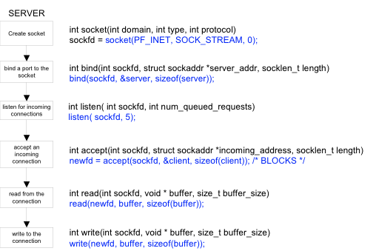
Server Side Socket Details

Slide 26
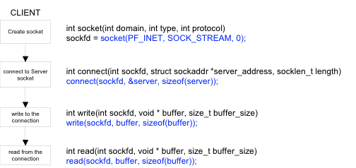
Client Side Socket Details

Slide 27
Setup for an Internet Domain Socket
struct sockaddr_in {
sa_family_t sin_family;
unsigned short int sin_port;
struct in_addr sin_addr;
unsigned char pad[...];
};
sin_family is set to Address Family AF_INET
sin_port is set to the port number you want to bind to
sin_addr is set to the IP address of the machine you are binding to (struct in_addr is a wrapper struct for an unsigned long). INADDR_ANY supports all interfaces (since a given machine may have multiple interface cards)
ignore padding

Slide 28
Setup for A Unix Domain Socket
struct sockaddr_un {
sa_family_t sun_family;
char sun_path[UNIX_PATH_MAX];
};
sun_family is set to Address Family AF_UNIX
sun_path is set to a UNIX pathname in the filesystem

Slide 29
Reading From and Writing To Stream Sockets
Sockets, like everything else, are like files:
low level IO:
read() system call
write() system call
higher level IO:
int recv(int socket, char *buf, int len, int flags);
blocks on read
returns 0 when other connection has terminated
int send(int socket, char *buf, int len, int flags);
returns the number of bytes actually sent
where flags may be one of:
MSG_DONTROUTE (don’t route out of localnet)
MSG_OOB (out of band data (think interruption))
MSG_PEEK (examine, but don’t remove from stream)

Slide 30
Closing a Socket Session
int close(int socket);
closes read/write IO, closes socket file descriptor
int shutdown( int socketfd, int how);
where how is:
0: no more receives allowed
1: no more sends are allowed
2: disables both receives and sends (but doesn’t close the socket, use close() for that)
Example: hangserver.c (hangman game)

Slide 31
Host and Network Byte Ordering
Different computer architectures store numbers differently:
Little Endian architectures (like VAX, Intel) store the least significant byte first
This means that within a (2-byte) word, the least significant byte is stored first, that is, at the lowest byte address
Big Endian architectures (like Sun Sparc, Motorola 68000, PowerPC) store the most significant byte appearing first
This means that within a (2-byte) word, the most significant byte is stored first, that is, at the lowest byte address
examples: ~mark/pub/51081/byteorder/linux/endian.sh and ~mark/pub/51081/byteorder/solaris/endian.sh
(on nunki.cs.uchicago.edu)

Slide 32
Why This Matters
TCP/IP mandates that big-endian byte ordering be used for transmitting protocol information
This means that little-endian machines will need to convert ip addresses and port numbers into big-endian form in order to communicate successfully
Note that big-endian architectures don’t actually have to do anything, because they already meet the specification

Slide 33
What’s To Be Done About It?
Several functions are provided to allow you to easily convert between host and network byte ordering, and they are:
to translate 32-bit numbers (i.e. IP addresses):
unsigned long htonl(unsigned long hostlong);
unsigned long ntohl(unsigned long netlong);
to translate 16-bit numbers (i.e. Port numbers):
unsigned short htons(unsigned short hostshort);
unsigned short ntohs(unsigned short netshort);

Slide 34
UDP Clients and Servers
Connectionless clients and servers create a socket using SOCK_DGRAM instead of SOCK_STREAM
Connectionless servers do not call listen() or accept(), and usually do not call connect()
Since connectionless communications lack a sustained connection, several methods are available that allow you to specify a destination address with every call:
sendto(sock, buffer, buflen, flags, to_addr, tolen);
recvfrom(sock, buffer, buflen, flags, from_addr, fromlen);
Examples: daytimeclient.c
Example: daytimeclient time.mit.edu

Slide 35
Servicing Multiple Clients
Two main approaches:
forking with fork()
selecting with select()
fork() approach forks a new process to handle each incoming client connection, essentially to act as a “miniserver” dedicated to each new client:
must worry about zombies created when parent loops back to accept() a new client (ignore SIG_CHILD signal)
inefficient
A better approach would be to have a single process handle all incoming clients, without having to spawn separate child “server handlers”. Enter select().

Slide 36
select()
int select(int numfiledescs, fd_set readfdsset, fd_set writefdsset, fd_set errorfdsset, struct timeval * timeout);
The select() system call provides a way for a single server to wait until a set of network connections has data available for reading
The advantage over fork() here is that no multiple processes are spawned
The downside is that the single server must handle state management on its own for all its new clients

Slide 37
select() (continued)
select() will return if any of the descriptors in readfdsset and writefdsset of file descriptors are ready for reading or writing, respectively, or, if any of the descriptors in errorfdsset are in an error condition
The FD_SET(int fd, fd_set *set) function will add the file descriptor fd to the set set
The FD_ISSET(int fd, fd_set *set) function will tell you if filedesc fd is in the modified set set
select() returns the total number of descriptors in the modified sets
If a client closes a socket whose file descriptor is in one of your watched sets, select() will return, and your next recv() will return 0, indicating the socket has been closed

Slide 38
Setting the timeval in select()
If you set the timeout to 0, select() times out immediately
If you set the timeout to NULL, select() will never time out, and will block indefinitely until a filedes is modified
If you don’t care about a particular file descriptor set, just set it to NULL in the call:
select (max, &readfds, NULL, NULL, NULL);
Here we only care about reading, and we want to block indefinitely until we do have a file descriptor ready to be read
examples: multiserver.c, multiclient.c

Slide 39
How to Reuse Addresses
Local ports are locked from rebinding for a period of time (usually a couple of minutes based on the TIME_WAIT state) after a process closes them. This is to ensure that a temporarily “lost” packet does not reappear, and then be delivered to a reincarnation of a listening server. But when coding and debugging a client server app, this is bothersome. The following code will turn this feature off:
int yes = 1;
server = socket(AF_INET, SOCK_STREAM, 0);
if (setsockopt(server, SOL_SOCKET, SO_REUSEADDR, &yes, sizeof(int)) < 0)
{
perror(“setsockopt SO_REUSEADDR");
exit(1);
}

Slide 40
Miscellaneous Socket Functions
int getpeername(int sockfd, struct sockaddr * addr, int *addrlen);
this tells you the hostname of the REMOTE connection embedded in addr
int gethostname(char * hostname, size_t size);
this tells you the hostname of your LOCAL connection
int inet_aton(const char * string_address, &(addr.sin_addr));
converts the const ip string_address (“192.168.3.1”) into an acceptable numeric form
addr.sin_addr = inet_addr(“192.168.3.1”);
does the same thing

Slide 41
More Miscellaneous Functions
struct hostent *gethostbyname(const char *hostname);
Does a DNS lookup and returns a pointer to a hostent structure that contains the host name, aliases, address type (AF_INET, etc.), length, and an array of IP addresses for this host (hostent.h_addr_list[0] is usually the one) (cf. /etc/nsswitch.conf) struct hostent { char *h_name; /*DNS host name*/ char **h_aliases; /*alias list*/ int h_addrtype; /* “AF_INET”, etc*/ int h_length; /* length of addr*/ char **h_addr_list; /*list of IP adds*/ };

Slide 42
And a Few More
struct servent * getservbyname(const char *servicename, const char *protocol)
struct servent * getservbyport(int port, const char *protocol)
example: serventptr = getservbyname(“daytime”, “udp”); struct servent { char * s_name; /*official service name*/ char **s_aliases; /* alias list */ int s_port; /*port num*/ char *s_proto; /* protocol: “tcp”, “udp”*/ };

Slide 43
Remote Procedure Calls
Digital ONC RPC

Slide 44
The Point
“What’s the difference between local and remote procedure calling?”
“Very little—that’s the point”
Remote Procedures generally accept and return pointers to data

Slide 45
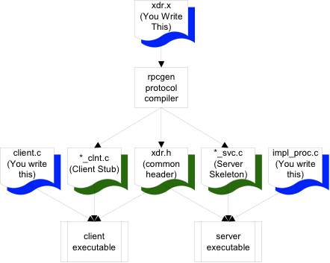
The Process

Slide 46
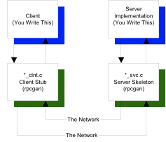
Call Sequence

Slide 47
Remote Services
SUN Remote Procedure Call
If the time to transfer the data is more than the time to execute a remote command, the latter is generally preferable.
UDP protocol is used to initiate a remote procedure, and the results of the computation are returned.

Slide 48
SUN RPC
Communication is message-based
When a server starts, it binds an arbitrary port and publishes that port and the PROGRAM and VERSION with the portmapper daemon (port 111)
When a client starts, it contacts the portmapper and asks where it can find the remote procedure, using PROGRAM and VERSION ids. The portmapper daemon returns the address and client and server communicate directly.

Slide 49
Sample protocol definition file (.x file)
this XDR file (somefile.x):
program NUMPROG
{
version NUMVERS
{
int READNUM(int) = 1; /* procedure number 1 */
} = 1; /* interface VERSION number */
} = 0x2000002; /* PROGRAM number */
is turned into this header file by rpcgen (somefile.h):
#define NUMPROG 0x2000002
#define NUMVERS 1
#if defined(__STDC__) || defined(__cplusplus)
#define READNUM 1
extern int * readnum_1(int *, CLIENT *);
extern int * readnum_1_svc(int *, struct svc_req *);

Slide 50
RPC Paradigms for Client Server
Fat Client-DBMS (2 Tier)
VB <=> Sybase (ODBC)
Motif C++ <=> DBMS (ctlib)
Fat Client-Application Server-DBMS
C Front End <=> C Business Logic <=> DBMS

Slide 51
RPC Under the Hood
RPC is important because it handles network details for you:
Network Details
Byte Ordering (Big Endian, Little Endian)
Alignment Details
2/4 Byte alignment
String Termination (NULL ?)
Pointers (how to handle migration of pointers?)

Slide 52
RPC eXternal Data Representation
XDR provides:
Network Transparency
Single Canonical Form using Big-Endian
4-Byte alignment
XDR passes all data across the wire in a byte stream
Filters

Slide 53
XDR Filters
Integer: int (4 bytes)
Unsigned Integer: unsigned int (4 bytes)
char: int (4 byte signed integer)
Double: double (8 bytes IEEE754 FP)
Float: float (4 bytes IEEE754 FP)
int week[7]
int orders <50> (variable length array)
opaque data<1000> any data

Slide 54
Building an RPC Application
Create XDR file (~mark/pub/518/rpc/[linux|sun]/numdisp.x)
run rpcgen to create
client stub: numdisp_clnt.c
server skeleton: numdisp_svc.c
common header: numdisp.h
write client.c and numdisp_proc.c
compile client and server (in subdirs)
run (client on devon, server on orcus)
example: ~mark/pub/51081/rpc/linux, ~mark/pub/51081/rpc/sun

