Slide 1
Lecture 9
Remote Procedure Calls
Introduction to Multithreaded Programming

Slide 2
Remote Procedure Calls
Digital ONC RPC

Slide 3
The Point
“What’s the difference between local and remote procedure calling?”
  “Very little—that’s the point”
Remote Procedures generally accept and return pointers to data

Slide 4
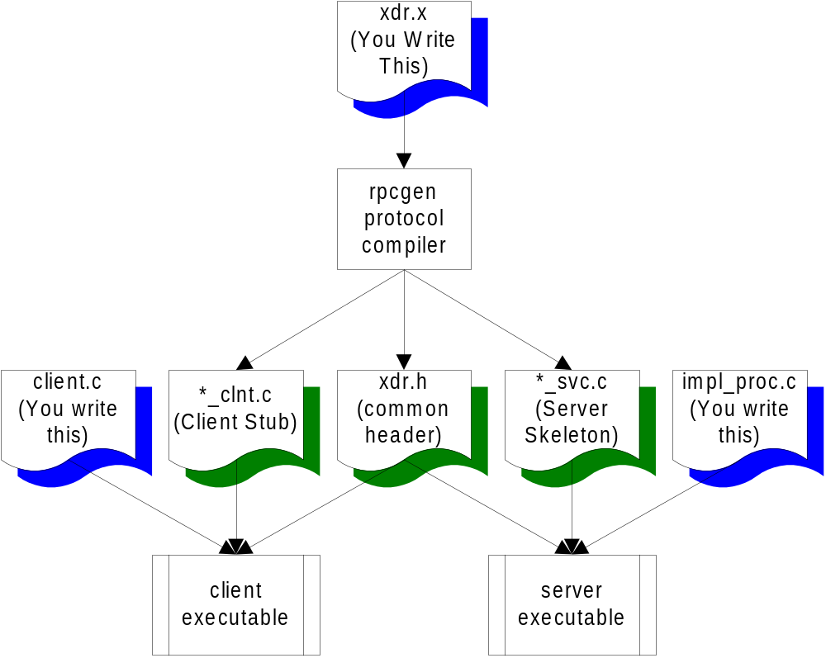
The Process

Slide 5
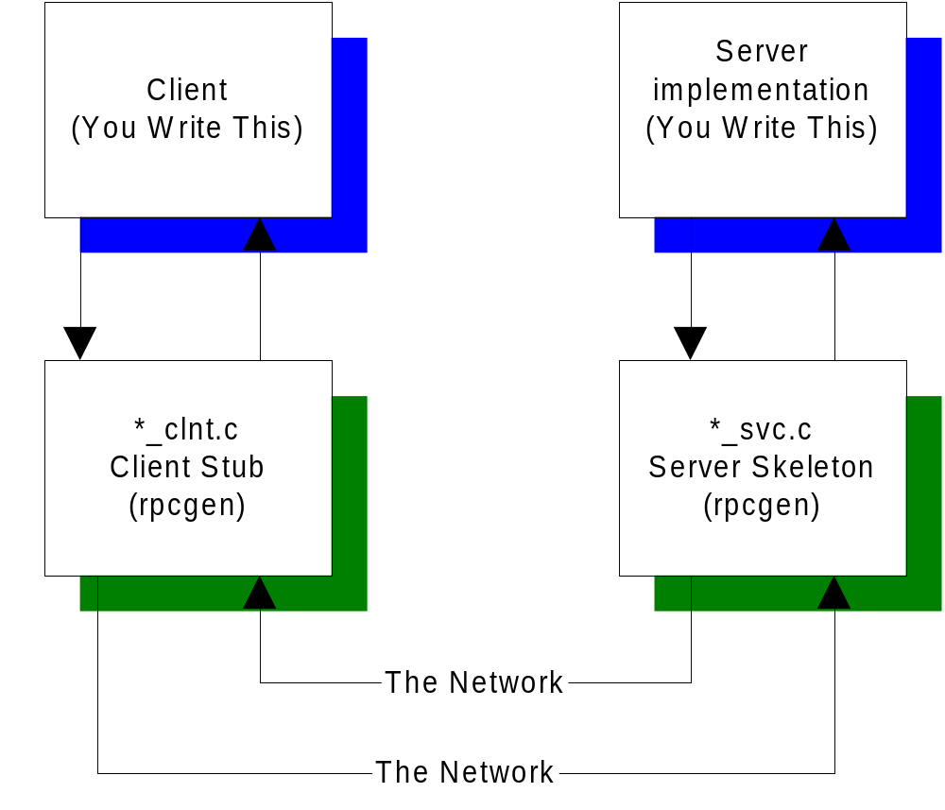
Call Sequence

Slide 6
Remote Services
SUN Remote Procedure Call
  If the time to transfer the data is more than the time to execute a remote command, the latter is generally preferable.
  UDP protocol is used to initiate a remote procedure, and the results of the computation are returned.

Slide 7
SUN RPC
Communication is message-based
When a server starts, it binds an arbitrary port and publishes that port and the PROGRAM and VERSION with the portmapper daemon (port 111)
When a client starts, it contacts the portmapper and asks where it can find the remote procedure, using PROGRAM and VERSION ids. The portmapper daemon returns the address and client and server communicate directly.

Slide 8
Sample protocol definition file
(.x file)
this XDR file (somefile.x):
program NUMPROG
{
version NUMVERS
{
int READNUM(int) = 1; /* version 1 */
} = 1; /* version of functions */
} = 0x2000002; /* PROGRAM number */
is turned into this header file by rpcgen (somefile.h):
#define NUMPROG 0x2000002
#define NUMVERS 1
#if defined(__STDC__) || defined(__cplusplus)
#define READNUM 1
extern int * readnum_1(int *, CLIENT *);
extern int * readnum_1_svc(int *, struct svc_req *);

Slide 9
RPC Paradigms for Client Server
Fat Client-DBMS (2 Tier)
  VB <=> Sybase (ODBC)
  Motif C++ <=> DBMS (ctlib)
Fat Client-Application Server-DBMS
  C Front End <=> C Business Logic <=> DBMS

Slide 10
RPC Under the Hood
RPC is important because it handles network details for you:
  Network Details
    Byte Ordering (Big Endian, Little Endian)
  Alignment Details
    2/4 Byte alignment
  String Termination (NULL ?)
  Pointers (how to handle migration of pointers?)

Slide 11
RPC eXternal Data Representation
XDR provides:
  Network Transparency
    Single Canonical Form using Big-Endian
    4-Byte alignment
    XDR passes all data across the wire in a byte stream
  Filters

Slide 12
XDR Filters
Integer: int (4 bytes)
Unsigned Integer: unsigned int (4 bytes)
char: int (4 byte signed integer)
Double: double (8 bytes IEEE754 FP)
Float: float (4 bytes IEEE754 FP)
int week[7]
int orders <50> (variable length array)
opaque data<1000> any data

Slide 13
Building an RPC Application
Create XDR file (~mark/pub/518/rpc/[linux|sun]/numdisp.x)
run rpcgen to create
  client stub: numdisp_clnt.c
  server skeleton: numdisp_svc.c
  common header: numdisp.h
write client.c and numdisp_proc.c
compile client and server (in subdirs)
run (client on devon, server on orcus)
example: ~mark/pub/518/rpc/linux, ~mark/pub/518/rpc/sun

Slide 14
Introduction to Multithreaded Programming with POSIX Pthreads
Pthreads Information
Threads FAQ
Pthread Tutorial at Amherst
Pthreads Programming Bouncepoint

Slide 15
Processes Revisited
A process is an active runtime environment that cradles a running program, providing an execution state along with certain resources, including file handles and registers, along with:
  a program counter (Instruction Pointer)
  a process id, a process group id, etc.
  a process stack
  one or more data segments
  a heap for dynamic memory allocation
  a process state (running, ready, waiting, etc.)
Informally, a process is an executing program

Slide 16
Multiprocessing Revisited
A multiprocessing or multitasking operating system (like Unix, as opposed to DOS) can have more than one process executing at any given time
This simultaneous execution may either be
  concurrent, meaning that multiple processes in a run state can be swapped in and out by the OS
  parallel, meaning that multiple processes are actually running at the same time on multiple processors

Slide 17
What is a Thread?
A thread is an encapsulation of some flow of control in a program, that can be independently scheduled
Each process is given a single thread by default
A thread is sometimes called a lightweight process, because it is similar to a process in that it has its own thread id, stack, stack pointer, a signal mask, program counter, registers, etc.
All threads within a given process share resource handles, memory segments (heap and data segments), and code. THEREFORE HEAR THIS:
  All threads share the same data segments and code segments

Slide 18
What’s POSIX Got To Do With It?
Each OS had it’s own thread library and style
That made writing multithreaded programs difficult because:
  you had to learn a new API with each new OS
  you had to modify your code with each port to a new OS
POSIX (IEEE 1003.1c-1995) provided a standard known as Pthreads
DCE threads were based on an early 4th draft of the POSIX Pthreads standard (immature)
Unix International (UI) threads (Solaris threads) are available on Solaris (which also supports POSIX threads)

Slide 19
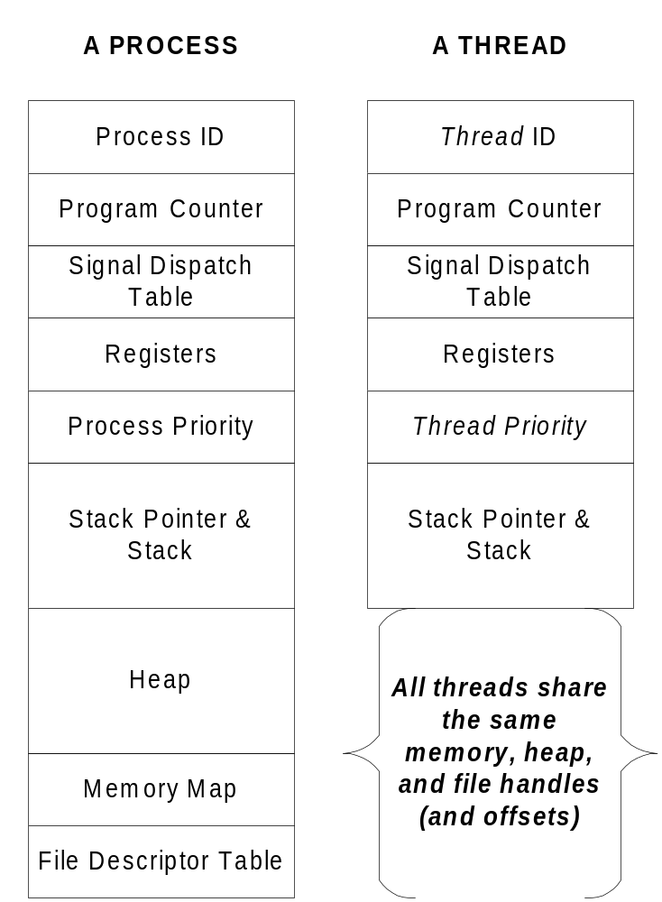
Once Again....

Slide 20
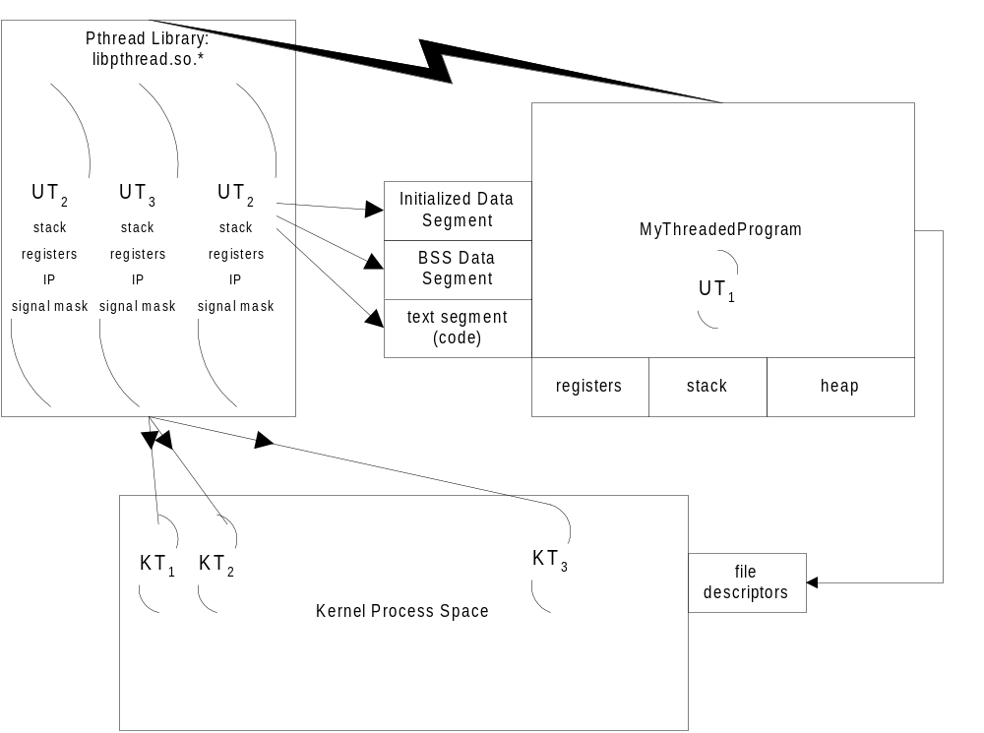
The Big Kahuna

Slide 21
Processes and Threads:
Creation Times
Because threads are by definition lightweight, they can be created more quickly that “heavy” processes:
  Sun Ultra5, 320 Meg Ram, 1 CPU
    94 forks()/second
    1,737 threads/second (18x faster)
  Sun Sparc Ultra 1, 256 Meg Ram , 1 CPU
    67 forks()/second
    1,359 threads/second (20x faster)
  Sun Enterprise 420R, 5 Gig Ram, 4 CPUs
    146 forks()/second
    35,640 threads/second (244x faster)
  Linux 2.4 Kernel, .5 Gig Ram, 2 CPUs
    1,811 forks()/second
    227,611 threads/second (125x faster)

Slide 22
Say What?
Threads can be created and managed more quickly than processes because:
  Threads have less overhead than processes, for example, threads share the process heap, all data and code segments
  Threads can live entirely in user space, so that no kernel mode switch needs to be made to create a new thread
  Processes don’t need to be swapped to create a thread

Slide 23
Analogies
Just as a multitasking operating system can have multiple processes executing concurrently or in parallel, so a single process can have multiple threads that are executing concurrently or in parallel
These multiple threads can be taskswapped by a scheduler onto a single processor (via a LWP), or can run in parallel on separate processors

Slide 24
Benefits of Multithreading
Performance gains
  Amdahl’s Law: speedup = 1 / (1 – p) + (p/n)
  the speedup generated from parallelizing code is the time executing the parallelizable work (p) divided by the number of processors (n) plus 1 minus the parallelizable work (1-p)
  The more code that can run in parallel, the faster the overall program will run
  If you can apply multiple processors for 75% of your program’s execution time, and you’re running on a dual processor box:
    1 / ((1 - .75) + (.75 / 2)) = 60% improvement
  Why is it not strictly linear? How do you calculate p?

Slide 25
Benefits of Multithreading (continued)
Increased throughput
Increased application responsiveness (no more hourglasses)
Replacing interprocess communications (you’re in one process)
Single binary executable runs on both multiprocessors as well as single processors (processor transparency)
Gains can be seen even on single processor machines, because blocking calls no longer have to stop you.

Slide 26
On the Scheduling of Threads
Threads may be scheduled by the system scheduler (OS) or by a scheduler in the thread library (depending on the threading model).
The scheduler in the thread library:
  will preempt currently running threads on the basis of priority
  does NOT time-slice (i.e., is not fair). A running thread will continue to run forever unless:
    a thread call is made into the thread library
    a blocking call is made
    the running thread calls sched_yield()

Slide 27
Models
Many Threads to One LWP
  DCE threads on HPUX 10.20
One Thread to One LWP
  Windows NT
  Linux (clone() function)
Many Threads to Many LWPs
  Solaris, Digital UNIX, IRIX, HPUX 11.0)

Slide 28
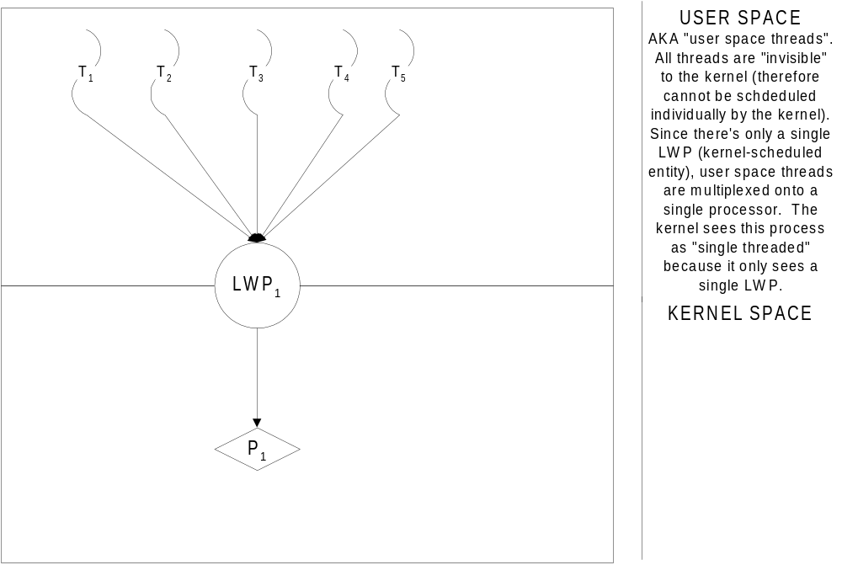
Many Threads to One LWP
DCE threads on HPUX 10.20

Slide 29
Mx1 Variances
very fast context switches between threads is executed entirely in user space by the threads library
unlimited number of user threads (memory limit) can support logical concurrency model only
parallelism is not possible, because all user threads map to a single kernel-schedulable entity (LWP), which can only be mapped on to a single processor
Since the kernel sees only a single process, when one user space thread blocks, the entire process is blocked, effectively block all other user threads in the process as well

Slide 30
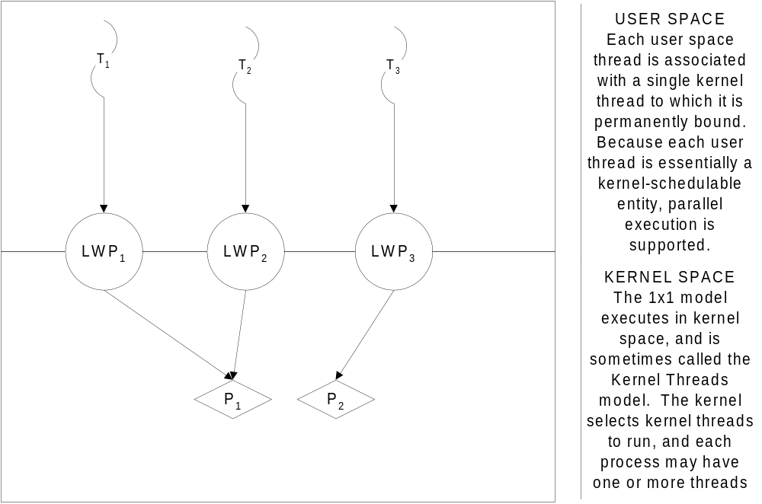
One Thread to One LWP( Windows NT, Linux)
(there may be no real distinction between a thread and LWP)

Slide 31
1x1 Model Variances
Parallel execution is supported, as each user thread is directly associated with a single kernel thread which is scheduled by the OS scheduler
slower context switches, as kernel is involved
number of threads is limited because each user thread is directly associated with a single kernel thread (in some instances threads take up an entry in the process table)
scheduling of threads is handled by the OS’s scheduler, threads are seldom starved
Because threads are essentially kernel entities, swapping involves the kernel and is less efficient than a pure user-space scheduler

Slide 32
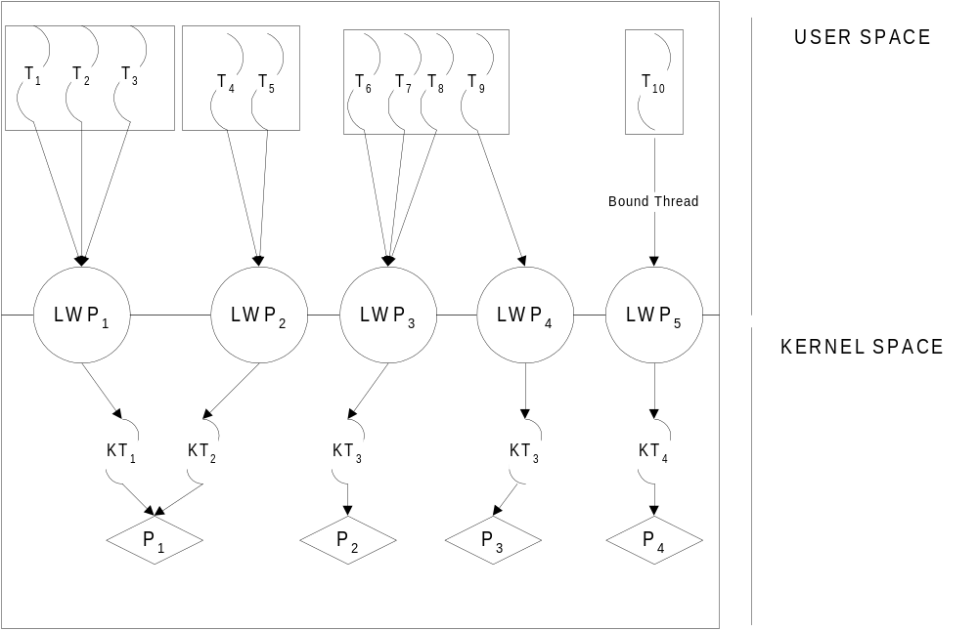
Many Threads to Many LWPs
Solaris, Digital UNIX, IRIX, HPUX 11.0

Slide 33
MxN Model Variances
Extraordinarily flexible, bound threads can be used to handle important events, like a mouse handler
Parallel execution is fully supported
Implemented in both user and kernel space
Slower context switches, as kernel is often involved
Number of user threads is virtually unlimited (by available memory)
Scheduling of threads is handled by both the kernel scheduler (for LWPs) and a user space scheduler (for user threads). User threads can be starved as the thread library’s scheduler does not preempt threads of equal priority (not RR)
The kernel sees LWPs. It does NOT see threads

Slide 34
Creating a POSIX Thread: pthread_create()
#include <pthread.h>
void * pthread_create(pthread_t *thread, const pthread_attr_t attr, void *(*thrfunc)(void *), void *args);
Each thread is represented by an identifier, of type pthread_t
Code is encapsulated in a thread by creating a thread function (cf. “signal handlers”)
Attributes may be set on a thread (priority, etc.). Can be set to NULL.
An argument may be passed to the thread function as a void **

Slide 35
Detaching a Thread
int pthread_detach(pthread_t threadid);
Detach a thread when you want to inform the operating system that the threads return result is unneeded
Detaching a thread tells the system that the thread (including its resources—like a 1Meg default stack on Solaris!) is no longer being used, and can be recycled
A detached thread’s thread ID is undetermined.
Threads are detached after a pthread_detach() call, after a pthread_join() call, and if a thread terminates and the PTHREAD_CREATE_DETACHED attribute was set on creation

Slide 36
“Wating” on a Thread: pthread_join()
int pthread_join(pthread_t thread, void** retval);
pthread_join() is a blocking call on non-detached threads
It indicates that the caller wishes to block until the thread being joined exits
You cannot join on a detached thread, only non-detached threads (detaching means you are NOT interested in knowing about the threads exit)

Slide 37
Exiting from a Thread Function
int pthread_exit(void * retval);
A thread ends when it returns from (falls out of) its thread function encapsulation
A detached thread that ends will immediately relinquish its resources to the OS
A non-detached thread that exists will release some resources but the thread id and exit status will hang around in a zombie-like state until some other thread requests its exit status via pthread_join()

Slide 38
Miscellaneous Functions
pthread_t pthread_self(void);
  pthread_self() returns the currently executing thread’s ID
int sched_yield(void);
  sched_yield() politely informs the thread scheduler that your thread will willingly release the processor if any thread of equal or lower priority is waiting
int pthread_setconcurrency(int threads);
  pthread_setconcurrency() allows the process to request a fixed minimum number of light weight processes to be allocated for the process. This can, in some architectures, allow for more efficient scheduling of threads

Slide 39
Managing Dependencies and Protecting Critical Sections
Mutexes
Condition Variables
Reader/Writer Locks
Semaphores
Barriers

Slide 40
Mutexes
A Mutex (Mutual Exclusion) is a data element that allows multiple threads to synchronize their access to shared resources
Like a binary semaphore, a mutex has two states, locked and unlocked
Only one thread can lock a mutex
Once a mutex is locked, other threads will block when they try to lock the same mutex, until the locking mutex unlocks the mutex, at which point one of the waiting thread’s lock will succeed, and the process begins again

Slide 41
Statically Initialized Mutexes
Declare and statically initialize a mutex:
pthread_mutex_t mymutex = PTHREAD_MUTEX_INITIALIZER;
Then, lock the mutex:
pthread_mutex_lock(&mymutex);
Then, unlock the mutex when done:
pthread_mutex_unlock(&mymutex);

Slide 42
NonStatically Initialized Mutexes
Declare a mutex:
pthread_mutex_t mymutex;
Initialize the mutex:
pthread_mutex_init(&mymutex, (pthread_mutexattr_t *)NULL );
Lock the mutex
pthread_mutex_lock(&mymutex);
Unlock the mutex:
pthread_mutex_unlock(&mymutex);

Slide 43
Dynamic Mutexes
Declare a mutex pointer:
pthread_mutex_t * mymutex;
Allocate memory for the mutex and pointer.
Optionally declare a mutex attribute and initialize it
pthread_mutexattr_t mymutex_attr;
pthread_mutexattr_init(&mymutex_attr);
initialize the mutex:
pthread_mutex_init(mymutex, &mymutex_attr);
Lock and Unlock the mutex as normal...
Finally, destroy the mutex
pthread_mutex_destroy(mymutex);

Slide 44
Condition Variables
A Condition variable is synchronization mechanism that allows multiple threads to conditionally wait, until some defined time at which they can proceed
Condition variables are different from mutexes because they don’t protect code, but procedure
A thread will wait on a condition variable until the variable signals it can proceed
Some other thread signals the condition variable, allowing other threads to continue.
Each condition variable, as a shareable datum, is associated with a particular mutex
Condition Variables are supported on Unix platforms, but not on NT

Slide 45
How Condition Variables Work
A thread locks a mutex associated with a condition variable
The thread tests the condition to see if it can proceed
If it can (the condition variable is true):
  your thread does its work
  your thread unlocks the mutex
If it cannot (the condition variable is false)
  the thread sleeps by calling cond_wait(&c,&m), and the mutex is automatically released for you
  some other thread calls cond_signal(&c) to indicate the condition is true
  your thread wakes up from waiting with the mutex automatically locked, and it does its work
  your thread releases the mutex when it’s done

Slide 46
General Details
Thread α
T₁: mutex_lock(&m);
T₂: while(! condition_ok)
T₃: while(cond_wait(&c,&m);
T₄:
T₅:
T₆:
T₇:
T₈: go_ahead_and_do_it();
T₉: mutex_unlock(&m);
Thread β
mutex_lock(&m);
condition_ok = TRUE;
cond_signal(&c);
mutex_unlock(&m);

Slide 47
Reader/Writer Locks
Mutexes are powerful synchronization tools, but too broad a use of mutexes can begin to serialize a multithreaded application
Often, a critical section only needs to be protected if multiple threads are going to be modifying (writing) the data
Often, multiple reads can be allowed, but mutexes lock a critical section without regard to reading and writing
Reader/Writer locks allow multiple threads in for reading only and only one writer thread in a given critical section

Slide 48
Barriers:
The Ultimate Top Ten Countdown
Sometimes, you want several threads to work together in a group, and not to proceed past some point in a critical section (the Barrier) before all threads in the group have arrived at the same point
A Barrier is created by setting its value to the number of threads in the group
A Barrier can be created that acts as a counter (similar to a counting semaphore), and each thread that arrives at the Barrier decrements the Barrier counter and goes to sleep.
Once all threads have arrived, the Barrier counter is 0, and all threads are signaled to awaken and continue
A Barrier is made up of both a mutex and a condition variable
Metaphor: A group of people are meeting for dinner at a restaurant. They all wait outside until all have arrived, and then go in.

Slide 49
Synchronization Problems
Deadlocks
Race Conditions
Priority Inversion

Slide 50
Deadlocks
(avoid with pthread_mutex_trylock())
Deadlocks can occur when locks are locked out of order (interactive). Neither thread can execute in order to allow the other to continue :
Thread α
T₁: pthread_mutex_lock(a);
T₂: pthread_mutex_lock(b);
Thread β
pthread_mutex_lock(b)
pthread_mutex_lock(a)
Or when a mutex is locked by the same thread twice (recursive)
Thread α
T₁: pthread_mutex_lock(a);
...
T_{n}: pthread_mutex_lock(a);

Slide 51
Race Conditions
Race conditions arise when variable assignment is undetermined, due to potential context swapping or parallelization:
Thread α
T₁: int x = 10;
T₂: /* context switch to β*/
T₃:
T₄:
T₅: printf(“%d”,x);
Thread β
x = 7;
/* context switch to α */

Slide 52
Priority Inversion
Imagine the following scenario:
A low priority thread acquires mutex m
A medium priority thread preempts the lower priority thread
A high priority thread preempts the medium priority thread, and needs to lock mutex m in order to proceed:
The mutex lock held by the sleeping low-priority thread blocks the high priority thread from acquiring the mutex and proceeding!

Slide 53
Inversion Solutions
Priority Inheritance Protocol for mutexes:
  any thread inherits the highest priority of all threads that block while holding a given mutex
  In the previous example, when the high priority thread blocks on the mutex m being held by the low priority thread, the priority of that low priority thread is bumped up to the priority of the highest priority thread blocking, thus increasing its chances for being scheduled
Priority Ceiling Protocol Emulation
  associates a priority with a mutex, and this priority is set to at least the priority of the highest priority thread that can lock the mutex
  When a thread locks a mutex, it’s priority is raised to the mutex’s priority

Slide 54
Threads and Signals
NB: Signals are not supported on NT
Under POSIX, a signal is delivered to the process, NOT to the thread or LWP
The signal is of course handled by a thread, and the one chosen to handle it is determined based on it’s priority, run-state, and most of all on the threads’ signal masks.
For synchronous signals (SIGFPE, SIGILL, etc.), the signal is delivered to the offending thread
One recommendation (Bil Lewis) is to have all threads but one mask all signals, and have a single thread handle all asynchronous signals by blocking on a sigwait() call.

