Slide 1
Interpretation of Reflexives under Ellipsis in Russian
Svetlana Kuznetsova, HSE University
RED-2025 conference, Graz
________________________________
https://github.com/eanor/reflexives_andan/tree/main

Slide 2
Strict/sloppy identity ambiguity
John likes his suit, and Bill does too.
John_{j} likes his_{j} suit, and Bill_{b} does [_{VP} like his_{j}/his_{b} suit] too.
If a pronoun is reconstructed with its original index, then the reading is strict, and the change of an index indicates a sloppy reading.
John corrected himself, before Bill did.
John corrected himself, before Bill [_{VP} corrected himself (=John/Bill)].
It was long believed that reflexives can only give rise to a sloppy reading (Williams 1977, Chomsky 1981, Reinhart 1983). However, in Sag (1976):
Betsy couldn’t imagine herself dating Bernie, but Sandy could.
= but Sandy could imagine Betsy dating Bernie. (strict reading)

Slide 3
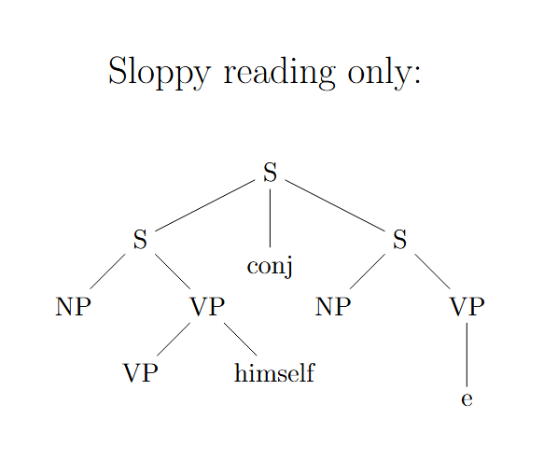
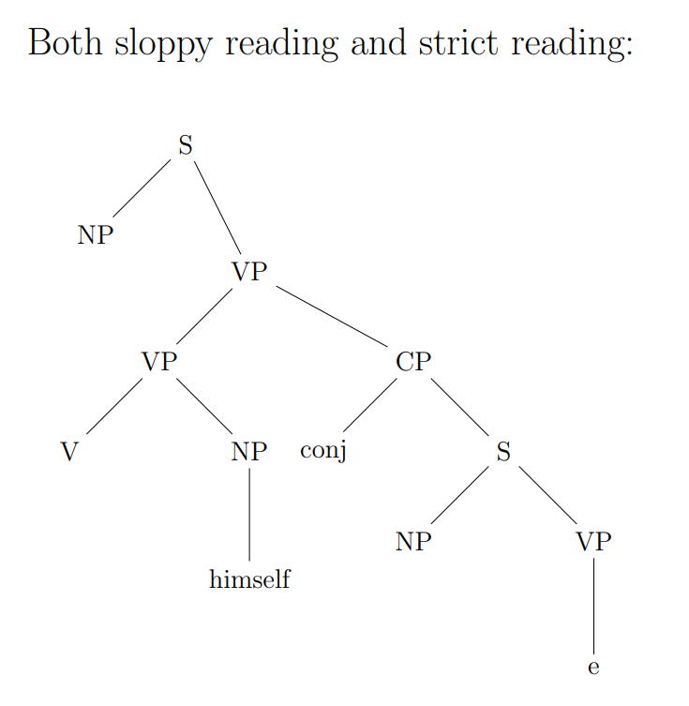
Existing theories: Hestvik (1995)
Purely syntactic, explains the presence/absence of a strict reading by the structure of the sentence;
coordination relationship → only sloppy reading, subordination → sloppy + strict reading;

Slide 4
Existing theories: Hestvik (1995)
2 operations: copying the VP and raising of a reflexive out of the VP at the LF;
The availability for both readings is explained by the order in which these operations are applied.
John [_{VP} corrected himself] before Bill e
John [_{VP} corrected himself] before Bill [_{VP} corrected himself]
John [_{α} himself_{i} [_{VP} corrected t_{i}]] before Bill [_{α} himself_{j} [_{VP} corrected t_{j}]]
(sloppy reading)
John [[_{VP} corrected himself] before Bill e]
John [_{α} himself_{i} [[_{VP} corrected t_{i}] before Bill e]]
John [_{α} himself_{i} [[_{VP} corrected t_{i}] before Bill [_{VP} corrected t_{i}]]]
(strict reading)

Slide 5
Existing theories: Kehler (2000, 2002)
Based on the discourse Causality Effect factor.
Types of discourse relationships: Resemblance, Causality Effect.
Resemblance
– a one-to-one correspondence between the set of entities mentioned in sentences (parallelism), is sensitive to syntactic identity and the condition A of the Binding Theory:
John_{i} defended himself_{i} and Bill did too.
Causality-Effect
— requires only an implicational relationship between clauses, the correlation of the propositional meanings of two sentences
→ strict reading is more likely:
John_{i} defended himself_{i}, so Bill did too.

Slide 6
Existing theories: Ong & Brasoveanu (2013)
The choice of identity is influenced by the lexical component of the verb – implicit causality (IC) biases (Garvey and Caramazza 1974, McKoon et al. 1993, Rohde 2008) can influence the resolution of a reflexive pronoun either as a semantical object or subject of the verb:
John disappointed Bill because he (=John) stole the book. (subject meaning: IC1 type)
John scolded Bill because he (=Bill) stole the book. (object meaning: IC2 type)
Ong & Brasoveanu (2013) state that factors listed in previous researches do not influence the choice of a reading for the reflexive as much, as the IC biases of a verb:
→ speakers are more likely to choose a strict reading for sentences with the IC2 verbs

Slide 7
Existing theories: Ong & Brasoveanu (2013)
Ong & Brasoveanu (2013) state that the subject-oriented IC1 verbs have de-transitivizer interpretation.
If John disgraced himself, Bill did too. (IC1 type) – sloppy reading preference
If John criticized himself, Bill did too. (IC2 type) – strict reading preference
If the overt reflexive himself in the antecedent is interpreted as a de-transitivizer – because IC1 verbs highlight their subject and the remainder of the sentence is ‘understood’ as a predication about the subject – the covert reflexive in the elided VP will likely receive the same de-transitivizer interpretation, which will yield the sloppy reading.
In contrast, the object-oriented IC2 verbs highlight the object and its causal efficacy. This would make the second, pronoun-like interpretation of the reflexive more salient in a conditional like (10). Then the covert reflexive in the elided VP will receive the pronominal interpretation. Since pronoun-like elements prefer to retrieve the most salient entity, the likelihood of retrieving John is higher.

Slide 8
Hypothesis
It is assumed that sebya would behave the same way as oneself in English in case of using the IC1 type verbs, because in Russian sebya performs the same function as reflexive postfix -sya – they both are often used to “reflexivize” verbs, yielding the sloppy reading. And, accordingly, it is expected to see a greater availability of the strict reading with the IC2 verbs.
Since Ong & Brasoveanu (2013) did not consider possessive reflexives in their study, it was decided to check whether their hypothesis works on the materials of Russian possessive reflexives. Since they cannot perform a “de-transitivizing” function, the IC should not affect the accessibility of the strict reading.
However, the availability of the strict reading should be influenced by the fact that the possessive reflexives are not co-argument with the subject, which means that semantically they should be more distinct, thus increasing the availability of strict reading.
Also, our hypothesis is that not only Implicit Causality can enhance the salience of an object, but also other factors.

Slide 9
Experiment design
The experiments were based on experiments from Ong and Brasoveanu (2013).
2 experimental studies: with reflexive pronoun sebya and with possessive reflexive svoy. The example of 1 experimental item:
type of coordinator |  | IC verb type
 |  | IC1 | IC2 | NONIC
conjunctive | and | Ljuba vdohnovila sebja na novye svershenija, i Vika tozhe. | Ljuba vinit sebja v proizoshedshem, i Vika tozhe. | Ljuba razreshila sebe poest' morozhenogo, i Vika tozhe.
conditional | if | Esli Ljuba vdohnovila sebja na novye svershenija, to Vika tozhe. | Esli Ljuba vinit sebja v proizoshedshem, to Vika tozhe. | Esli Ljuba razreshila sebe poest' morozhenogo, to Vika tozhe.
subordinative | so | Ljuba vdohnovila sebja na novye svershenija, poetomu Vika tozhe. | Ljuba vinit sebja v proizoshedshem, poetomu Vika tozhe. | Ljuba razreshila sebe poest' morozhenogo, poetomu Vika tozhe.

Slide 10
Experiment design
In each experiment, there were 4 experimental items with 9 examples in which the type of verb and the type of sentence coordinator varied (a total of 36 examples for each experiment).
An example stimulus is provided below:
.
context: U Ljuby i Viki byla podruga Alena, no Ljuba s Alenoj porugalis', i Alena pereehala. (Lyuba and Vika had a friend, Alyona, but Lyuba and Alyona had a fight, and Alyona moved out.) stimulus: Ljuba vinit sebja v proizoshedshem, i Vika tozhe. (Lyuba blames herself for what happened, and so does Vika.) Vy ponimaete jeto predlozhenie kak: (You understand this sentence as:)
strict reading: ... Vika vinit Ljubu v proizoshedshem. (Vika blames Lyuba for what happened.) da (yes) net (no)
sloppy reading: ... Vika vinit sebja v proizoshedshem. (Vika blames herself for what happened.) da (yes) net (no)

Slide 11
Experiment design
To test the hypothesis about the influence of other factors on the salience of the object, we added strict reading bias to the context.
It was decided to give one group of respondents sentences with neutral context (control group), and the other with a bias for a strict reading (experimental group), e.g.:
context: ‘Petya and Vanya are students and often participate in projects together. Petya was very lazy this time. Their programming project was rated "satisfactory".’
stimulus: V etot raz Petya kritikuet sebya, i Vanya tozhe.
‘This time, Petya criticizes himself, and Vanya does too.’

Slide 12
Experiment design
There also were filler items, some of which double-checked the IC-type of a verb, using the test from Garvey and Caramazza (1974), e.g.:
The list of verbs, used in the study:
IC1: scare, humiliate, motivate, reassure, confuse;
IC2: hate, value, blame, praise, respect;
NON-IC: remind, notice, hit, see, acknowledge.
Petja pomyl Vane kvartiru, potomu chto on prolil na pol gazirovku. Kak Vam kazhetsja, kto prolil na pol gazirovku? Petya cleaned Vanya's apartment because he spilled soda on the floor. Who do you think spilled soda on the floor?
Petya Vanya

Slide 13
Participants
52 respondents completed the first experiment, 42 completed the second experiment, with a 1:1 ratio of the control and experimental groups.
For the 1 experiment a total of 3744 observations were collected, 3024– for the 2 experiment.
The respondents’ age varied from 18 to 65 years old.
All participants are native speakers of Russian.

Slide 14
Methods
binary logistic regression was chosen as the model to compute statistics data, since we are interested in the probability of the influence of various effects on the binary distribution of the strict or sloppy readings:
(11) answer ~ conj + ic + context + cause_effect + (1 | speaker_id) – 1 experiment
(12) answer ~ conj * ic * context * cause_effect + (1 | speaker_id) – 2 experiment
the Causality Effect from Kehler (2000, 2002) was attested, but did not have any statistical significance, so it is not presented in the model and in the results
random effect variable (1 | speaker_id) was also attested, and also was not significant

Slide 15
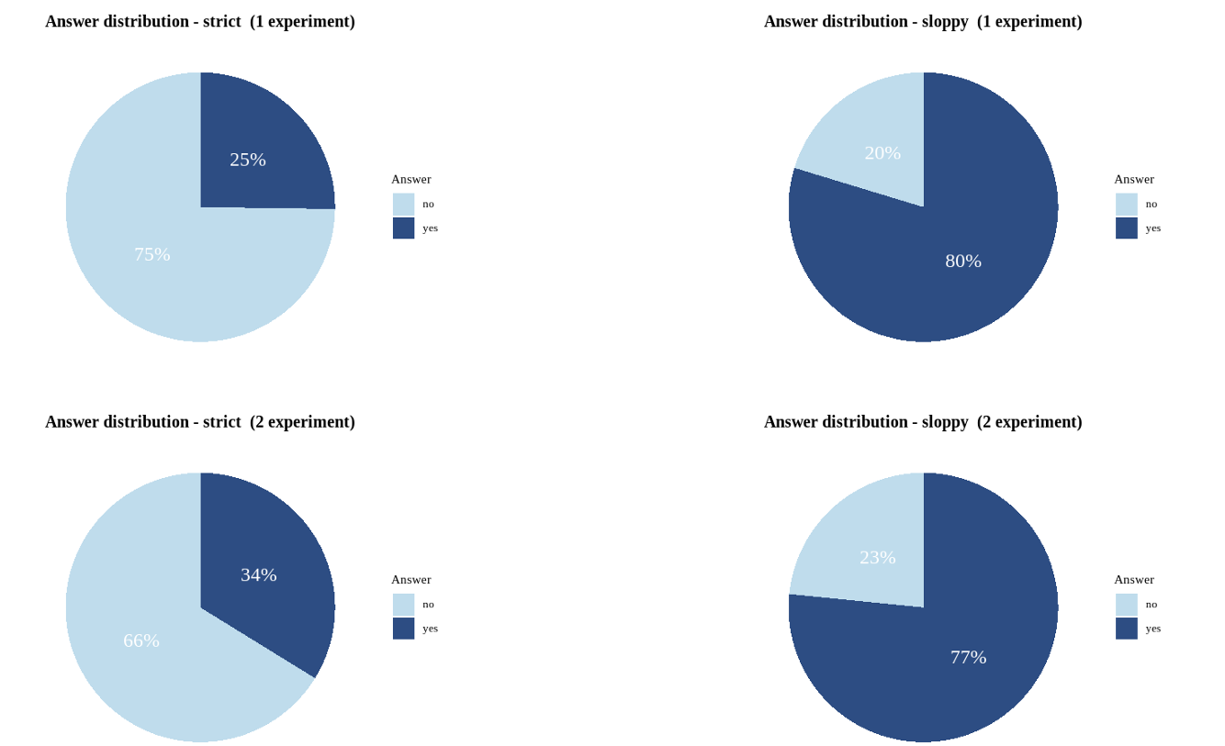
Results: Experiment 1 & 2
In general, there was a higher percentage of strict readings with the pronominal reflexives, than with the possessive reflexives.
The expected result was that there is always significantly more sloppy readings than strict readings.

Slide 16
Results: Experiment 1
The results of Experiment 1 almost completely replicate those of Ong and Brasoveanu (2013).
Using the Simultaneous Evaluation with a Type III ANOVA the following results were obtained:
the if type of coordinator (β_{𝑖𝑓}=0.301, SE=0.154, p-value=0.01) and IC2 type of verb (β𝐼𝐶2=0.354, SE=0.146, p-value=0.01) slightly decreased the availability of sloppy readings, while the so type of coordinator (β_{𝑆𝑂}=0.618, SE=0.147, p-value<0.001) decreased the probability of the sloppy reading significantly and the absence of context bias (β_{𝑁𝑂𝐵𝐼𝐴𝑆}=1.290, SE=0.129, p-value<0.001) was extremely significant for the presence of the sloppy reading;
within each parameter, the presence of IC2 verb type (β_{𝐼𝐶2}=0.556, SE=0.135, p-value<0.001) increased the percentage of strict readings, and the absence of context bias (β_{𝑁𝑂𝐵𝐼𝐴𝑆}=0.860, SE=0.111, p-value<0.001) had the most influence on the availability of a strict reading, therefore supporting the claims that the IC2 verb type and the presence of context bias influence the choice of the strict reading.

Slide 17
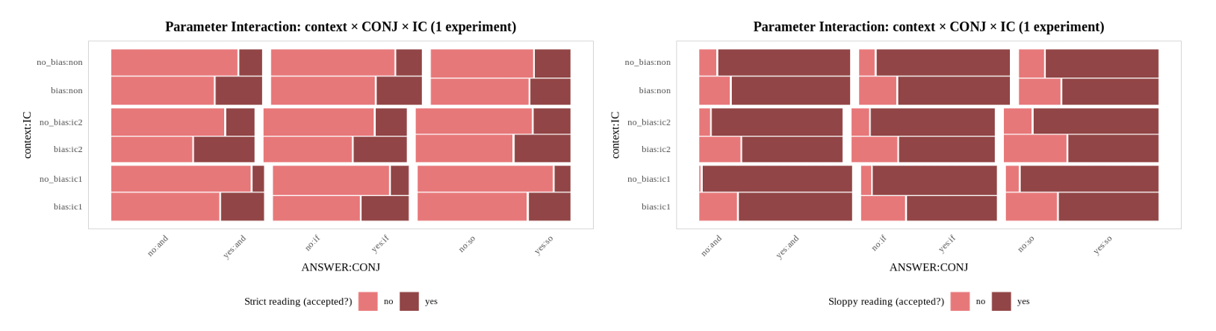

Slide 18
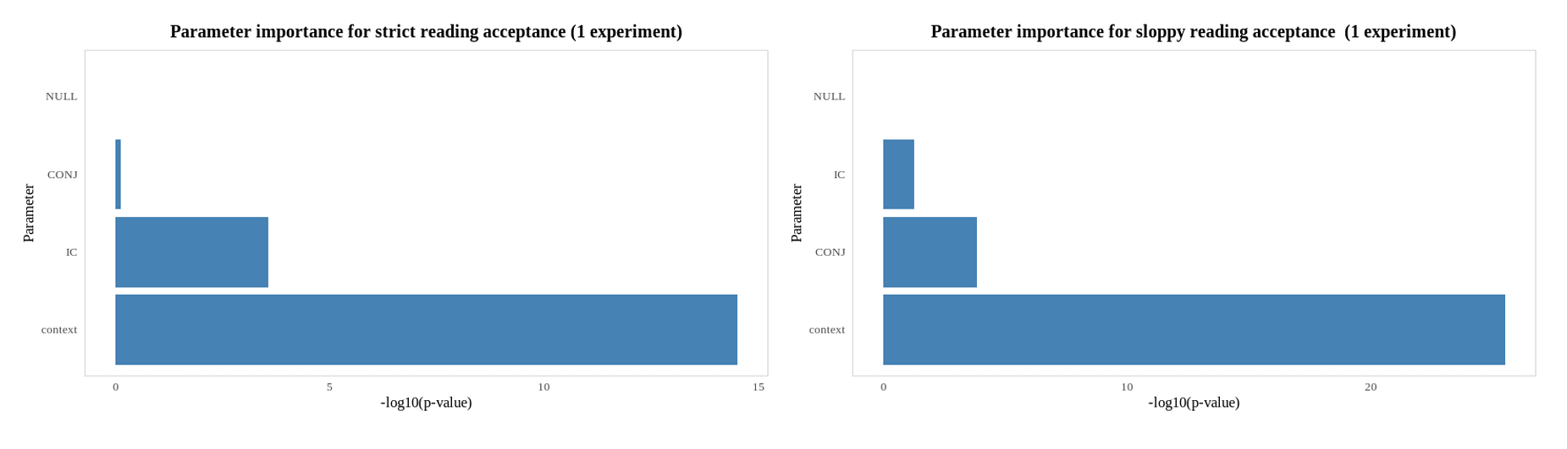
Results: Experiment 1
the IC verb type (χ²=17.299, df=2, p-value<0.001) and the presence of a context bias (χ²=62.182, df=1, p-value<0.001) turned out to be significant for the strict reading;
the type of coordinator(χ²=18.185, df=2, p-value<0.001), the IC type of verb (χ²=6.472, df=2, p value=0.01) and the context bias (χ²=112.134, df=1, p-value<0.001) were all significant for the presence of a sloppy reading, with context bias as the most significant parameter.

Slide 19
Results: Experiment 1
→ A higher probability of using strict reading in sentences with context bias towards strict reading;
→ and also in sentences containing IC2 verbs.
→ the type of connective was not so important, however, the if connective decreased the probability of a sloppy reading, and connective so increased the probability of a strict reading
→ The reverse pattern is observed for sloppy reading.

Slide 20
Results: Experiment 1
Traditionally, reflexive pronouns have 2 possible interpretations:
‘de-transitivizer’ interpretation
pronominal interpretation
Russian IC1 verbs especially get “de-transitivized” with reflexives, because in Russian sebya sometimes performs the same function as reflexive postfix -sya – they both are often used as operators on verbs: reflexivization turns a 2-place predicate into a 1-place predicate by identifying two of its arguments as identical, thus “de-transitivizing” the verb, and yielding the sloppy reading.

Slide 21
Results: Experiment 1
If the verb has a strong connotation that the center or a causee of an action is a subject, then the speaker's attention will be focused on the subject’s entity, provoking the sloppy reading (IC1 verbs).
In the case of verbs of IC2 type, this conversion causing sloppy reading gets blocked, since sebya receives focus as the object of the verb, and its identity function gets focused too, boosting the salience of the reflexive. The likelihood of the pronominal resolution of the reflexive gets higher, thus yielding the strict reading.

Slide 22
Results: Experiment 1
Vitya shokiru-et sebya, i Vanya tozhe [e].
Vitya shock-PRS.3SG self.ACC and Vanya too
Vitya will shock himself, and Vanya will [e] too.
Vitya pohval-it sebya, i Vanya tozhe [e].
Vitya praise-PRS.3SG self.ACC and Vanya too
Vitya will praise himself, and Vanya will [e] too.
This way, in (12) the possibility of the strict reading ‘Vanya will shock Vitya’, is significantly lower than the possibility of strict reading ‘Vanya will praise Vitya’ in (13).
IC1 type verb in the antecedent clause → the sentence will be resolved through sloppy reading
IC2 type verb → the object of the verb becomes more semantically expressed and more prominent, which means the likelihood of retrieving the strict reading gets higher too.

Slide 23
Results: Experiment 2
The results of Experiment 2 were rather sloppy, but still aligned with the hypothesis.
This time, for the presence of the sloppy reading only the absence of context bias (β_{𝑁𝑂𝐵𝐼𝐴𝑆} = 1.596, SE = 0.460, p-value < 0.001) was extremely significant. For the presence of the strict reading the statistically significant effect was also the absence of neutral context (β_{𝑁𝑂𝐵𝐼𝐴𝑆} = 1.073, SE = 0.370, p value = 0.001). As for the interaction terms, most interaction terms involving CONJ and IC weren’t significant, except for IC_non:context_no_bias, which is statistically significant (β_{𝐼𝐶𝑛𝑜𝑛∶𝑐𝑜𝑛𝑡𝑒𝑥𝑡𝑛𝑜𝑏𝑖𝑎𝑠} = 1.138, SE = 0.516, p-value = 0.01), and one three-way interaction shows weak trends toward significance: CONJ_if:IC_non:context_no_bias (β_{𝐶𝑂𝑁𝐽𝑖𝑓∶𝐼𝐶𝑛𝑜𝑛∶𝑐𝑜𝑛𝑡𝑒𝑥𝑡𝑛𝑜𝑏𝑖𝑎𝑠} = 1.753, SE = 0.724, p-value = 0.01).

Slide 24
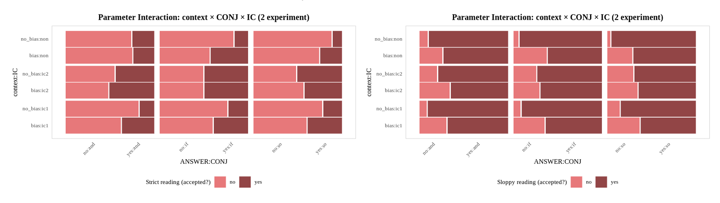
Results: Experiment 2

Slide 25
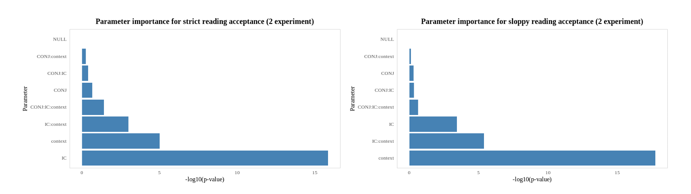
Results: Experiment 2
The choice of the strict reading was most influenced by IC (χ² = 13.682, df = 2, p-value = 0.001) and the context bias (χ² = 8.942, df = 1, p-value = 0.001), and for the sloppy reading the context type was the most important parameter (χ² = 14.325, df = 1, p-value < 0.001).

Slide 26
Results: Experiment 2
→ A higher probability of using strict reading in sentences containing IC2 verbs;
→ A higher probability of using sloppy reading without context bias;
→ An unexpected results with the context type and IC verb type parameters interaction;

Slide 27
Results: Experiment 2
This is a somewhat unexpected result, as in Russian possessive reflexives do not coincide in form with pronominal reflexives, and rather act as an index role for the nouns they define. That is, these reflexives do not carry any ‘de-transitivizing’ function for the verb, and implicit causality still works as expected.
Which suggests that the “de-transitivization” of the verb is not what is important, but rather the semantic bias towards either subject or object, and the resulting argument salience.

Slide 28
Additional factors that influence salience: pragmatics influence
It is suggested that pragmatics operate in a modular manner, independently of syntax, and affect the bias of reading.
Pragmatics too, can boost the salience of one of the arguments of the verb – hence affect the choice of identity.
Most previous studies have taken into account the pragmatics within the sentence, and have not explored the extra-sentential context.

Slide 29
Additional factors that influence salience: pragmatics influence
In ellipsis site there can be any of the entities that are in alternative focus with the antecedent in the antecedent clause: the antecedent itself or the entity co-indexed to its binder (subject).
The focus of the speaker’s attention may add some bias to one of these entities.
Akmajian (1973:218) says that a focus can highlight some syntactic constituent not only as an intonation center, but also highlight it in a semantic sense.
An entity in comparison with other entities from the set gets highlighted, since pronoun-like elements “prefer to retrieve the most salient entity” (Ong and Brasoveanu 2013).
And the most salient entity in this case, of course, will be the one specifically mentioned in the context.
If something is specifically mentioned, then it must be pragmatically important, so the speaker’s attention will focus on such entity and consider it a common ground (Clark and Bangerter 2004).

Slide 30
Discussion
Despite the fact that the theory of Ong and Brasoveanu (2013) turned out to be true for Russian - Implicit Causality does indeed affect the presence of strict or sloppy reading, their argumentation is refuted by the results of the test with possessive reflexives. It may be worth doing more research on the possessive reflexives.
Other hypotheses were correct:
There is a bigger accessibility to the strict reading with possessive reflexives;
Not only Implicit Causality can enhance the salience of an object: contrastive focus and pragmatics can do so too. And the most important factor that affects the choice of the reading is which of the recoverable objects (from the antecedent clause or the subject binding the omitted reflexive) is more salient.

Slide 31
Conclusion
To summarize, the accessibility of any reading depends on the factors that increase the salience of one or another object at the ellipsis site. The increase in the likelihood of strict reading is influenced by:
the presence of IC2 verbs;
pragmatics bias towards the strict reading.

Slide 32
Acknowledgments
Many thanks to
Alexander Podobryaev, Timofey Dedov, Kseniya Dunaeva
and to all respondents who completed the survey.

Slide 33
References
Akmajian, A. (1973). The role of focus in the interpretation of anaphoric expressions.
Clark, H. H., & Bangerter, A. (2004). Changing ideas about reference. In Experimental pragmatics (pp. 25-49). London: Palgrave Macmillan UK.
Dahl, Ö. (1973). On so-called ‘sloppy identity’. Synthese, 26(1), 81–112. https://doi.org/10.1007/bf00869757
Fox, D. (2000). Economy and semantic interpretation (Vol. 35). MIT press.
Foley, C., Núñez del Prado, Z., Barbier, I., & Lust, B. (2003). Knowledge of variable binding in VP–Ellipsis: Language acquisition research and theory converge. Syntax, 6(1), 52-83.
Garvey, C., & Caramazza, A. (1974). Implicit causality in verbs. Linguistic inquiry, 5(3), 459-464.
Johnson, K. (2001). What VP ellipsis can do, and what it can't, but not why. The handbook of contemporary syntactic theory, 439-479.
Hestvik, A. (1995). Reflexives and ellipsis. Natural Language Semantics, 3(2), 211-237.

Slide 34
References
Kehler, A. (2000). Coherence and the resolution of ellipsis. Linguistics and Philosophy, 23, 533-575.
Kehler, A. (2002). Coherence, reference, and the theory of grammar.
Ong, M., Brasoveanu, A. (2013). Strict and sloppy reflexives in VP-ellipsis.
Sag, I. (1976). Deletion and Logical Form. Doctoral dissertation, MIT.
Williams, E. (1977). Discourse and Logical Form, Linguistic Inquiry 8, 101-139.

