Slide 1
Today’s Lesson Plan
Math
Art
Geography
Biology

Slide 2
Math: Squares
1/16

Slide 3
Math: Triangle
2/16

Slide 4
Math: Circle
3/16

Slide 5
Math: Trapezoid
4/16

Slide 6
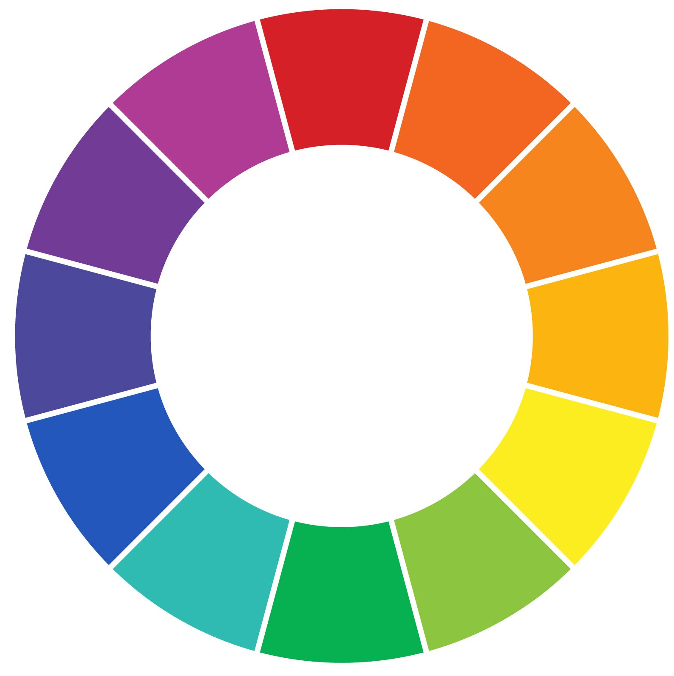
Art: Colors
5/16

Slide 7
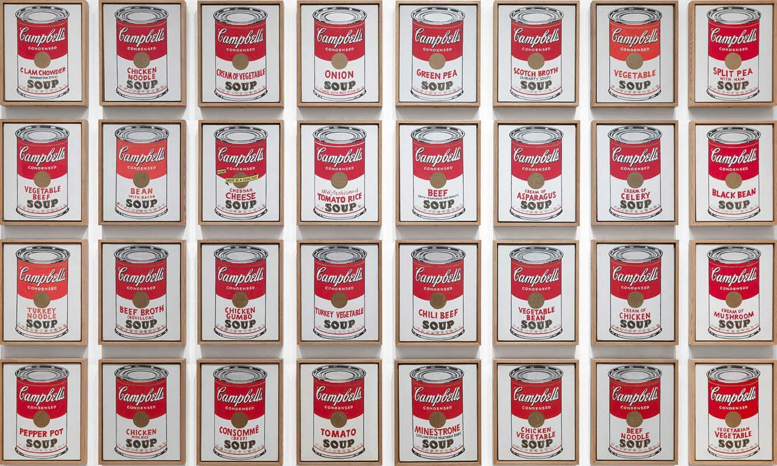
Art: Pop art
6/16

Slide 8
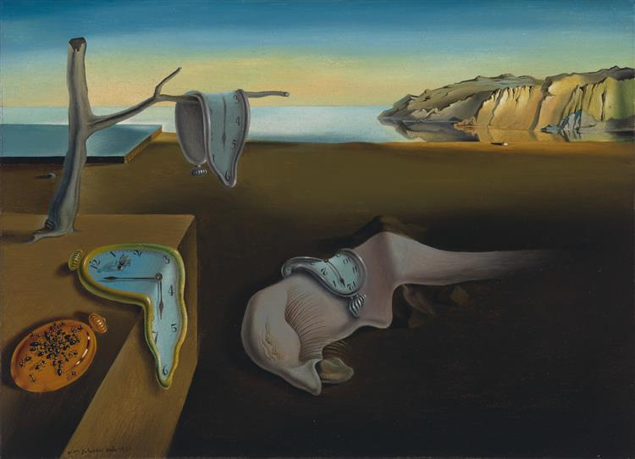
Art: Surrealism
7/16

Slide 9
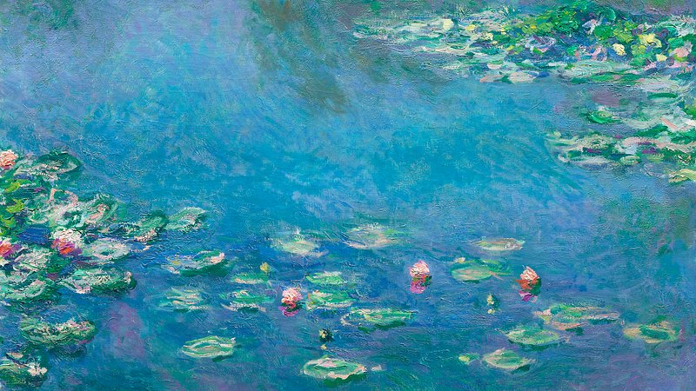
Art: Impressionism
8/16

Slide 10
Recess Time

Slide 11

Geography: Mountains
9/16

Slide 12

Geography: Lakes
10/16

Slide 13
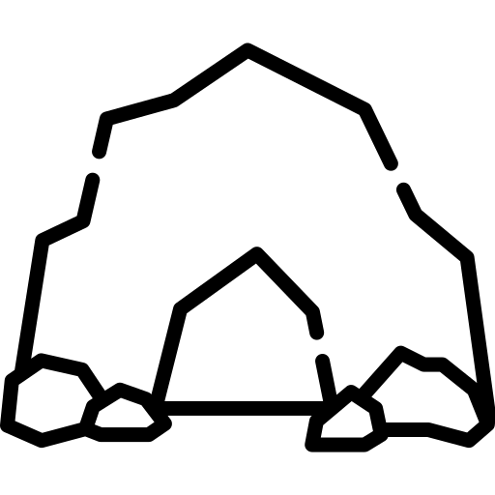

Geography: Caves
11/16

Slide 14


Geography: Canyons
12/16

Slide 15


Biology: Cells
13/16

Slide 16


Biology: Brain
14/16

Slide 17

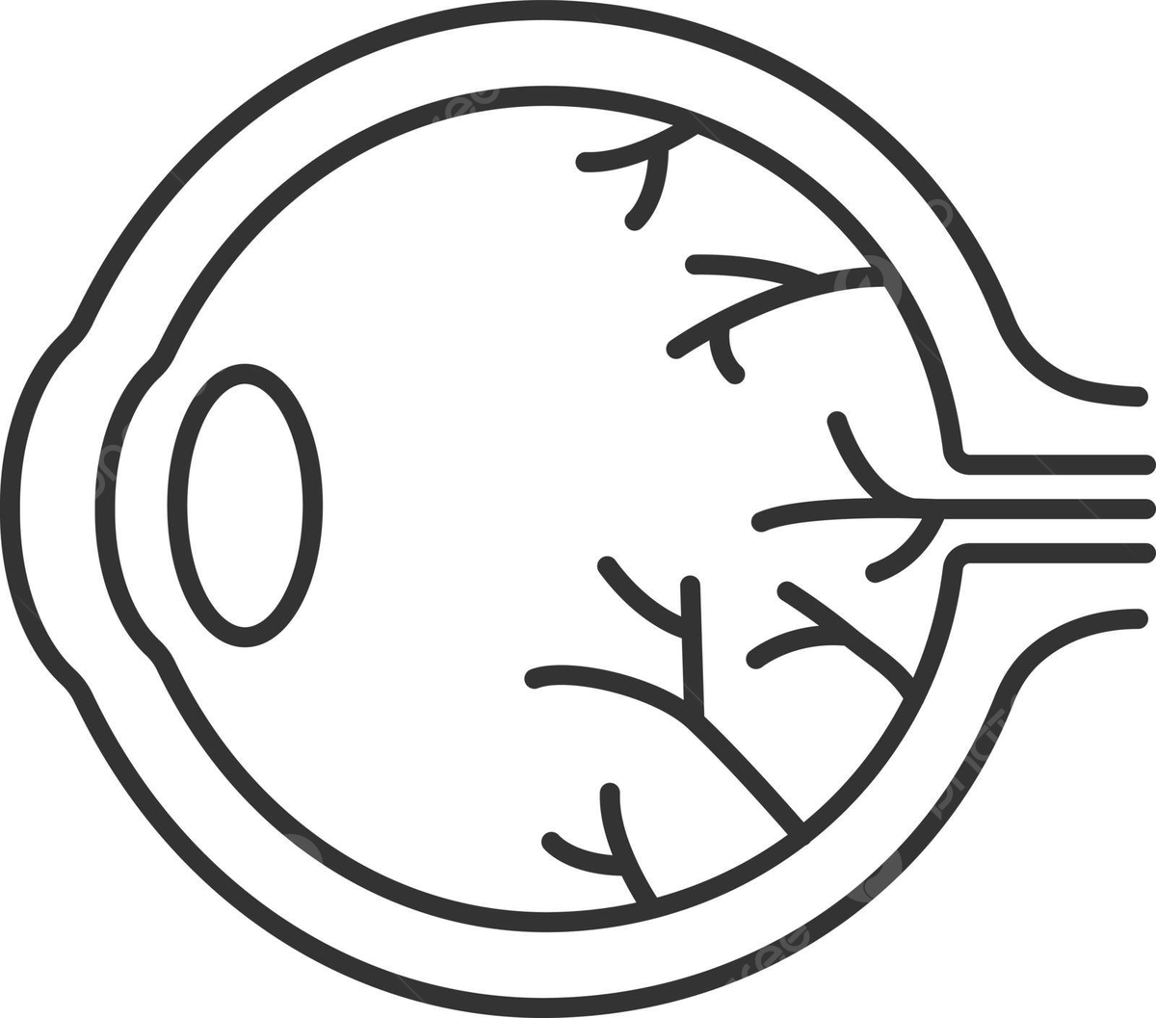
Biology: Eye
15/16

Slide 18

Biology: Heart
16/16

Slide 19
End of slides

