Slide 1

Effective Altruism (a quick introduction)
Notes:
People who are active in this are prolific writers and philosophers… great deal I’m glossing over here…
I’m necessarily going to gloss over a lot of things

Slide 2
What motivates the EA movement
People in the richest countries in the world have great power: we can each save many lives and prevent a great deal of suffering, unless we:
Don’t know how to use our resources effectively or
Decide not to
Notes:
“each save many lives and prevent a great deal of suffering”
--that’s the statement that requires the most defending here… (GiveWell is at the forefront of measuring just what is the most good that can be done per dollar in reducing suffering and death due to poverty…)

Slide 3
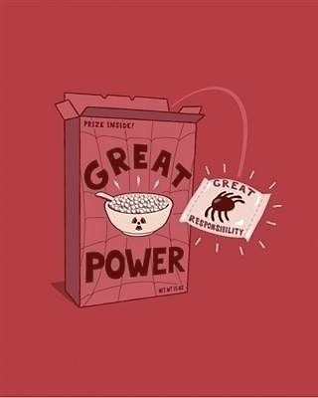

Slide 4
What motivates the EA movement
Members of the movement:
Have decided that helping others is their primary goal
Use reason, evidence, and their resources to maximize their personal impact
Notes:
(in many cases meaning large donations)

Slide 5
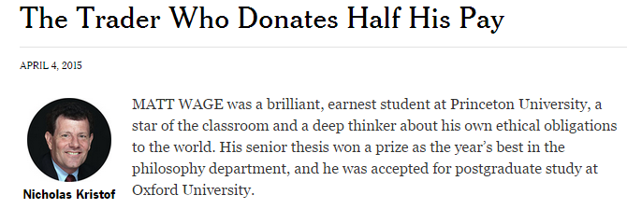
Notes:
So one example of a very effective altruist we like to talk about is Matt Wage.

Slide 6

“Suppose you see a burning building, and you run through the flames and kick a door open, and let one hundred people out. That would be the greatest moment in your life. And I could do as much good as that!”
Notes:
(Matt Wage)
A philosophy student who realized he could do more good by working in hedge funds instead of going on to graduate study in philosophy, and has been able to fund a lot of high-impact work as a result

Slide 7

How can we tell how efficient a charity is?
What kinds of aid programs tend to have a large impact per dollar spent?
Which charities run these programs most efficiently?
Which charities currently have “room for more funding”?
Notes:
(Requires a high degree of transparency and cooperation with GiveWell

Slide 8

How much good can we do?
Malaria-prevention bednets: about $7 per net distributed
About $3340 per child’s life saved
A modest U.S. lifetime income totals about $1m
Even 1% of $1m donated to AMF would save three lives on average
Notes:
It takes on average about 500 bed nets distributed to the areas AMF operates in to save one child’s life. They can distribute one additional bednet for each additional donation of about $7.

Slide 9



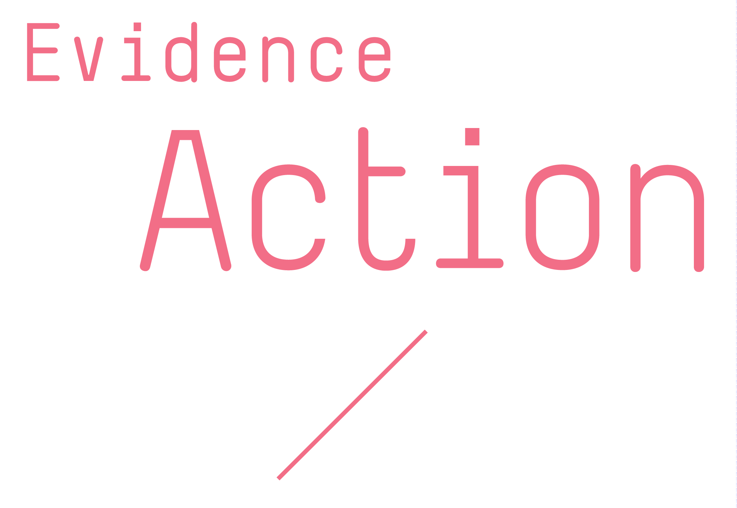

GiveWell’s top recommended charities
Notes:
Parasitic worm infections that can be treated very very cheaply, which increases quality of life and also appears to increase the amount of schooling children get

Slide 10
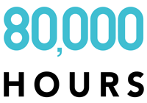
What’s the most effective use of my life’s work, given my education, talents, and career so far?
Replaceable vs. unreplaceable work
Funding work by others vs. working directly
Notes:
So they consider issues such as….
And give general advice for people who are switching into higher-impact careers.

Slide 11


Notes:
Encourage people to pledge a percentage of their income to effective charities (such as those recommended by GiveWell)

Slide 12
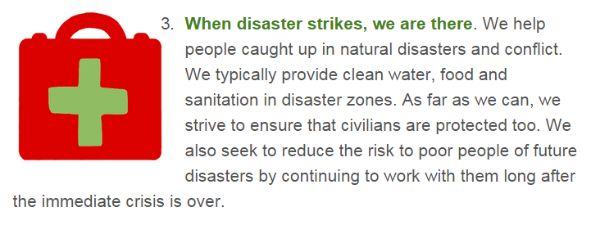
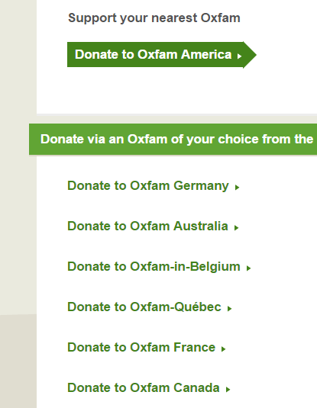
The current small-donor market: competing appeals
Organizations self-advocate and raise awareness of problems they are equipped to address
Notes:
Traditional, organization-focused:
Organizations do the most good they can given their organization’s scope and the will of their donors
Organizations seek donations by raising awareness of problems they are equipped to address
An impact-driven market:
Independent organizations assess the suitability of charities to match donors’ intent
What if a donor market emerges that simply aims to efficiently reduce suffering and death by any means?

Slide 13
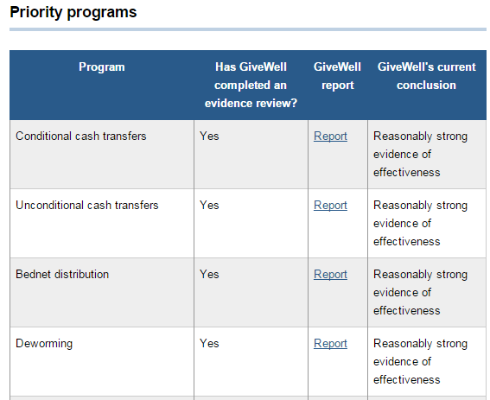
An efficient program-delivery market
Organizations transparently self-assess and experiment
Independent evaluators assess the effectiveness of interventions and the efficiency of organizations that deliver them
Notes:
Traditional, organization-focused:
Organizations do the most good they can given their organization’s scope and the will of their donors
Organizations seek donations by raising awareness of problems they are equipped to address
An impact-driven market:
Independent organizations assess the suitability of charities to match donors’ intent
What if a donor market emerges that simply aims to efficiently reduce suffering and death by any means?

Slide 14
Building an impact-focused donor market for charity programs
Giving What We Can, The Life You Can Save (encourage donations among impact-focused individuals)
GiveWell (point impact donors to the right charities)
Philanthropic advisors? (could nudge major donors in an impact-oriented direction)
Notes:
(Philanthropic advisors mostly maligned by EA so far – see Singer’s book pointing out all the lame causes one advisor mentions)
[“And with that I’ll let Angela introduce Agora Fund and how it’s addressing the donor market.”]

Slide 15
Philosophical questions
Whose suffering or flourishing matters?
How do we prioritize major goals?
Preventing death and suffering due to poverty and illness
Reducing suffering of animals in the modern factory farming system (numerically dwarfs human suffering, but no reliable interventions)
Reducing threats to humanity’s future (huge potential impact, no reliable interventions)
Meta-charity (supporting charity evaluation, prioritization research, growing the EA movement)
Notes:
Threats to humanity’s future, which, after all, could continue for billions or trillions of years, so it concerns quite a lot of potential future people.

Slide 16

15-inch macbook pro with retina display: $2,499
Notes:
Let’s say you’re relaxing by a pond with your brand new 15-inch macbook pro with retina display – retail price $2,499.
And just as it

Slide 17
Economic and logistic questions
What charities make the best use of donations?
Impact of aims
Program types
Transparency, outcome measurement, experimentation
As an individual, is the work that I do:
Replaceable?
High-impact?

Slide 18
A few organizations in the Effective Altruist movement
Provide the kind of analysis that helps us do the most good we can

Slide 19
Major ethical tenets
Our intuitions about how to do the most good can be wrong
E.g., scope insensitivity
Ethics built for social behavior in kin-based foraging societies
Applying reason
The amount of good we (citizens of affluent nations) can do is greater than usually recognized
The amount we can increase our own comfort is insignificant compared to the amount of good we can do for others
Morally, we should use our resources to help as much as we can (we’ll still be much more comfortable than most people)
When we help others, we shouldn’t be biased by similarity of others to ourselves (so we should only help those in our own communities if we can do more good for them than we could do elsewhere)
We should avoid unnecessary waste (earn to give if it’s more efficient than direct work; donate to charities with demonstrable efficiency)

Slide 20
Etc. (more watermark slides)

Slide 21
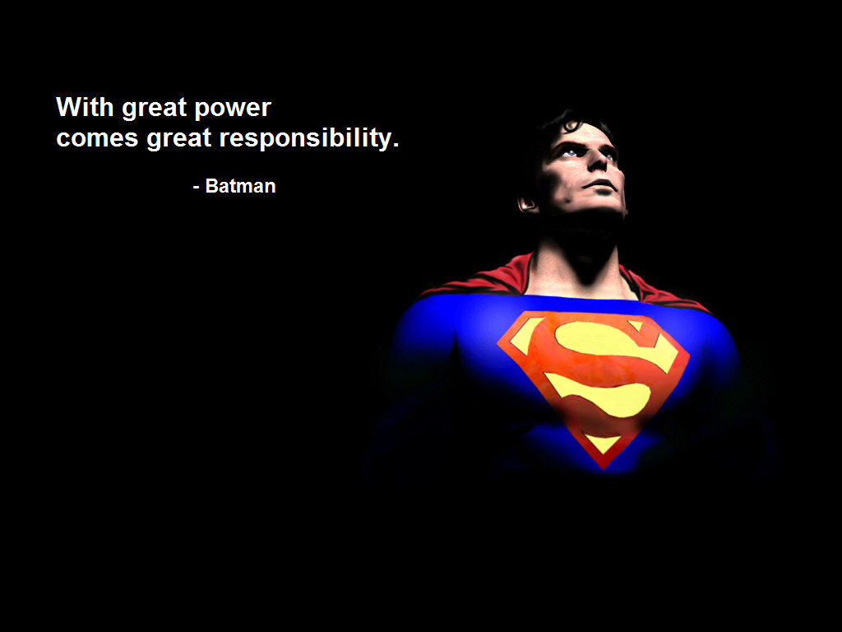

Slide 22
Economics
Strategies for most value for resources used
Career choice
Donation strategy
Evaluation of charities
Approach (programs)
Transparency
Scientific approach (e.g. genuine experimentation)

