Slide 1
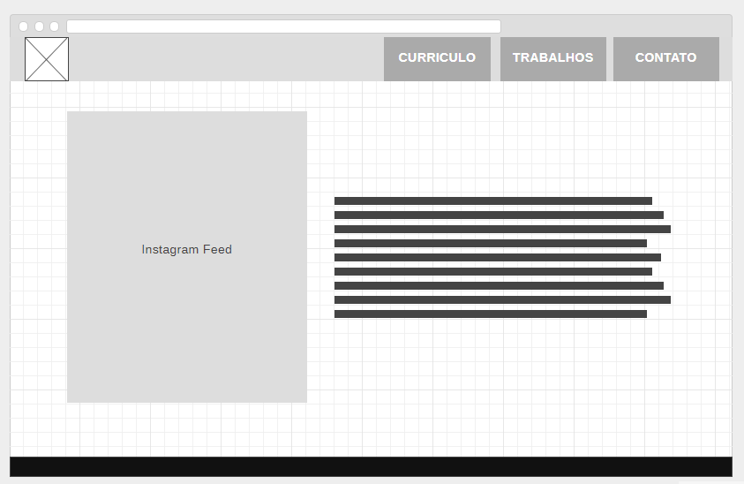
https://wireframe.cc/HdVfUB

Slide 2
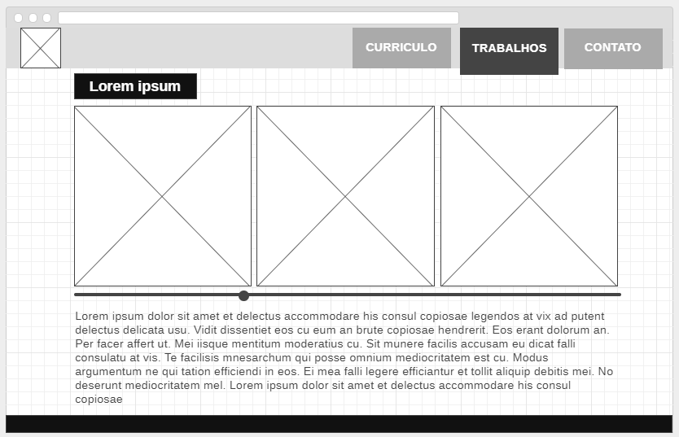
https://wireframe.cc/gNJHhe

Slide 3
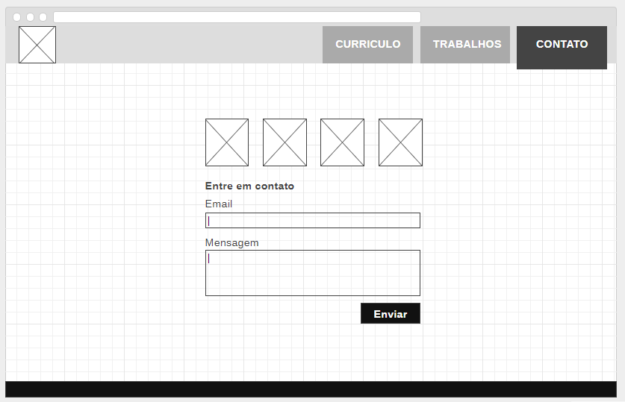
https://wireframe.cc/11vyHP

Slide 4
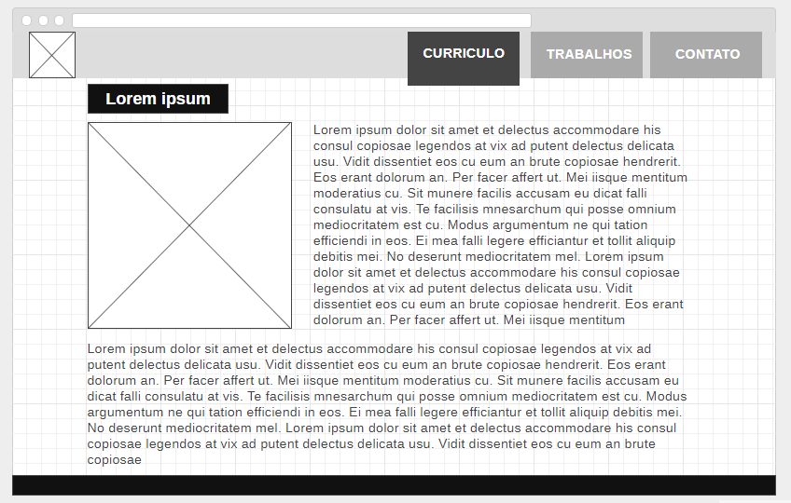
https://wireframe.cc/Vci71I

Slide 5
