Slide 1
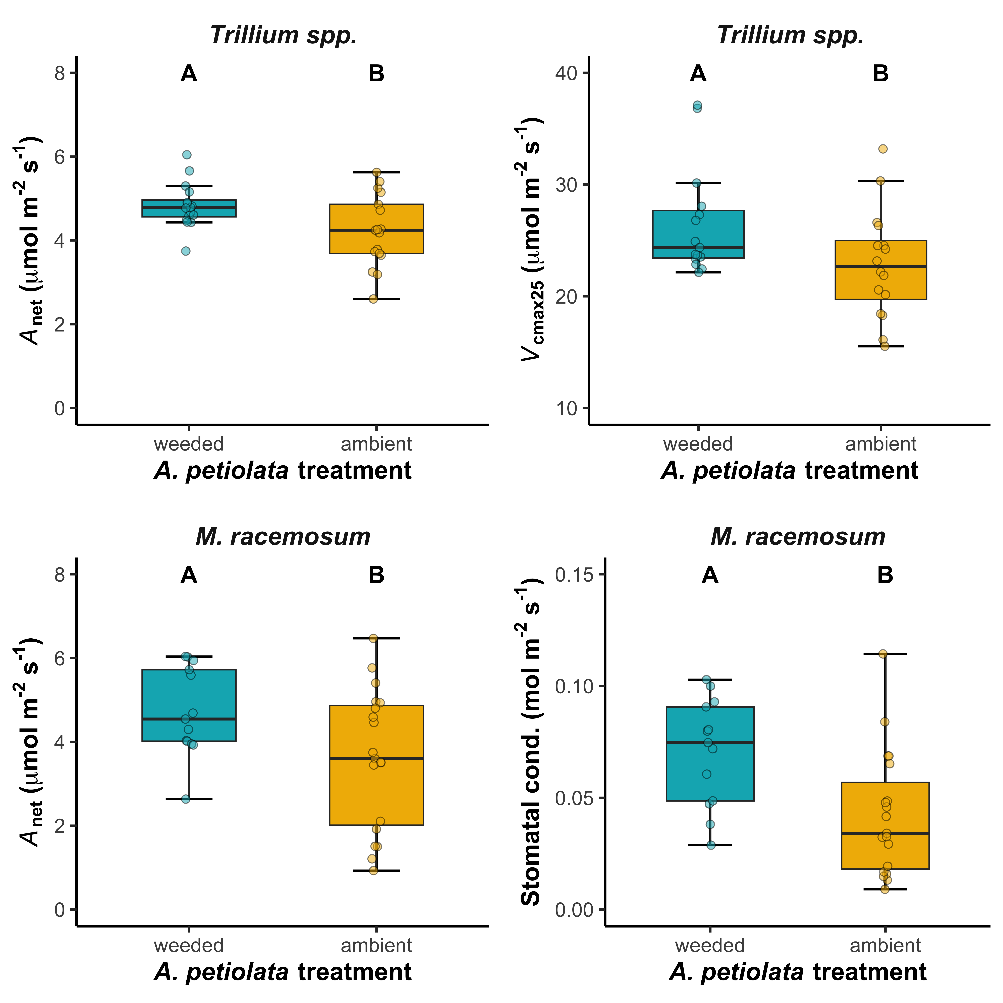
A. petiolata decreases native plant photosynthesis
Indicative of nutrient
limitation in Trillium spp.
Indicative of water
limitation in Trillium spp.
Perkowski et al. (in review)

