Slide 1
2024 Trillium Trail field campaign

Slide 2
COMPOSITE 1 (C1)
C2
C3
C4
1
2
3
4
5
6
* 5 plots
7
8
9
10
11
12
C5
C6
C7
C8
13
14
15
16
17
18
19
20
21
22
23
24
C9
C10
C11
C12
25
26
27
28
29
30
ambient
31
32
33
34
35
36
weeded

Slide 3
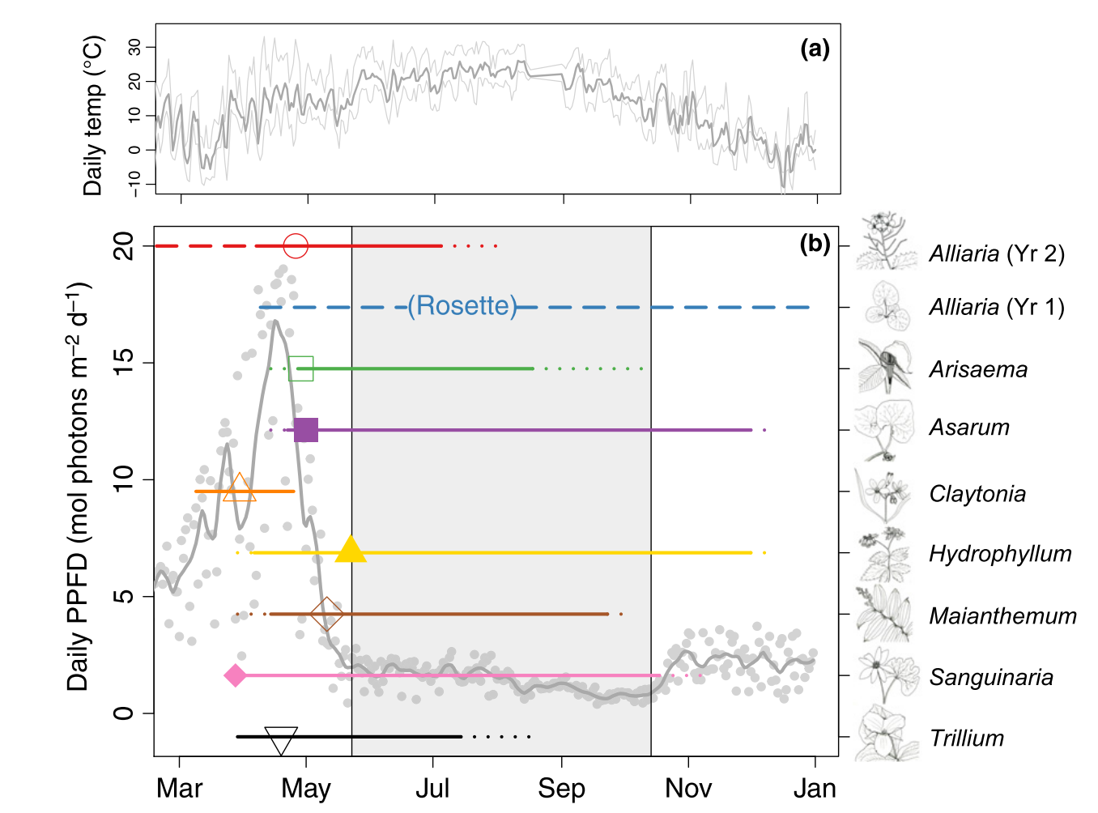
Heberling et al. (2019)

Slide 4
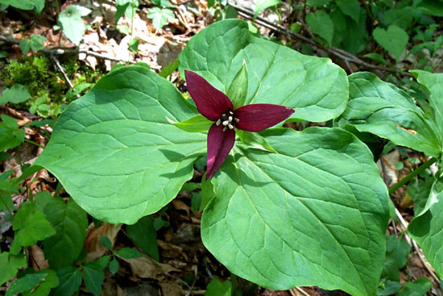
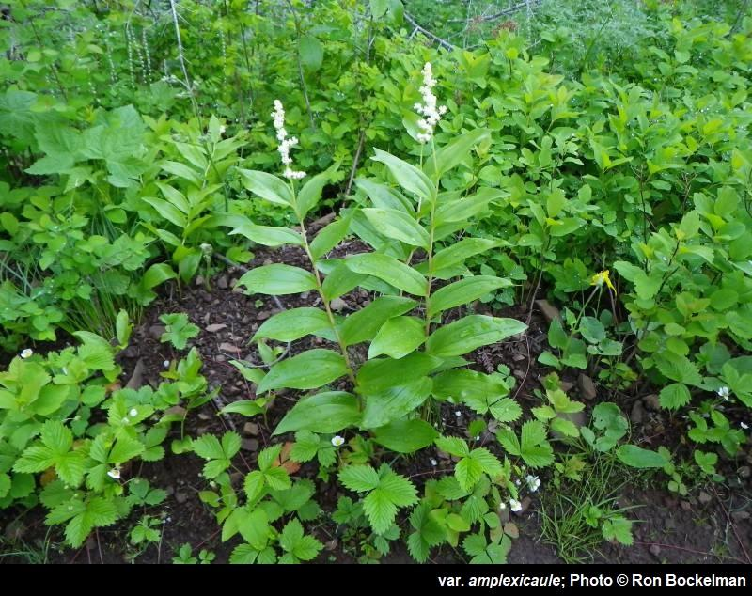
Maianthemum racemosum
Trillium erectum
Native understory species
AM-associating
Perennial clonally reproducing
species with winter dieback
Heberling et al. (2019)

Slide 5
Field sampling plan
Track carbon budgets of two focal species w/ and w/o A. petiolata presence
Weekly gas exchange measurements
Weekly chlorophyll fluorescence measurements
Weekly A. petiolata density counts
Under canopy LAI (?)
Sample size (n = 48 per species * 2 species)
16 individuals of each species from each plot (8 weeded; 8 ambient)
3 plots

Slide 6
Timeline
Evan travel to PGH to start field work first week of April
Potentially solo field work until second focal species emerges
Need help when second focal species emerges
Hannah join after graduation
Kelly join whenever (but at least May-June when not helping Alissar)
Field work wraps up July 31 (but Maianthemum does have leaves until November…)

