Slide 1
Null treatment effects on photosynthesis and photosynthetic capacity
A_{net}
V_{cmax25}
J_{max25}
Same response as previous two years in the field!
Fluxes are comparable to late season measurements from last year

Slide 2
Stomatal conductance
Stomatal conductance is reduced in plants that had a legacy of growing with garlic mustard (NW plants < W plants, p=0.011)
Stomatal conductance is reduced in plants growing with weeded AMF community (W fungal source < NW fungal source, p=0.005)

Slide 3
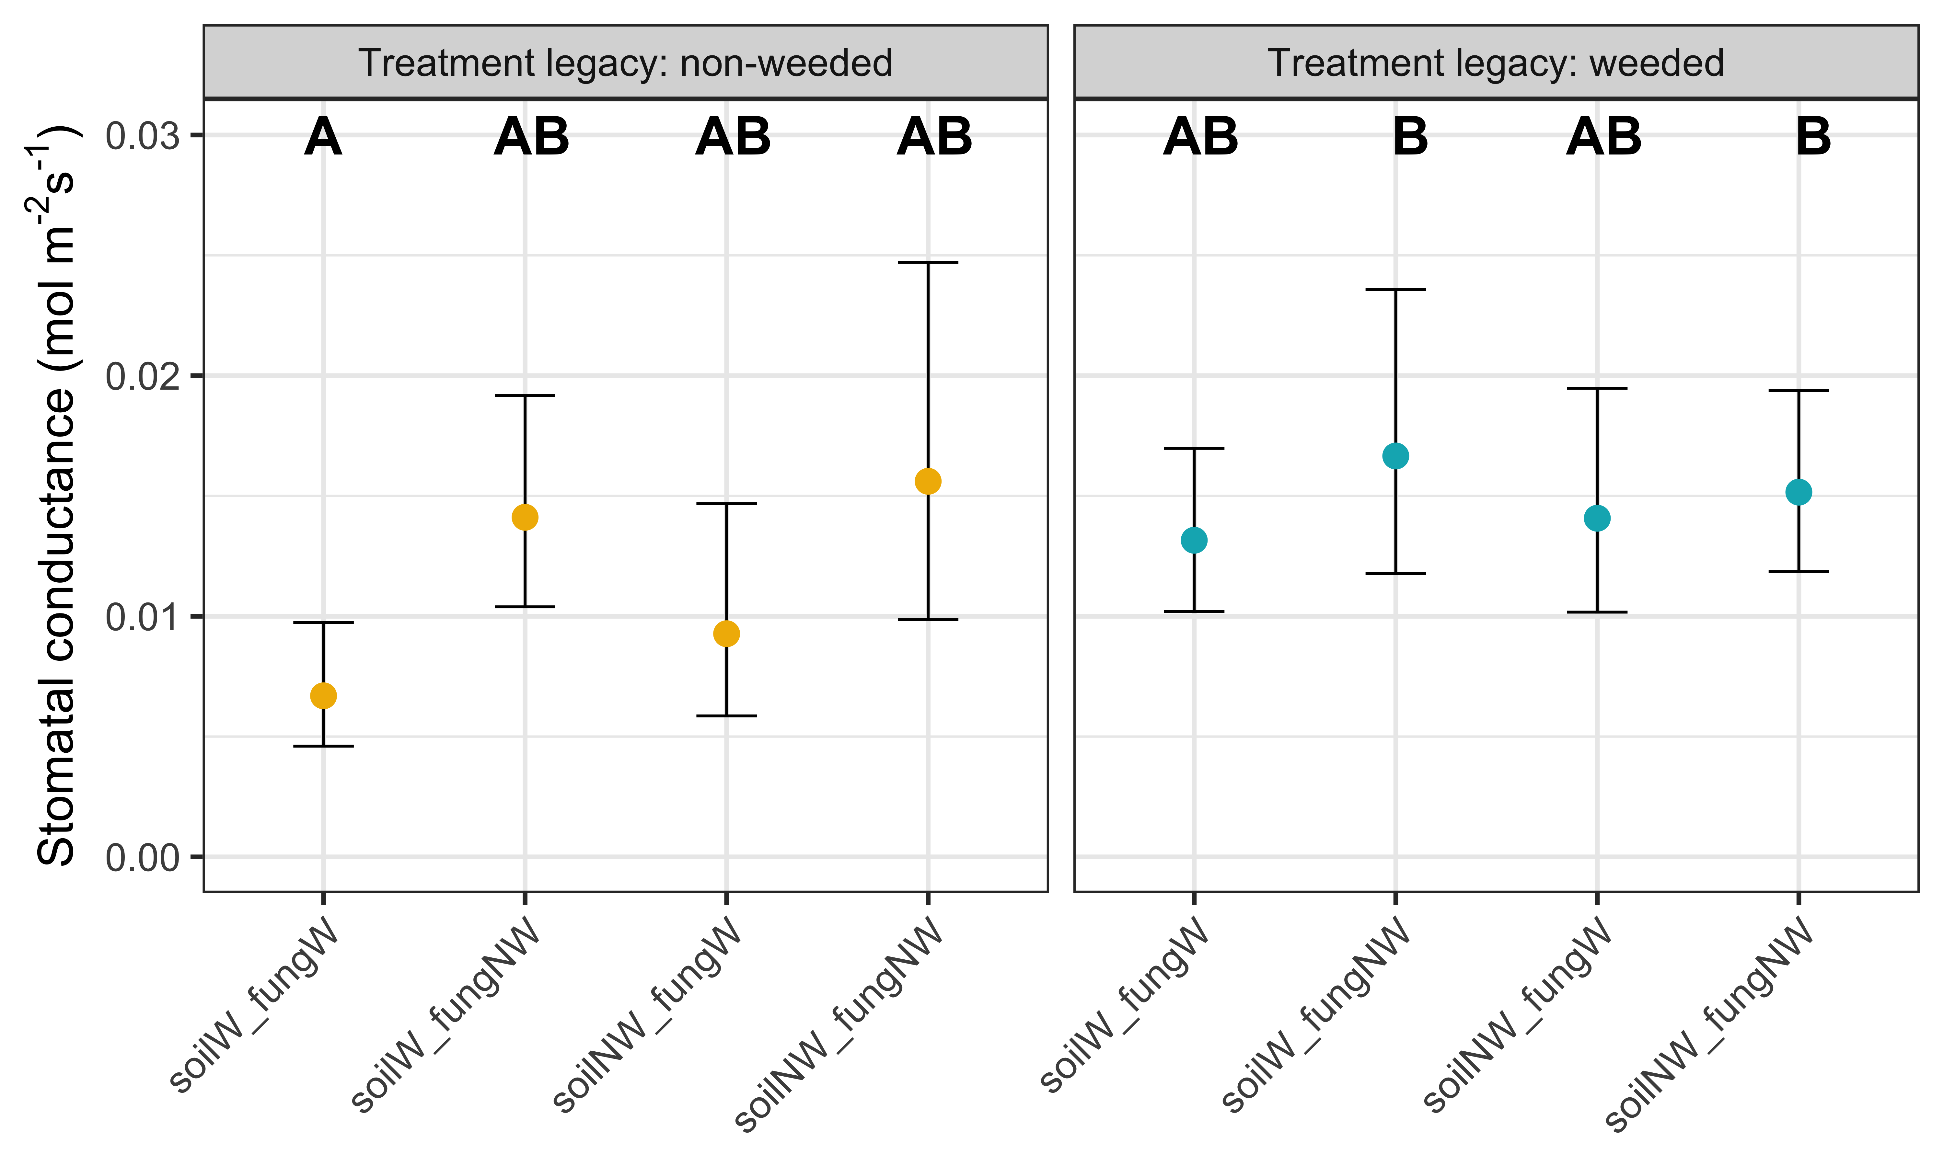
** same response for iWUE (given null A_{net} response to treatment combinations

Slide 4
φ_{PSII}
φ_{PSII} is marginally reduced in plants that had a legacy of growing with garlic mustard (NW plants < W plants, p=0.098)
3-way interaction: Non-weeded plants grown in weeded soil and with the weeded AM fungal community had lower φ_{PSII} than:
Weeded plants grown in non-weeded soil and with the non-weeded AM fungal community
Weeded plants grown in weeded soil and with the weeded AM fungal community

Slide 5
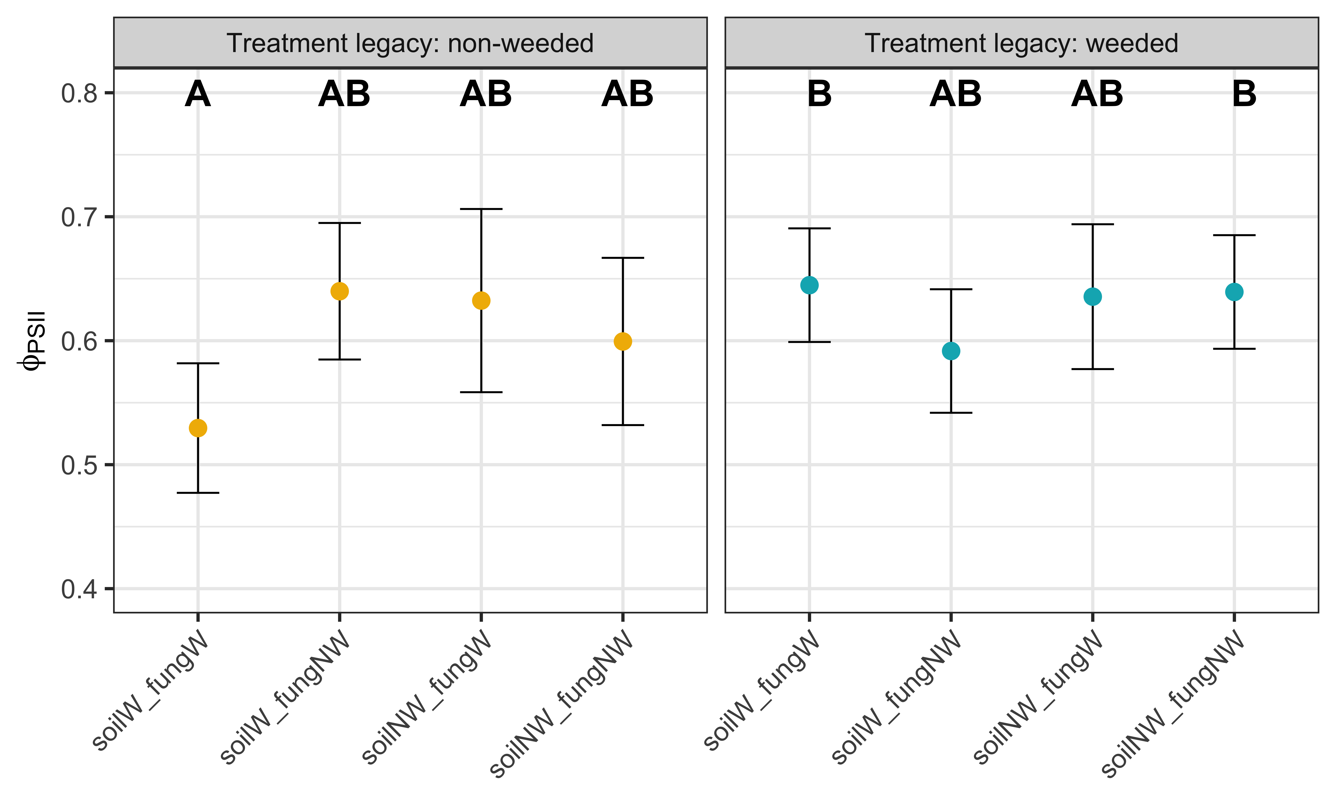

Slide 6
Total leaf area
Total leaf area (proxy for plant size) is reduced in plants that had a legacy of growing with garlic mustard (NW plants < W plants, p=0.030)
Total leaf area is marginally greater in plants grown with the AM fungal community from non-weeded plots (W fungal source < NW fungal source, p=0.08)
Three-way interaction: there is only one pairwise difference across treatment combinations:
Non-weeded plants grown in non-weeded soil but weeded fungal source have reduced total leaf area compared to non-weeded plants grown in non-weeded soil and non-weeded fungal source

Slide 7
