Slide 1
Pot experiment physiology update
Trillium Trail group meeting
06.19.2026

Slide 2
Model fitting notes
LMEMs include:
Individual fixed effect terms for PlantGMTrt, ExpSoilSource, and ExpFungSource
All possible interaction terms
Wet rhizome weight as additional fixed effect to account for size
Better way to do this? Dry aboveground biomass?
Random intercept terms for field plot and photosynthesis machine

Slide 3
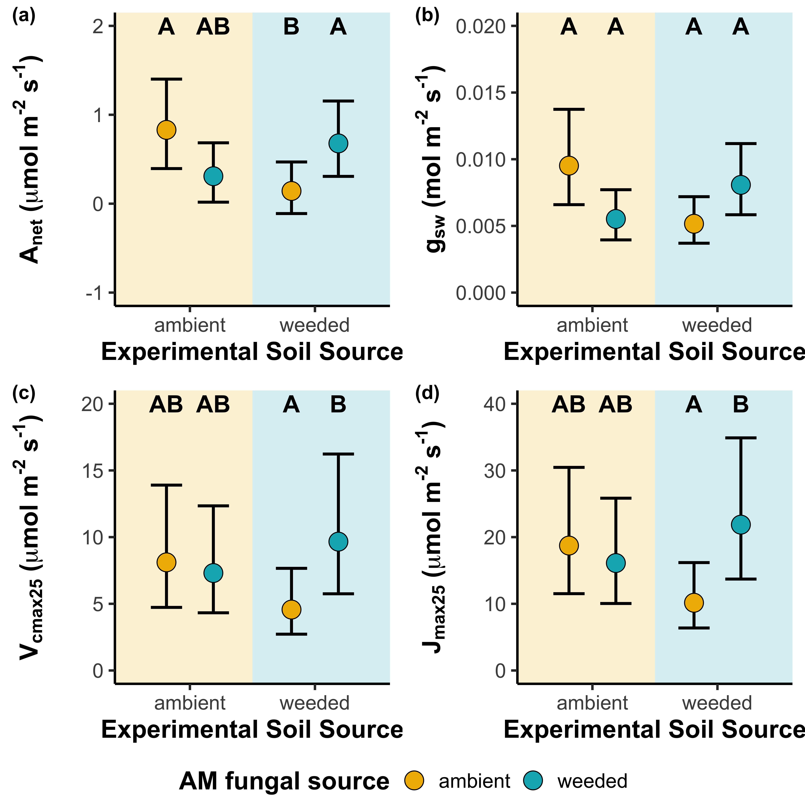
Net photosynthesis (A_{net})
No individual treatment effect
Weeded AMF increases net photosynthesis, but only when plants were grown in weeded soils
Weeded AMF also only increased net photosynthesis in plants with legacy of growing in weeded plots
Stomatal conductance (g_{sw})
No individual treatment effect
Stomatal conductance is lower in plants grown in weeded soils, but only for those inoculated with ambient AMF
Photosynthetic capacity (V_{cmax25}, J_{max25})
Weeded AMF increased V_{cmax25} and J_{max25}, but only when plants were grown in weeded soils
Weeded AMF also increased parameters when plants had legacy of growing in weeded plots
AMF × Soil source: p<0.001
AMF × Soil source: p=0.002
AMF × Soil source: p=0.019
AMF × Soil source: p=0.005

Slide 4
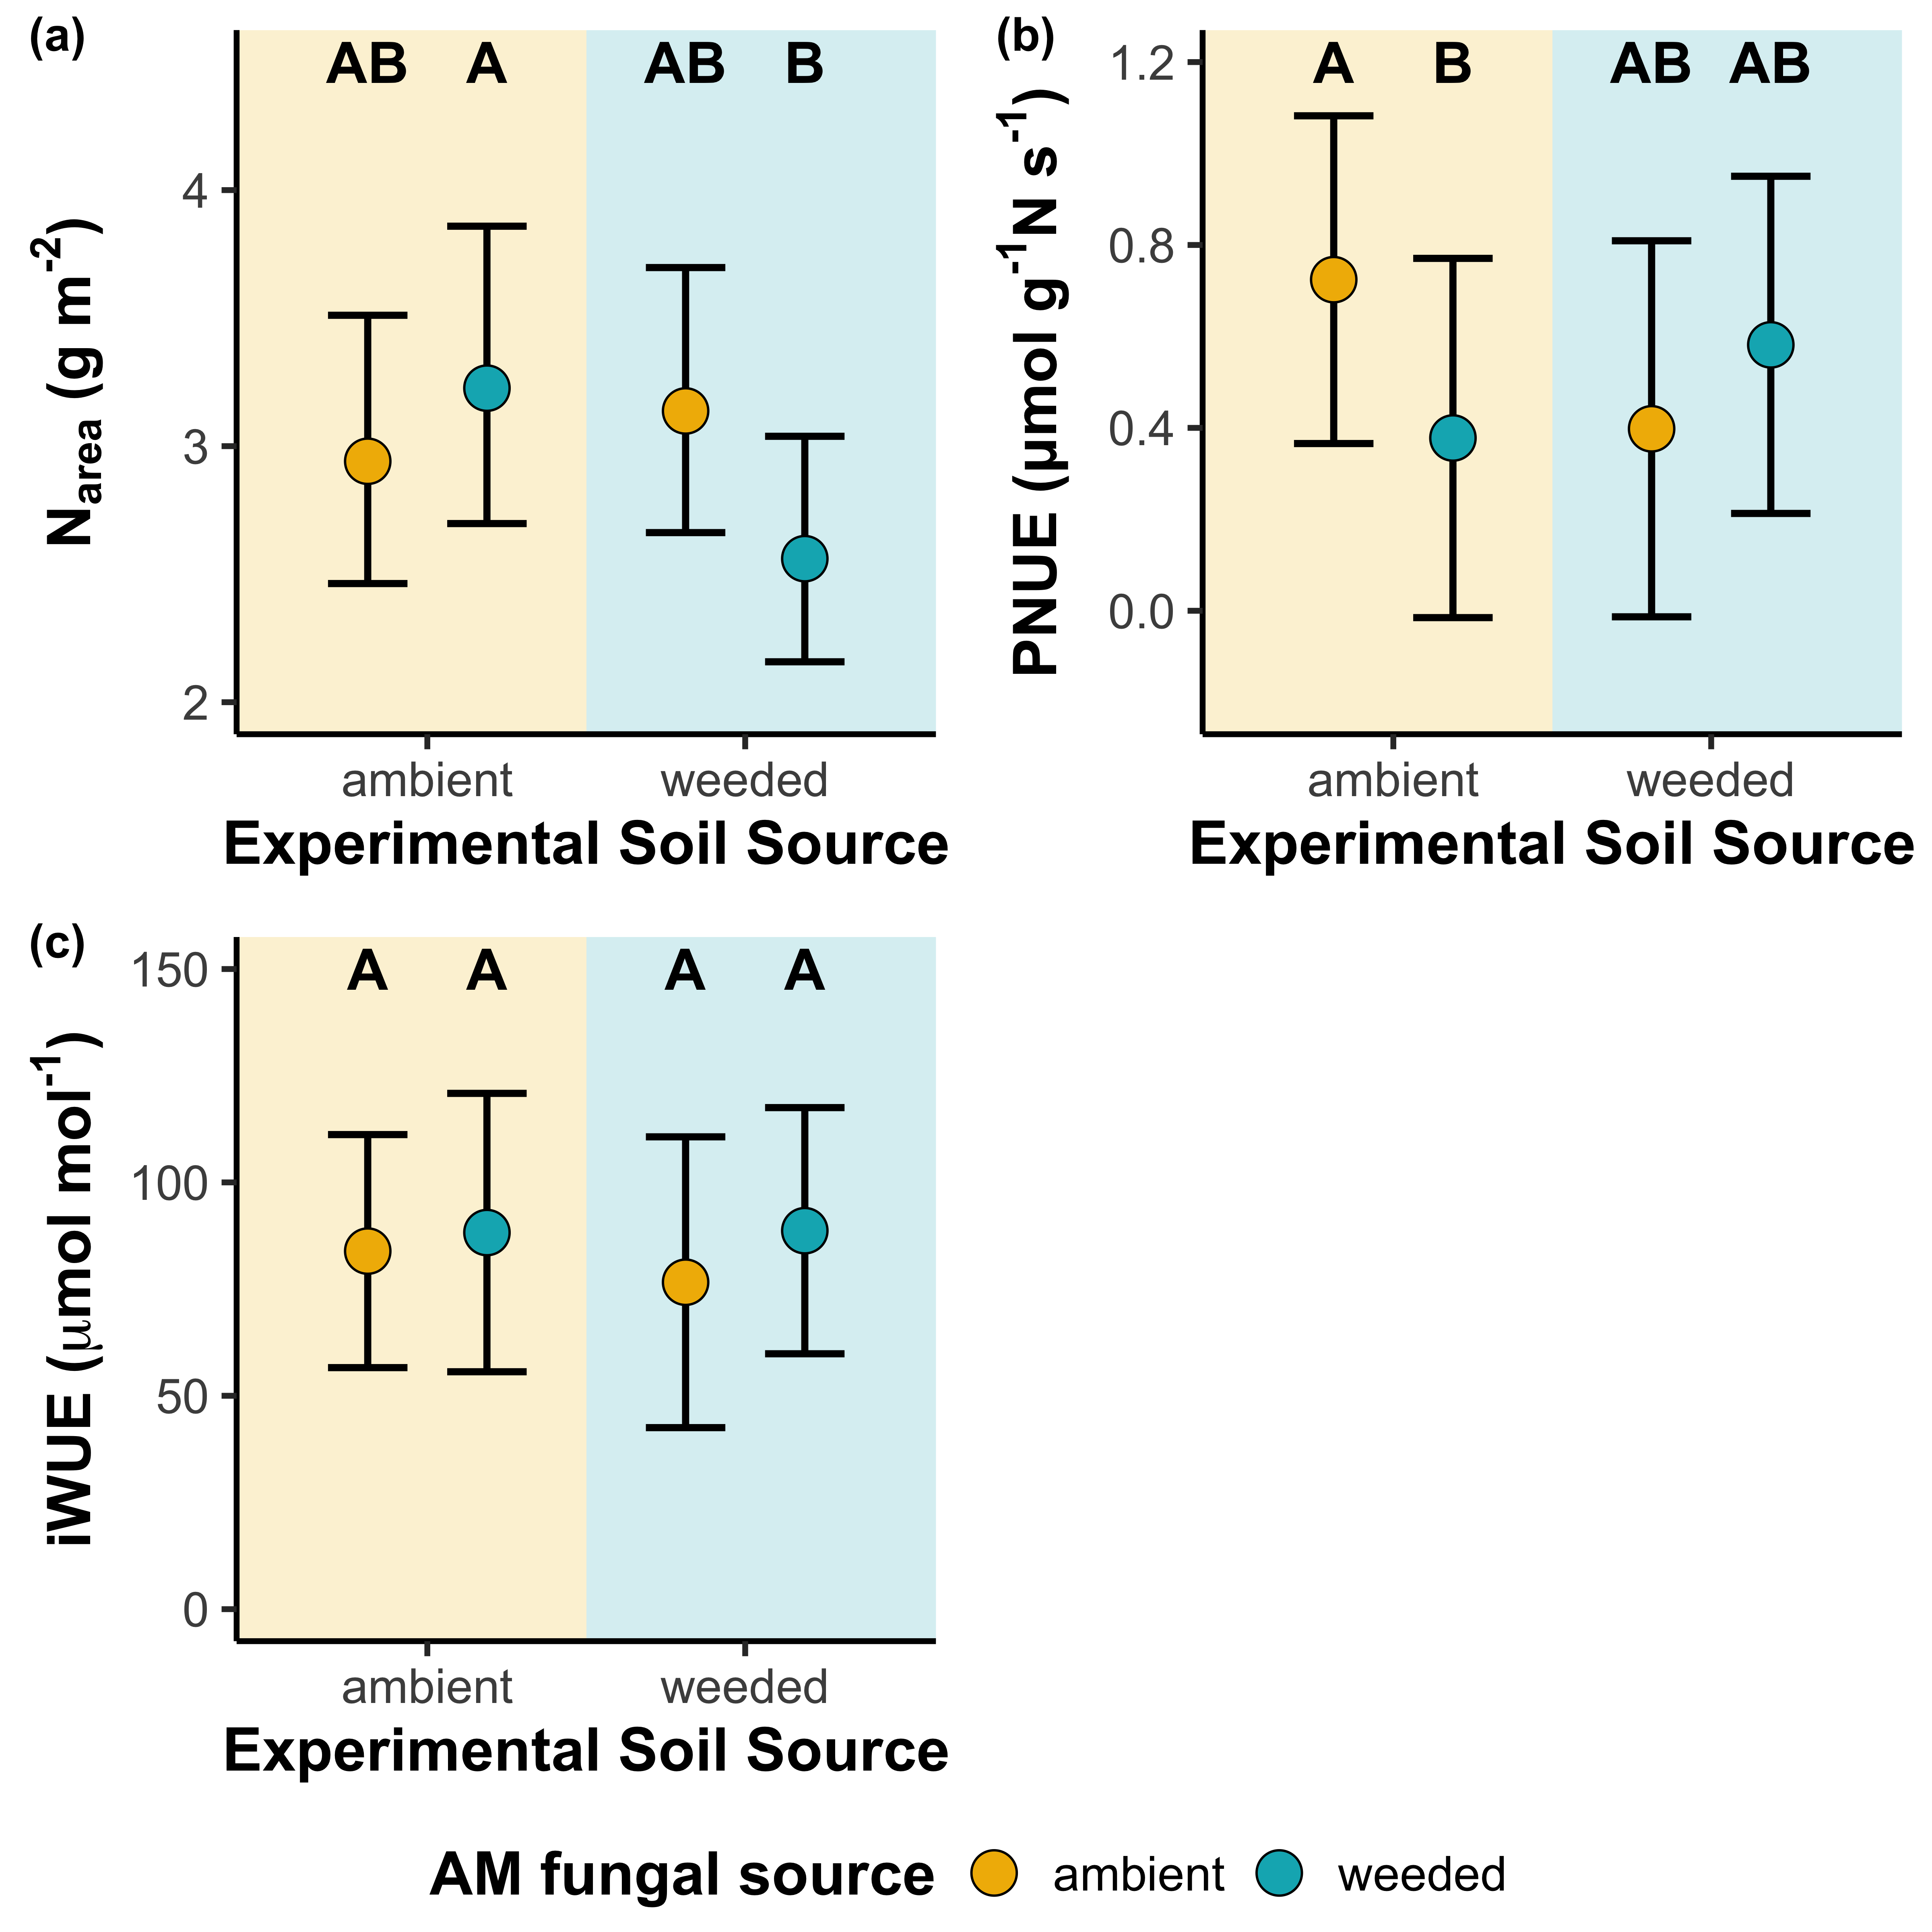
Area-based leaf N content (N_{area})
No individual treatment effect
Leaf N content was greater when plants were grown in ambient soils, but only when inoculated with weeded AMF or when plants had ambient treatment legacy
Photosynthetic nitrogen-use efficiency (PNUE)
No individual treatment effect
Weeded AMF increased PNUE in weeded soils; ambient AMF increased PNUE in ambient soils
Three-way interaction: ExpSoilSource * ExpFungSource interaction only observed in plants with weeded treatment legacy
Intrinsic water-use efficiency (iWUE)
No individual or interaction effect
AMF × Soil source: p=0.052
AMF × Soil source: p=0.042
AMF × Soil source: p=0.763

Slide 5
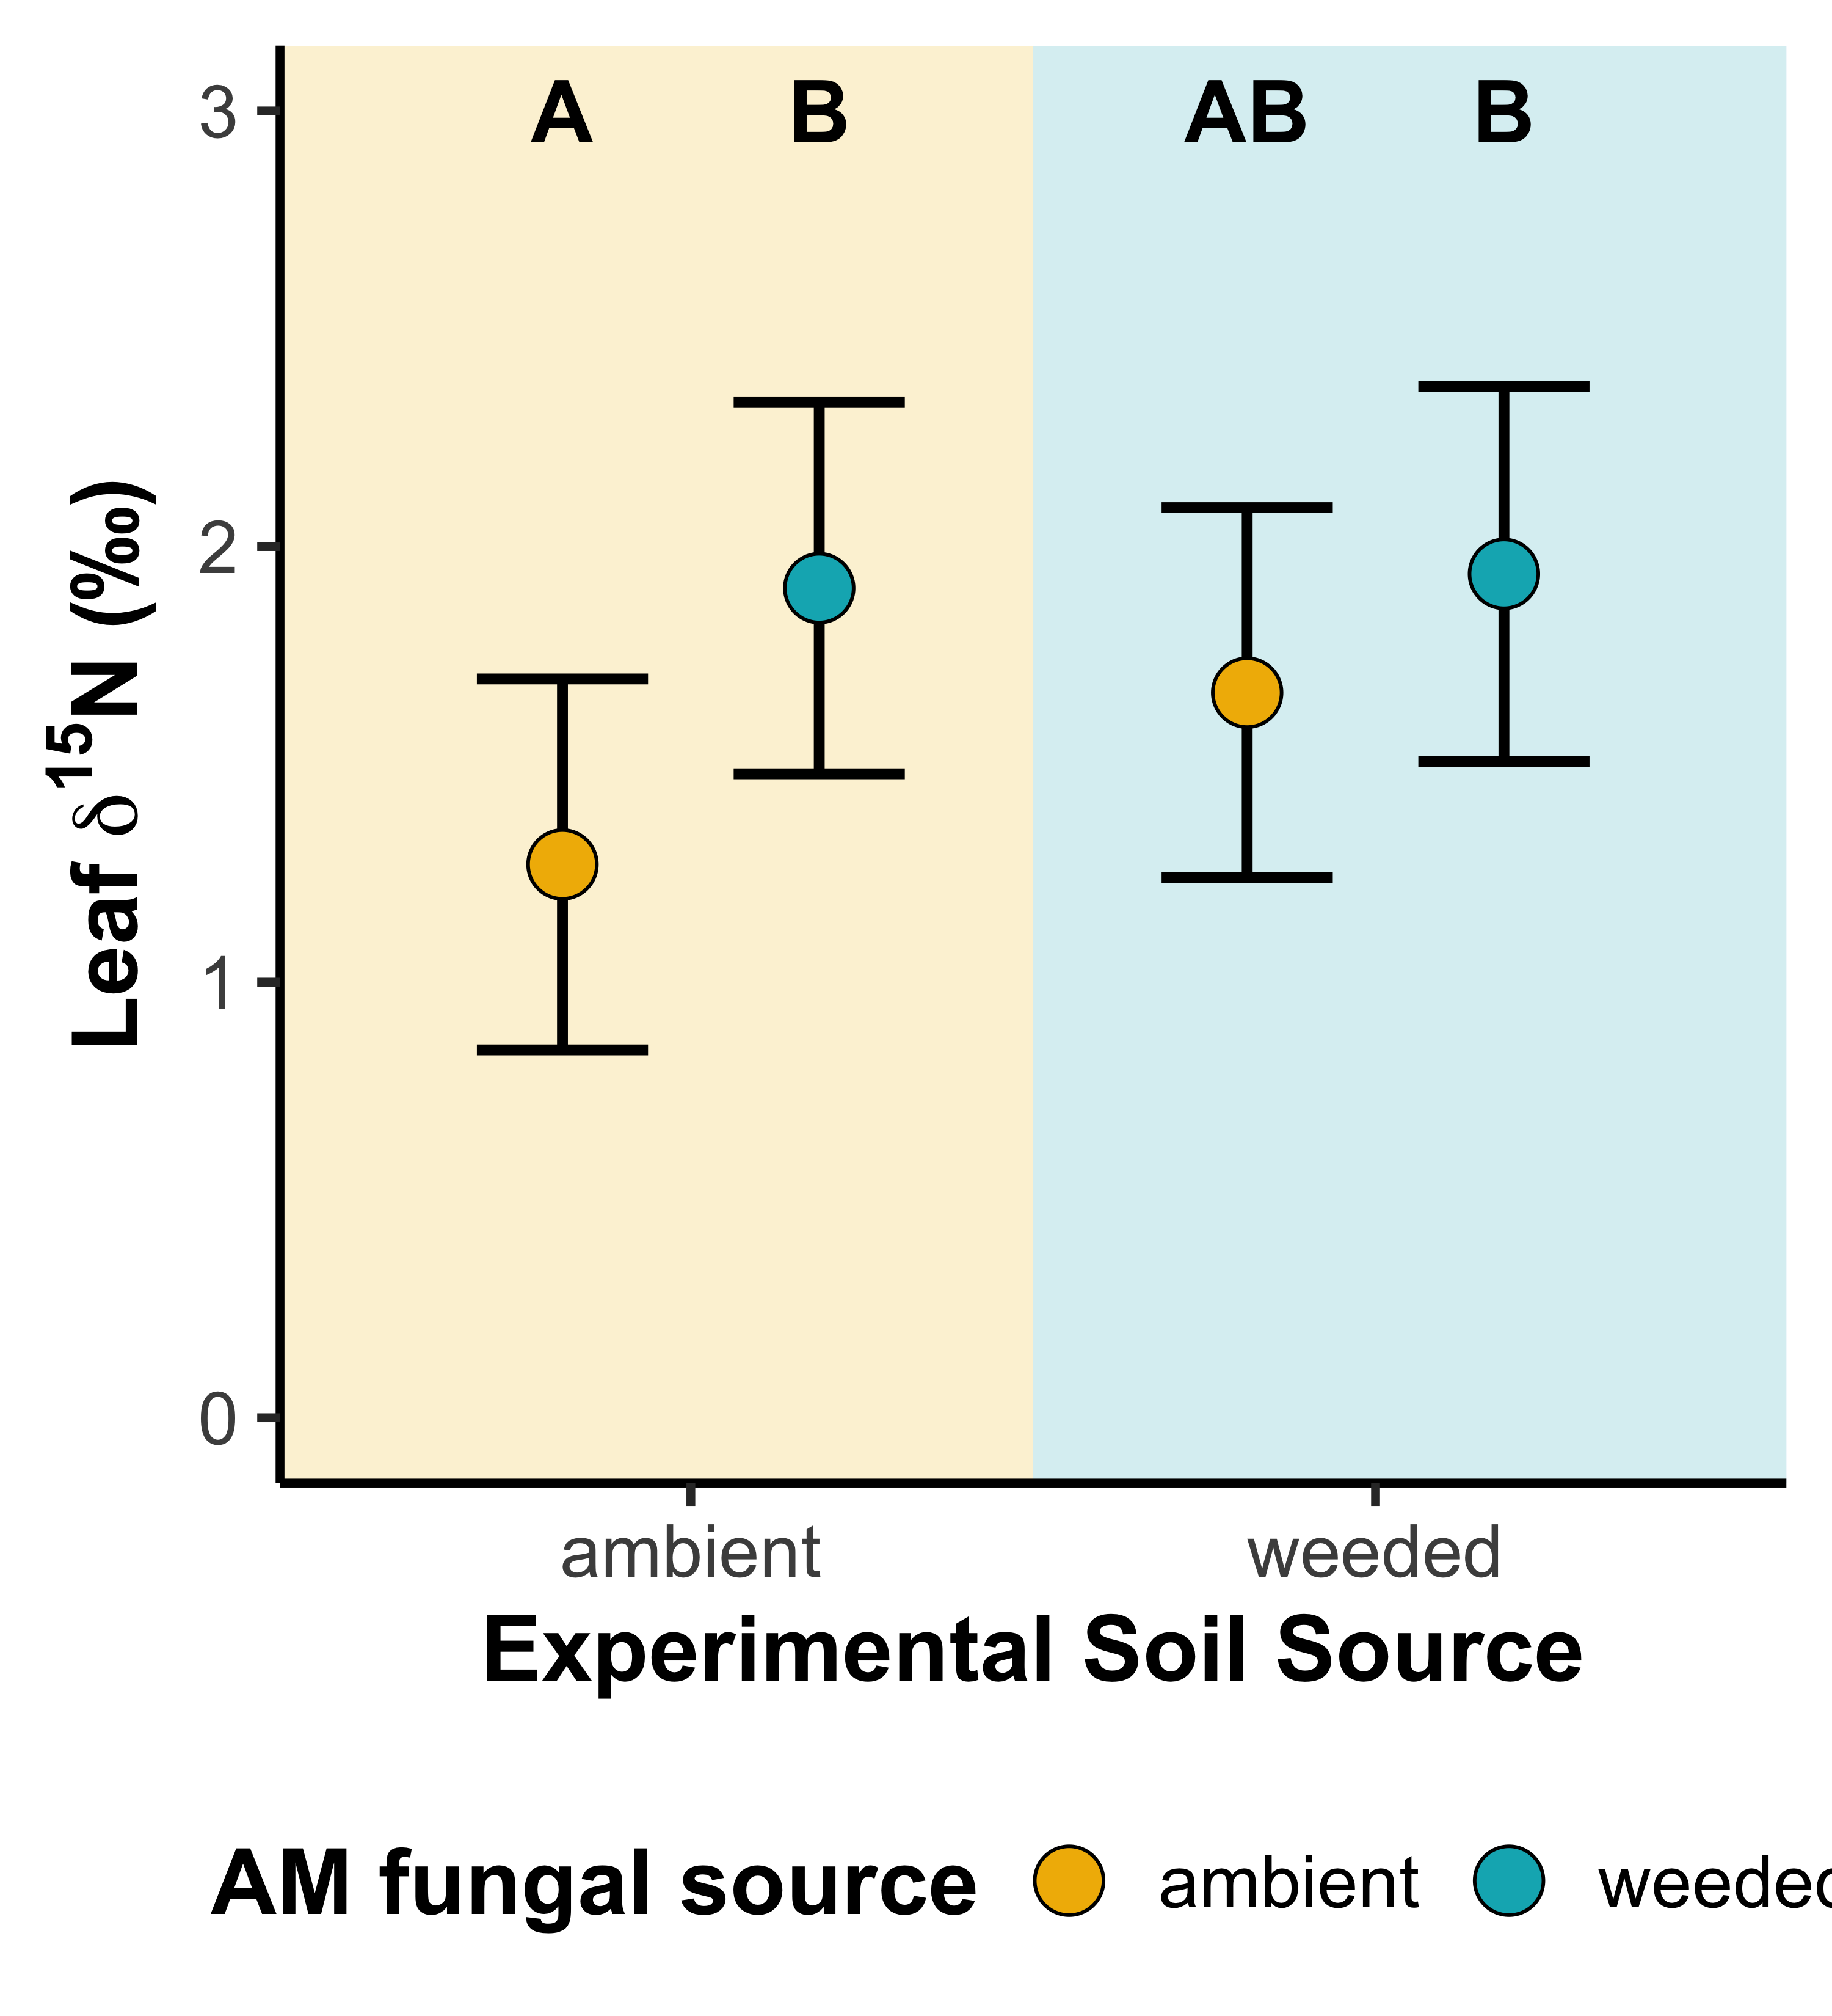
Leaf δ¹⁵N
Weeded AMF increased leaf δ¹⁵N
Plants grown in weeded soils have marginally greater leaf δ¹⁵N (p=0.061)
AMF × Soil source: p=0.109

Slide 6
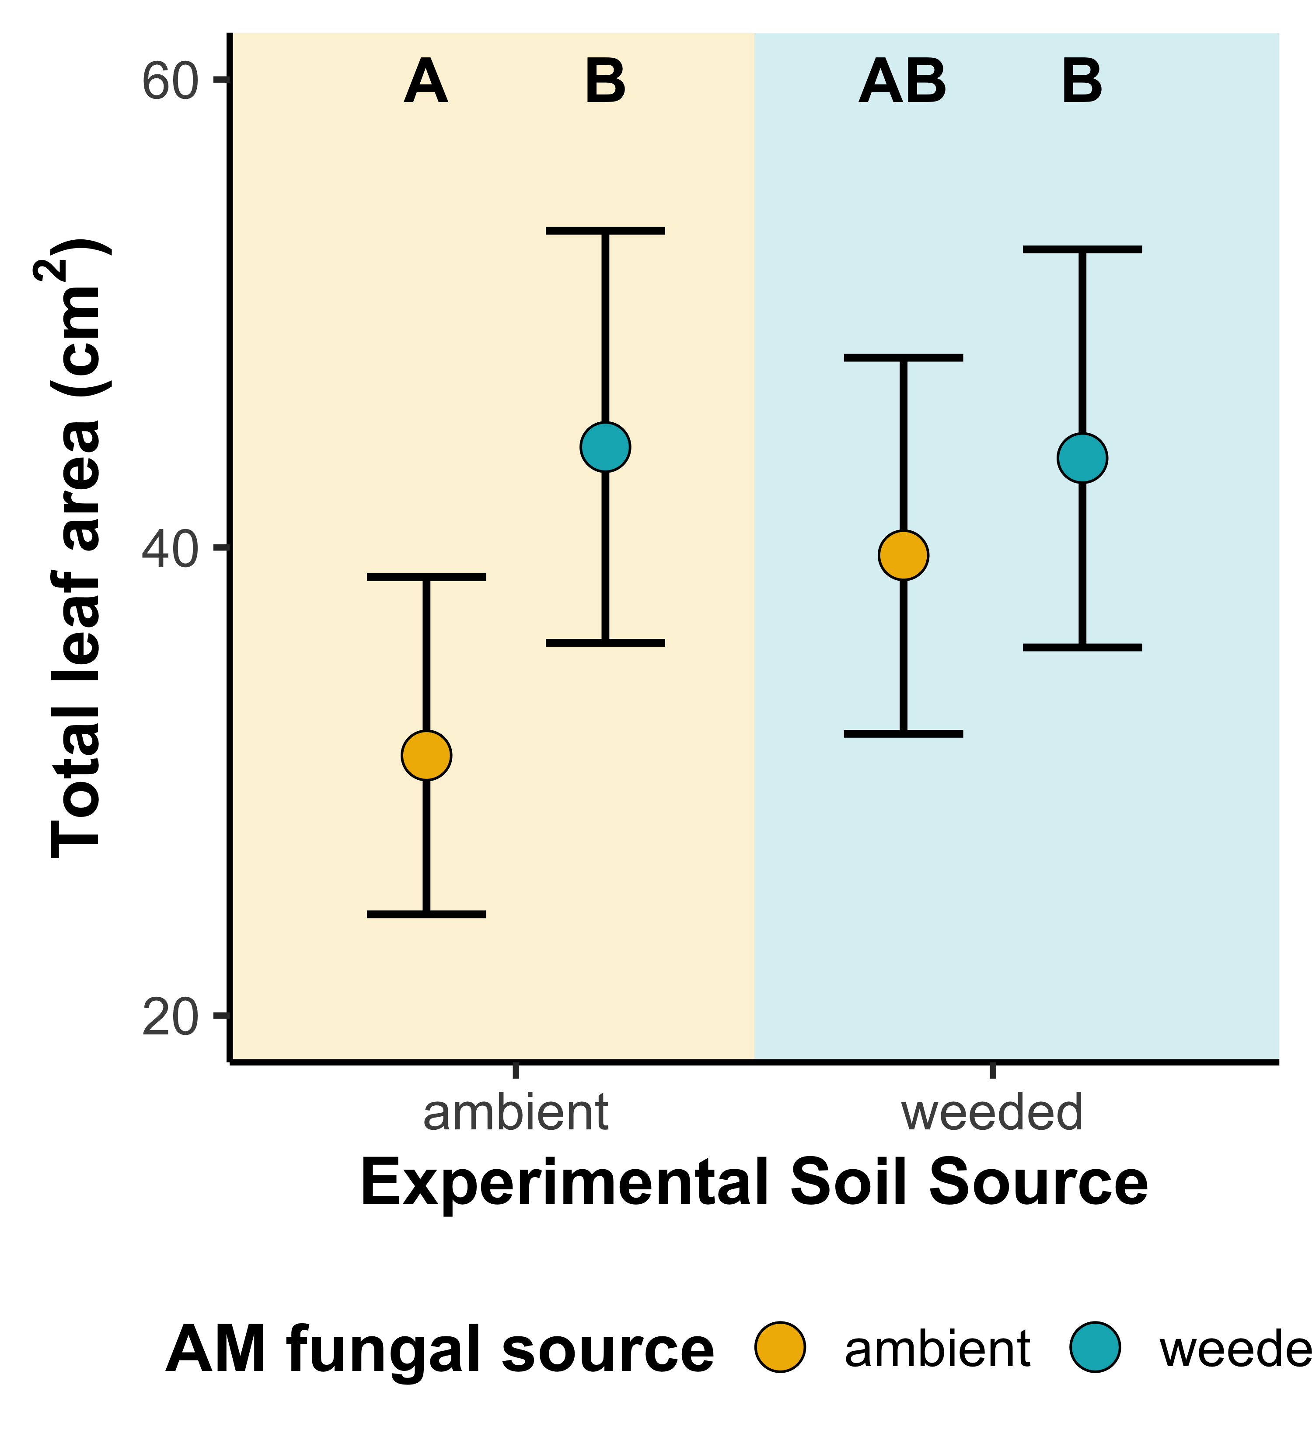
Total leaf area
Weeded AMF increase total leaf area
Marginal three-way interaction: weeded AMF increased total leaf area in ambient soils only, but this interaction was also only observed in plants with weeded treatment legacy
AMF × Soil source: p=0.176

Slide 7
Some takeaways
Photosynthetic and leaf δ¹⁵N responses are coordinated
Photosynthetic responses are predominately nutrient-driven
Strong leaf N, photosynthetic capacity treatment responses, limited stomatal conductance and water-use efficiency treatment responses
Same as field observations
Soil source plays an important role in shaping fungal source responses. Soil characteristics will help clarify mechanism
Weeded AMF community
+
N uptake through AMF
+
Photosynthetic N investment

