Slide 1
Soil nutrients, not inoculation status, drives Glycine max (L.) water and nitrogen economics: implications for including acquisition strategy in least-cost frameworks

Slide 2
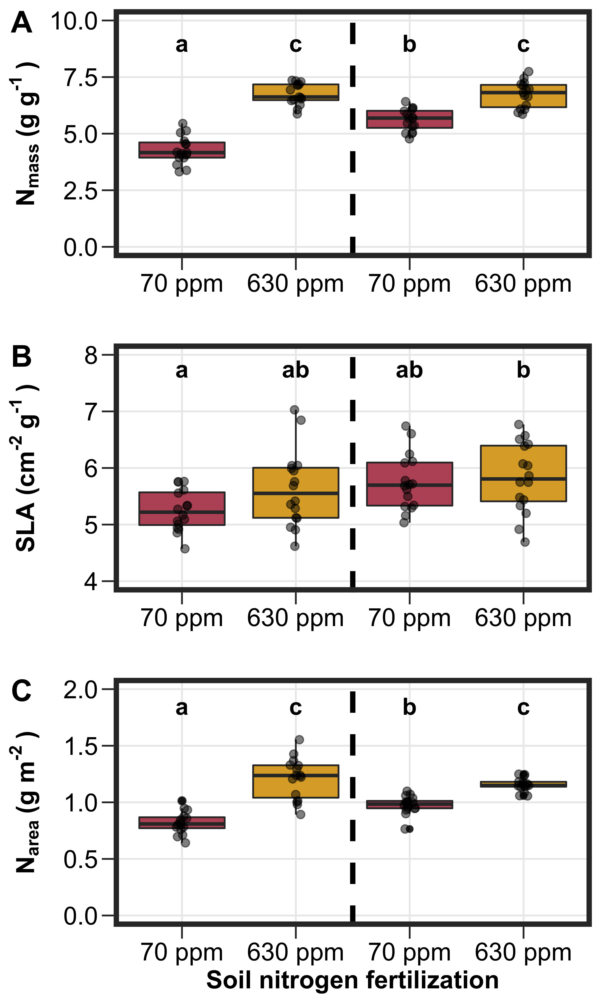
Fig. 1
Figure 1. Impacts of soil nitrogen fertilization and inoculation status on leaf nitrogen concentrations (panel A), specific leaf area (panel B), and leaf nitrogen per leaf area (panel C). Soil nitrogen fertilization is represented on the x-axis. Individual points reference individual measurements that comprised each boxplot. The pair of boxplots to the left of the vertical dashed line represent individuals that had not been inoculated with B. japonicum, while the pair of boxplots to the right of the vertical dashed line represent individuals that had been inoculated with B. japonicum. Compact lettering indicates pairwise comparisons where Tukey: p<0.05. Actual pairwise comparison test results are included in summary tables found in the supplement
Not inoculated
Inoculated

Slide 3
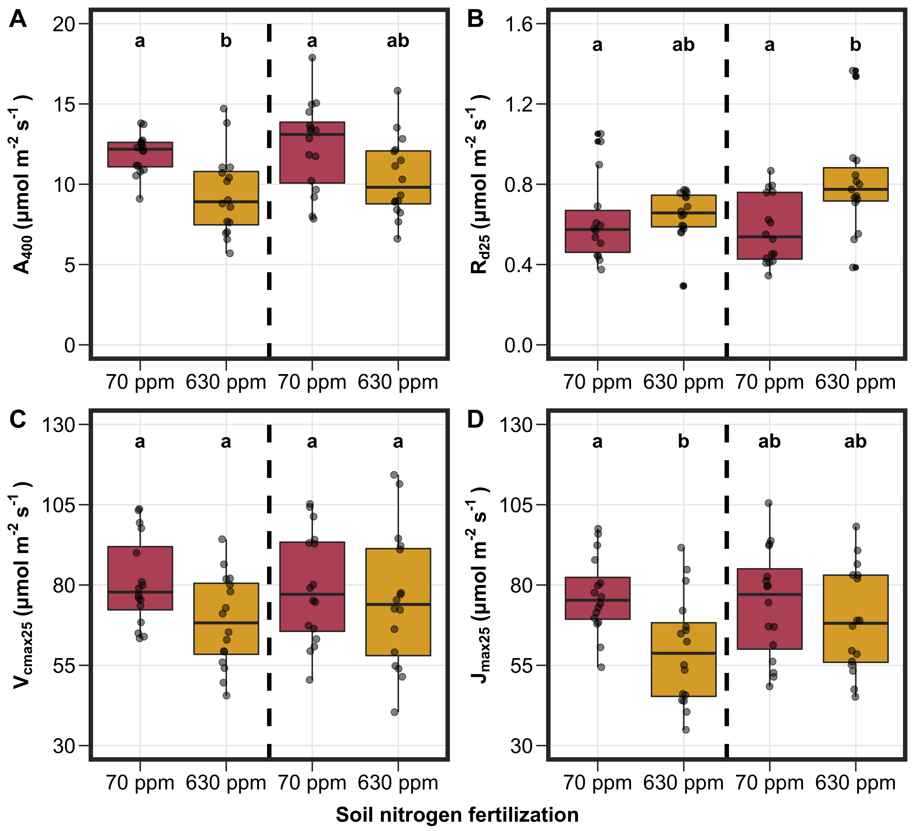
Fig. 2
Figure 2. Impacts of soil nitrogen fertilization and inoculation status on net photosynthesis (panel A), dark respiration (panel B), maximum Rubisco carboxylation rate (panel C), and maximum rate of RuBP regeneration. Soil nitrogen fertilization is represented on the x-axis. Individual points reference individual measurements that comprised each boxplot. The pair of boxplots to the left of the vertical dashed line represent individuals that had not been inoculated with B. japonicum, while the pair of boxplots to the right of the vertical dashed line represent individuals that had been inoculated with B. japonicum. Compact lettering indicates pairwise comparisons where Tukey: p<0.05. Actual pairwise comparison test results are included in summary tables found in the supplement

Slide 4
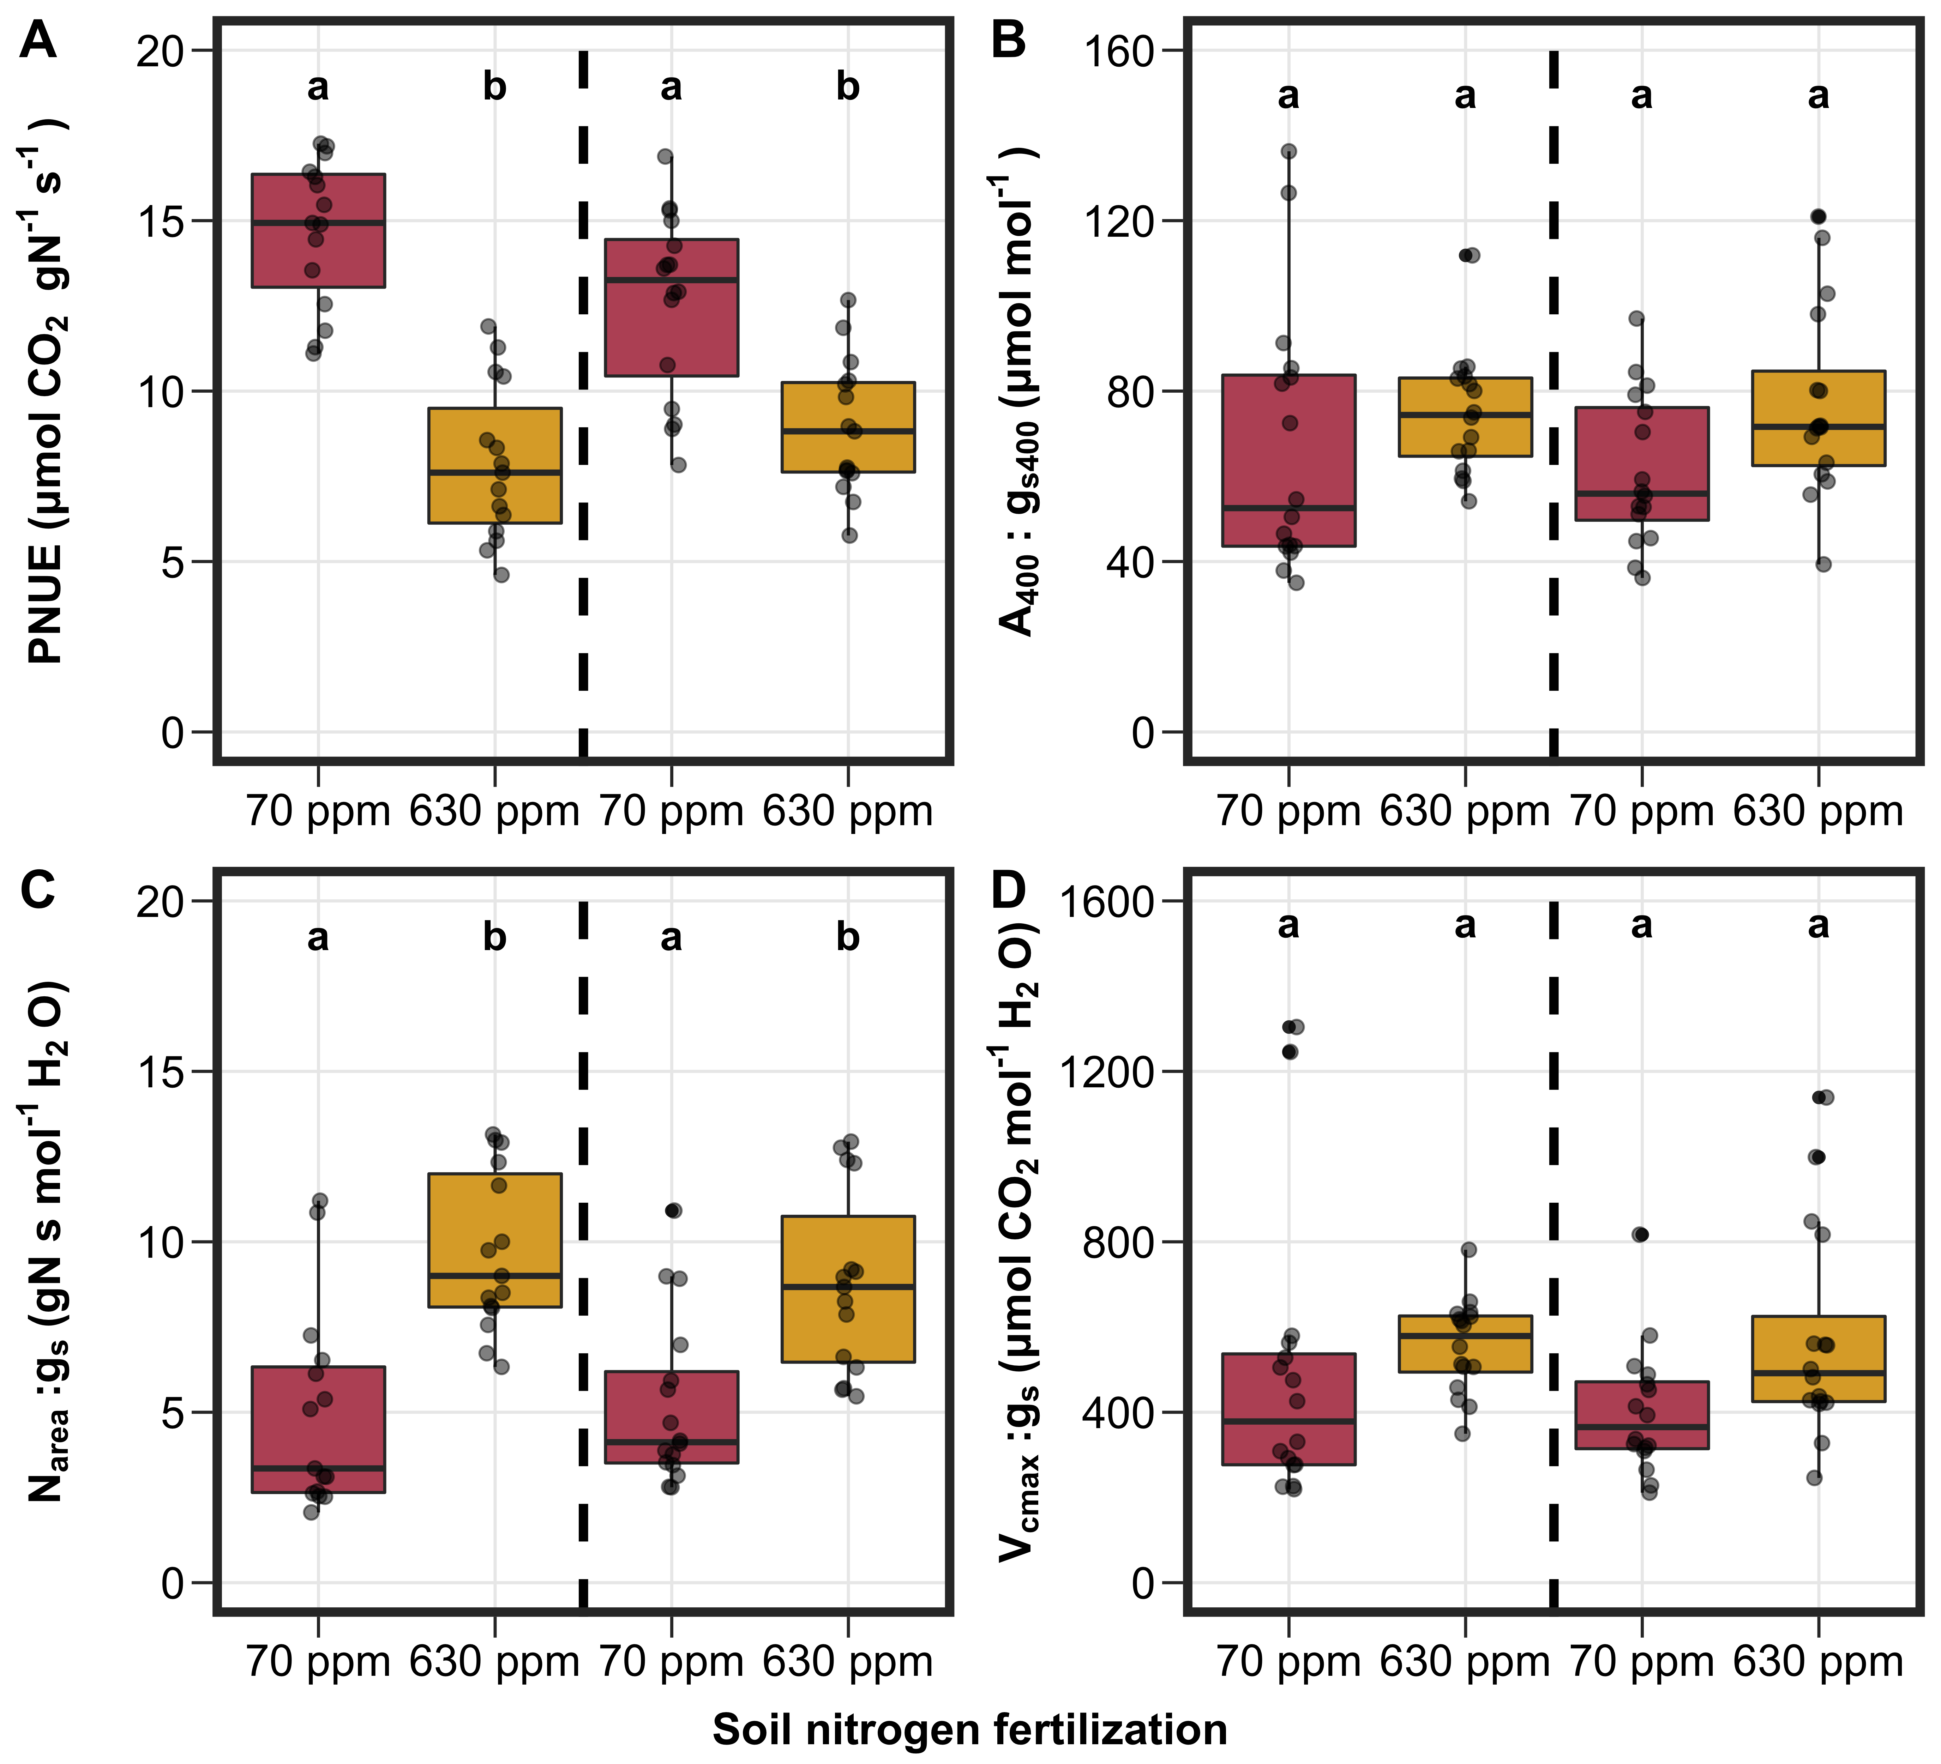
Fig. 3
Figure 3. Impacts of soil nitrogen fertilization and inoculation status on photosynthetic nitrogen-use efficiency (panel A), water-use efficiency (panel B), leaf nitrogen allocation per stomatal conductance (panel C), and maximum Rubisco carboxylation rate per stomatal conductance. Soil nitrogen fertilization is represented on the x-axis. Individual points reference individual measurements that comprised each boxplot. The pair of boxplots to the left of the vertical dashed line represent individuals that had not been inoculated with B. japonicum, while the pair of boxplots to the right of the vertical dashed line represent individuals that had been inoculated with B. japonicum. Compact lettering indicates pairwise comparisons where Tukey: p<0.05. Actual pairwise comparison test results are included in summary tables found in the supplement

Slide 5
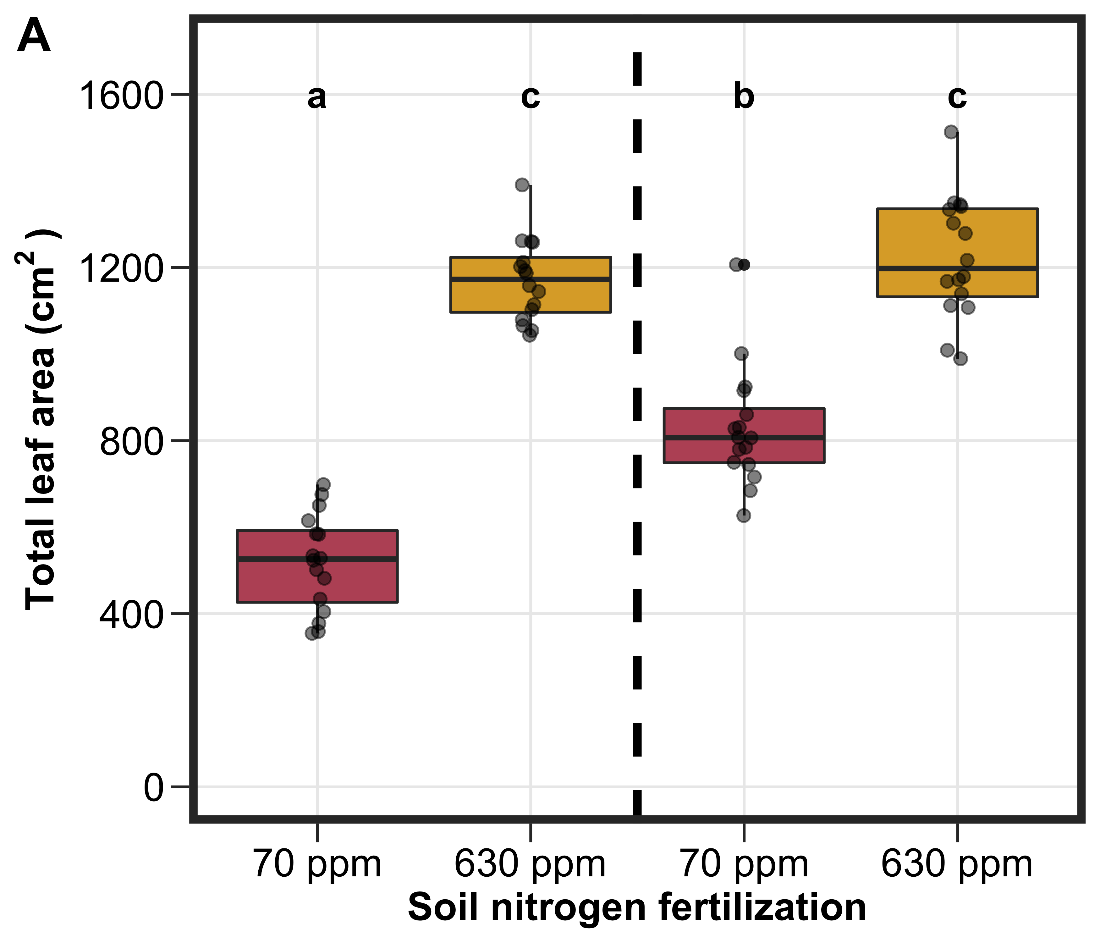
Fig. 4
Figure 3. Impacts of soil nitrogen fertilization and inoculation status on total leaf area (panel A) and whole plant biomass (to be panel B). Soil nitrogen fertilization is represented on the x-axis. Individual points reference individual measurements that comprised each boxplot. The pair of boxplots to the left of the vertical dashed line represent individuals that had not been inoculated with B. japonicum, while the pair of boxplots to the right of the vertical dashed line represent individuals that had been inoculated with B. japonicum. Compact lettering indicates pairwise comparisons where Tukey: p<0.05. Actual pairwise comparison test results are included in summary tables found in the supplement

