Slide 1
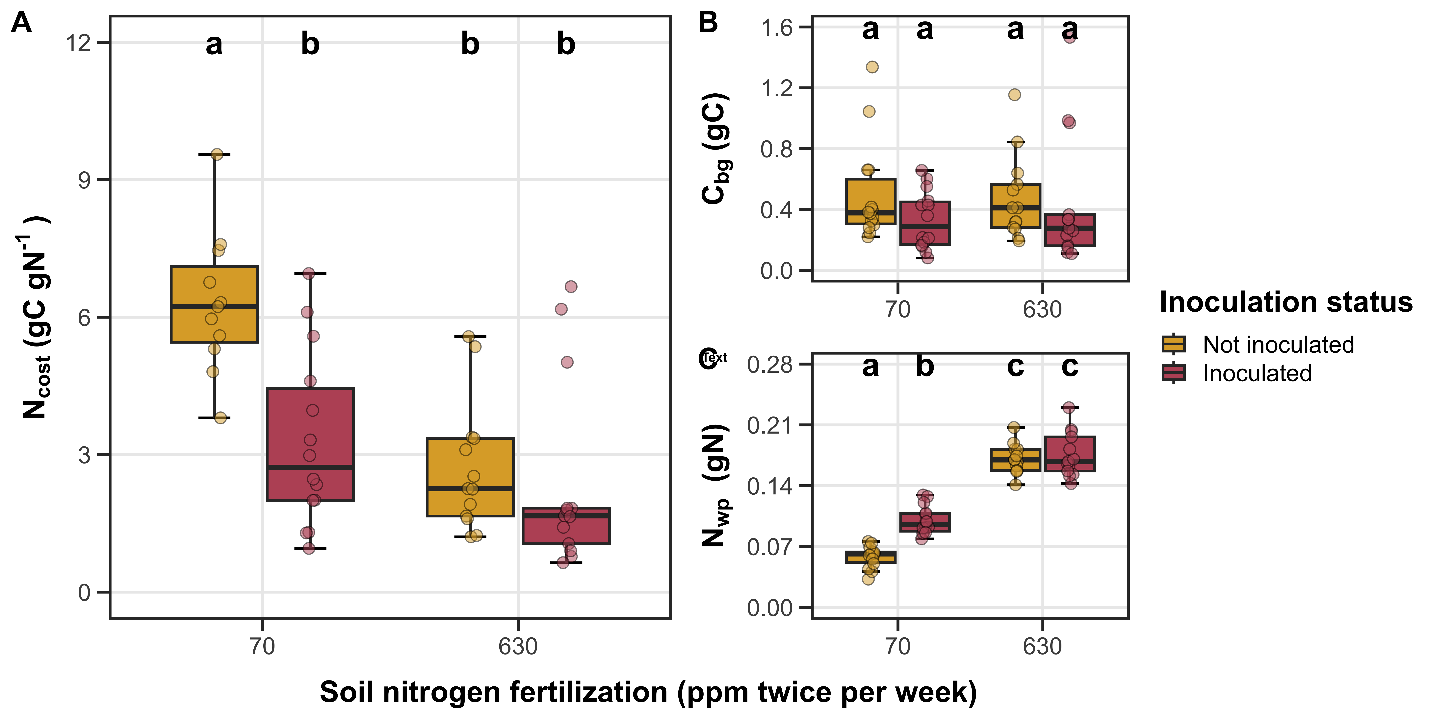

Figure 1. Effects of soil nitrogen fertilization and inoculation on G. max structural carbon costs to acquire nitrogen (“N_{cost}”; panel A), belowground carbon biomass (“C_{bg}”; panel B), and whole-plant nitrogen biomass (“N_{wp}”; panel C). Soil nitrogen fertilization is represented on the x-axis, while inoculation treatment is represented by colored boxplots. Yellow shaded boxplots indicate individuals that were not inoculated with B. japonicum, while red shaded boxplots indicate individuals that were inoculated with B. japonicum. Boxes are the upper (75% percentile) and lower (25% percentile) quartile. The whiskers are the minimum and maximum value, calculated as 1.5 times the upper and lower quartile value. Colored dots are individual data points, jittered for visibility. The lettering above each box indicates the results from post-hoc Tukey’s tests with different lettering indicating statistically different groups (Tukey: p<0.05).

Slide 2
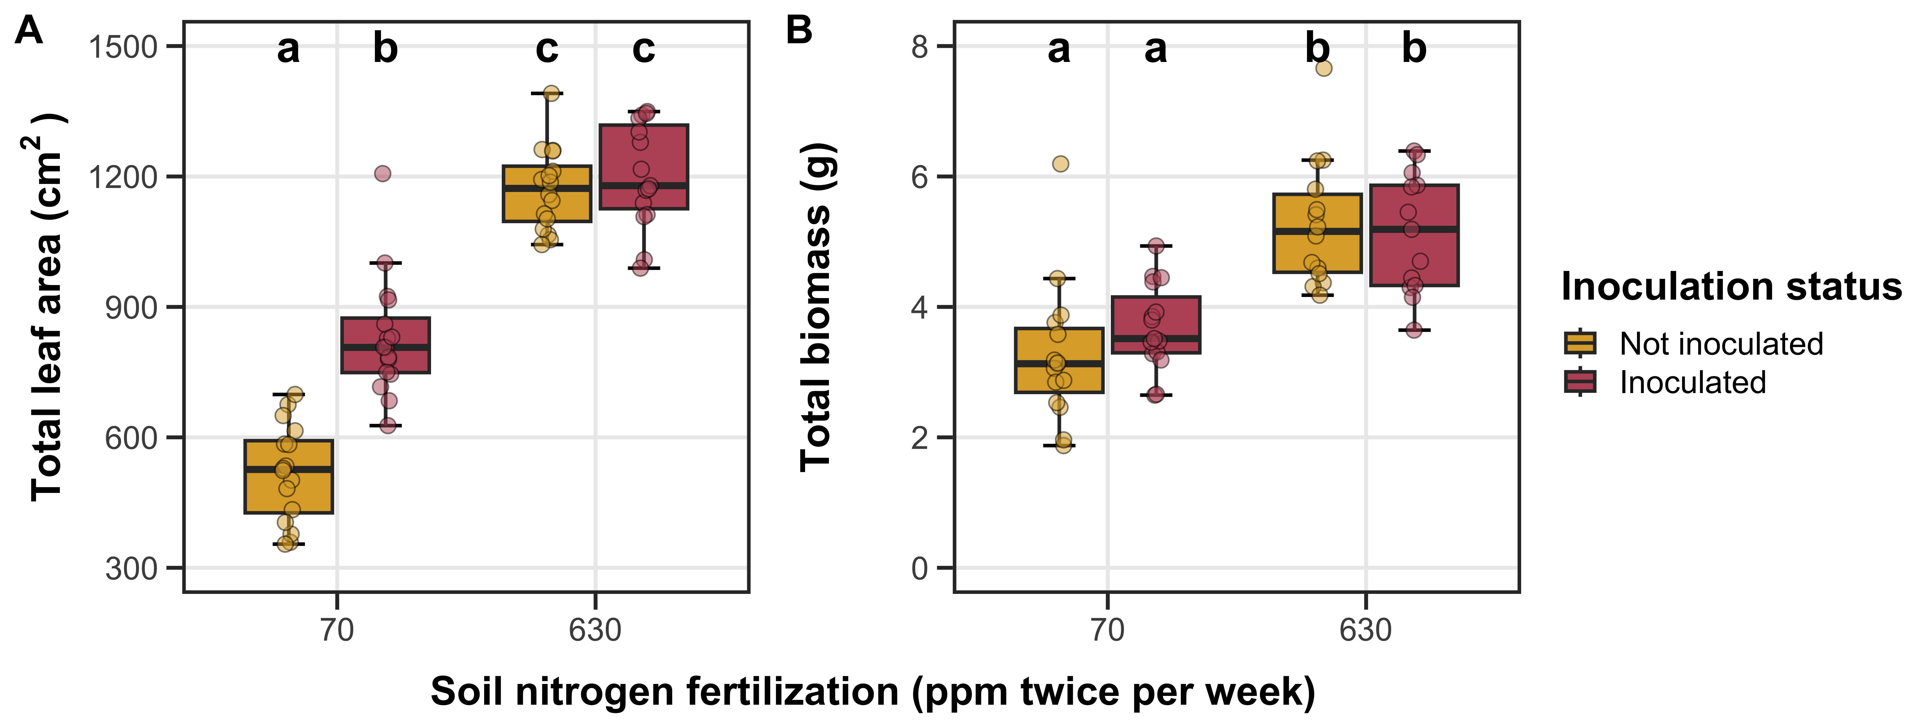
Figure 2. Effects of soil nitrogen fertilization and inoculation on G. max total leaf area (panel A), total biomass (panel B). Soil nitrogen fertilization is represented on the x-axis, while inoculation treatment is represented by colored boxplots. Yellow shaded boxplots indicate individuals that were not inoculated with B. japonicum, while red shaded boxplots indicate individuals that were inoculated with B. japonicum. Boxes are the upper (75% percentile) and lower (25% percentile) quartile. The whiskers are the minimum and maximum value, calculated as 1.5 times the upper and lower quartile value. Colored dots are individual data points, jittered for visibility. The lettering above each box indicates the results from post-hoc Tukey’s tests with different lettering indicating statistically different groups (Tukey: p<0.05).

Slide 3
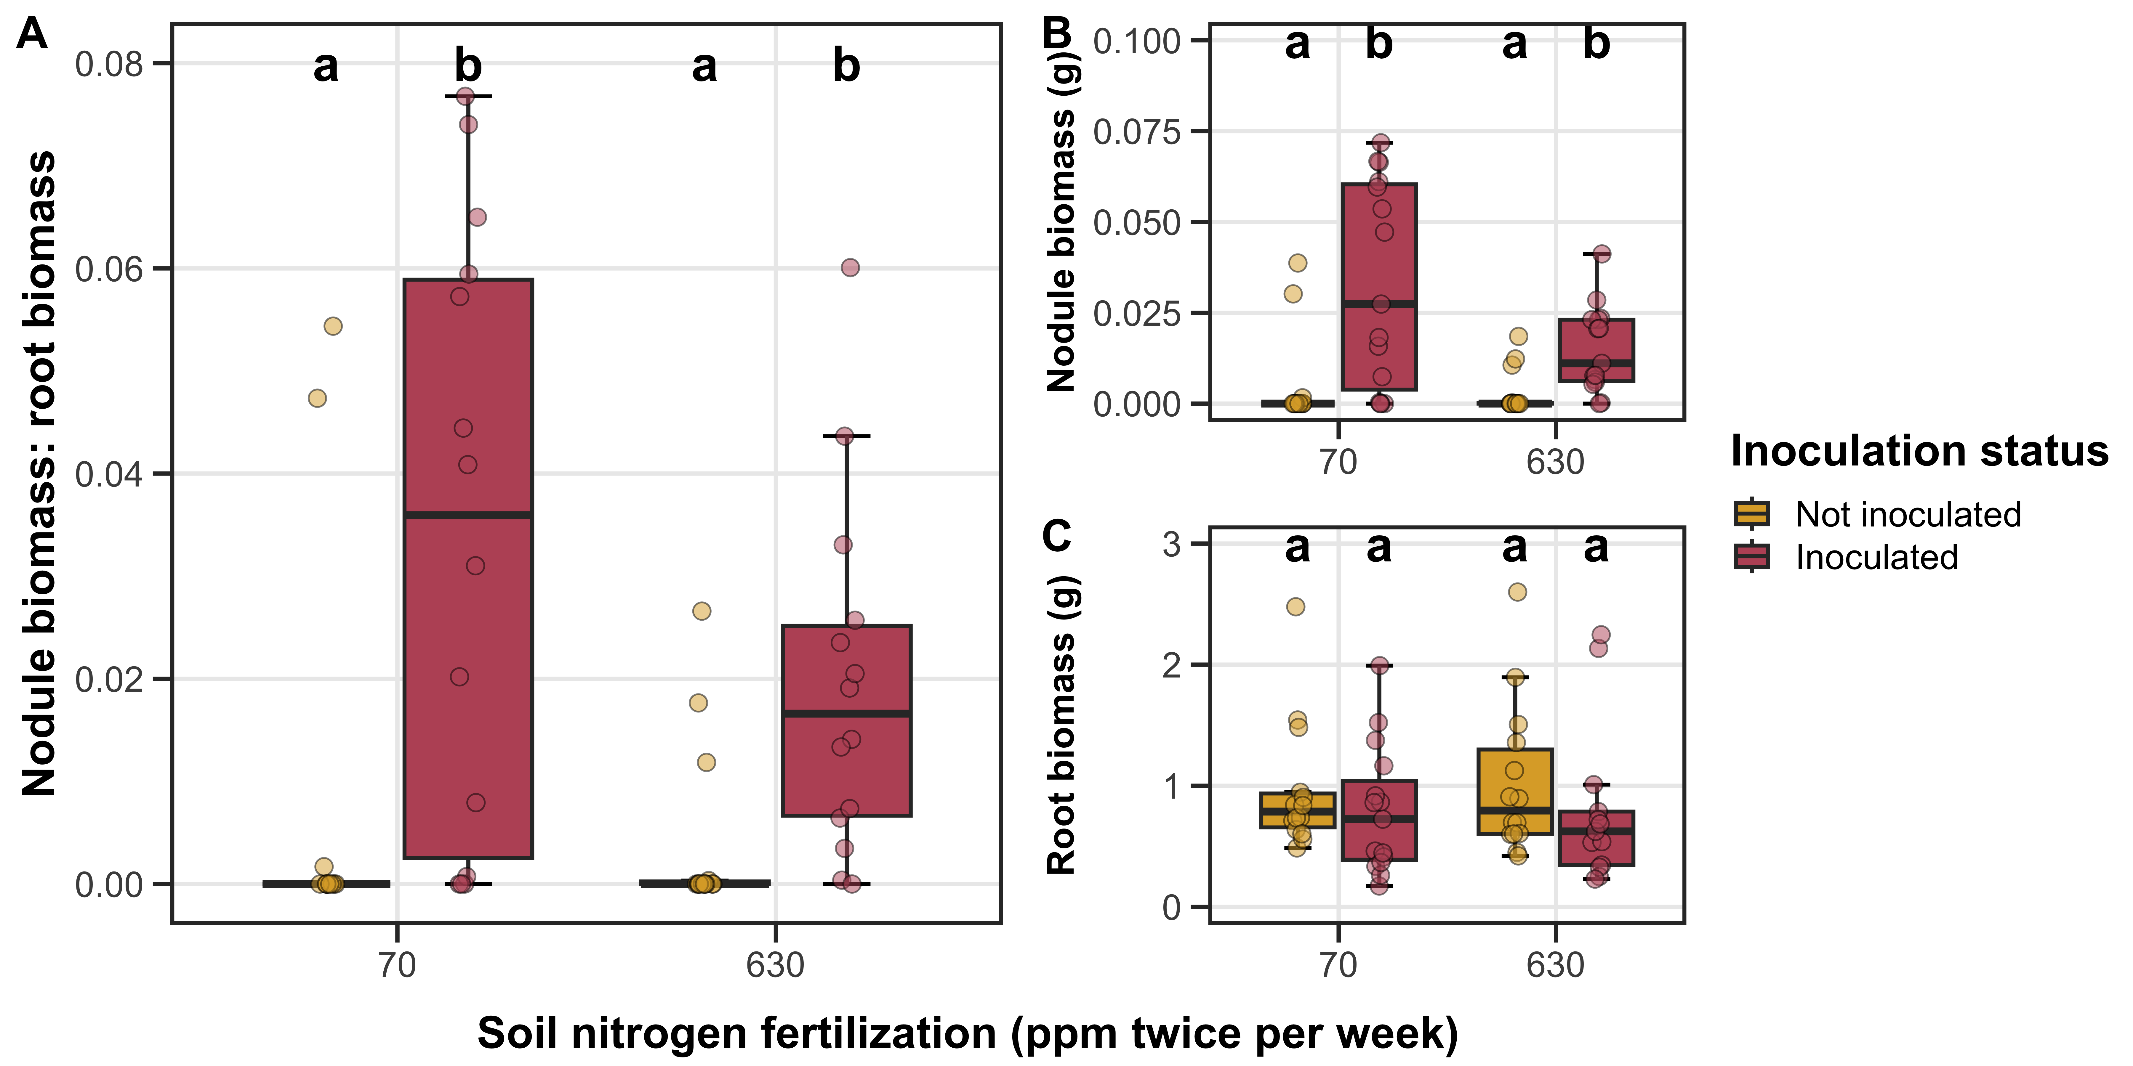
Figure 3. Effects of soil nitrogen fertilization and inoculation on G. max nodule biomass: root biomass (panel A), nodule biomass (panel B), and root biomass (panel C). Soil nitrogen fertilization is represented on the x-axis, while inoculation treatment is represented by colored boxplots. Yellow shaded boxplots indicate individuals that were not inoculated with B. japonicum, while red shaded boxplots indicate individuals that were inoculated with B. japonicum. Boxes are the upper (75% percentile) and lower (25% percentile) quartile. The whiskers are the minimum and maximum value, calculated as 1.5 times the upper and lower quartile value. Colored dots are individual data points, jittered for visibility. The lettering above each box indicates the results from post-hoc Tukey’s tests with different lettering indicating statistically different groups (Tukey: p<0.05).

