Slide 1
Soil nutrients, not inoculation status, drives Glycine max (L.) water and nitrogen economics: implications for including acquisition strategy in least-cost frameworks

Slide 2
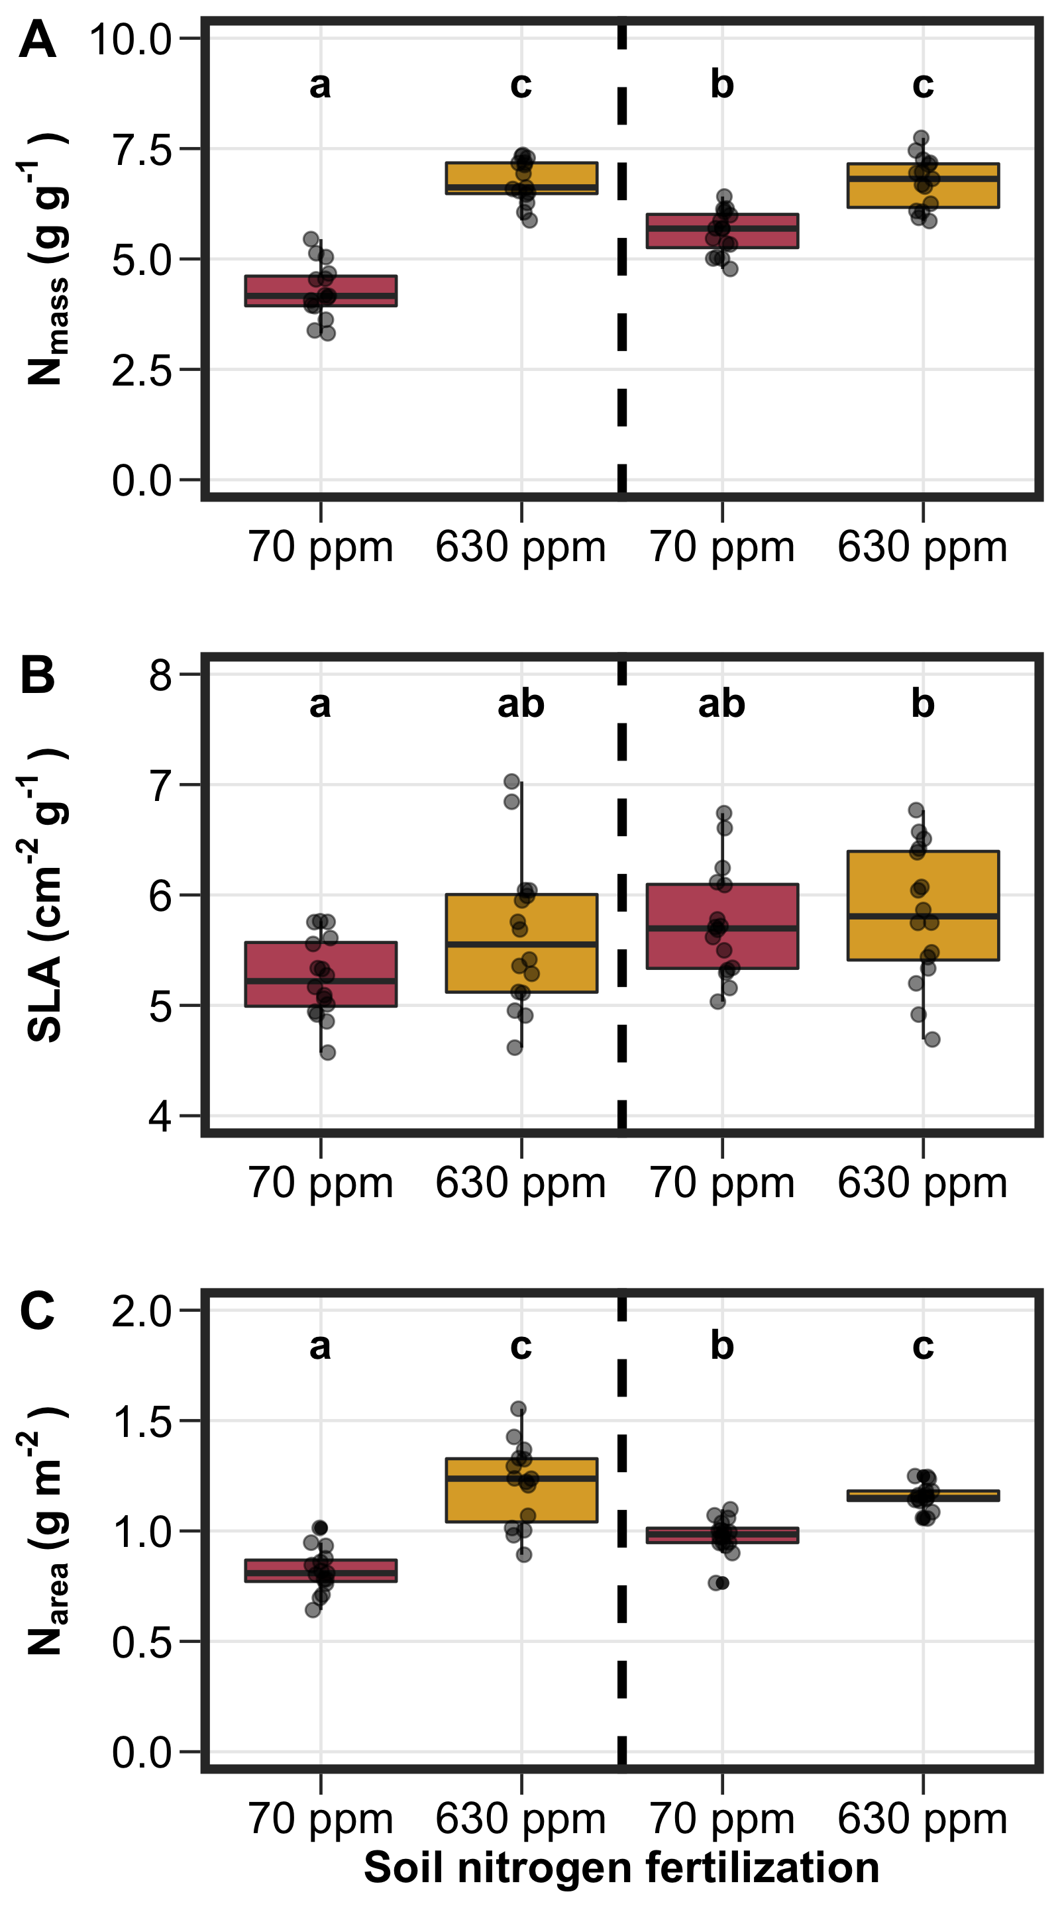
Fig. 1

Slide 3
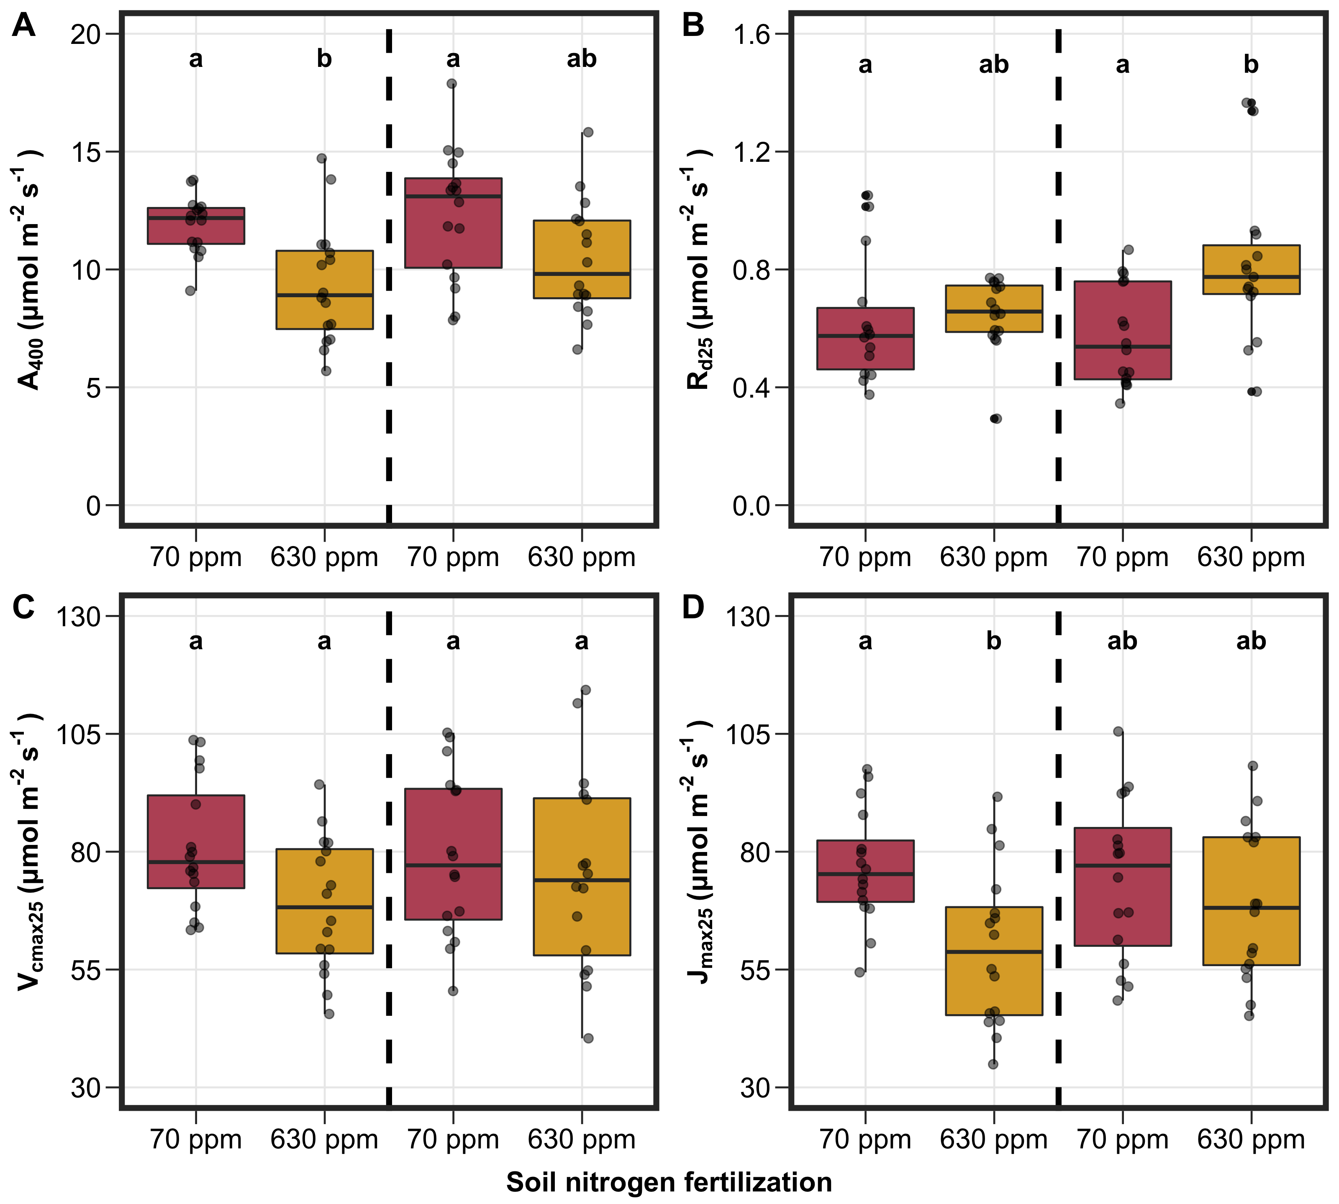
Fig. 2

Slide 4
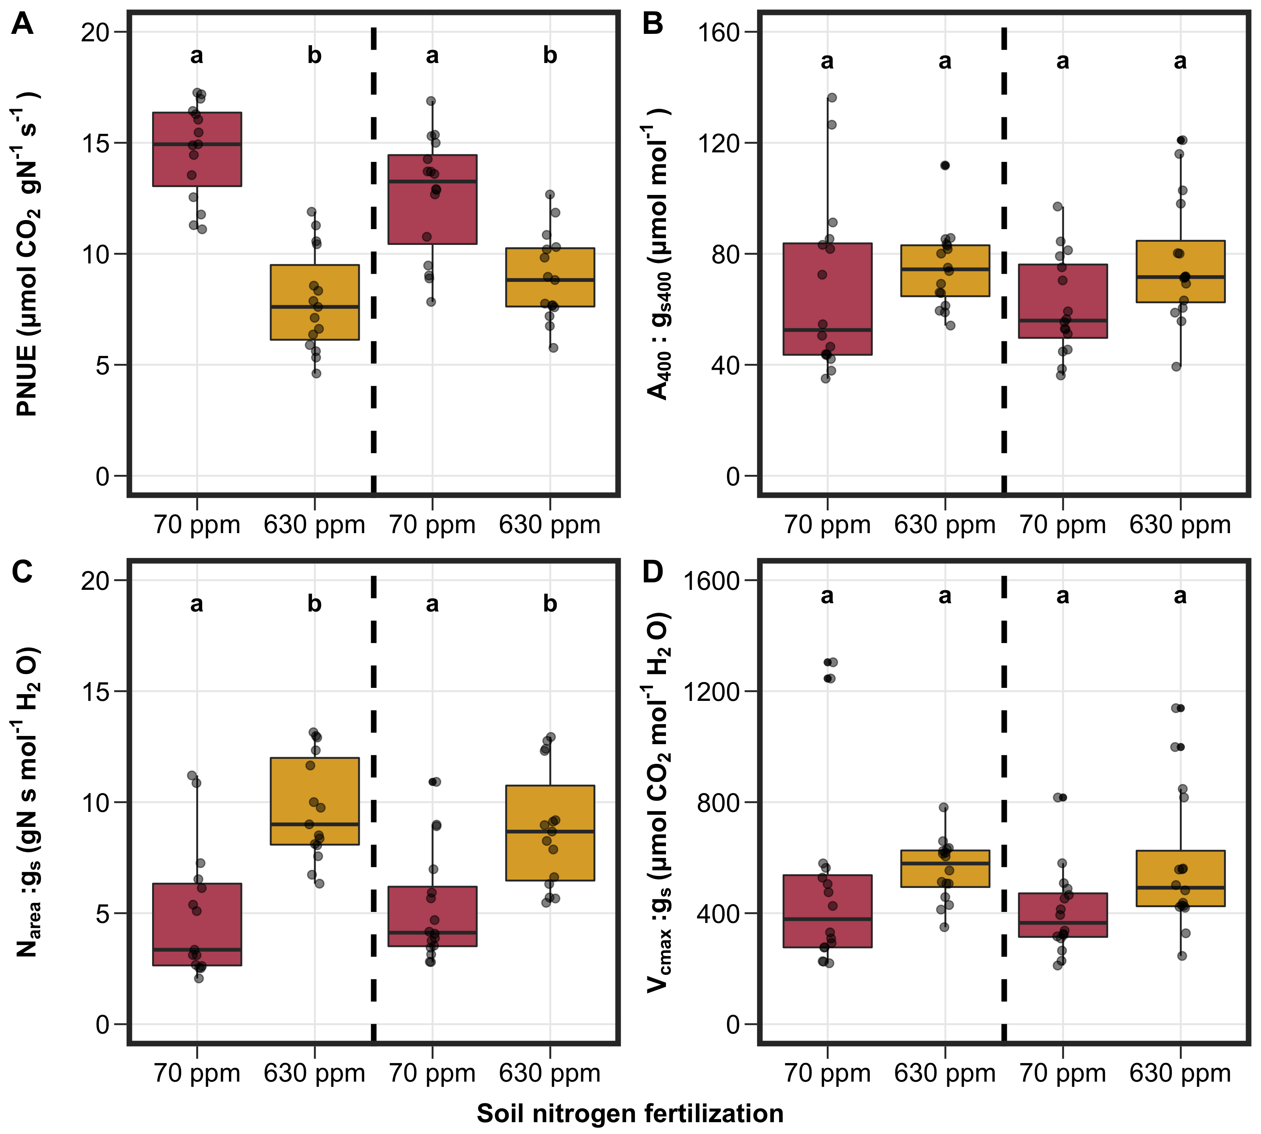
Fig. 3

