Slide 2
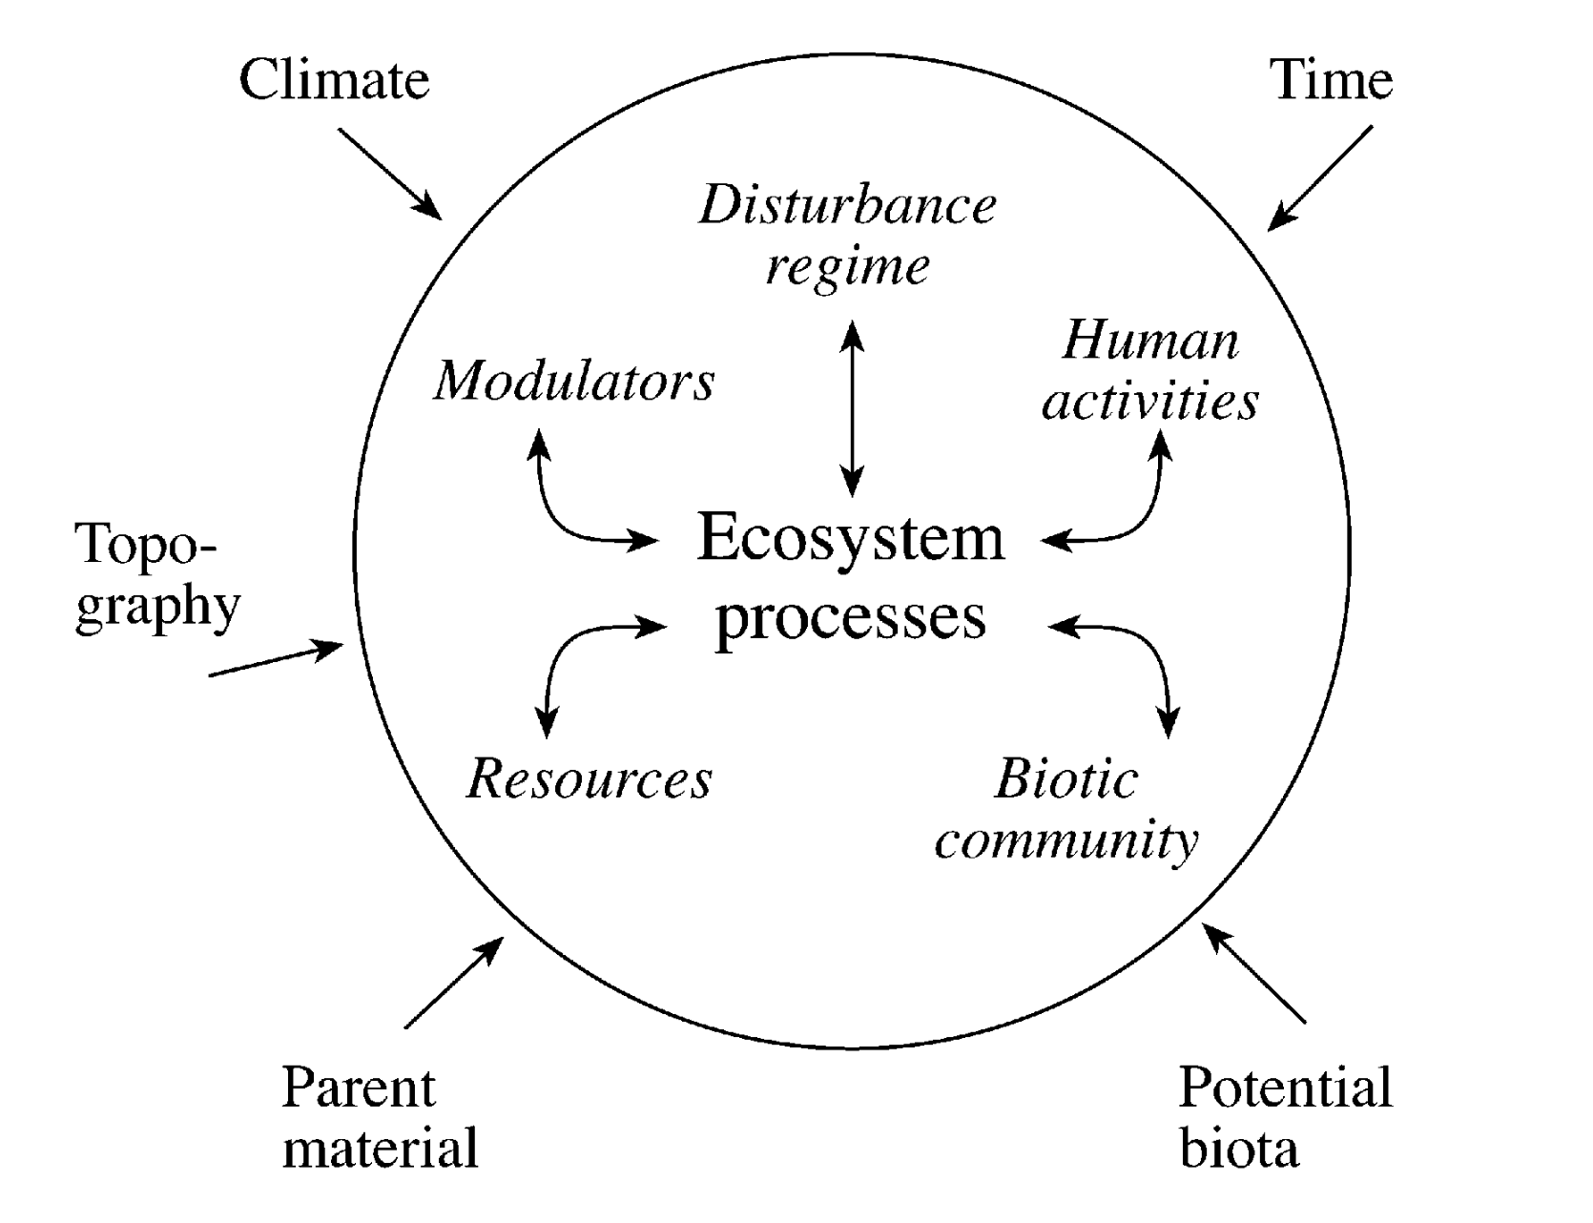
State factors (outside of the circle) govern soil properties and ecosystem processes
But the effects of these state factors on ecosystem processes depend on a few interactive controls (inside of the circle)

