Slide 1
Let’s schedule graduate student discussion leads

Slide 2
Remaining weeks and their topics (pick 2!)
Date | Topic | Lead
February 10 | Water and energy balance
February 17 | Carbon inputs
February 24 | Ecosystem carbon budgets
March 2 | Plant nutrient use and nutrient cycling
March 9 | Species and trophic dynamics
March 23 | Temporal dynamics
March 30 | Landscape heterogeneity and ecosystem dynamics
April 6 | Changes in the Earth system
April 13 | Managing and sustaining ecosystems

Slide 3
Feedbacks of Terrestrial
Ecosystems to Climate
Change
Field CB, Lobell DB, Peters HA, Chiariello NR. 2007. Feedbacks of Terrestrial Ecosystems to Climate Change. Annual Review Environment and Resources 32:1-29.

Slide 4
Feedbacks are often visualized using systems diagrams
Input
Process
Output
Input
+
Process
-
Output
Indirect effects of input on output is the
product of the signs of each step

Slide 5
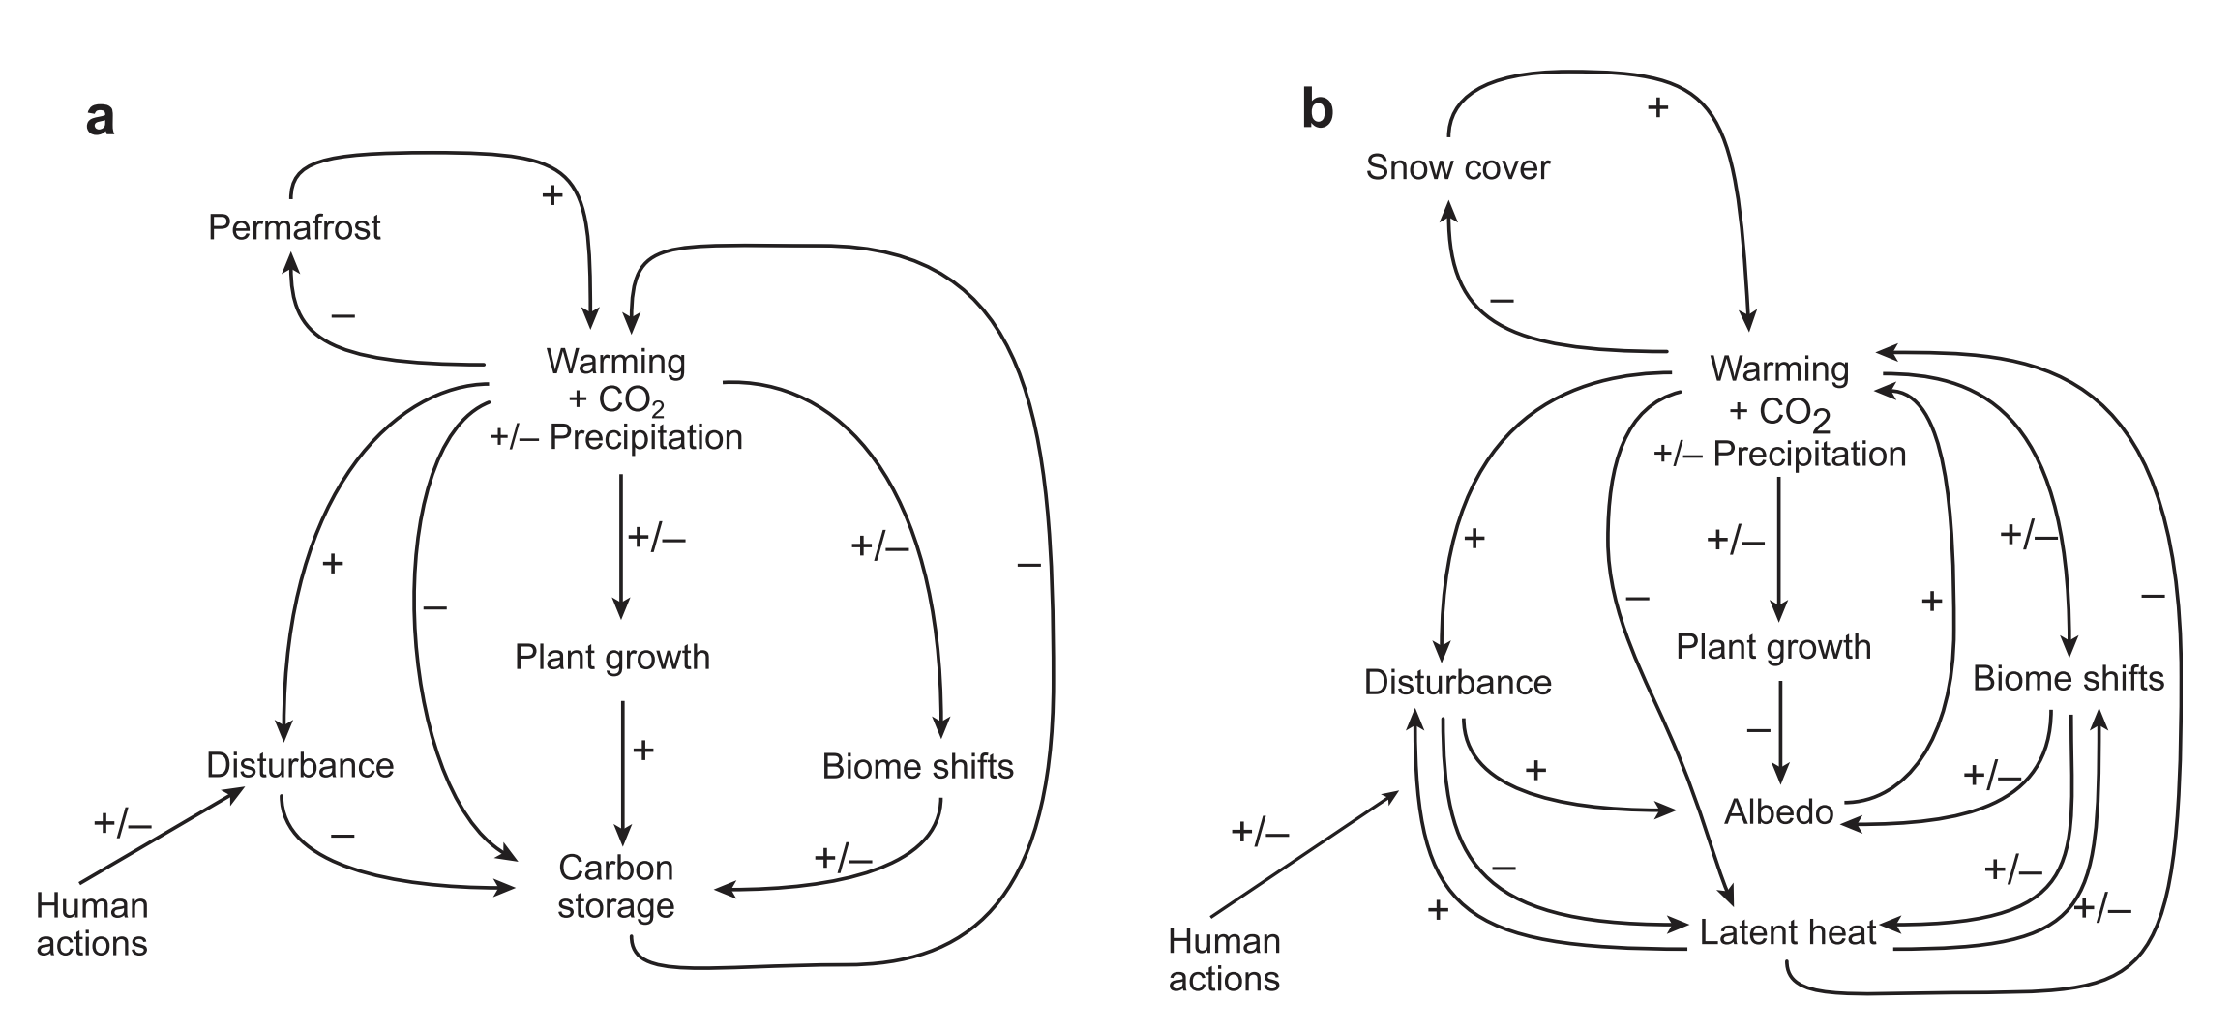
Responses of terrestrial ecosystem feedbacks to climate occur through two mechanisms

Slide 6
Let’s try our hand at system’s diagrams!
Pick an ecosystem.
Create a systems diagram that explains the direct and indirect effects of warming on different ecosystem processes, with indirect effects on ecosystem services of your choosing

Slide 7
Let’s try our hand at system’s diagrams!
Pick an ecosystem.
Create a systems diagram that explains the direct and indirect effects of warming on different ecosystem processes, with indirect effects on ecosystem services of your choosing
Now, add precipitation frequency as an input. Add any additional direct/indirect paths

Slide 8
Turn in sheet
Undergraduate students: please write whether you prefer to work individually or as a group for the literature review
  If working as a group, please define who you are going to be working with
Graduate students: please write which weeks you will be leading a paper discussion

