Slide 1
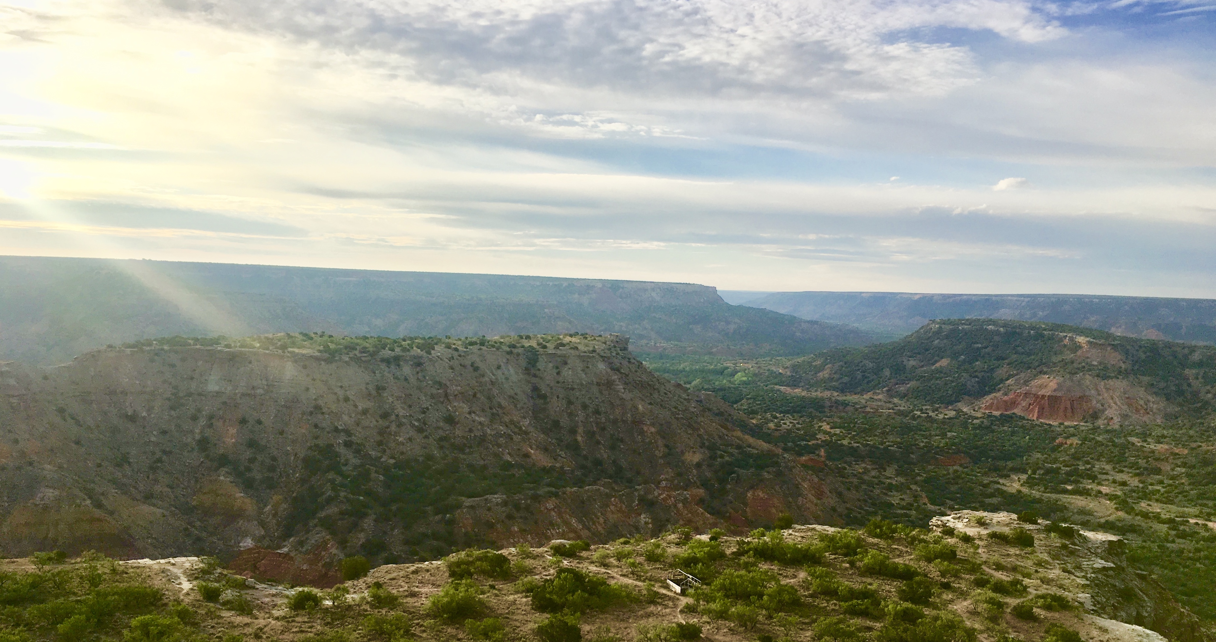
Drivers of plant nutrient acquisition and allocation strategies and their influence on plant responses to environmental change
Evan A. Perkowski
Dissertation Defense
March 07, 2023, 1pm CT ESB1 Room 120
Zoom link:
https://texastech.zoom.us/j/93966902565?pwd=YVZEc0F6dytNY3B1SlNjM1lDVW1VUT09

