Slide 1
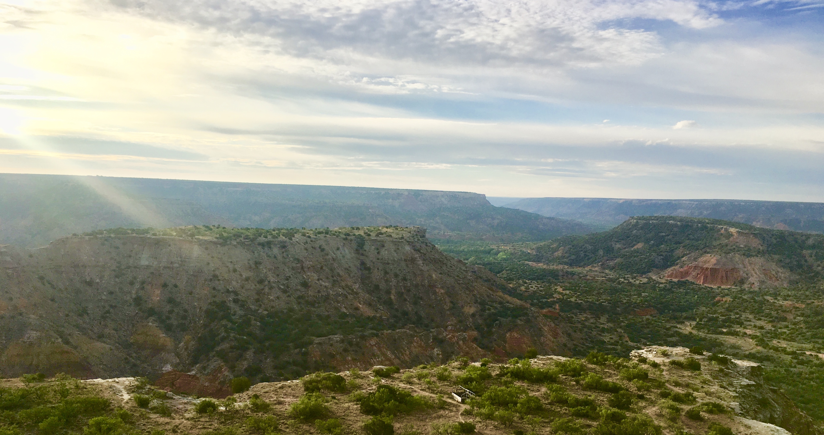
Drivers of plant nutrient acquisition and allocation strategies and their influence on plant responses to environmental change
Evan A. Perkowski
Dissertation Defense
March 07, 2023, 1pm CT ESB1 Room 120
Zoom link:
[fill in here]

Slide 2
Adapted from Fig 5.12 in IPCC (2021)

Slide 3
Photosynthesis represents the largest carbon flux between the atmosphere and land surface
Adapted from Fig 5.12 in IPCC (2021)

Slide 4
Terrestrial biosphere models must accurately simulate photosynthetic processes to predict ecosystem responses to environmental change
Notes:
Thus, accurately simulating photosynthetic processes and their feedbacks to global change is critical toward generating accurate predictions for ecosystem responses and feedbacks to global change.

