Slide 1
Overview of CNP Working Group Goals and Progress
2025 LEMONTREE Annual Meeting
2025.08.26

Slide 2
Main goal: review current evidence and develop a theory for understanding optimal plant responses to P availability

Slide 3
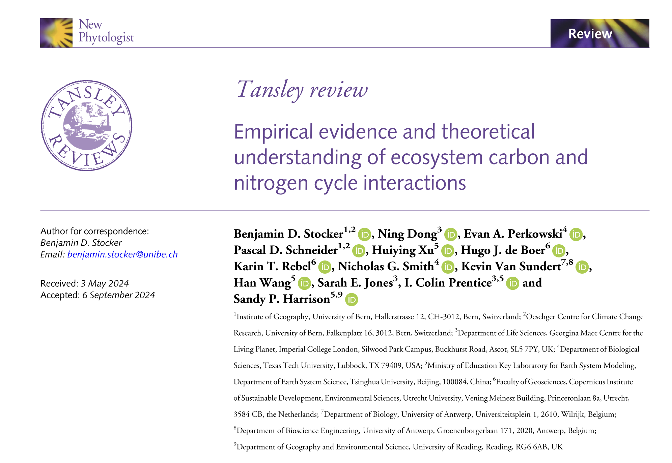

Slide 4
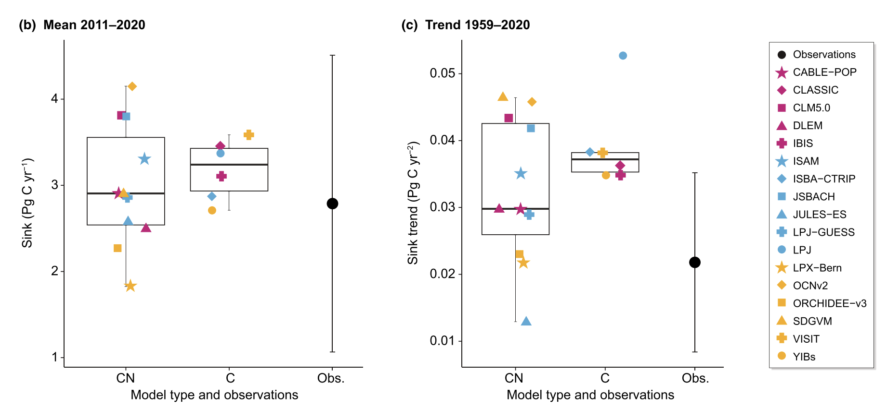
Stocker et al. (2025) New Phytologist

Slide 5
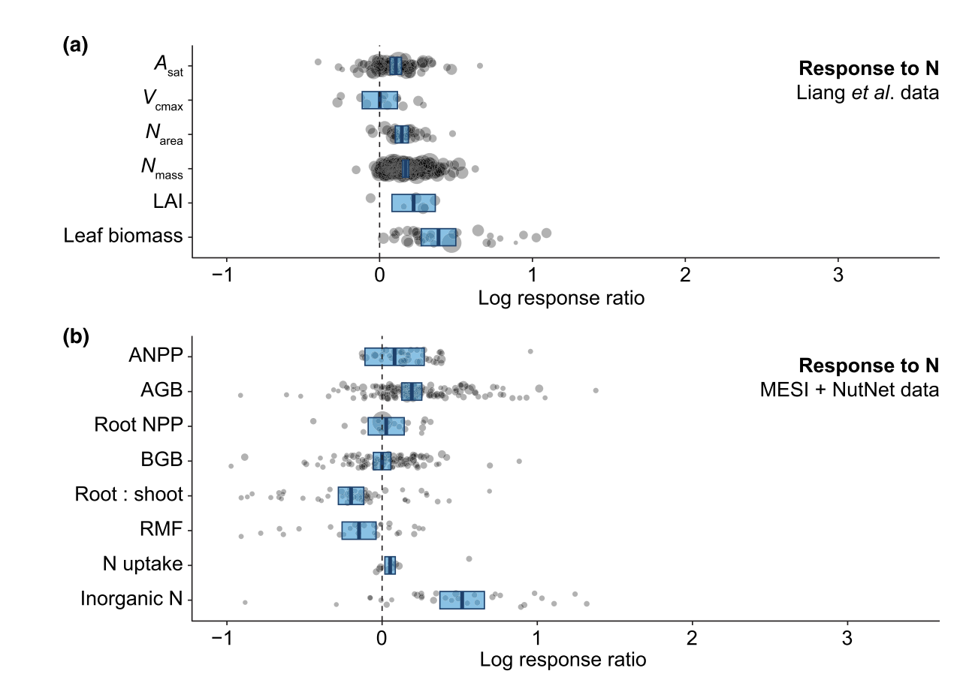
Stocker et al. (2025) New Phytologist

Slide 6
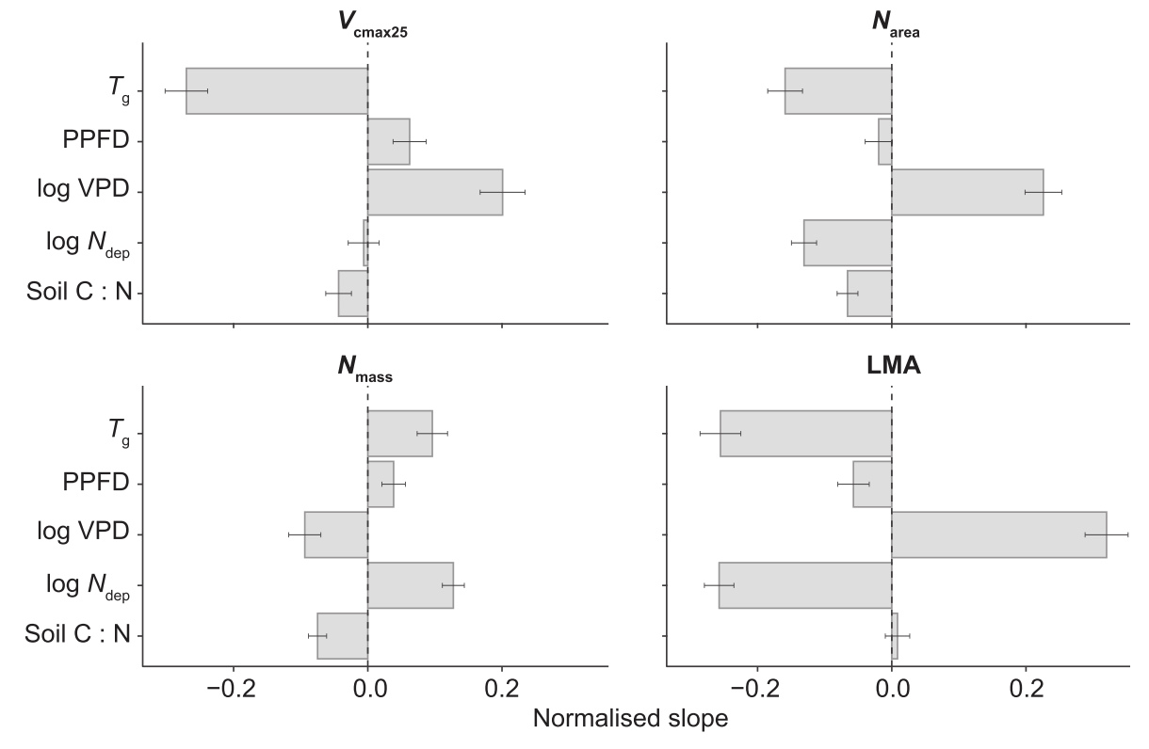
Stocker et al. (2025) New Phytologist

Slide 7
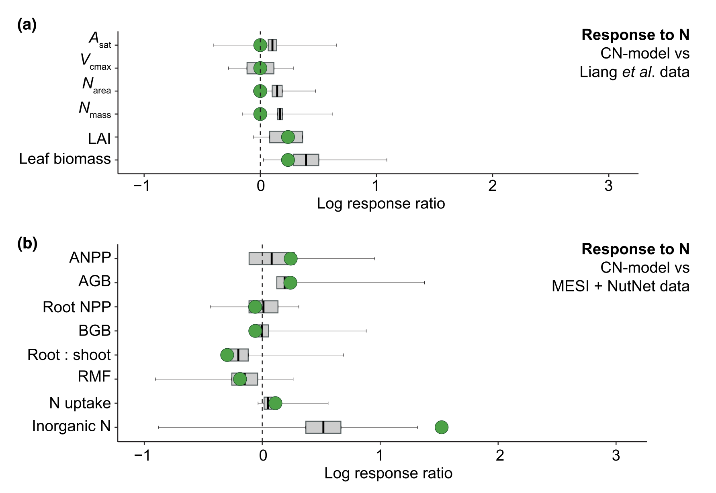
Stocker et al. (2025) New Phytologist

Slide 8
CNP Working Group Progress

Slide 9
CNP Working Group Progress Y4
Task/Working Group Product | Milestone | Proposed Deadline | Notes
6.1 P Cycle Review paper | Report on how phosphorus is currently implemented in models | Dec-24 | Complete, report available
 | Evaluation of simulated C sink trends by models with and without P cycle | Dec-24 | Complete, report available
 | Report on meta-analysis of leaf and whole-plant responses to phosphorus addition | Jan-25 | Complete, report available. Meta-analysis proposed as stand-alone product and review paper display item

Slide 10
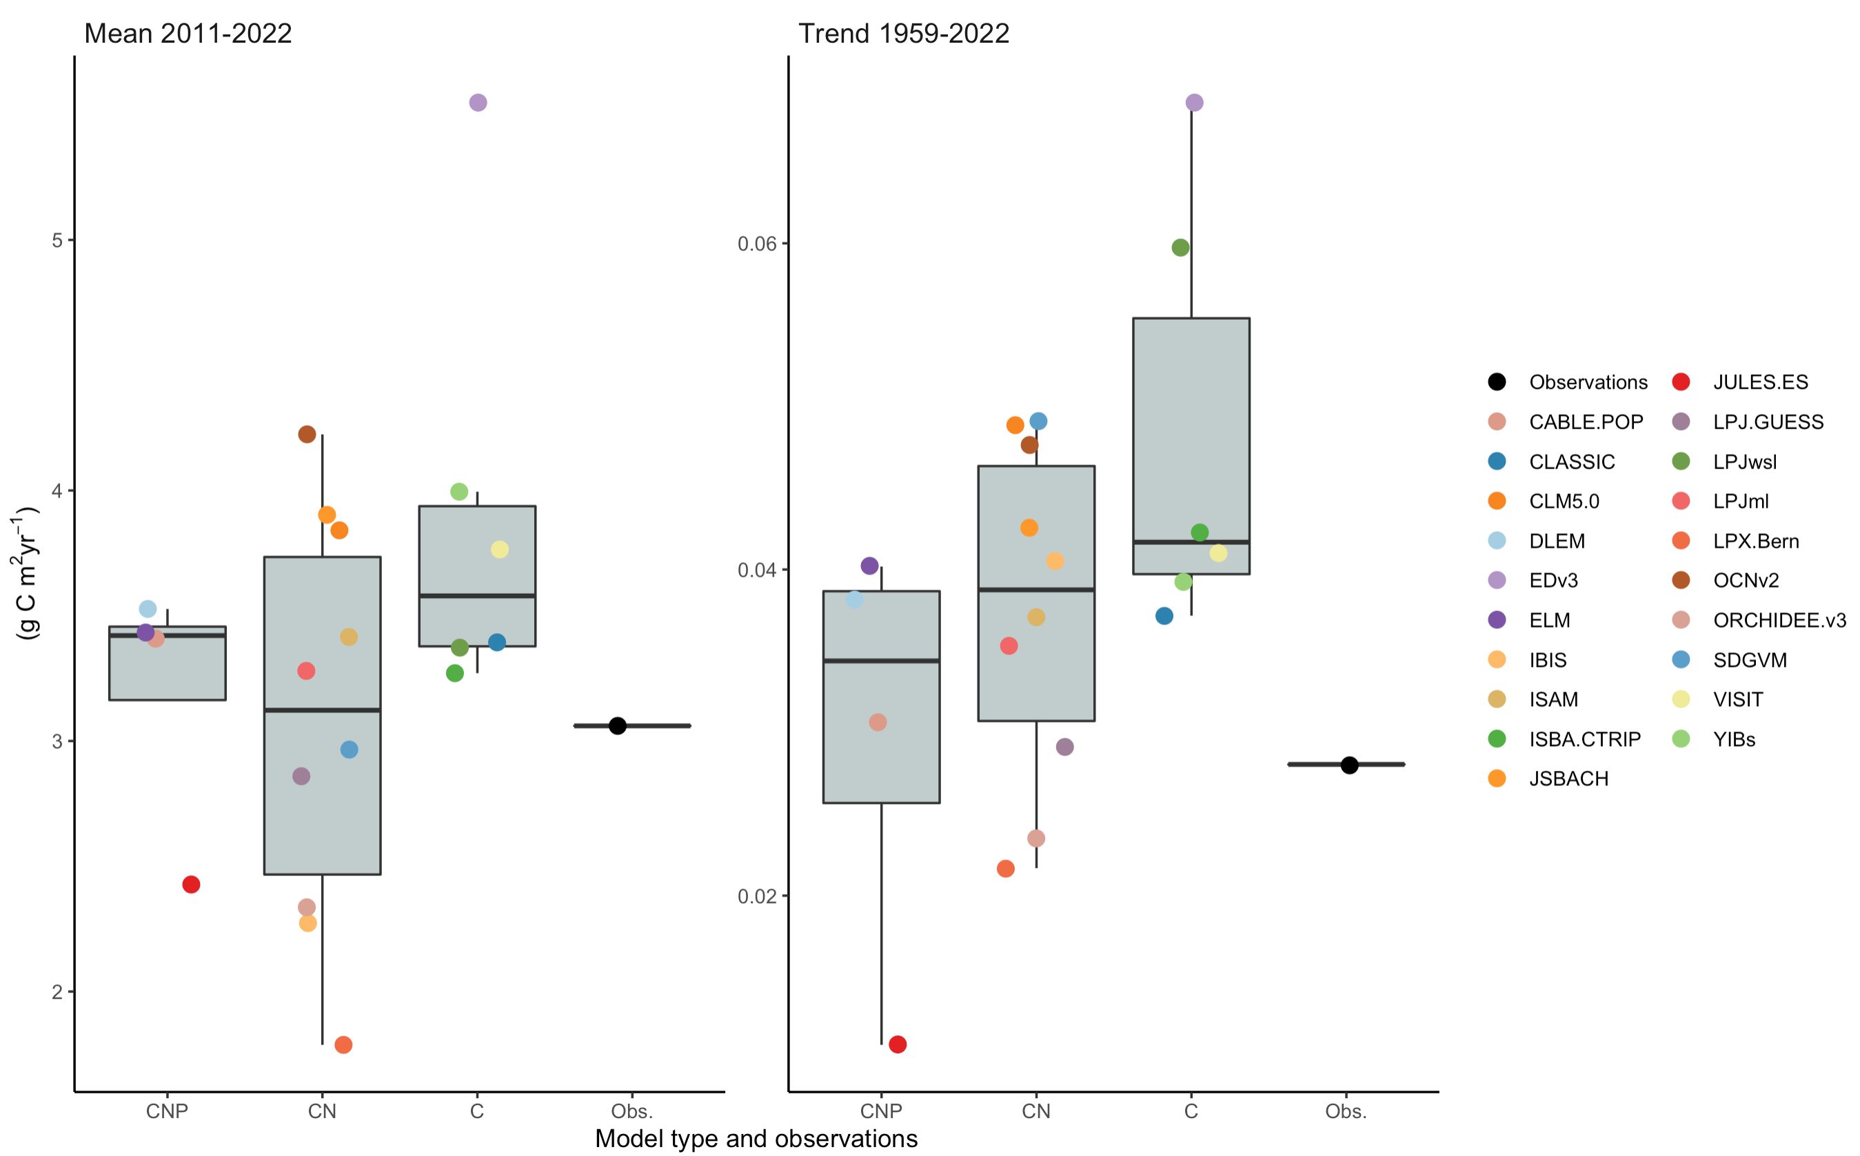
Note: CNP and CN models differ by more than just incorporation of P cycle… next steps are to run model
Experiments changing dose of P to isolate effect of P cycle on these trends

Slide 11
CNP Working Group Outlook Y5
Task/Working Group Product | Milestone | Proposed Deadline | Notes
3.13 N and P controls | Meta-analysis | Dec-25 | Meta analysis paper of N, P, N+P addition effects on leaf and whole-plant traits
3.13 N and P controls | P fractionation | Dec-25 (?) | Analysis of leaf phosphorus fractionation data in response to soil and climate variables
3.13 N and P Controls | Theory development | Dec-25 | Meta analysis and analysis of fractionation data has started discussion on hypothesis generation.
6.2 P Cycle Review Paper | Final manuscript | Dec-25 | Nick Smith and Keith Bloomfield agree to lead effort

Slide 12
