Slide 1
N x CO₂ x BNF growth chamber experiment
LEMONTREE Experimental Working Group – March 01, 2022
Notes:
We know that increasing CO2 generally has a negative impact on stomatal conductance, leaf nutrient allocation, and photosynthetic capacity; and that these patterns often correspond with biomass stimulation over time
Given this, some have suggested that nutrient limitation could be the primary control of photosynthetic responses to increasing CO2, potentially due to progressive nutrient limitation associated with increased whole plant nutrient demand over time.
An alternative hypothesis, based on least-cost theory, suggests that plants respond to increasing CO2 by downregulating nutrient allocation to Rubisco carboxylation, which maximizes resource use efficiency at the leaf level and increases nutrient allocation to whole plant growth

Slide 2
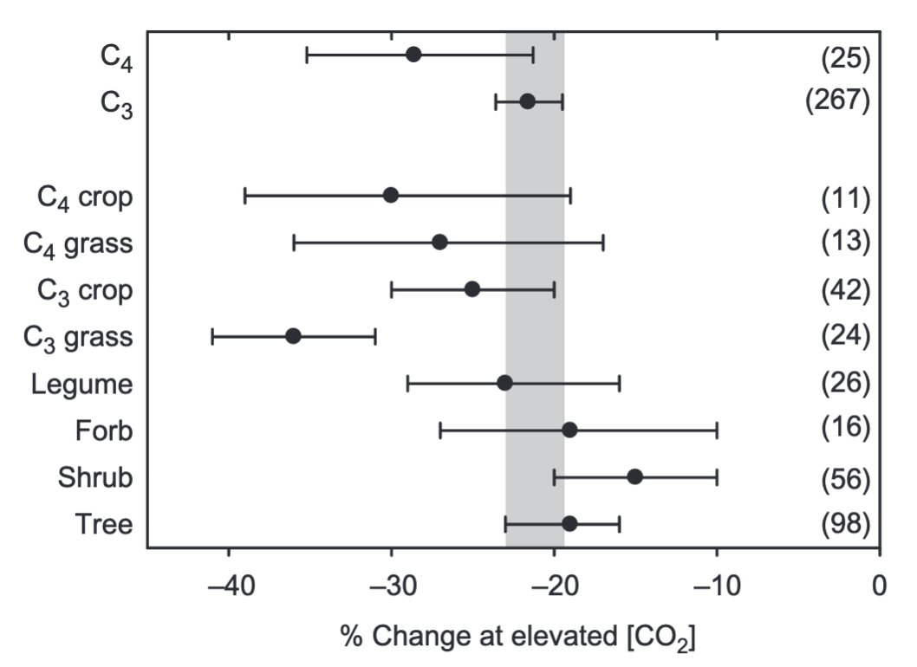
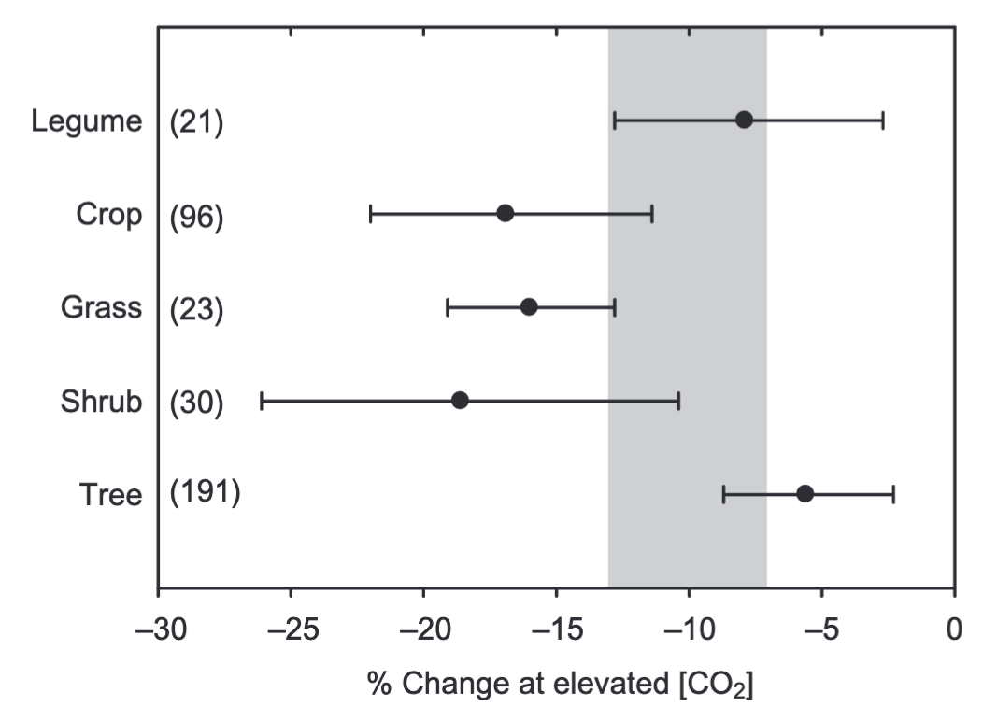
Increasing CO₂ generally decreases stomatal conductance and photosynthetic capacity…
Stomatal conductance
Photosynthetic capacity
Ainsworth & Rogers (2007) Plant, Cell & Environment
Notes:
We know that increasing CO2 generally has a negative impact on stomatal conductance, leaf nutrient allocation, and photosynthetic capacity.
This is a study from Ainsworth and Rogers showing the impacts of increasing CO2 on stomatal conductance in the left panel and photosynthetic capacity in the right panel
You can see that regardless of photosynthetic pathway or plant functional type that increasing CO2 generally decreases stomatal conductance and photosynthetic capacity

Slide 3
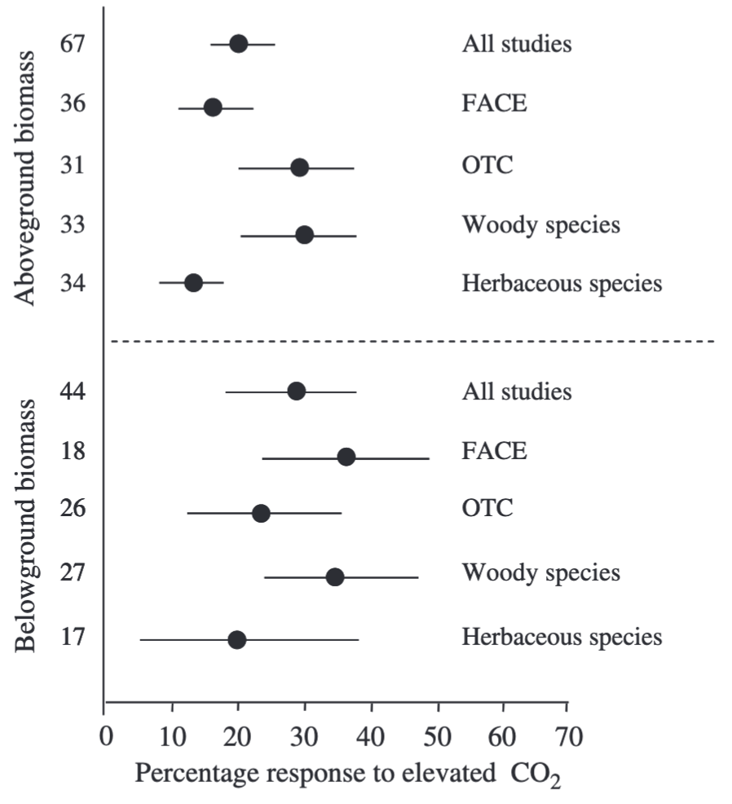
… which tends to correspond with stimulations in whole plant growth
Aboveground biomass
Belowground biomass
de Graaf et al. (2006) Global Change Biology
Notes:
Reductions in stomatal conductance and photosynthetic capacity often correspond with biomass stimulation over time, as indicated from these two plots from de Graaf et al. in (2006), where aboveground and belowground biomass generally increased with increasing CO2.
Given the fact that increasing CO2 stimulates growth, and that growth is commonly limited by nutrient availability, some have suggested that nutrient limitation could be the primary control of photosynthetic responses to increasing CO2.
Previous work points to a progressive nutrient limitation hypothesis, which predicts a reduction in belowground nutrient availability over time with increasing CO2 due to increased whole plant nutrient demand over time.
The progressive nutrient limitation hypothesis indicates an acute stimulation in whole plant growth with increasing CO2, but a gradual reduction in growth over time as nitrogen progressively becomes more limited

Slide 4
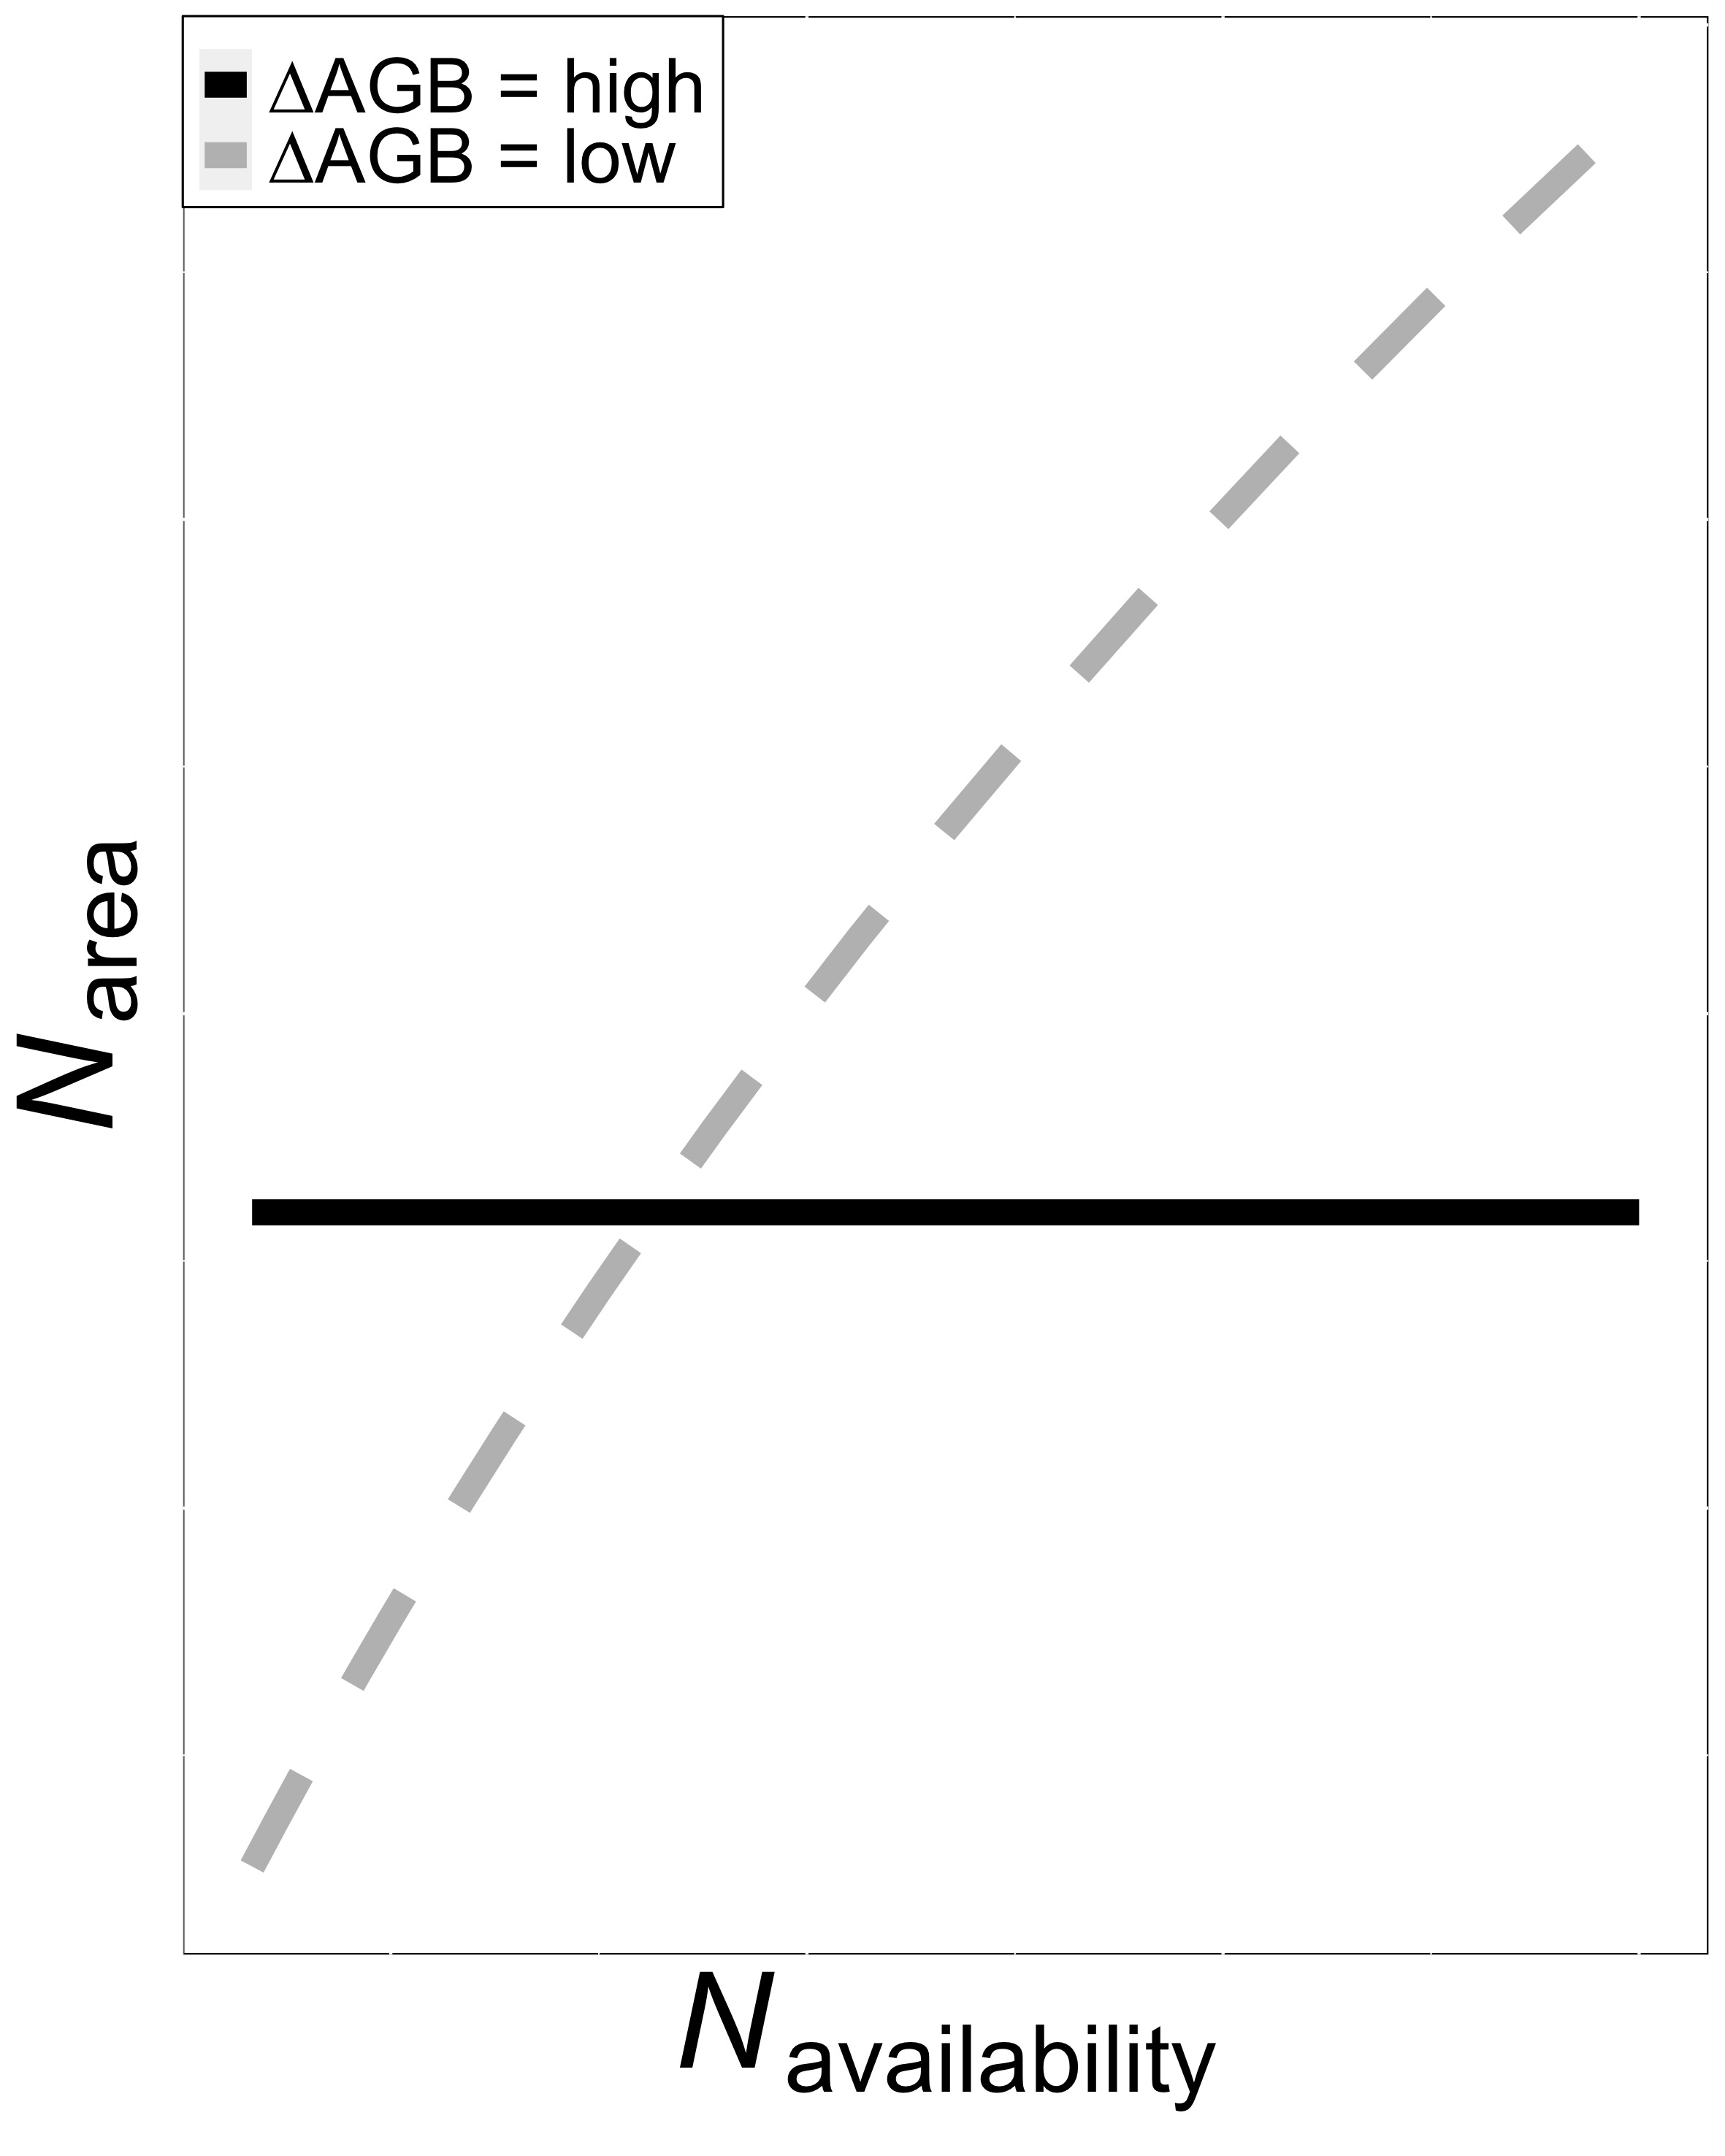
Discrepancies in leaf and whole plant responses to CO₂ may lead to tradeoffs between leaf and whole plant nutrient allocation
Smith et al. (in prep)
Notes:
Discrepancies between leaf and whole plant responses to increasing CO2 could indicate possible tradeoffs between leaf and whole plant nutrient allocation
This is a figure from a paper that Nick is working on that I think highlights tradeoffs between leaf and whole plant nutrient allocation quite nicely.
Soil nitrogen availability is on the x-axis and leaf nitrogen allocation is on the y-axis.
The colored lines indicate whether soil nitrogen availability is causing a large or small change in aboveground biomass.
When soil nitrogen availability causes a large change in aboveground biomass, there are limited effects of soil nitrogen availability on leaf nitrogen allocation.
Large shifts in aboveground biomass due to soil nitrogen availability are likely driven by increases in whole plant nutrient demand, potentially due to nutrient limitation or increases in CO2 or temperature
Alternatively, when soil nutrients have little or no effect on whole plant growth, then we expect strong stimulations in leaf nutrient allocation.
This could be driven by reductions in water availability relative to water or high leaf nutrient demand associated with increases in temperature or light availability
In response to increasing CO2, we expect that increasing soil nutrient availability will increase nutrient investments toward whole plant growth, potentially at the expense of leaf nutrient allocation

Slide 5
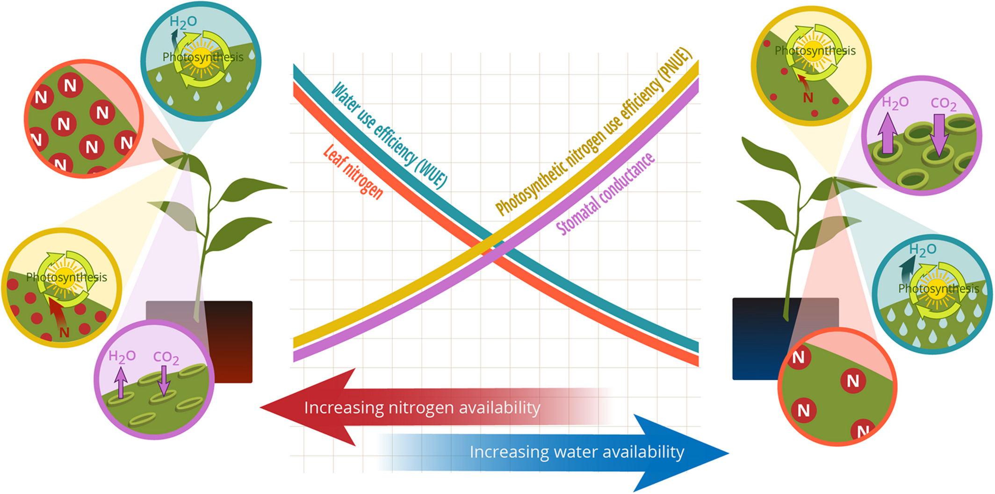
Maintain photosynthesis with greater water use efficiency at expense of nitrogen use efficiency, or vice versa
Bialic-Murphy et al. (2021) Ecology Letters
Notes:
While some have reasoned that these leaf and whole plant responses may be due to progressive nutrient limitation, an alternative hypothesis based on least cost theory suggests that leaf and whole plant responses to increasing CO2 may be driven by tradeoffs between nitrogen and water use at the individual leaf level.
The theory suggests that plants can maintain leaf level photosynthesis by shifting leaf nitrogen allocation and stomatal conductance such that unit costs of using nitrogen and water are minimized.
As a result, there are a few possible explanations for how plants might respond to increasing CO2 at the leaf level
First, if plants directly decrease stomatal conductance in response to increasing CO2, then plants might increase leaf nutrient allocation to induce some sort of water-savings mechanism.
We would also expect these patterns to increase with soil nutrient availability or acquisition strategy that minimizes costs of acquiring soil resources
However, if plants directly downregulate photosynthetic capacity in response to increasing CO2, then plants might increase their stomatal conductance, leading to a reduction in leaf nutrient allocation and water-use efficiency, but a stimulation in nitrogen-use efficiency

Slide 6

Maintain photosynthesis with greater water use efficiency at expense of nitrogen use efficiency, or vice versa
Bialic-Murphy et al. (2021) Ecology Letters
Notes:
We’re currently not sure whether plant acclimation responses to increasing CO2 are driven by stomatal conductance or photosynthetic biochemical responses to CO2, or if these patterns are a product of interactions between stomatal and biochemical responses to CO2.
We also are not sure how soil nutrient availability or acquisition strategy modifies these patterns, or how tradeoffs between leaf and whole plant allocation further modify these patterns.
There have been a few studies that have pointed to mechanisms that drive whole plant or leaf level responses to increasing CO2, soil nutrients, and acquisition strategy, but no studies come to mind that investigate these patterns through an integrated leaf and whole plant trait approach

Slide 7
Key questions
How does atmospheric CO₂ modify effects of soil nutrient availability on tradeoffs between leaf nutrient allocation and whole plant growth?

Slide 8
Key questions
How does atmospheric CO₂ modify effects of soil nutrient availability on tradeoffs between leaf nutrient allocation and whole plant growth?
How does atmospheric CO₂ modify effects of soil nutrient availability on tradeoffs between nutrient and water use?

Slide 9
Key questions
How does atmospheric CO₂ modify effects of soil nutrient availability on tradeoffs between leaf nutrient allocation and whole plant growth?
How does atmospheric CO₂ modify effects of soil nutrient availability on tradeoffs between nutrient and water use?
To what extent does inoculation with nitrogen-fixing bacteria influence the two questions listed above?

Slide 10
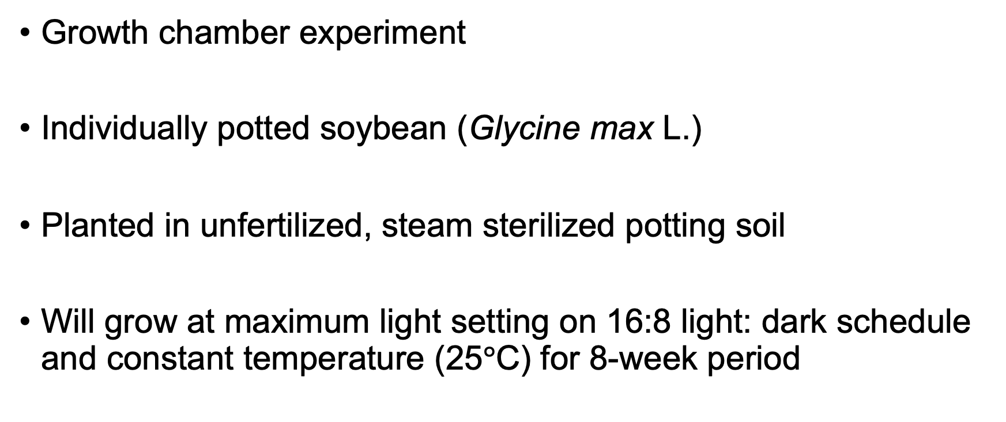
Experimental setup
Growth chamber experiment
Individually potted soybean (Glycine max L.)
Planted in unfertilized, steam sterilized potting soil
Will grow at maximum light setting on 16:8 light: dark schedule and constant temperature (25$°$C) for 8-week period
Notes:
Steam sterilized potting soil seemed to work well from Joseph’s experiment

Slide 11
Experimental setup
Nutrient acquisition strategy treatments
Soil nitrogen treatments
Atmospheric carbon dioxide treatments
0 ppm N
70 ppm N
+ BNF
400 ppm CO₂
140 ppm N
210 ppm N
- BNF
1000 ppm CO₂
280 ppm N
350 ppm N
All treatments will be combined in a full-factorial design with 6 reps per treatment combination (n = 144 total)

Slide 12
Plant measurements
Leaf measurements
Whole plant measurements
Carbon costs to acquire nitrogen (Root carbon mass / whole plant nitrogen mass)
Whole plant biomass
Total leaf area
Root nodule number, root nodule biomass
Leaf nitrogen allocation (N_{mass}; SLA; N_{area})
A_{net}, V_{cmax25}, J_{max25}, g_{s,} R_{d25}
J_{max25}:V_{cmax25}; R_{d25}:V_{cmax25}; stomatal limitation
PNUE, χ (from leaf δ¹³C), N_{area}:g_{s}, V_{cmax}:g_{s}

Slide 13
Timeline for Experiment 4
Start experiment in March/April 2022; end in May/June 2022
Harvest and tissue processing finished by August 2022
Data analysis finished by September 2022
Could perhaps lead a working group meeting on results

Slide 14
Extra slides

Slide 15
Hypothesis 1a: Increasing CO₂ should increase leaf production and whole plant growth through a stimulation in whole plant nutrient demand
CO₂
Whole plant nutrient demand
Belowground carbon allocation
Whole plant nutrient acquisition
Leaf production
Whole plant growth
Positive effect
Negative effect
Notes:
Increasing CO2 should increase whole plant demand to acquire nutrients that support growth
This should increase belowground carbon allocation for plants to acquire soil resources either through direct uptake or through symbioses with nitrogen-fixing bacteria or mycorrhizal fungi
Regardless of nutrient acquisition strategy, increasing belowground carbon allocation should have a positive effect on whole plant nutrient acquisition
This should cause plants to invest nitrogen toward leaf production to take full advantage of increased CO2 concentration, resulting in a stimulation of whole plant growth

Slide 16
Hypothesis 1a: Increasing CO₂ should increase leaf production and whole plant growth through a stimulation in whole plant nutrient demand
BNF
CO₂
Whole plant nutrient demand
Belowground carbon allocation
Whole plant nutrient acquisition
Leaf production
Whole plant growth
Positive effect
Negative effect
Notes:
In species who form associations with nitrogen-fixing bacteria, root nodulation should increase with increasing CO2 due to increased belowground carbon allocation.
This should increase the positive effect of increasing CO2 on leaf production and whole plant growth, particularly in low soil nutrient environments
I do expect the impacts of BNF in modifying effects of CO2 on leaf production and whole plant growth to be dependent on soil nutrient availability, which we will get to in a second

Slide 17
Hypothesis 1b: Increased soil nutrient supply should increase the positive effect of eCO₂ on leaf production and whole plant growth, but will depend on whether individuals associate with nitrogen-fixing bacteria
CO₂
Whole plant nutrient demand
Belowground carbon allocation
Whole plant nutrient acquisition
Leaf production
Soil nutrient availability
Whole plant growth
Positive effect
Negative effect
Notes:
But first, in isolation of BNF inoculation status, increasing soil nutrient availability should increase whole plant nutrient acquisition, but should also decrease belowground carbon allocation.
This should result in an increase in per-root nutrient uptake, reducing whole plant carbon costs to acquire nitrogen and increasing whole plant nutrient acquisition.
Therefore, increasing soil nutrient availability should increase the positive impact of CO2 on leaf production and growth.
However, reductions in belowground carbon allocation with increasing soil nutrient availability will likely decrease reliance on microbial symbionts with increasing soil nutrient availability.

Slide 18
Hypothesis 1b: Increased soil nutrient supply should increase the positive effect of eCO₂ on leaf production and whole plant growth, but will depend on whether individuals associate with nitrogen-fixing bacteria
BNF
CO₂
Whole plant nutrient demand
Belowground carbon allocation
Whole plant nutrient acquisition
Leaf production
Soil nutrient availability
Whole plant growth
Positive effect
Negative effect
Notes:
As a result of this, soil nutrient availability should should indirectly decrease root nodulation and reliance on nitrogen-fixing bacteria for nitrogen.
This should cause individuals inoculated with nitrogen-fixing bacteria to shift their primary mode of nitrogen acquisition away from nitrogen fixation and toward direct uptake with increasing soil nutrient availability.
I therefore expect that inoculation with BNF will increase the positive effect of increasing CO2 on leaf production and growth, but only under low soil nutrient conditions.
However, impacts of inoculation with BNF will decrease with increasing soil nutrient availability, as inoculated individuals will shift their dominant mode of nutrient acquisition away from nitrogen fixation and toward direct uptake

Slide 19
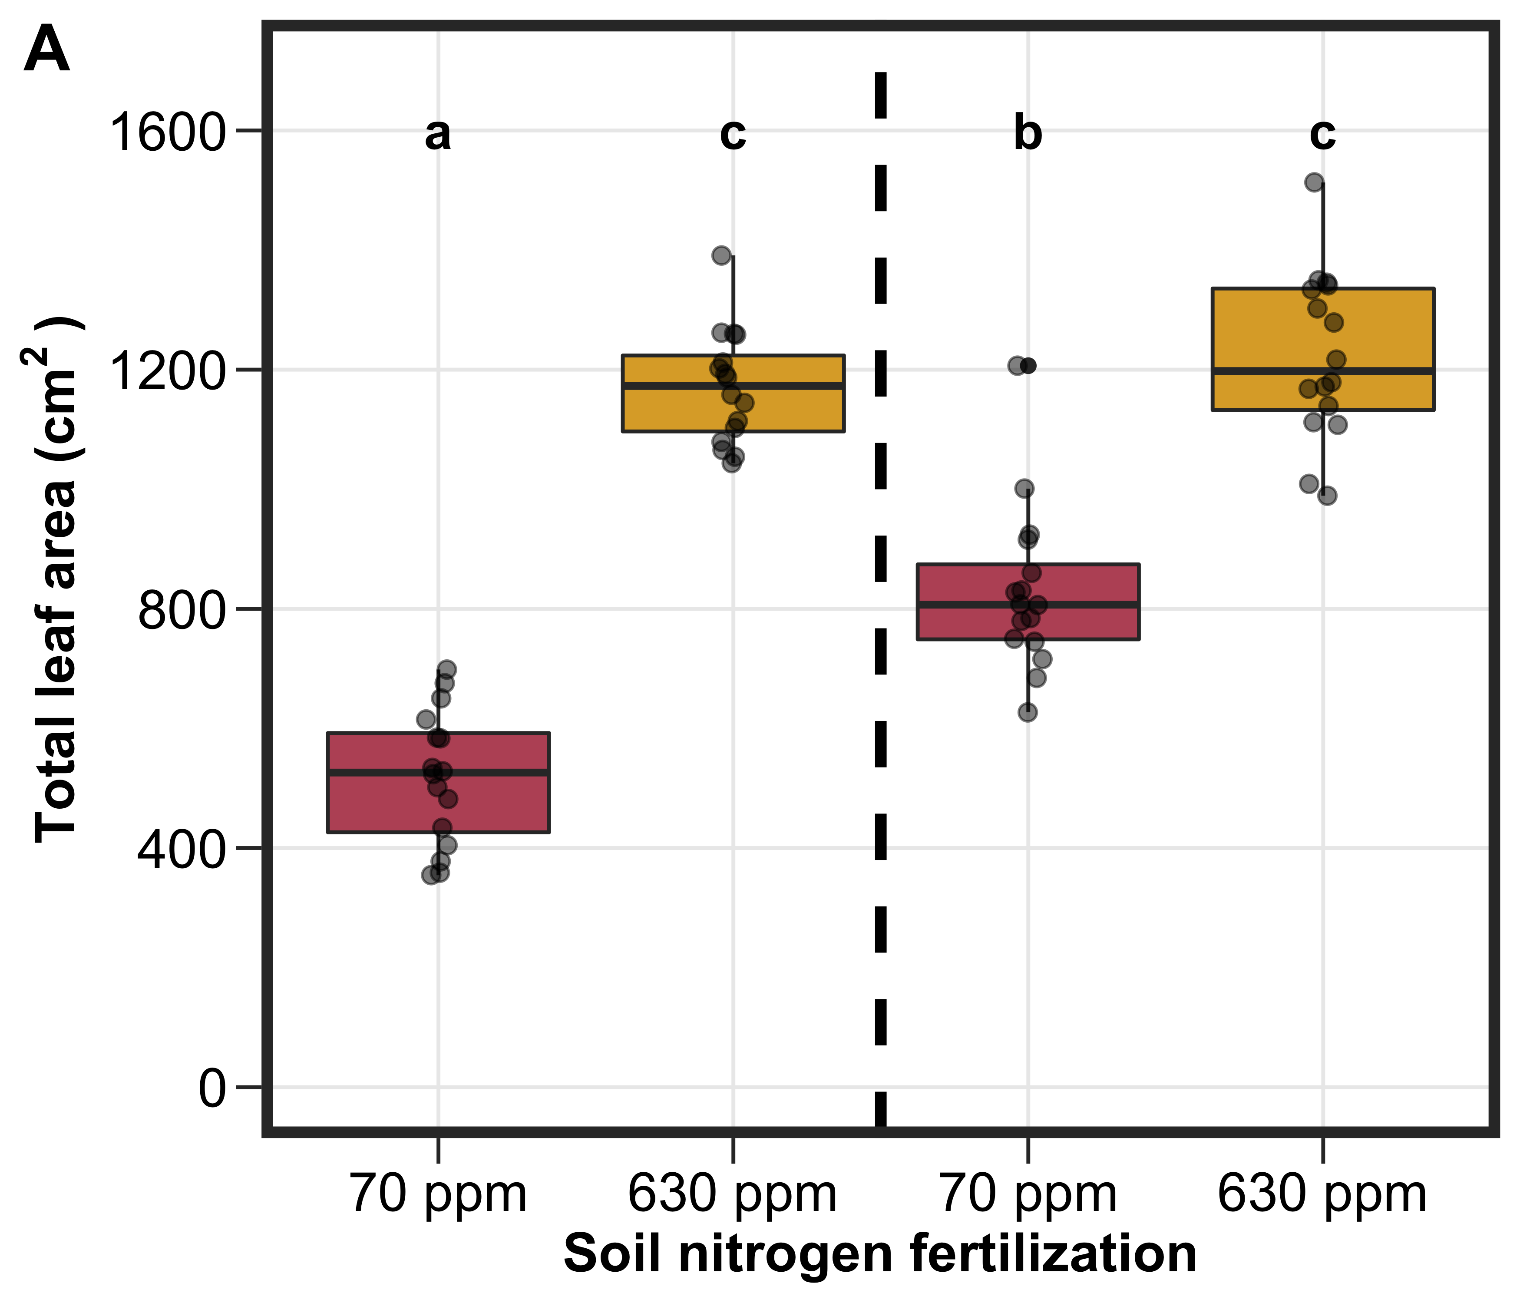
Hypothesis 1b: Increased soil nutrient supply should increase the positive effect of eCO₂ on leaf production and whole plant growth, but will depend on whether individuals associate with nitrogen-fixing bacteria
Inoculation with BNF should increase total leaf area and growth under low soil nutrients, but have similar total leaf area and growth under high soil nutrients
Not inoculated
Inoculated
Notes:
Some data from a recent experiment in our lab supports the interactive role of soil nutrients and inoculation status on leaf production.
This was a greenhouse experiment from one of our undergraduate researchers where soybean was grown under two levels of soil nitrogen and either inoculated or not inoculated with nitrogen-fixing bacteria.
On the x-axis is the two soil nutrient levels and on the y-axis is total leaf area.
The two boxplots to the left of the vertical dashed line indicate individuals that were not inoculated with BNF, while the boxplots to the right of the vertical dashed line indicate those that were inoculated with BNF
As you can see, inoculation with BNF increased total leaf area under the low soil nitrogen treatment, but had similar total leaf area under the two high soil nutrients
This was likely driven by a shift in the dominant mode of nutrient acquisition from nitrogen fixation to direct uptake, but confirmation of this is ongoing.

Slide 20
Hypothesis 2
Soil nutrient availability
BNF
CO₂
Leaf nutrient demand to maintain photosynthetic capacity
Leaf nutrient allocation
Photosynthetic capacity
Stomatal conductance
Leaf-level photosynthesis
Nutrient use efficiency
Water use efficiency
Positive effect
Negative effect
Notes:
Moving on to the leaf level, this is the general schematic explaining how I might expect increasing CO2, soil nutrient availability, and inoculation status to modify leaf photosynthesis, leaf nutrient allocation, and tradeoffs between nutrient and water use
It is a bit complex, which might be important in how I shape the post-experiment statistics, but I am going to make this a bit simpler by breaking it down into a few smaller hypotheses

Slide 21
Hypothesis 2a: Increasing CO₂ will have a direct positive effect on leaf-level photosynthesis due to increased substrate needed to drive photosynthesis forward
Soil nutrient availability
BNF
CO₂
Leaf nutrient demand to maintain photosynthetic capacity
Leaf nutrient allocation
Photosynthetic capacity
Stomatal conductance
Leaf-level photosynthesis
Nutrient use efficiency
Water use efficiency
Positive effect
Negative effect
Notes:
The first hypothesis is that increasing CO2 will have a direct positive effect on leaf photosynthesis.
This would be presumably driven by increased substrate availability needed to drive photosynthetic reactions forward, or a reduction in photorespiration in C3 species due to increased [CO2] relative to [O2]
This hypothesis indicates that soil nutrient availability and BNF will not necessarily have any effect on leaf photosynthesis
Photorespiration = Rubisco oxidizes oxygen, causing a waste in Rubisco resources away from CO2 carboxylation

Slide 22
Hypothesis 2b: Increasing CO₂ will decrease leaf-level photosynthesis as a function of reduced stomatal conductance
Soil nutrient availability
BNF
CO₂
Leaf nutrient demand to maintain photosynthetic capacity
Leaf nutrient allocation
Photosynthetic capacity
Stomatal conductance
Leaf-level photosynthesis
Nutrient use efficiency
Water use efficiency
Positive effect
Negative effect
Notes:
The second hypothesis is that increasing CO2 will directly reduce stomatal conductance, as stomates do not need to be as open in order to draw in enough CO2 to move photosynthesis forward
As there is generally a positive relationship between stomatal conductance and leaf-level photosynthesis, I would expect there to be an indirect negative effect of increasing CO2 on leaf photosynthesis.
This hypothesis also indicates that soil nutrient availability and BNF inoculation will have no effect on leaf photosynthesis

Slide 23
Hypothesis 2c: Increasing CO₂ will decrease leaf-level photosynthesis as a function of reduced maintenance costs for photosynthetic capacity
Soil nutrient availability
BNF
CO₂
Leaf nutrient demand to maintain photosynthetic capacity
Leaf nutrient allocation
Photosynthetic capacity
Stomatal conductance
Leaf-level photosynthesis
Nutrient use efficiency
Water use efficiency
Positive effect
Negative effect
Notes:
The third hypothesis is that increasing CO2 will decrease leaf-level photosynthesis as a function of reduced maintenance costs for photosynthetic capacity.
I also expect leaf nutrient demand to be positively related to leaf nutrient allocation, and for leaf nutrient allocation to be positively related to photosynthetic capacity
Together, these patterns suggest that increasing CO2 would have a negative impact on leaf nutrient allocation, photosynthetic capacity, and leaf level photosynthesis

Slide 24
Hypothesis 2c: Increasing CO₂ will decrease leaf-level photosynthesis as a function of reduced maintenance costs for photosynthetic capacity
Soil nutrient availability
BNF
CO₂
Leaf nutrient demand to maintain photosynthetic capacity
Leaf nutrient allocation
Photosynthetic capacity
Stomatal conductance
Leaf-level photosynthesis
Nutrient use efficiency
Water use efficiency
Positive effect
Negative effect
Notes:
If tradeoffs between nitrogen and water use exist, I expect photosynthetic capacity to have a negative effect on stomatal conductance.
This negative relationship would be due to the minimization of unit costs of nitrogen and water use associated with photosynthetic least-cost theory, where a stimulation in photosynthetic capacity would lead to a reduction in stomatal conductance to maintain minimum unit resource costs
As a result, I expect stomatal conductance to increase with increasing CO2, potentially reducing the negative effect of increasing CO2 on leaf-level photosynthesis

Slide 25
Hypothesis 2c: Increasing CO₂ will decrease leaf-level photosynthesis as a function of reduced maintenance costs for photosynthetic capacity
Soil nutrient availability
BNF
CO₂
Leaf nutrient demand to maintain photosynthetic capacity
Leaf nutrient allocation
Photosynthetic capacity
Stomatal conductance
Leaf-level photosynthesis
Nutrient use efficiency
Water use efficiency
Positive effect
Negative effect
Notes:
Photosynthetic capacity is negatively related to nitrogen-use efficiency, while stomatal conductance is negatively related to water use efficiency.
Given this, I expect that increasing CO2 should increase stomatal conductance, leading to a reduction in water use efficiency.
Given the negative effect of increasing CO2 on photosynthetic capacity, I also expect an increase in nutrient use efficiency

Slide 26
Hypothesis 2c: Increasing CO₂ will decrease leaf-level photosynthesis as a function of reduced maintenance costs for photosynthetic capacity
Soil nutrient availability
BNF
CO₂
Leaf nutrient demand to maintain photosynthetic capacity
Leaf nutrient allocation
Photosynthetic capacity
Stomatal conductance
Leaf-level photosynthesis
Nutrient use efficiency
Water use efficiency
Positive effect
Negative effect
Notes:
I also expect soil nutrient availability and BNF inoculation to have an impact on leaf photosynthesis, leaf nutrient allocation, and tradeoffs between nitrogen and water use
Specifically, increasing soil nutrient availability should have a positive impact on leaf nutrient allocation regardless of inoculation status,
and this should reduce the negative impact of increasing CO2 on photosynthetic capacity and leaf photosynthesis
Increasing soil nutrient availability should also reduce the positive impact of increasing CO2 on stomatal conductance, leading to a further reduction in the negative impact of increasing CO2 on leaf photosynthesis.
Finally, increasing soil nutrient availability should reduce the positive effect of CO2 on nitrogen use efficiency and negative effect of CO2 on water use efficiency

Slide 27
Hypothesis 2c: Increasing CO₂ will decrease leaf-level photosynthesis as a function of reduced maintenance costs for photosynthetic capacity
Soil nutrient availability
BNF
CO₂
Leaf nutrient demand to maintain photosynthetic capacity
Leaf nutrient allocation
Photosynthetic capacity
Stomatal conductance
Leaf-level photosynthesis
Nutrient use efficiency
Water use efficiency
Positive effect
Negative effect
Notes:
Under low soil nutrient availability, I expect those inoculated with BNF to have a larger stimulation in leaf nutrient allocation than those not inoculated with BNF.
This will allow those inoculated with BNF to have reduced negative impacts of increasing CO2 on photosynthetic capacity and leaf photosynthesis under low soil nutrient availability conditions compared to those not inoculated with BNF.
However, under high soil nutrient availability conditions, I expect individuals to be acquiring nutrients via direct uptake regardless of inoculation status, so soil nutrient availability would reduce the negative impact of increasing CO2 on leaf-level photosynthesis regardless of BNF inoculation

Slide 28
Hypothesis 2d: Increasing CO₂ will decrease leaf-level photosynthesis as a function of reduced maintenance costs for photosynthetic capacity and reduced stomatal conductance
Soil nutrient availability
BNF
CO₂
Leaf nutrient demand to maintain photosynthetic capacity
Leaf nutrient allocation
Photosynthetic capacity
Stomatal conductance
Leaf-level photosynthesis
Nutrient use efficiency
Water use efficiency
Positive effect
Negative effect
Notes:
My last leaf-level hypothesis is that:
If increasing CO2 explains more variance in stomatal conductance than photosynthetic capacity, then there will be a more robust negative effect of increasing CO2 on leaf level photosynthesis.
This is because increasing CO2 would indirectly reduce leaf photosynthesis through two pathways. The first through a direct reduction in stomatal conductance and the second through an indirect reduction through reduced maintenance costs for photosynthetic capacity
If there is a direct impact of CO2 on stomatal conductance, then nitrogen and water use efficiencies would both increase with increasing CO2.
We would observe similar impacts of soil nutrient availability and BNF inoculation status on nitrogen use efficiency;
however, stomatal conductance would be primarily determined by CO2 concentrations and would be independent of soil nutrient availability and BNF inoculation status

Slide 29
Hypothesis 2
Soil nutrient availability
BNF
CO₂
Leaf nutrient demand to maintain photosynthetic capacity
Leaf nutrient allocation
Photosynthetic capacity
Stomatal conductance
Leaf-level photosynthesis
Nutrient use efficiency
Water use efficiency
Positive effect
Negative effect
Notes:
This is the general framework for understanding how CO2, soil nutrient availability, and BNF might impact leaf physiology
I think the complexity of this systems diagram is fascinating, as some pathways suggest a positive impact of increasing CO2 on leaf-level photosynthesis, while others suggest a negative impact.
Understanding how soil nutrients and nitrogen fixation modify impacts of increasing CO2 on leaf and whole plant processes is critical if we want to accurately model and predict these processes in land surface or Earth system models,
I also haven't seen any studies that measure leaf and whole plant traits in a CO2 x soil nitrogen x BNF experiment setup before

Slide 30
Timeline for Experiment 4
Start experiment in March/April 2022 using growth chambers in ESB I
Only one growth chamber available
Two separate trial runs for each CO₂ treatment (2 months each)
Temperature, relative humidity, and PAR sensors set up through both trials
Harvest and tissue processing should take another 2 months
Data analysis, manuscript draft finished by end of calendar year?

Slide 31
Products from Experiment 4
1-2 publications
Structural carbon costs to acquire nitrogen responses to N fixation, N fertilization, and CO₂
Leaf and whole plant nitrogen allocation responses to N fixation, N fertilization, and CO₂
A few conferences in winter 2022 (AGU?) and summer 2023 (BSA/ESA)
Notes:
Be clear on the experimental design (species, symbionts, how symbionts address each of these pieces

