Slide 1
Experimental Chapter 4: N x CO₂ x BNF growth chamber experiment

Slide 2
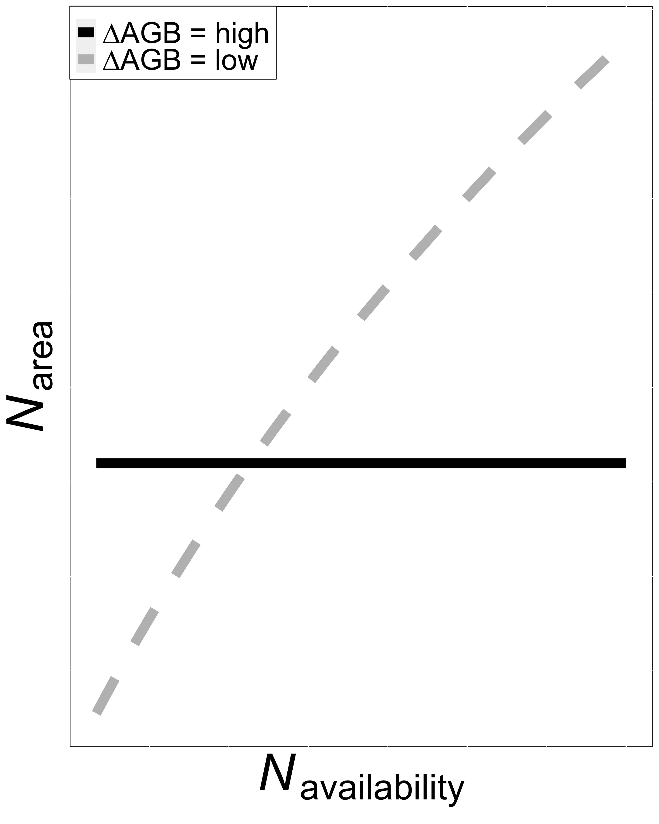
Option #1: Invest extra nitrogen toward whole plant growth at expense of leaf nitrogen
Smith et al. (in prep)
Notes:
There are a few studies pointing toward a tradeoff between nitrogen allocation toward whole plant growth and allocation toward photosynthetic leaf tissue.
This is a figure from a paper that Nick is working on that I think highlights this tradeoff quite nicely.,
Soil nitrogen availability is on the x-axis and leaf nitrogen allocation is on the y-axis.
The colored lines indicate whether soil nitrogen availability is causing a large or small change in aboveground biomass.
When soil nitrogen availability causes a large change in aboveground biomass, there are limited effects of soil nitrogen availability on leaf nitrogen allocation.
Large shifts in aboveground biomass are likely driven by increases in whole plant nutrient demand, potentially due to nitrogen limitation or colimitation or other environmental factors that increase whole plant nutrient demand, such as CO2 or temperature
Alternatively, there may be a stronger stimulation in leaf nitrogen allocation when there is a small change in aboveground biomass in response to an increase in nutrient availability.
My second chapter showed support for these tradeoffs, where there were stronger leaf nitrogen allocation responses to soil nutrient availability than stem growth

Slide 3
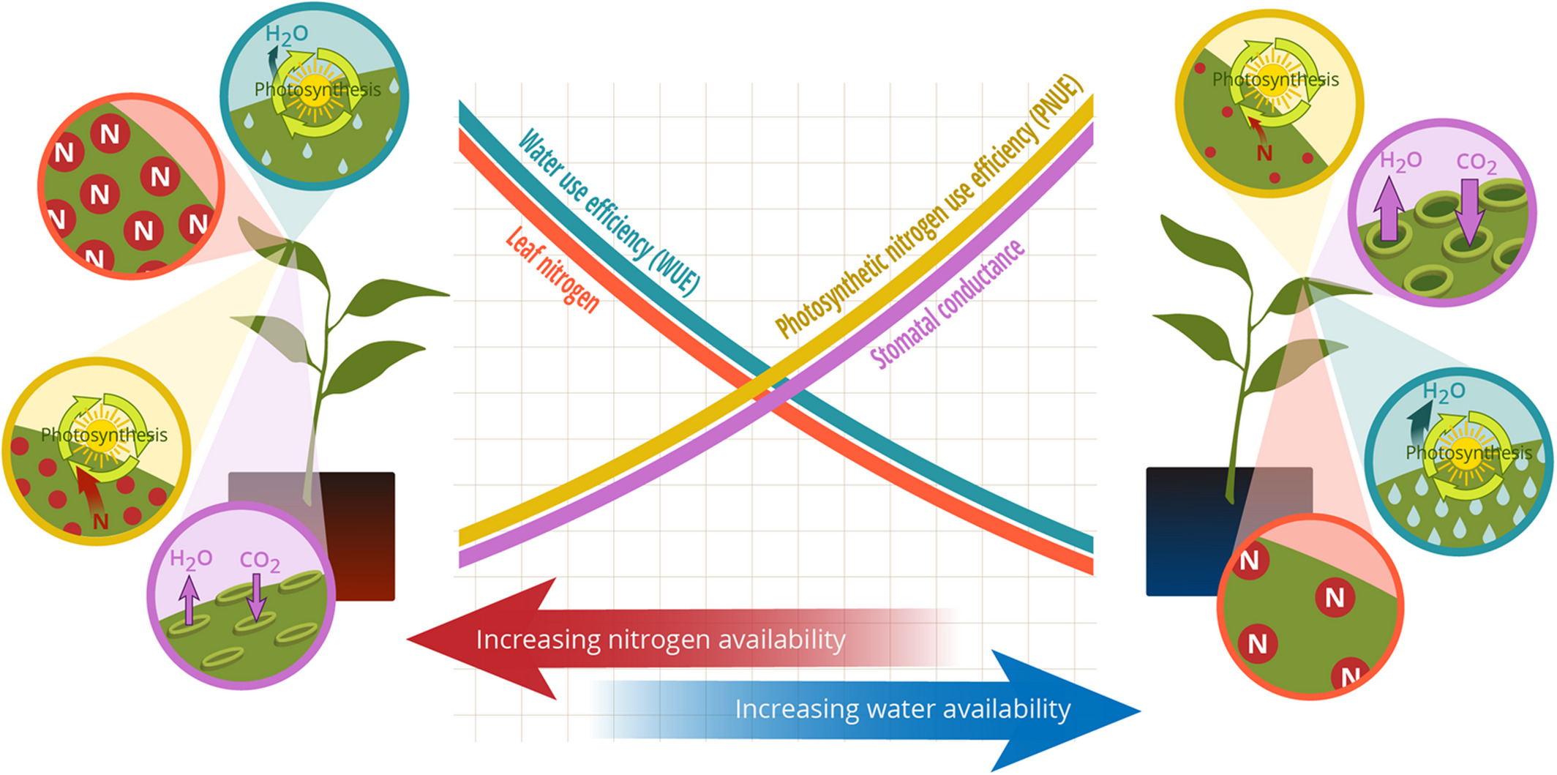
Option #2: Maintain photosynthesis with greater water use efficiency at expense of nitrogen use efficiency
Bialic-Murphy et al. (2021) Ecol. Letters
Notes:
The second option depends on whether whole plant growth or leaf nitrogen allocation exhibits larger responses to soil nitrogen availability
If whole plant growth has limited responses to soil nitrogen availability, plants might allocate nitrogen to photosynthetic leaf tissue based on leaf nitrogen demand to build and maintain photosynthetic machinery.
This option is predicated on recent optimality frameworks suggesting that plants should trade inefficient use of an abundant resource for efficiency a more limiting resource.
This means that if nitrogen is relatively more available than water, then plants can maintain a similar photosynthetic output by increasing nitrogen allocation toward photosynthetic leaf tissue in order to increase water-use efficiency

Slide 4
Key questions
How does atmospheric CO₂ modify effects of soil nutrient availability on tradeoffs between leaf nutrient allocation and whole plant growth?

Slide 5
Key questions
How does atmospheric CO₂ modify effects of soil nutrient availability on tradeoffs between leaf nutrient allocation and whole plant growth?
How does atmospheric CO₂ modify effects of soil nutrient availability on tradeoffs between nutrient and water use?

Slide 6
Key questions
How does atmospheric CO₂ modify effects of soil nutrient availability on tradeoffs between leaf nutrient allocation and whole plant growth?
How does atmospheric CO₂ modify effects of soil nutrient availability on tradeoffs between nutrient and water use?
To what extent does inoculation with nitrogen-fixing bacteria influence the two questions listed above?

Slide 7
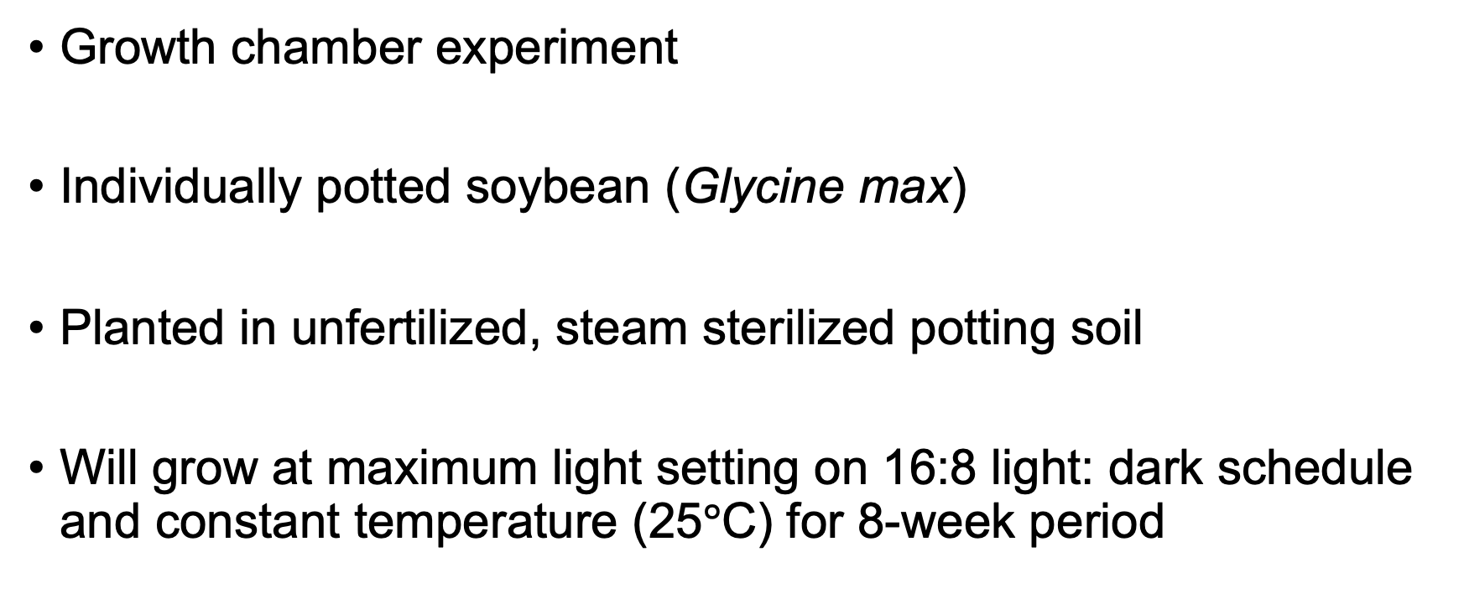
Experimental setup
Growth chamber experiment
Individually potted soybean (Glycine max)
Planted in unfertilized, steam sterilized potting soil
Will grow at maximum light setting on 16:8 light: dark schedule and constant temperature (25$°$C) for 8-week period
Notes:
Steam sterilized potting soil seemed to work well from Joseph’s experiment

Slide 8
Experimental setup
Nutrient acquisition strategy treatments
Soil nitrogen treatments
Atmospheric carbon dioxide treatments
0 ppm N
+ BNF
70 ppm N
400 ppm CO₂
- BNF
210 ppm N
1000 ppm CO₂
630 ppm N
All treatments will be combined in a full-factorial design with 10 reps per treatment combination (n = 160 total)
Notes:
10 reps per treatment combo * 16 treatment combos = 160 individuals

Slide 9
Plant measurements
Leaf measurements
Whole plant measurements
Carbon costs to acquire nitrogen (Root carbon mass / whole plant nitrogen mass)
Whole plant biomass
Total leaf area
Root nodule number, root nodule biomass
Leaf nitrogen allocation (N_{mass}; SLA; N_{area})
A_{net}, V_{cmax25}, J_{max25}, g_{s,} R_{d25}
J_{max25}:V_{cmax25}; R_{d25}:V_{cmax25}; stomatal limitation
PNUE, χ (from leaf δ¹³C), N_{area}:g_{s}, V_{cmax}:g_{s}

Slide 10
Timeline for Experiment 4
Start experiment in March/April 2022 using growth chambers in ESB I
Only one growth chamber available
Two separate trial runs for each CO₂ treatment (2 months each)
Temperature, relative humidity, and PAR sensors set up through both trials
Harvest and tissue processing should take another 2 months
Data analysis, manuscript draft finished by end of calendar year?

Slide 11
Extra slides for hypotheses

Slide 12
Hypothesis 1a: Increasing CO₂ should increase leaf production and whole plant growth through a stimulation in whole plant nutrient demand
CO₂
Whole plant nutrient demand
Belowground carbon allocation
Whole plant nutrient acquisition
Leaf production
Whole plant growth
Positive effect
Negative effect
Notes:
Increasing CO2 should increase whole plant demand to acquire nutrients that support growth
This should increase belowground carbon allocation for plants to acquire soil resources either through direct uptake or through symbioses with nitrogen-fixing bacteria or mycorrhizal fungi
Regardless of nutrient acquisition strategy, increasing belowground carbon allocation should have a positive effect on whole plant nutrient acquisition
This should cause plants to invest nitrogen toward leaf production to take full advantage of increased CO2 concentration, resulting in a stimulation of whole plant growth

Slide 13
Hypothesis 1a: Increasing CO₂ should increase leaf production and whole plant growth through a stimulation in whole plant nutrient demand
BNF
CO₂
Whole plant nutrient demand
Belowground carbon allocation
Whole plant nutrient acquisition
Leaf production
Whole plant growth
Positive effect
Negative effect
Notes:
In species who form associations with nitrogen-fixing bacteria, root nodulation should increase with increasing CO2 due to increased belowground carbon allocation.
This should increase the positive effect of increasing CO2 on leaf production and whole plant growth, particularly in low soil nutrient environments
I do expect the impacts of BNF in modifying effects of CO2 on leaf production and whole plant growth to be dependent on soil nutrient availability, which we will get to in a second

Slide 14
Hypothesis 1b: Increased soil nutrient supply should increase the positive effect of eCO₂ on leaf production and whole plant growth, but will depend on whether individuals associate with nitrogen-fixing bacteria
CO₂
Whole plant nutrient demand
Belowground carbon allocation
Whole plant nutrient acquisition
Leaf production
Soil nutrient availability
Whole plant growth
Positive effect
Negative effect
Notes:
But first, in isolation of BNF inoculation status, increasing soil nutrient availability should increase whole plant nutrient acquisition, but should also decrease belowground carbon allocation.
This should result in an increase in per-root nutrient uptake, reducing whole plant carbon costs to acquire nitrogen and increasing whole plant nutrient acquisition.
Therefore, increasing soil nutrient availability should increase the positive impact of CO2 on leaf production and growth.
However, reductions in belowground carbon allocation with increasing soil nutrient availability will likely decrease reliance on microbial symbionts with increasing soil nutrient availability.

Slide 15
Hypothesis 1b: Increased soil nutrient supply should increase the positive effect of eCO₂ on leaf production and whole plant growth, but will depend on whether individuals associate with nitrogen-fixing bacteria
BNF
CO₂
Whole plant nutrient demand
Belowground carbon allocation
Whole plant nutrient acquisition
Leaf production
Soil nutrient availability
Whole plant growth
Positive effect
Negative effect
Notes:
As a result of this, soil nutrient availability should should indirectly decrease root nodulation and reliance on nitrogen-fixing bacteria for nitrogen.
This should cause individuals inoculated with nitrogen-fixing bacteria to shift their primary mode of nitrogen acquisition away from nitrogen fixation and toward direct uptake with increasing soil nutrient availability.
I therefore expect that inoculation with BNF will increase the positive effect of increasing CO2 on leaf production and growth, but only under low soil nutrient conditions.
However, impacts of inoculation with BNF will decrease with increasing soil nutrient availability, as inoculated individuals will shift their dominant mode of nutrient acquisition away from nitrogen fixation and toward direct uptake

Slide 16
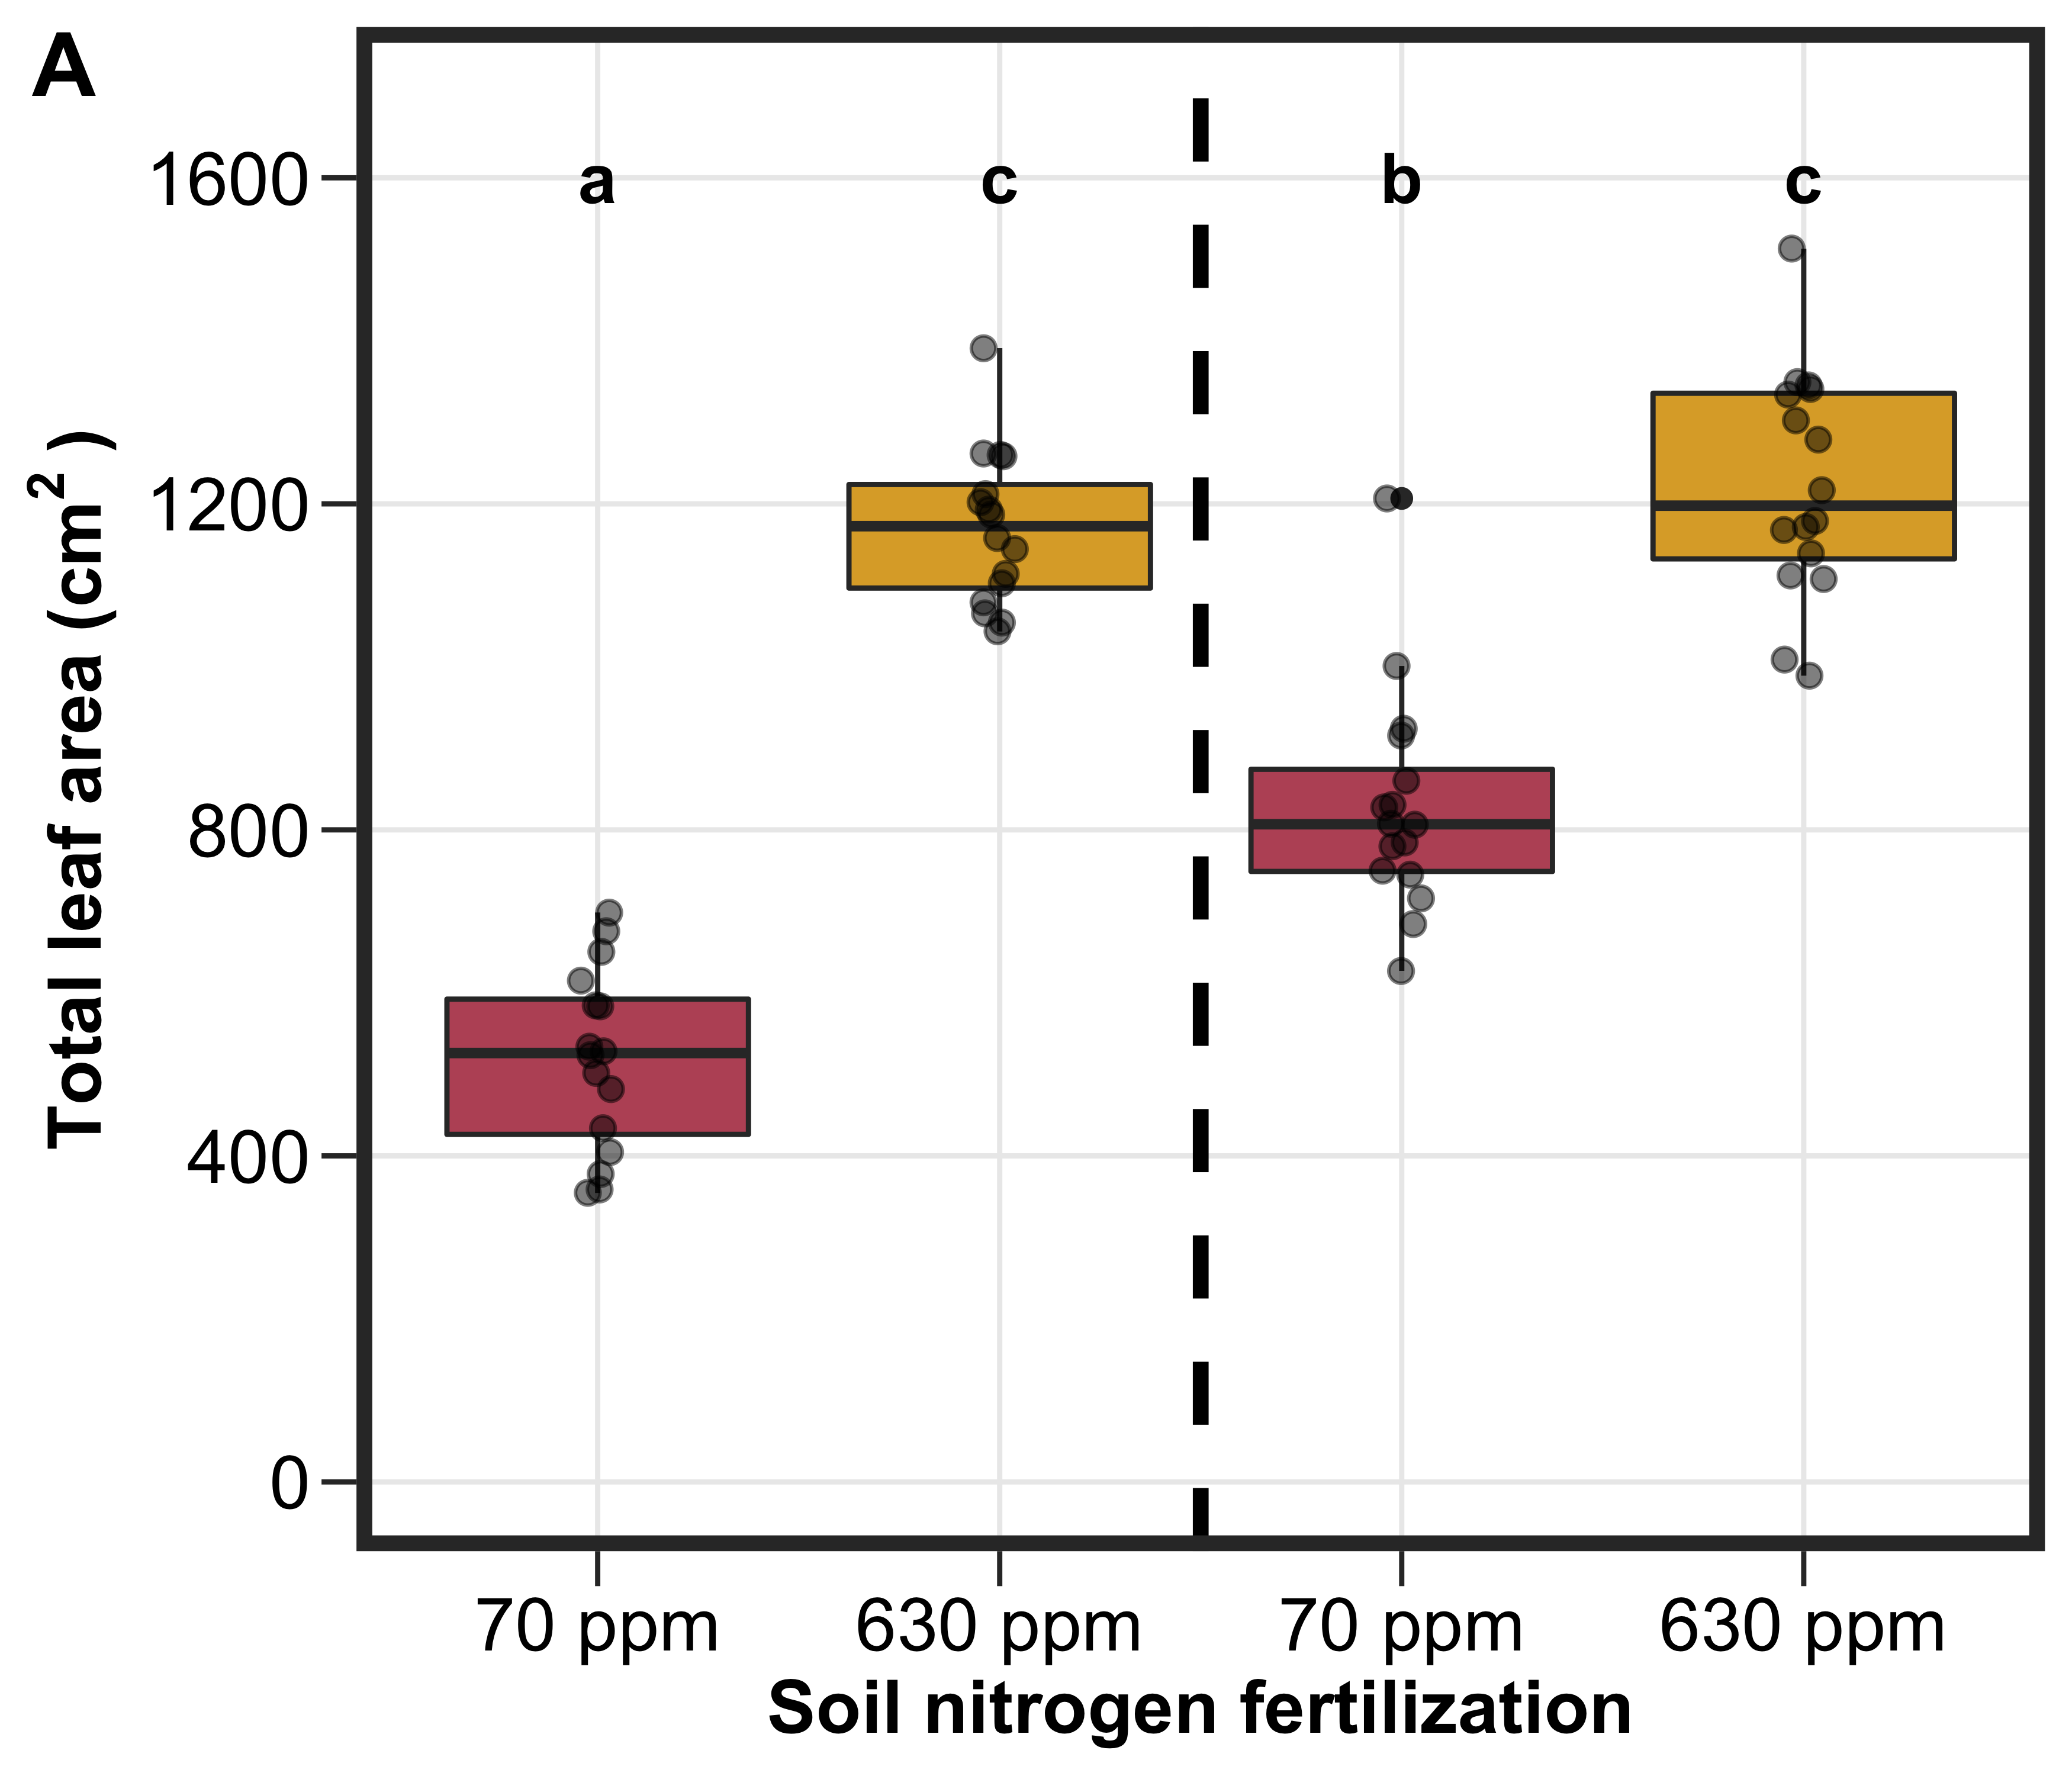
Hypothesis 1b: Increased soil nutrient supply should increase the positive effect of eCO₂ on leaf production and whole plant growth, but will depend on whether individuals associate with nitrogen-fixing bacteria
Inoculation with BNF should increase total leaf area and growth under low soil nutrients, but have similar total leaf area and growth under high soil nutrients
Not inoculated
Inoculated
Notes:
Some data from a recent experiment in our lab supports the interactive role of soil nutrients and inoculation status on leaf production.
This was a greenhouse experiment from one of our undergraduate researchers where soybean was grown under two levels of soil nitrogen and either inoculated or not inoculated with nitrogen-fixing bacteria.
On the x-axis is the two soil nutrient levels and on the y-axis is total leaf area.
The two boxplots to the left of the vertical dashed line indicate individuals that were not inoculated with BNF, while the boxplots to the right of the vertical dashed line indicate those that were inoculated with BNF
As you can see, inoculation with BNF increased total leaf area under the low soil nitrogen treatment, but had similar total leaf area under the two high soil nutrients
This was likely driven by a shift in the dominant mode of nutrient acquisition from nitrogen fixation to direct uptake, but confirmation of this is ongoing.

Slide 17
Hypothesis 2
Soil nutrient availability
BNF
CO₂
Leaf nutrient demand to maintain photosynthetic capacity
Leaf nutrient allocation
Photosynthetic capacity
Stomatal conductance
Leaf-level photosynthesis
Nutrient use efficiency
Water use efficiency
Positive effect
Negative effect
Notes:
Moving on to the leaf level, this is the general schematic explaining how I might expect increasing CO2, soil nutrient availability, and inoculation status to modify leaf photosynthesis, leaf nutrient allocation, and tradeoffs between nutrient and water use
It is a bit complex, which might be important in how I shape the post-experiment statistics,
but I am going to make this a bit simpler by breaking it down into a few smaller hypotheses

Slide 18
Hypothesis 2a: Increasing CO₂ will have a direct positive effect on leaf-level photosynthesis due to increased substrate needed to drive photosynthesis forward
Soil nutrient availability
BNF
CO₂
Leaf nutrient demand to maintain photosynthetic capacity
Leaf nutrient allocation
Photosynthetic capacity
Stomatal conductance
Leaf-level photosynthesis
Nutrient use efficiency
Water use efficiency
Positive effect
Negative effect
Notes:
The first hypothesis is that increasing CO2 will have a direct positive effect on leaf photosynthesis.
This would be presumably driven by increased substrate availability needed to drive photosynthetic reactions forward, or a reduction in photorespiration in C3 species due to increased [CO2] relative to [O2]
This hypothesis indicates that soil nutrient availability and BNF will not necessarily have any effect on leaf photosynthesis
Photorespiration = Rubisco oxidizes oxygen, causing a waste in Rubisco resources away from CO2 carboxylation

Slide 19
Hypothesis 2b: Increasing CO₂ will decrease leaf-level photosynthesis as a function of reduced stomatal conductance
Soil nutrient availability
BNF
CO₂
Leaf nutrient demand to maintain photosynthetic capacity
Leaf nutrient allocation
Photosynthetic capacity
Stomatal conductance
Leaf-level photosynthesis
Nutrient use efficiency
Water use efficiency
Positive effect
Negative effect
Notes:
The second hypothesis is that increasing CO2 will directly reduce stomatal conductance, as stomates do not need to be as open in order to draw in enough CO2 to move photosynthesis forward
As there is generally a positive relationship between stomatal conductance and leaf-level photosynthesis, I would expect there to be an indirect negative effect of increasing CO2 on leaf photosynthesis.
This hypothesis also indicates that soil nutrient availability and BNF inoculation will have no effect on leaf photosynthesis

Slide 20
Hypothesis 2c: Increasing CO₂ will decrease leaf-level photosynthesis as a function of reduced maintenance costs for photosynthetic capacity
Soil nutrient availability
BNF
CO₂
Leaf nutrient demand to maintain photosynthetic capacity
Leaf nutrient allocation
Photosynthetic capacity
Stomatal conductance
Leaf-level photosynthesis
Nutrient use efficiency
Water use efficiency
Positive effect
Negative effect
Notes:
The third hypothesis is that increasing CO2 will decrease leaf-level photosynthesis as a function of reduced maintenance costs for photosynthetic capacity.
I also expect leaf nutrient demand to be positively related to leaf nutrient allocation, and for leaf nutrient allocation to be positively related to photosynthetic capacity
Together, these patterns suggest that increasing CO2 would have a negative impact on leaf nutrient allocation, photosynthetic capacity, and leaf level photosynthesis

Slide 21
Hypothesis 2c: Increasing CO₂ will decrease leaf-level photosynthesis as a function of reduced maintenance costs for photosynthetic capacity
Soil nutrient availability
BNF
CO₂
Leaf nutrient demand to maintain photosynthetic capacity
Leaf nutrient allocation
Photosynthetic capacity
Stomatal conductance
Leaf-level photosynthesis
Nutrient use efficiency
Water use efficiency
Positive effect
Negative effect
Notes:
If tradeoffs between nitrogen and water use exist, I expect photosynthetic capacity to have a negative effect on stomatal conductance.
This negative relationship would be due to the minimization of unit costs of nitrogen and water use associated with photosynthetic least-cost theory, where a stimulation in photosynthetic capacity would lead to a reduction in stomatal conductance to maintain minimum unit resource costs
As a result, I expect stomatal conductance to increase with increasing CO2, potentially reducing the negative effect of increasing CO2 on leaf-level photosynthesis

Slide 22
Hypothesis 2c: Increasing CO₂ will decrease leaf-level photosynthesis as a function of reduced maintenance costs for photosynthetic capacity
Soil nutrient availability
BNF
CO₂
Leaf nutrient demand to maintain photosynthetic capacity
Leaf nutrient allocation
Photosynthetic capacity
Stomatal conductance
Leaf-level photosynthesis
Nutrient use efficiency
Water use efficiency
Positive effect
Negative effect
Notes:
Photosynthetic capacity is negatively related to nitrogen-use efficiency, while stomatal conductance is negatively related to water use efficiency.
Given this, I expect that increasing CO2 should increase stomatal conductance, leading to a reduction in water use efficiency.
Given the negative effect of increasing CO2 on photosynthetic capacity, I also expect an increase in nutrient use efficiency

Slide 23
Hypothesis 2c: Increasing CO₂ will decrease leaf-level photosynthesis as a function of reduced maintenance costs for photosynthetic capacity
Soil nutrient availability
BNF
CO₂
Leaf nutrient demand to maintain photosynthetic capacity
Leaf nutrient allocation
Photosynthetic capacity
Stomatal conductance
Leaf-level photosynthesis
Nutrient use efficiency
Water use efficiency
Positive effect
Negative effect
Notes:
I also expect soil nutrient availability and BNF inoculation to have an impact on leaf photosynthesis, leaf nutrient allocation, and tradeoffs between nitrogen and water use
Specifically, increasing soil nutrient availability should have a positive impact on leaf nutrient allocation regardless of inoculation status,
and this should reduce the negative impact of increasing CO2 on photosynthetic capacity and leaf photosynthesis
Increasing soil nutrient availability should also reduce the positive impact of increasing CO2 on stomatal conductance, leading to a further reduction in the negative impact of increasing CO2 on leaf photosynthesis.
Finally, increasing soil nutrient availability should reduce the positive effect of CO2 on nitrogen use efficiency and negative effect of CO2 on water use efficiency

Slide 24
Hypothesis 2c: Increasing CO₂ will decrease leaf-level photosynthesis as a function of reduced maintenance costs for photosynthetic capacity
Soil nutrient availability
BNF
CO₂
Leaf nutrient demand to maintain photosynthetic capacity
Leaf nutrient allocation
Photosynthetic capacity
Stomatal conductance
Leaf-level photosynthesis
Nutrient use efficiency
Water use efficiency
Positive effect
Negative effect
Notes:
Under low soil nutrient availability, I expect those inoculated with BNF to have a larger stimulation in leaf nutrient allocation than those not inoculated with BNF.
This will allow those inoculated with BNF to have reduced negative impacts of increasing CO2 on photosynthetic capacity and leaf photosynthesis under low soil nutrient availability conditions compared to those not inoculated with BNF.
However, under high soil nutrient availability conditions, I expect individuals to be acquiring nutrients via direct uptake regardless of inoculation status, so soil nutrient availability would reduce the negative impact of increasing CO2 on leaf-level photosynthesis regardless of BNF inoculation

Slide 25
Hypothesis 2d: Increasing CO₂ will decrease leaf-level photosynthesis as a function of reduced maintenance costs for photosynthetic capacity and reduced stomatal conductance
Soil nutrient availability
BNF
CO₂
Leaf nutrient demand to maintain photosynthetic capacity
Leaf nutrient allocation
Photosynthetic capacity
Stomatal conductance
Leaf-level photosynthesis
Nutrient use efficiency
Water use efficiency
Positive effect
Negative effect
Notes:
My last leaf-level hypothesis is that:
If increasing CO2 explains more variance in stomatal conductance than photosynthetic capacity, then there will be a more robust negative effect of increasing CO2 on leaf level photosynthesis.
This is because increasing CO2 would indirectly reduce leaf photosynthesis through two pathways. The first through a direct reduction in stomatal conductance and the second through an indirect reduction through reduced maintenance costs for photosynthetic capacity
If there is a direct impact of CO2 on stomatal conductance, then nitrogen and water use efficiencies would both increase with increasing CO2.
We would observe similar impacts of soil nutrient availability and BNF inoculation status on nitrogen use efficiency;
however, stomatal conductance would be primarily determined by CO2 concentrations and would be independent of soil nutrient availability and BNF inoculation status

Slide 26
Hypothesis 2
Soil nutrient availability
BNF
CO₂
Leaf nutrient demand to maintain photosynthetic capacity
Leaf nutrient allocation
Photosynthetic capacity
Stomatal conductance
Leaf-level photosynthesis
Nutrient use efficiency
Water use efficiency
Positive effect
Negative effect
Notes:
This is the general framework for understanding how CO2, soil nutrient availability, and BNF might impact leaf physiology
I think the complexity of this systems diagram is fascinating, as some pathways suggest a positive impact of increasing CO2 on leaf-level photosynthesis, while others suggest a negative impact.
Understanding how soil nutrients and nitrogen fixation modify impacts of increasing CO2 on leaf and whole plant processes is critical if we want to accurately model and predict these processes in land surface or Earth system models,
I also haven't seen any studies that measure leaf and whole plant traits in a CO2 x soil nitrogen x BNF experiment setup before

