Slide 1

Artificial Life by C. Langton
Presented by: Enrique Areyan
Instructor: Luis M. Rocha
I585: Biologically Inspired Computing
Indiana University

Slide 2
Agenda
Overview of Key Concepts
The Biology of Possible Life
Biological Automata
Recursively Generated Objects
Evolution & Genetic Algorithms
The Role of Computers in Life Generation
Linear vs. Nonlinear systems
Conclusion

Slide 3
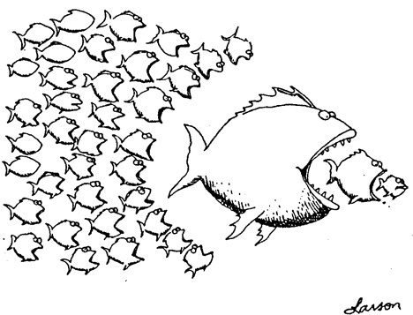
Overview of Key Concepts
AL is the study of man-made systems that exhibit behaviors characteristic of natural living systems.
Biology attempts to analyze (top-down) living organisms while AL attempt to synthesize (bottom-up approach) life-like behaviors within computers and other artificial media.
AL can contribute with biology by exploring not only life-as-we-know-it but life-as-it-could-be

Slide 4
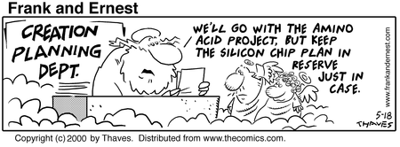
The Biology of Possible Life
life-as-we-know-it vs. life-as-it-could-be
Biology: study of life-as-we-know-it, based on carbon-chain chemistry, the only kind of life available for study.
Is it possible to derive general theories from single examples?
Life, as a dynamic physical process, could “haunt” other physical material. What matters is the organization of such material.

Slide 5
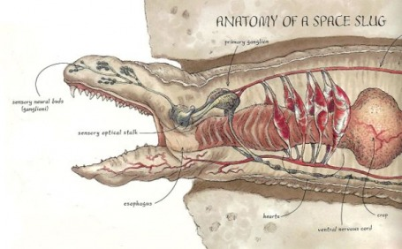

The Biology of Possible Life
According to Langton, life, as a process and regardless of its material bases, must share certain universal features
What are these universal features? The answer will allow us to recognize life by its dynamic form alone, without reference to its matter
We could try to synthesize alternative life forms, life-as-it-could-be, to search for universal features of life

Slide 6
Artificial Life
A field that uses a synthetic approach to the study of life-as-it-could-be. Life as a property of the organization of the matter, rather than a property of the matter itself.
Biology deals with the material basis (using an analytical, top-down approach) whereas AL deals with the formal basis (using a synthetic, bottom-up, distributed, local determination of behavior approach).
Construct large aggregates of simple, rule-governed objects, which interact with one another in a nonlinearly fashion.
Key Idea: Emergent behavior

Slide 7
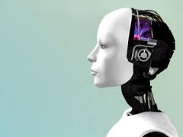
Artificiality
Connotes perceptual similarity but essential difference, resemblance from without rather than within.
The artificial object imitates the real by turning the same face to the outer system.
AL seeks to capture the behavioral essence of the components of a system – if organized correctly they should exhibit the same behavior as the natural system

Slide 8
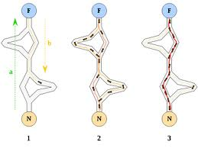
Artificiality
Force the basic components (behavioral primitives) of a system to obey basic rules of interaction among them, organized them as in the real system and let the behavior of interest emerge.
The computer is the right tool for this computing-intensive approach.
Illustrative idea: colony of ants.

Slide 9
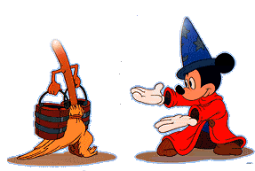
The Animation of Machines
There is no need to “bring” life to a machine, we only need to organize its components in such a way that their interactive dynamics is “alive”
Reject vitalism
How we go about creating behaviors generators?
Consider that nature is fundamentally distributed and parallel
AL main focus is to create behaviors generators, i.e. identify the mechanisms by which behavior is generated and controlled in natural systems, and recreate these in artificial systems.

Slide 10
Biological Automata
AL searches for abstractions of the logical form of organisms from its material configuration
Behavior generation in nature is primarily bottom-up, exceedingly parallel and distributed
Genotypes and Phenotypes are key from the biological behavior generation point of view
Genotypes: set of genetic instructions encoded in the linear sequence of nucleotide bases that constitutes the DNA
Phenotypes: is the physical organism itself, the structure that emerge in space and time as the result of the interpretation of the genotype in the context of a particular environment
Morphogenesis is the process from genotypes to phenotypes

Slide 11
Biological Automata
Generalized genotypes (GTYPE) and phenotypes (PTYPE)The idea is to abstract the way nature generates behavior to approach other, non-biological situations
GTYPE = largely unordered set of low-level rules
PTYPE = behaviors/structures that emerge out of the interactions among GTYPE in some specific environment
Think of GTYPE as an abstract specification for a set of “machines” and PTYES as the result of this interaction.
Nowhere is the behavior as a whole specified. The global behavior of the aggregate is a consequence of many interactions.
Local, nonlinear interaction produces PTYPE.

Slide 12
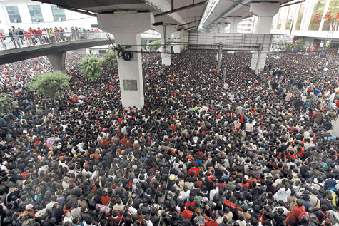
Unpredictability of PTYPE from GTYPE
The set of all possible PTYPE is huge (factorial order) on the set of possible GTYPES. Many possible behaviors.
Trade-off between behavioral richness and predictability.
We cannot know (through a formal procedure) which specific alterations must be made to a GTYPE to effect a desired change in PTYPE!
They may be a way to change a GTYPE to alter an specific portion of PTYPE but it is not feasible to compute (exhaustive search)
Nature addresses this issue through a process of trial and error grounded on natural selection, arguably the only efficient procedure

Slide 13

Recursively Generated Objects (RGO)
From recursive rules (GTYPE) that apply to local structures emerges complex structures or behavior (PTYPE) of the global system.
This is a much simpler approach to the generation of complex behavior than its alternative, top-down, analytical approach (counter example: expert system).
RGO is a general approach to construct GTYPE/PTYPE systems
GTYPE = the recursive description of the object
PTYPE = the developing structure or the recursively-generated object or behavior obtained trough a process of morphogenesis.
The system starts with a single part to which the rules are applied recursively over and over again.

Slide 14
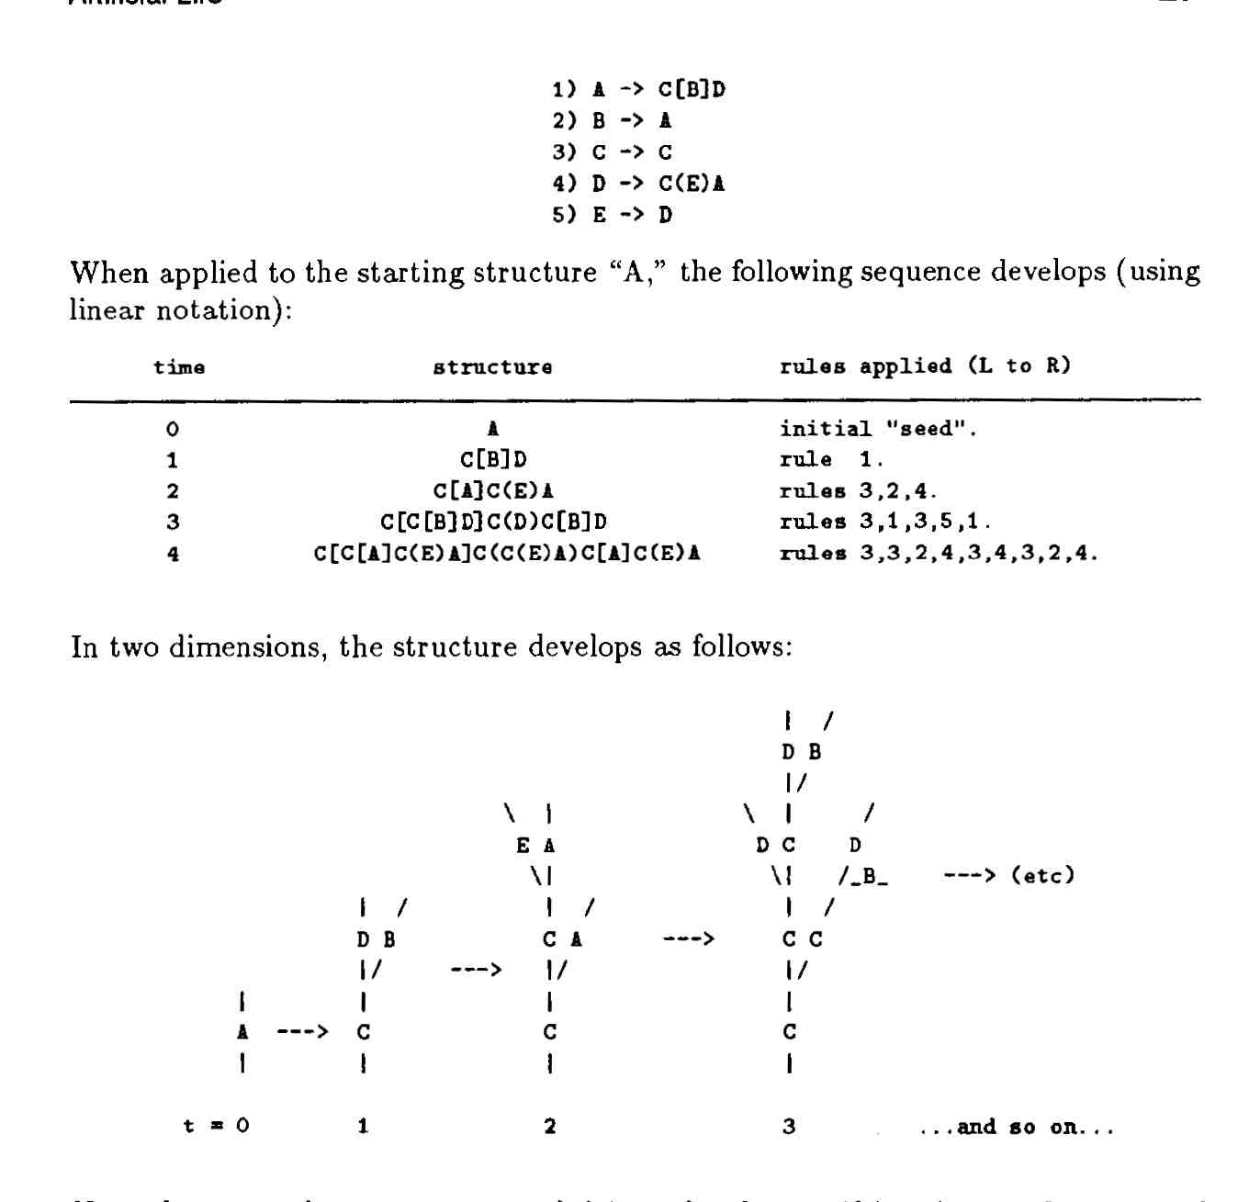
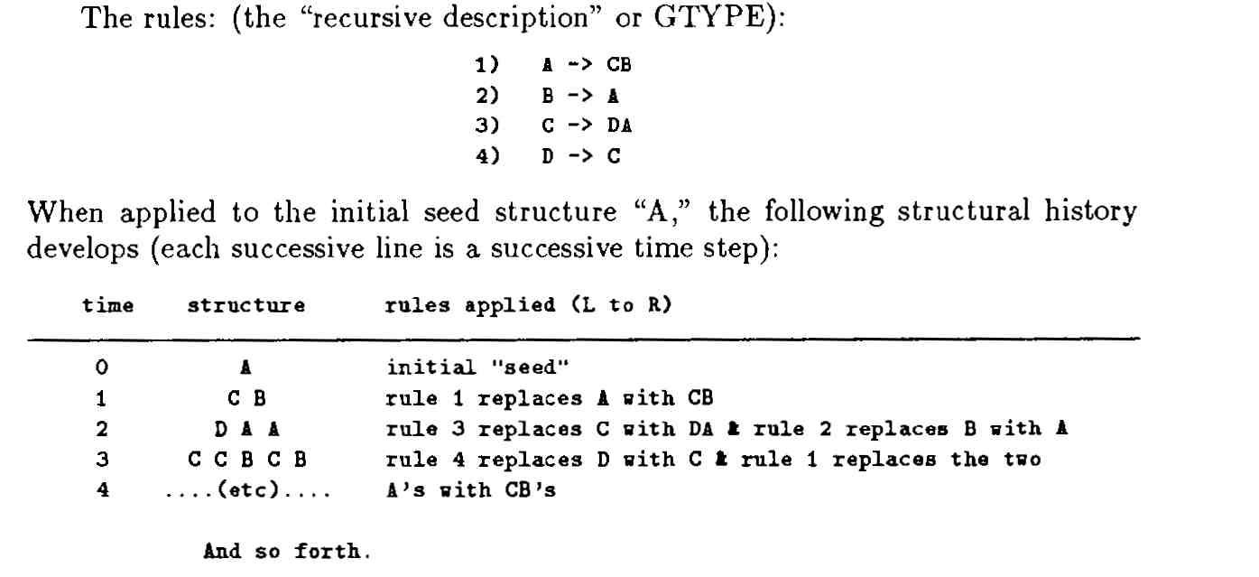
Examples of RGO:
Growth and development of structural PTYPE
Lindenmayer systems: Simple Linear Growth/Branching Growth
Development of a behavioral PTYPE
Simulation of flocking behavior

Slide 15
Evolution & Genetic Algorithms
How do we go about finding GTYPES that will generate lifelike PTYPES?
Traditional Trial & Error relies on our preconceived notions of what life-like behavior (PTYPES) should be. We are missing on much of the search space.
A possible solution: nature’s “Intelligent” Trial & Error, or evolution by the process of natural selection among variants.
Use natural selection as an algorithm to search the GTYPE space

Slide 16
General schema of a Genetic Algorithm
Form populations of PTYPE by interpreting a set of GTYPES within a specific environment. Let the different PTYPES interact with one another and with the environment.
Evaluate the relative, application-specific performance (fitness function) of PTYPES and select (with certain probability) the GTYPES of the best performing PTYPES. The best the PTYPE, the higher the chances of selecting its associated GTYPE.
Out of these GTYPES select a pair and reproduce them (apply genetic operators, e.g. crossover operator) in such a way that the copies are similar but not identical to the originals.
Replace the least successful GTYPES with the offspring recently created. Repeat steps 1-4 ad infinitum.

Slide 17
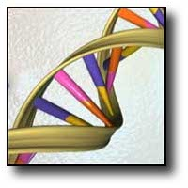
Genetic Algorithms
As imposed by the formal limitations on predictability, we have to let each GTYPE interact with the environment and others in order to explicitly evaluated its performance as expressed by its associated PTYPE.
The GA explores a very large space of possible PTYES in an intelligent manner. In general, the GA selects the GTYPES building blocks most often associated with the most successful PTYPES thus, biasing the sample towards a probable better population of GTYPES.

Slide 18
The Roles of Computers on Life Generation
Both AI and AL are concerned with generating complex behavior and employ the computer to study complex, natural phenomena. However, they do this very different:
AI uses the technology of computation as a model of intelligence. In other words, it attempts to “explain” life as a kind of computer program.
AL attempts to develop a new computational paradigm based on natural processes that support living organism. AL uses the computer as a tool to explore the dynamics of interacting information structures or programs.

Slide 19
The Roles of Computers on Life Generation
In the context of AL:
Computer should be thought of as an important laboratory that provides an alternative medium within which we can try to synthesize life.
If we consider life just as a myriad of information structures interacting with one another, then computer is the primary tool for the manipulation (synthesis) of information.
Computer as a workstation for performing scientific experiments within artificial universes. Let the Computer take care of the mundane -but huge amount of- calculations.

Slide 20

The Roles of Computers on Life Generation
Complex behavior does not need to have complex roots.
If the same is true about what we call life, then we can try the much simpler task of synthesizing complex behavior in the computer rather than creating it from a top-down approach.

Slide 21
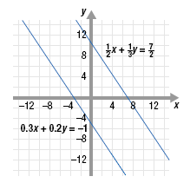
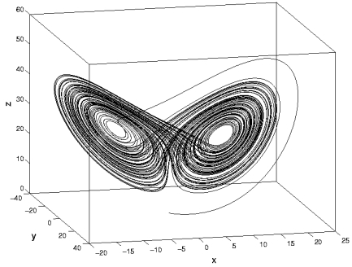
Linear vs. Nonlinear systems
Linear systems: the behavior of the whole is just the sum of the behavior of its parts.
Obey the superposition principle. Analysis should be effective to understand this systems.
Nonlinear systems: The behavior of interest arise out of interactions between the parts not the part themselves
Does not obey the superposition principle.. The behavior disappears if parts are studied independently. Analysis won’t work; try the inverse of analysis, i.e. synthesis.

Slide 22
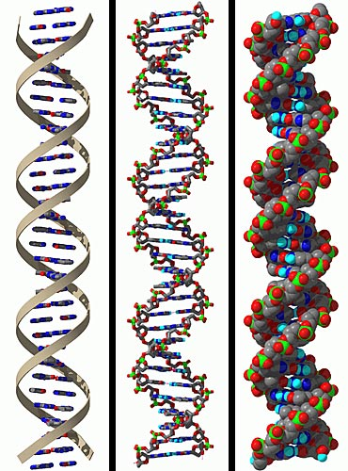
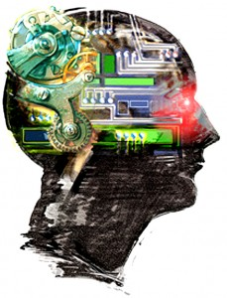

Conclusion
The process of evolution by natural selection (Blind Watchmaker) has created “seeing watches” capable of understanding what makes them “tick”, i.e. humans, which in turn may be able in the future to construct “watches” of their own design.

Slide 23
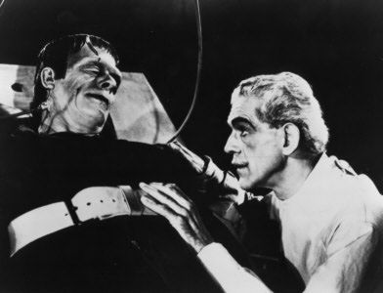
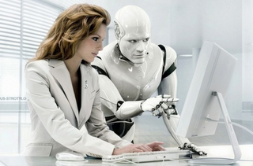
Conclusion – Topics of Discussion
How can we justify our manipulations?
How can we take it upon ourselves to create life, even within the artificial domain of computers, and then snuff it out again by halting the program or pulling the plug?
What right to existence does a physical process acquire when it is a “living process”, regardless of the medium in which it takes place?
Why should these rights accrue only to process with a particular material constitution and not another?
AL is a technical as well as a social, moral, philosophical and religious challenge.

Slide 24
References
Langton, C. [1989]. “Artificial Life” In Artificial Life. C. Langton (Ed.). Addison-Wesley. pp. 1-47.
A REAL Quarterhorse? http://www.radioactivechief.com/?m=200601
Exogorth http://starwarsdatabase.weebly.com/exogorth.html
Same face to the outer system http://www.maximumpc.com
The “artificial” thinker http://virtuallyalive.com/
Millions of people http://designative.info/2008/02/02/millions-stranded-by-the-snow-in-holiday-havoc/
DNA models http://www.wired.com/medtech/health/news/2003/02/57674
AI http://blog.american.com/2011/02/artificial-intelligence-and-agency/
Linear Systems http://www.algebra-calculator.com/solving-linear-systems-of-equations-by-elimination.html
Nonlinear systems http://www.ece.ualberta.ca/~marquez/Research_Interests.html
Complex Behavior http://avoidtherush.wordpress.com/2010/03/28/notes-on-flocking-behavior/
ACO http://www.thefullwiki.org/Ant_colony_optimization
Jaquet-Droz http://www.automates-anciens.com/english_version/pictures_jaquet_droz_androids/
Old-Clocks http://mainstreetmemories.blogspot.com/2009/03/are-hours-shorter-in-hereor-is-it-just.html
Programmable Controller http://www.omron-ap.com/product_info/CPM2A/index.asp
General purpose Computer http://www.omron-ap.com/product_info/CPM2A/index.asp
Mickey Fantasia http://images.sodahead.com/
Bottom-up http://cyberunions.org/theory/
Plan-b http://www.princeton.edu/~hos/Mahoney/articles/models/models.html

