Slide 1
Evolving Ants
Enrique Areyan
School of Informatics and Computing
Indiana University
January 24, 2012

Slide 2
About Me & Evolving Ants (EVA)
Enrique Areyan – Master Student (CS) at SoIC. You can contact me at eareyan@umail.iu.edu. Also, check out my web page for this project!
http://www.enriqueareyan.com/evolvingants
EVA - Final Project for I585 BionInspired Computing course, under the supervision of Dr. Luis Rocha.
EVA was built on top of AntFramework, a project I did as my undergraduate thesis in UCV (Universidad Central de Venezuela)

Slide 3
Agenda
Preliminaries
Motivation
What is EVA?
The algorithm
Evolutionary Strategy
Simple Genetic Encoding
L-System Genetic Encoding
Genetic Operators
Experiments
Results
Conclusion and Future Work

Slide 4
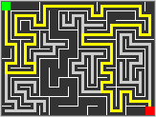
Preliminaries
For the purpose of this project, EVA works in a perfect Maze (with some effort it can be made to work in other types of environments)
A perfect Maze has one and only one path from any cell in the maze to any other cell. A cell is a node in a graph.

Slide 5
Motivation
Is it true that by providing genetic information to each individual ant in an Ant Colony Optimization algorithm solutions may be found faster in environments that do not change often (e.g. Maze, the topology in a commercial network, etc)?
How do we go about encoding such genetic information?
How would such an strategy compare with traditional ant colony optimization and genetic algorithms?

Slide 6
What is EVA?
EVA is a novel combination of traditional ant colony optimization (ACO) algorithm with genetic algorithm (GA).
An ant is provided with genetic information (individual “memory”) that it uses together with stigmergic information (shared “memory”) to construct solutions to a path in a maze.
The genes of an ant indirectly encode the series of steps it took to reach the source of food from its nest.

Slide 7
EVA
Population of ants will be evolved using a GA, whose fitness function will test the "effort" ants made (i.e., number of steps) and cost function of the path found.
The best or more “fit” ants will be reproduced using roulette wheel selection, random crossover point, fair probability of crossover and low probability of mutation.
In latter runs of the algorithm, an ant will use both its internal and share memory to make the decision about which nodes to visit.

Slide 8
EVA – Decision Rule
α and β control the influence of
the genetic and pheromone trail on
on the ant’s decision
Probability of ant k to visit
node j when visiting node i
Genetic information of ant k
Different encodings are possible
Stigmergic information on node
i going to node j
Note that EVA generalizes ACO:
By setting α=0, we have traditional ACO
By setting β=0, we have traditional GA
Notes:
Alpha = 0 => traditional ACO; Beta = 0 => genetic algorithm

Slide 9
The algorithm
Initialize Parameters (ACO,GA,EvolvingAnts)
Initialize Random Population of Ants
While stop-condition-not-reached do
Node = start node
For each Ant in Population do
While node-is-not-goal do
Node = selectNextNode(node,ant)
Run Genetic Algorithm with solutions found
Function selectNextNode(node n,ant a)
For each node reachable from n do
Individual-Decision = a.develop()
Collective-Decision = getPheromoneTrail(n)
R = uniformRandomNumber(0,1)
Choose node n’ such that R > (Individual-Decision + Collective-Decision) / normalizer factor
Return n’

Slide 10
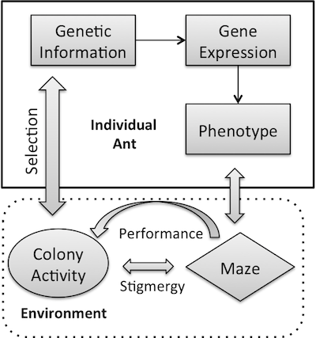
Evolutionary Strategy
Notes:
EVA’s ant agent phenotype/genotype mapping and developmental process, in stigmergic interaction with the environment.

Slide 11
Simple Encoding
An ant’s gene is a string of fix length from the four-letter alphabet . A random string of a fixed length is generated and assigned as the ant’s genes.
When making a decision, the function G is just the count of each letter in the string, e.g., if the ant’s gene is the string “UUDL”, then:
G(“U”, “UUDL”) = 0.5, G(“D”, “UUDL”) =G(“L”, “UUDL”) = 0.25, and G(“R”, “UUDL”) = 0
This encoding is mainly used as a control case to test against more sophisticated strategies such as L-System.

Slide 12
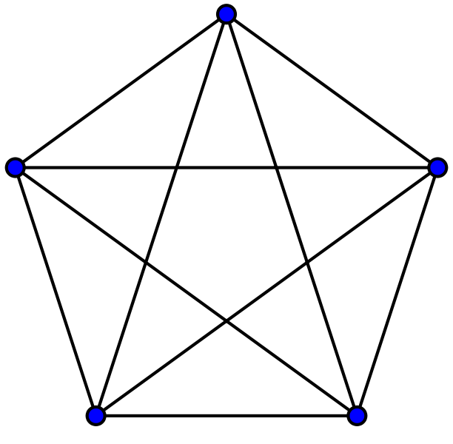
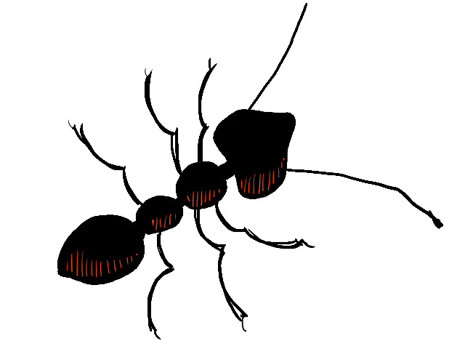
Simple Encoding - Example
2
U = 0.5
Ant’s Gene = “UULR”
1
L = 0.25
3
R = 0.25
D = 0
5
4

Slide 13
L-System Encoding
Ant’s genes G=(Σ, σ,F), where
Σ={U,D,L,R}
σ∈Σ* , is the axiom, which is initialized to be a random string from Σ* the set of all possible strings of alphabet Σ
F = {F₁,F₂,F₃,F₄}, four rules that map from each letter in Σ to Σ*. Each rule is initialized randomly
This is your typical L-System but with four production rules, each one mapping from an action in the maze to a string.

Slide 14
L-System Expression
Unlike the simple gene, before the ant uses the information stored in its genes this must go trough a “developmental” phase:
Iteration of the L-System a fix number of times resulting in string S
The weights used as G(k) are now the proportion of each letter in the string S, similar to the simple gene.

Slide 15
Why use an L-System?
There is a clear genotype/phenotype mapping between the system’s axiom and final string, through a developmental phase.
Encode of self-similar information which can be useful in a maze structure where a lot of the decision are similar
Compact a lot of information effectively.
The L-System stands as a suitable metaphor for an ant’s genetic information.

Slide 16
Genetic Operations
Those ants that constructed the best solution (so far) are selected for reproduction. How does this work?
Simple encoding: the best ants’ genes are reproduced taking a random crossover point and allowing for mutation
L-System encoding: The crossover operator takes two genes G_{u},G_{v}, and a random number r uniformly distributed between 0 and 3, and replaces the rules (F₀,F_{r}) of gene G_{u} with rules (F_{r},F₃) of gene G_{v}. A single gene can also be mutated, meaning that a rule F_{j} will be changed randomly.

Slide 17
Experiments
EVA was tested on mazes of different sizes, i.e., from 20 cells to 300 cells, in increment of 10 cells.
20,30,40, …, 290 and 300.
For each maze, different topologies of the mazes were tested. For instance, for the maze of dimension 40, three different topologies were created having 5, 10 and 20 cells per row.
For each of these topologies, 10 different mazes were tested. For convenience, node 0 is the nest and node n is the food source.

Slide 18
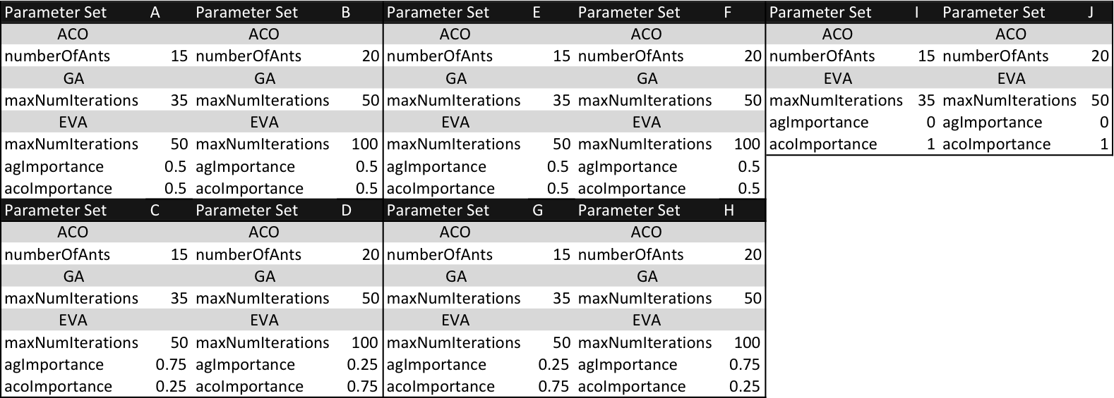
Experiments
Parameters used to test EVA
Simple gene-EVA (A-D)
L-System-EVA (E-H)
ACO (parameters I and J)
EVA (parameters sets A through H)

Slide 19
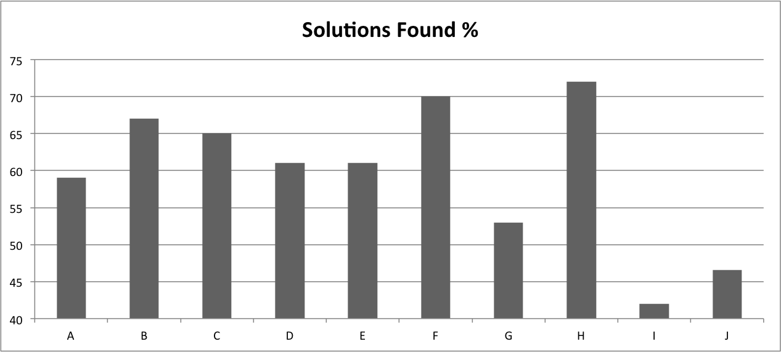
Results

Slide 20
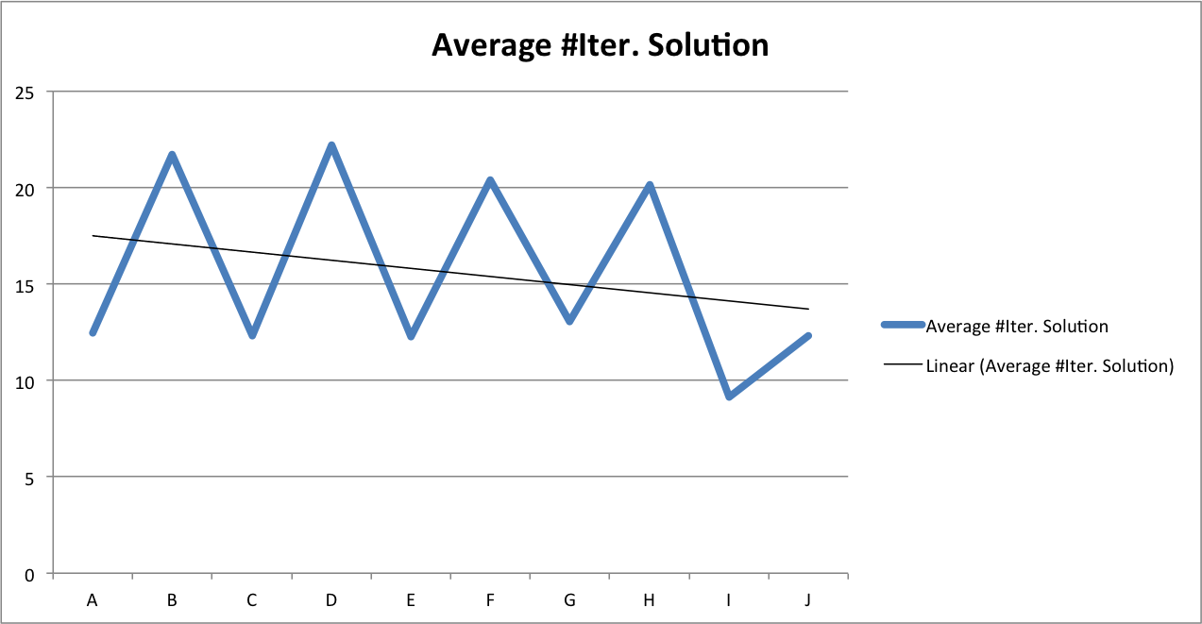
Results

Slide 21
Conclusion
EVA is a viable optimization algorithm.
Results of the experiments performed using EVA suggests that this algorithm outperforms a pure ACO algorithm when tested under the conditions previously described.
The performance of EVA varies drastically with the choice of the genetic encoding of the evolutionary algorithm.
An direct genotype/phenotype mapping (Simple Gene) is outperformed by another strategy that uses an intermediary, growth phase.

Slide 22
Conclusion – Future Work
Other evolutionary strategies can be tested:
Cellular automata
Boolean Networks
etc
Other functions mapping from the string to actions in the environment can be created and tested.
Other kind of environments can also be tested.
Thank you for your attention!

