Slide 1
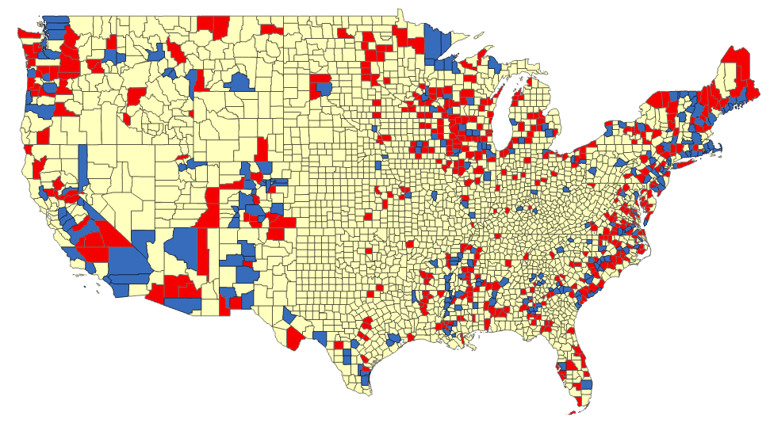

Exploring Statistical GIS Mapping Techniques To Forecast Future Election Outcomes
Battleground Counties in 2016 Pres Election
Edgar Arguello
AIT722 Fall 2021

Slide 2
Project Motivation Background
The basis of my project
ArcGIS user community projects that exploit exploratory analysis of socio-economic variables which correlated with Republican votes in the 2016 Presidential Election.
Was geography a factor in the 2016 election?—Analytics | Documentation (arcgis.com)
To motivate present and future American voters to better understand the “big picture” of their socio-economic community around them
My curiosity to explore computational techniques to analyze past (2016) & future elections (2024). Will add new explanatory variables to forecast 2024 Presidential Election outcome
2020 Presidential Election Voting Data by county
Vaccination rates
Agency for Toxic Substances & Disease Registry’s (CDC/ATSDR SVI Index)
Identifies socially vulnerable populations

Slide 3
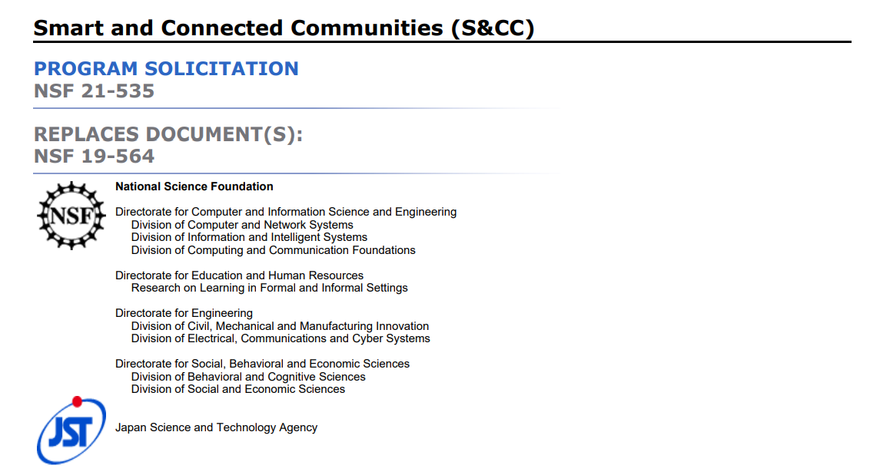
Smart & Connected Communities (S&CC)-Problem Statement
How do we identify on a map, unique & evolving community characteristics at the US county-level?
Party? Republican Vs Democratic Presidential votes
Socio-Economic factors? (%college degree, HHI, etc.)
Social Vulnerability? (CDC/ATSDR SVI Index)
Govt trust & compliance? (Vaccination rates %)
Where are these characteristics trending & shifting?
Population size, demographics, economic opportunity
Available services which impact overall community culture, needs, and opportunities
Technology, built and natural environments

Slide 4
S&CC Stakeholders
Political actors:
Local or national (legislators, governors) currently in office
Aspiring political actors (candidates running for city, county, state, or federal Government office)
Municipal organizations:
Executive-level educators (County-level)
Health and Human social service agencies
Urban and rural planners
Nonprofit or philanthropic Businesses organizations (NGOs, foundations, civil society members, etc.)
Commercial or private for-profit, nonprofit organizations (NGOs, foundations, civil society members, etc.)

Slide 5
Approach to Problem
Apply data science statistical GIS mapping techniques
Merging geographical & socio-economic (Geo-Social) demographics data spatially on a map

Slide 6
Project Tasks
Data Collection
2016 Presidential Elections results (includes additional socio-economic variables)
2020 Presidential Elections results
CDC Vaccination data by US county (includes (CDC/ATSDR SVI Index data)
Clean & Shape Data
Remove rows & columns that are not needed
Clean/delete rows with: N/A, UNK, redundancies
Group and average certain variables (i.e., Vaccine rates for 1 week period)
Merge 2020 Election results data with 2016 socio-economic data, vaccine, and SVI index data
ArcGIS
Import cleaned data
Perform exploratory & explanatory analysis
Build individual map layers based on Geographic Weighted Regression (GWR) results

Slide 7
Data Collected For Project
Base layer Shapefile for every county in the Continental US
2020 presidential vote percentages (Republican and Democratic) by county
CDC Vaccination rates across US Counties (SVI index)
2016 presidential vote percentages (Republican and Democratic) by county
socioeconomic explanatory variables (See Examples)
2016 Ave HH Income
2016 Diversity Index
2016 Population Density
% Seniors (Age 65+)
% Republican Vote
% Democrat Vote
% Blue Collar Workers
% Never Married
% College Degree

Slide 8
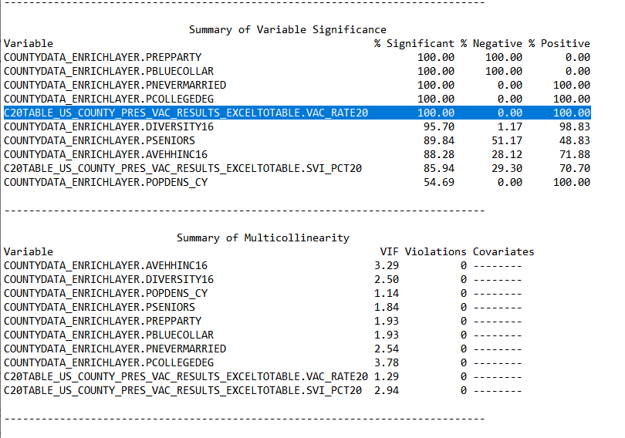
Data Exploratory & Explanatory Analysis
ArcGIS - Statistical Techniques for Mapping Data Relationships
Exploratory Regression Analysis (OLS)
Explanatory Regression Analysis
Run best model from results of exploratory regression - “Best” R² value
Dep var: PCT_Dem for 2020 Election
Dep var: PCT_VacRate Most current (Dec 2021)
Dep var: PCT_Rep for 2016 Election

Slide 9
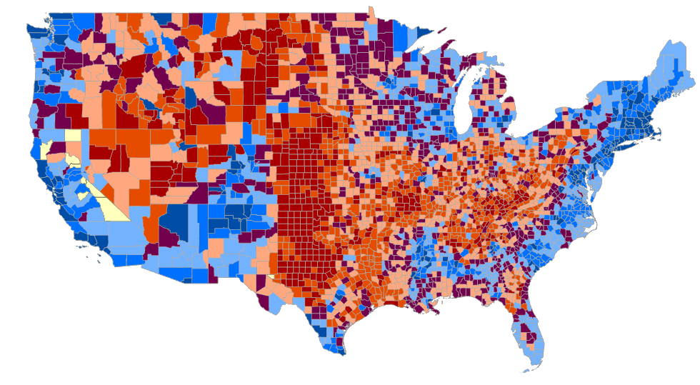
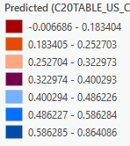
Geographic Weighted Regression (GWR) - ArcGIS
How well does Vaccination Rate predict for voting Democrat in future? (we will find out in 2024)
Dependent Var
Percent who voted for Biden in 2020
PCT_Dem
Independent control Var
Vaccination Rate (Dec 2021)
(VacRate20)

Slide 10
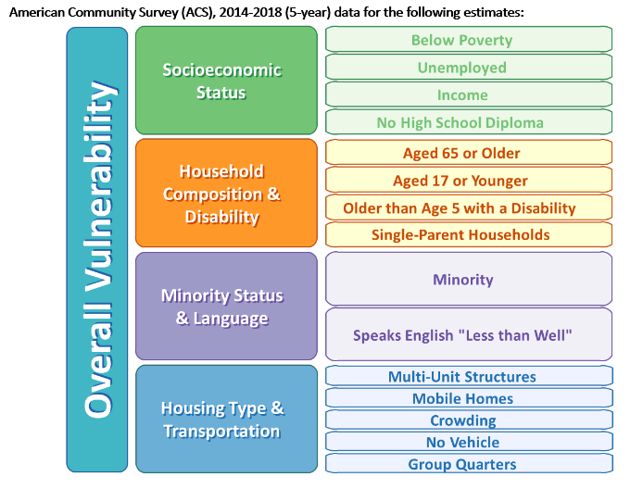
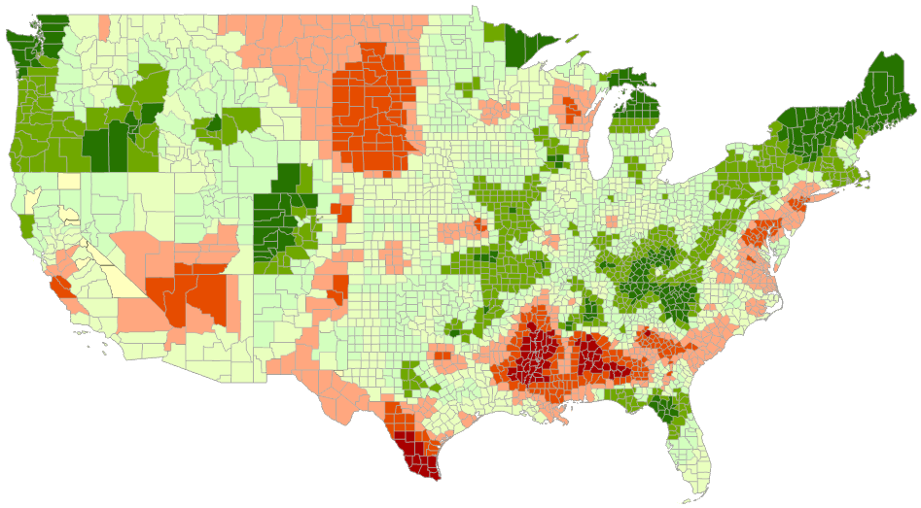
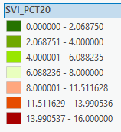
Vulnerability Index Map- ArcGIS
CDC/ATSDR SVI Index data

Slide 11
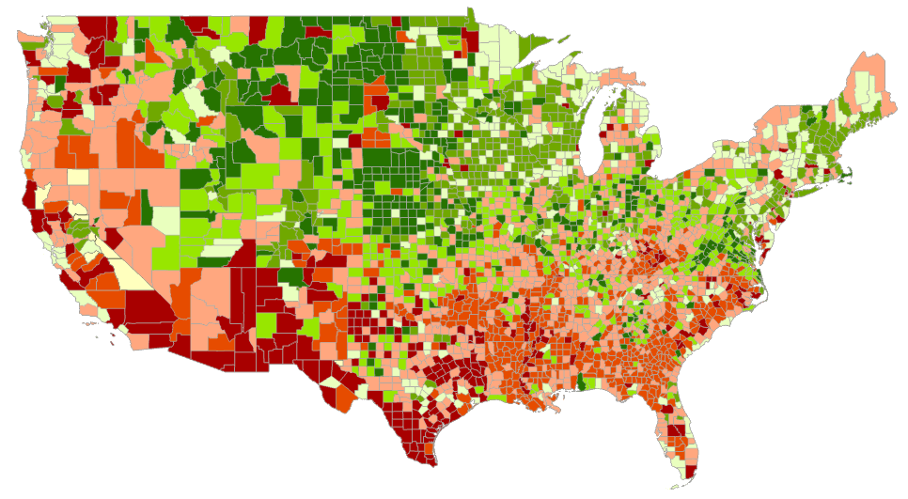
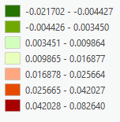
Geographic Weighted Regression (GWR) - ArcGIS
How well does SVI index predict for voting Democrat in future? (we will find out in 2024)
CDC/ATSDR SVI Index data
Dependent Var:
Percent who voted for Biden in 2020
(PCT_Dem)
Independent Var:
SVI INDEX (0 -16)(SVI_PCT20)

Slide 12
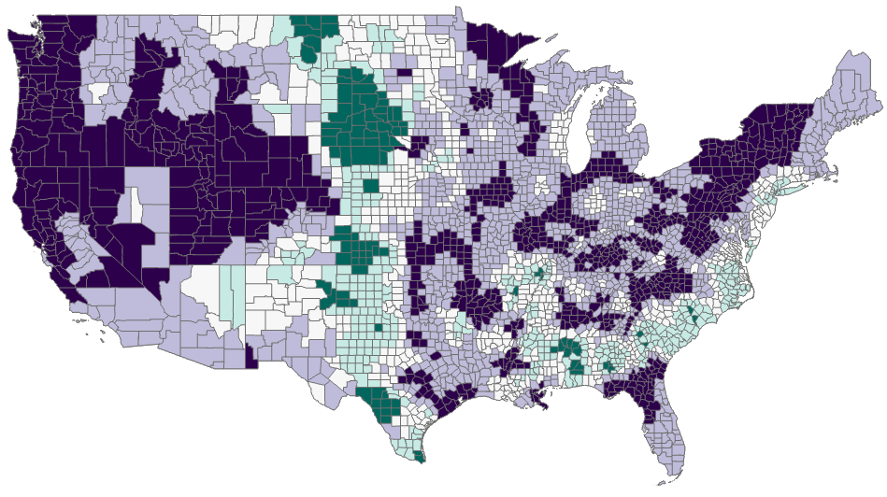
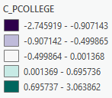
Geographic Weighted Regression (GWR) - ArcGIS
How well did College Degree predict for voting Republican in 2016?
Dependent Var
Percent who voted for Trump in 2016
PCT_Rep
Independent control Var
College Educated
(C_PCOLLEGE)

Slide 13
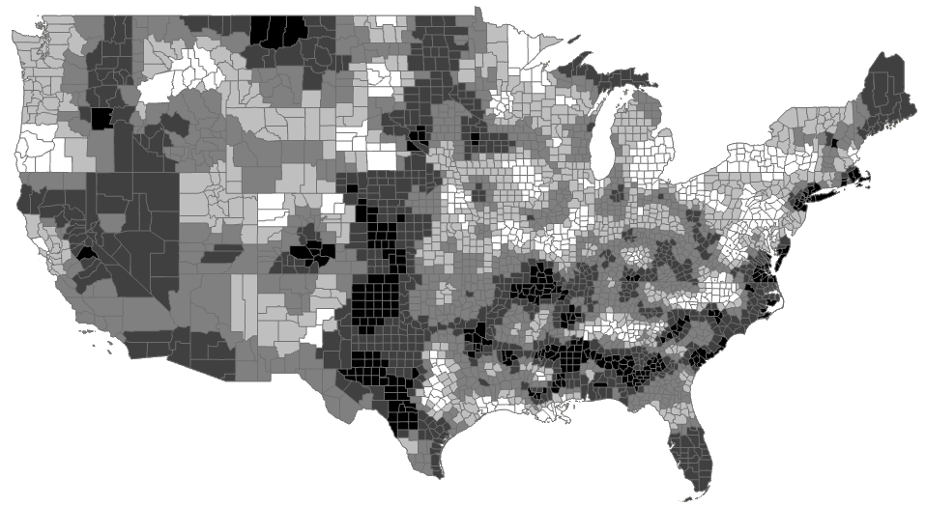
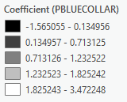
Geographic Weighted Regression (GWR) - ArcGIS
How well did Blue collar predict for voting Republican in 2016?
Dependent Var
Percent who voted for Trump in 2016
PCT_Rep
Independent control Var
Blue Collar
(PBLUECOLLAR)

Slide 14

Discussion
Exploratory Regression Analysis helped narrow down & only keep the most significant variables
Explanatory Regression helped identify the best models (variable combinations) to run against the dep variable
Geographic Weighted Regression (GWR) was only conducted after identifying best models
Achieved very high prediction for 2016 Republican votes between College degree & Blue Collar.
Anticipate high prediction for 2024 Presidential Democratic votes based on vaccination rates alone
SVI index doesn’t seem to be as high at predicting for 2024 Presidential Democratic votes

Slide 15
Conclusion
The data analytic approach for this work was designed with the intention to solve the defined problem. The thorough data analysis that was performed in this project was conducted with extensive datasets, appropriately fit to better understand county-level communities across the United States. We believe that the results are conclusive and effective in solving the proposed problem.
The results from this project have improved our understanding of the unique & evolving community characteristics in the US at the county-level. Some of the trends that have been identified from this analysis regarding government trust and compliance are a bit alarming. It seems that there are “resistance areas” where vaccination rates are low (less than 20%). Perhaps this analysis can be helpful to health & human services stakeholders in addressing this problem. Stakeholders such as political actors, municipal organizations, non-profit and philanthropic businesses, and commercial & private organizations should be able to benefit from this analysis work as well.
It is with optimism that future data scientists and practitioners find inspiration from this work to further expand this research.

Slide 16

Questions?
earguel/Jekyll_Dev (github.com)

