Slide 1
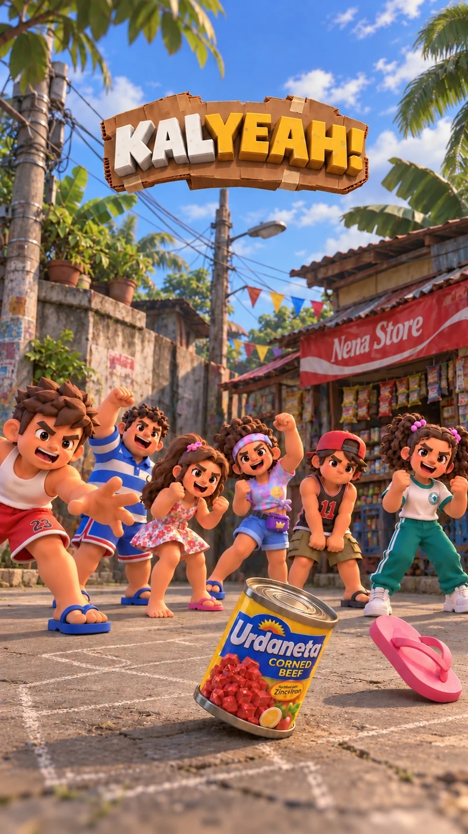

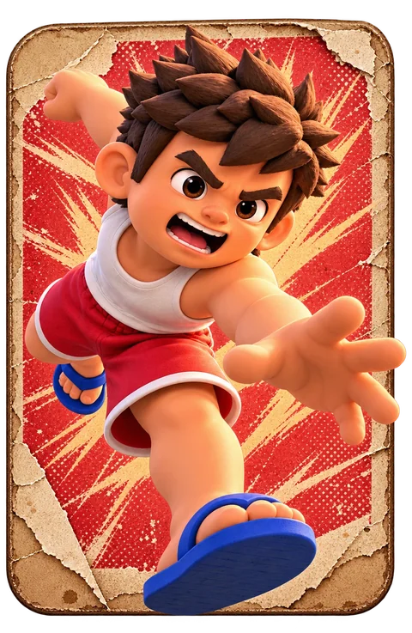
Mga larong Pinoy sa kalye, in your pocket.
A fast 3v3 street-game MOBA for Android. Portrait, one thumb, a full match in minutes.
Android APK
Made with Godot 4.6
Notes:
Open with the logo. One sentence: Kalyeah turns the Filipino street games every kid grew up on into a quick multiplayer game for phones. Portrait, one thumb, a match in minutes.

Slide 2
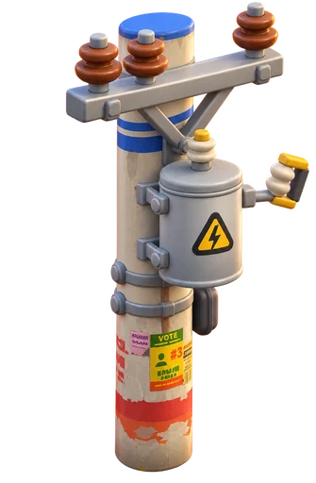
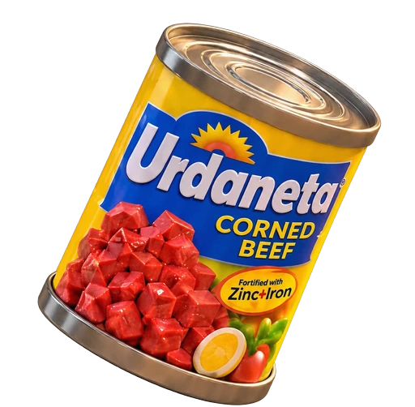
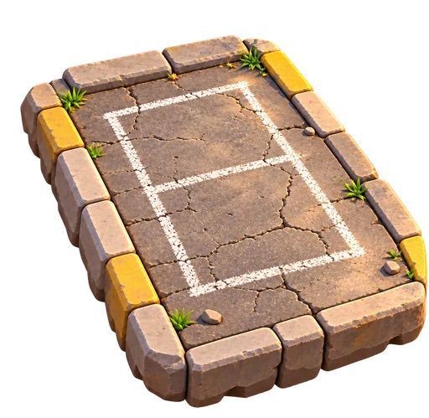
The street is our original multiplayer
1
Games we all know
Bato-bato-pik, tumbang preso, jackstones, trumpo, patintero, agawan base. No rulebook needed.
2
Every toy is a weapon
A flip-flop, a tin can, a paper wall, a spinning top. Familiar objects, readable at a glance.
3
Skill beats spending
Agawan Base
Tumbang Preso
Patintero
No accounts, ranks, levels, items or hero classes. Everyone starts equal, every match.
The three street games in Kalyeah
Notes:
The hook: nobody has to be taught these games. Pinoy kids know them. We keep the rules intuitive and turn the objects into readable weapons.

Slide 3
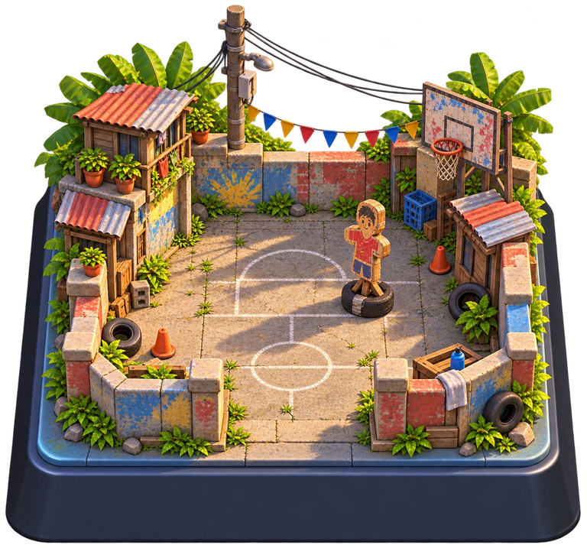




Take their post, or tag them all
Tap to move
Tap the street and your kid runs there. Drag to steer.
Capture the post
Stand in the enemy base to capture it. Two kids make it faster, three faster still.
Tag everyone
Zero HP means tagged, never out. Wipe the other team for an instant point.
Rescue teammates
Hold the rescue area for 5 seconds to free a tagged friend.
3v3
3:00
First to 3
kids a team
per round
5 or 7 in rooms
Notes:
Core loop. Tap to move, no virtual stick. Win a point by holding the enemy's electric post, or by tagging the whole other team. Tagged players wait on the sidewalk until a teammate rescues them, so nobody sits out for long.

Slide 4
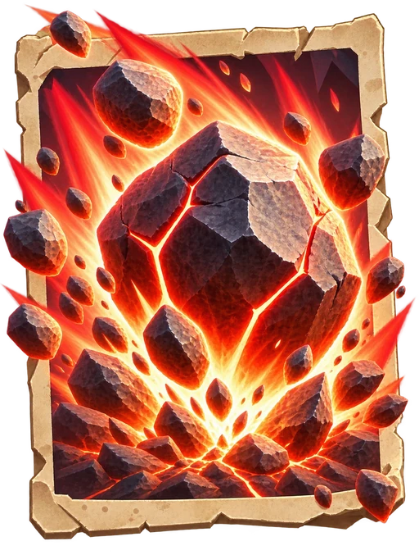
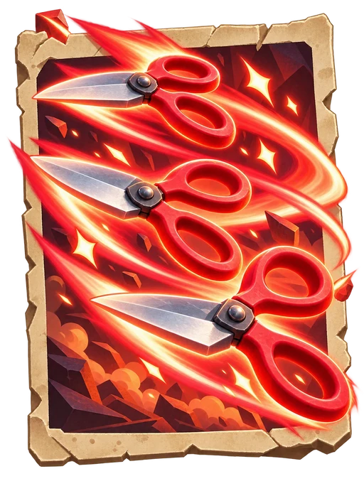
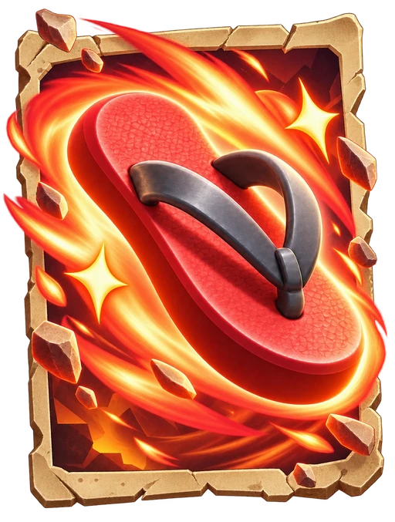
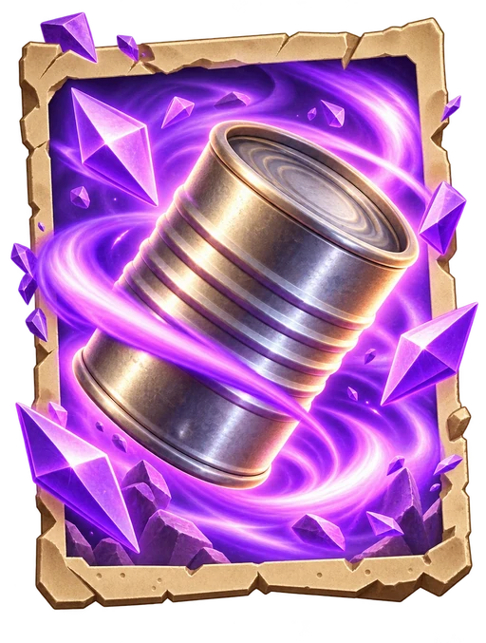
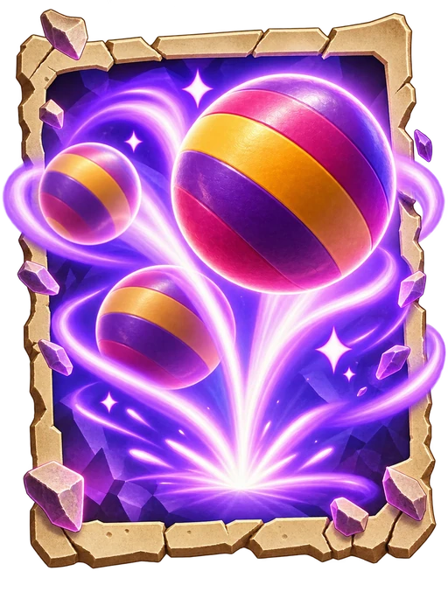
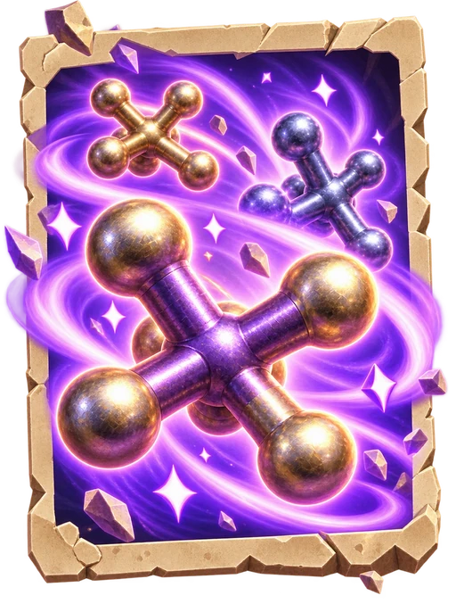
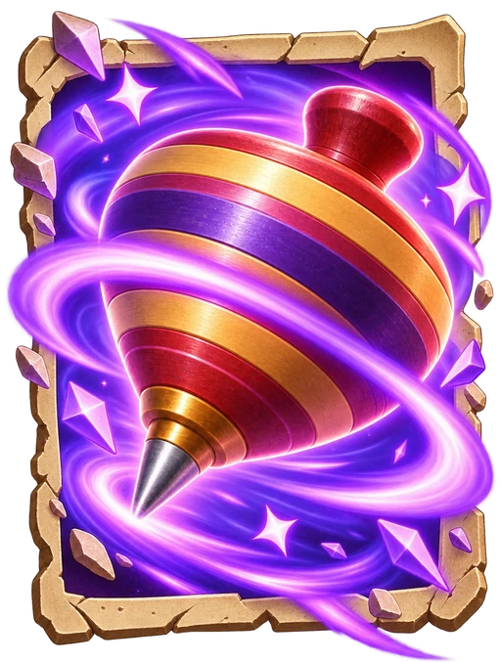




Four cards, no basic attack
Shuffled deck
Elixir
Three roles
Every weapon sits in a shuffled deck. You hold four, and the next one waits in line.
Cards cost elixir that refills as you play. Every cast is a decision.
Attack, Crowd Control and Block, across 12 weapons from four street games.
Notes:
Think Clash Royale hand: four cards, elixir, cycling. Players never pick weapons in the lobby, so every match plays differently. Weapons: rocks, scissors, flip-flops, tin can, bouncy ball, jacks, spinning top, paper shield.

Slide 5


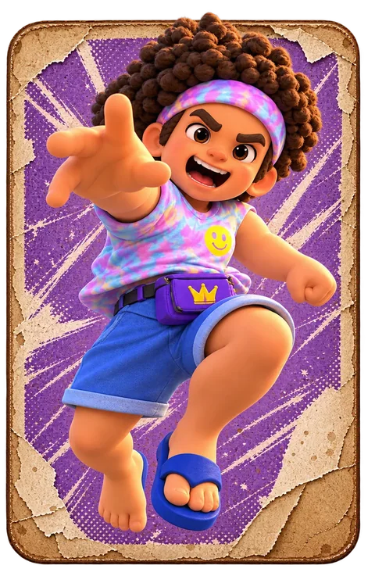
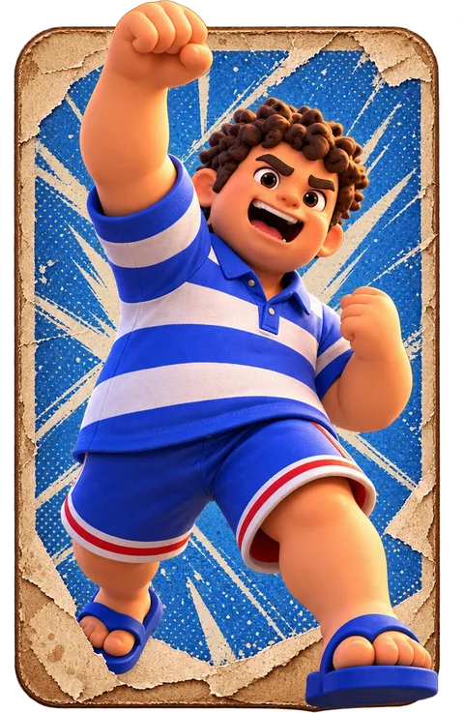
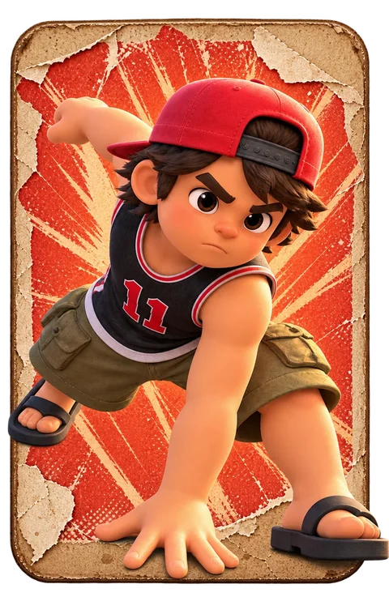
Six kids, one fair fight
Cosmetic only
Everyday Pinoy style
Same health, speed and hitbox for every kid. Your pick never changes the fight.
Tsinelas, jerseys, bestida, ponytails. Every kid gets the same animation quality and the same confident poses.
Notes:
Junjun, Ligaya, Migo, Toni, Popoy and Inday. They show a range of Filipino kids, written with respect: identity comes through clothes and style. A team never has the same kid twice.

Slide 6
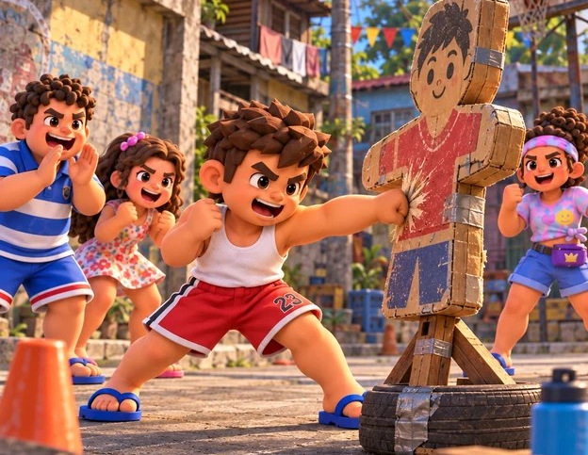
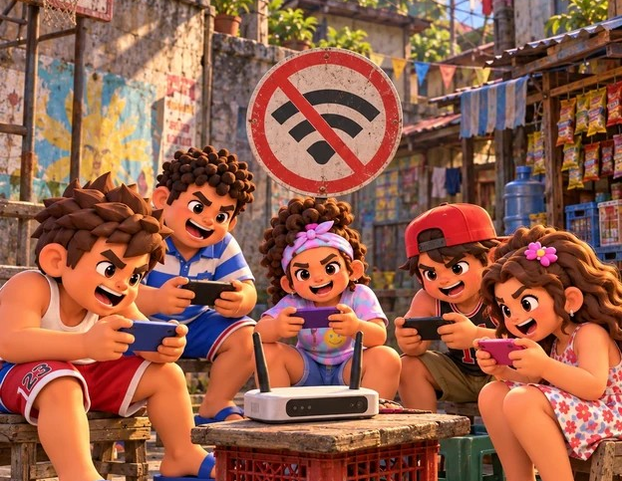
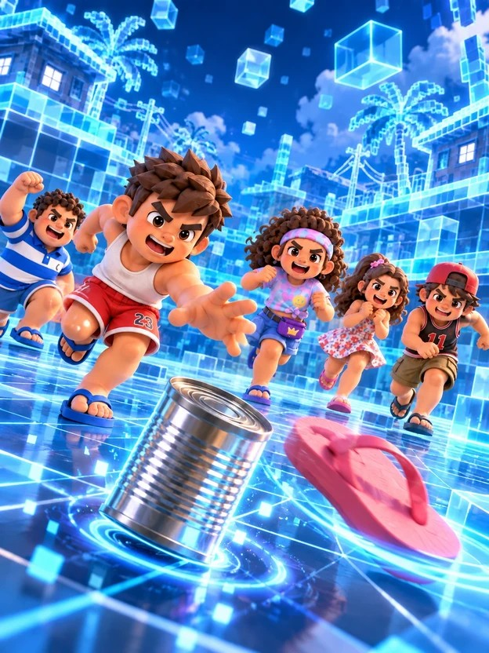
Play your way, signal or not
Practice
Hotspot
Online
Offline 3v3 against bots. Learn the cards, no server needed.
One phone hosts, friends on the same network join. Auto-detected, no code.
Private or open 3v3 rooms with an 8-character code or a QR scan.
Notes:
Three ways in. Practice works offline so a judge can try it anywhere. Hotspot turns the host's phone into the game server, which suits barangay meetups with no internet. Online uses an authoritative game server for rooms by code.

Slide 7
More street games, one app
Tumbang Preso
Patintero
Agawan Base
Throw the slipper, topple the can. One taya guards it; everyone else plays for points.
Guards hold the lines, runners dash across and back. Dive to slip through.
The flagship team mode, with cards and elixir. Shown on the previous slides.
Tumbang Preso and Patintero play in Practice today; room play is next.
Notes:
Be honest about status: Agawang Base is the full multiplayer mode. Tumbang Preso and Patintero are playable in Practice, with 5-minute matches and a simple knob and button. Online and hotspot rooms for them are the next step.

Slide 8
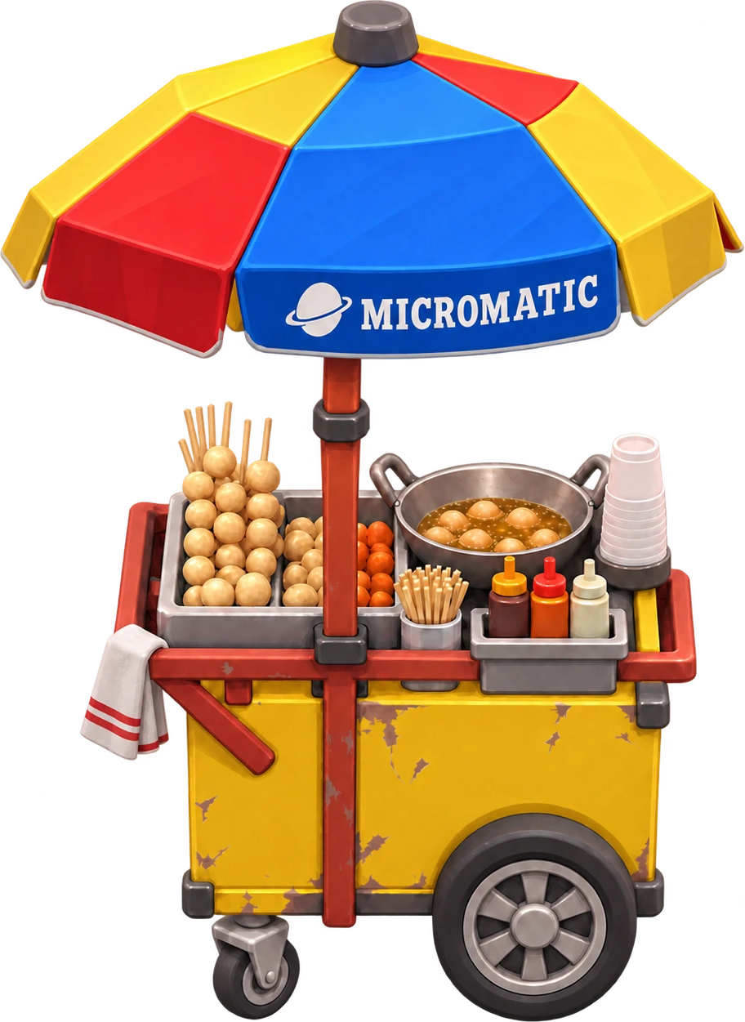
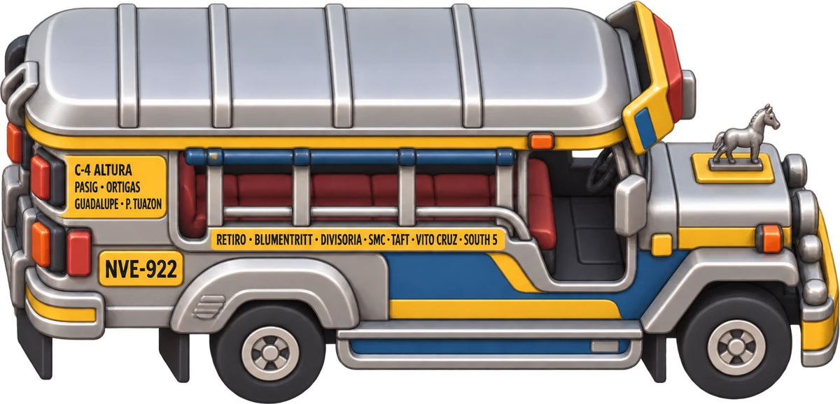
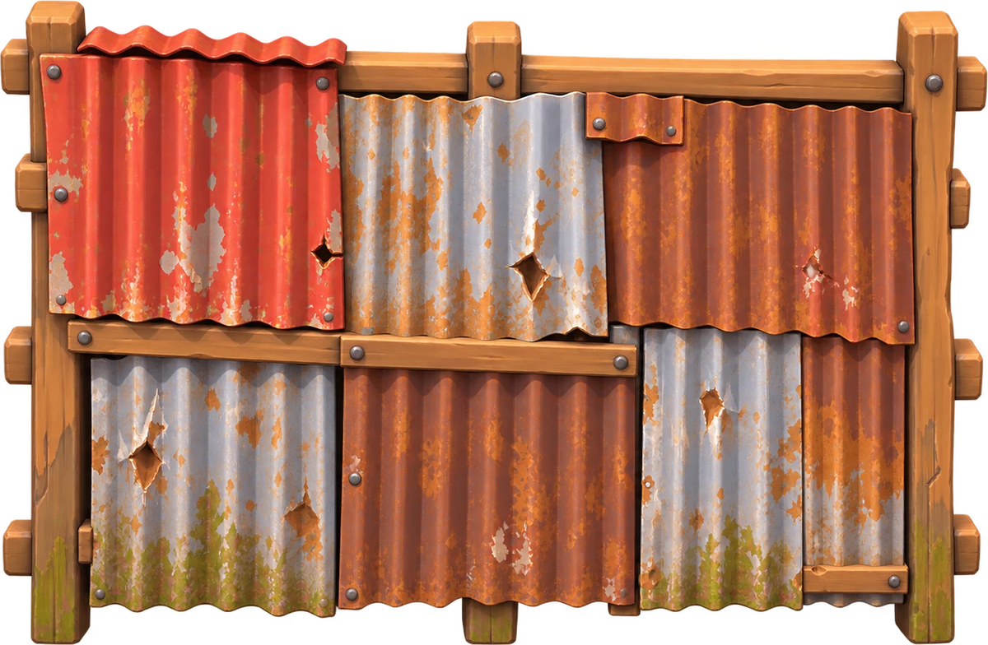



Chunky, painted, Pinoy
Fixed camera
Toy-like 3D
Street details
The whole 24 × 48 m street is always on screen. Nothing shrinks with distance.
Soft shapes, saturated colour and thick silhouettes that read on a 5-inch screen.
Jeepney paint, sari-sari signs, tin roofs, hopscotch chalk and warm daylight.
Notes:
Visual identity: a Clash-style design language, inspired but not copied, with Filipino street details. The boundary pieces here (fishball cart, jeepney, tin fence) stand at the top end of the street in the match.

Slide 9




Built to run on a real phone
One plain APK
Server-authoritative
Android 8+, arm64, portrait only. Only the permissions the game uses. No accounts.
Clients send inputs only. A headless Godot server runs the match, or a host phone does on a hotspot.
One shared simulation
Tested on every build
The same fixed 30 Hz rules run online, offline and in tests. Every number lives in data files.
A full unit and integration suite gates each APK, plus an emulator smoke test.
Notes:
For technical judges: Godot 4.6, GDScript with static types, WebSocket multiplayer, sim/view split so the same rules run everywhere, and a workflow that builds and inspects the APK on every merge.

Slide 10
Where we are, what is next
Playable today
Next up
Agawang Base 3v3 with cards, tags and rescues
12 weapons and six kids
Practice vs bots, Hotspot and Online rooms
Tumbang Preso and Patintero in Practice
Debug APK built and tested on every merge
Check Hotspot and touch feel on real phones
Tumbang Preso and Patintero in rooms
Balance with real-player matches
Signed release build (M6)
Notes:
Keep this honest. Rules, weapons, rooms and the pipeline are in place. What still needs phones is touch feel, Hotspot on real networks and performance. A signed release is the last milestone.

Slide 11
Come play.
Install the APK and play a practice match in under a minute.
kalyeah-promo.vercel.app
Notes:
Close on the call to action: the website has the latest APK. Invite judges to try Practice first.

