Slide 1
Coding Test
Drandreb Earl O. Juanico

Slide 2
Data Ingestion and Structural Validation
Row counts
Main data: 4,158,454 rows
Ports: 10,927 rows
Importer normalized: 46,175 rows
Missing values (nothing much to worry)
Only 3 rows in main data do not have country_of_origin
~0.000072%
Total: 4 TEU (~0.00000074%)

Slide 3
TEU data standardized
string values → floats
TEU<0 → None
Extreme outliers were winsorized

Slide 4
Exploratory Data Analysis
Univariate Analysis
Distribution Inequality
Country Dependency
Logistics Analysis

Slide 5
Univariate Analysis
Purpose: understand distributions and scale
Import Volume
TEU distribution
Overall, per-company, per-country-of-origin, per port-of-unlading
Inequalities
Heavy-tailedness, Lorenz curves, Gini coefficients
Temporal Trends
Monthly TEU trends

Slide 6
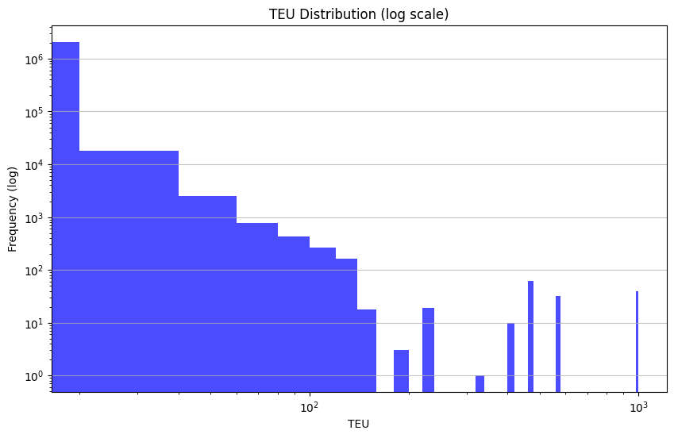
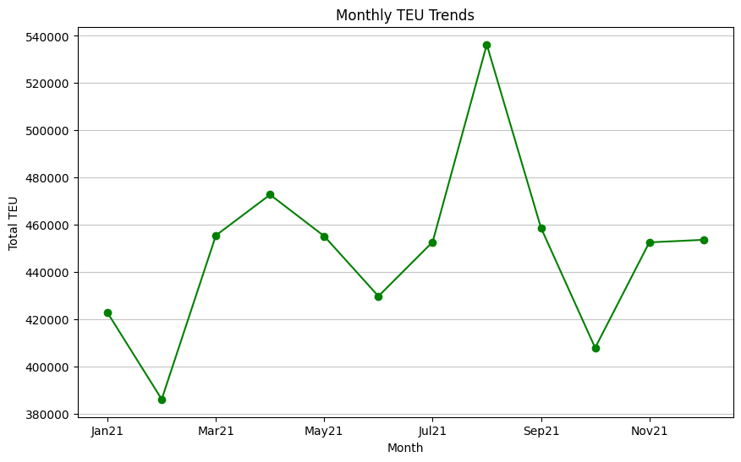
Univariate Analysis
Basis of Importer Segmentation

Slide 7
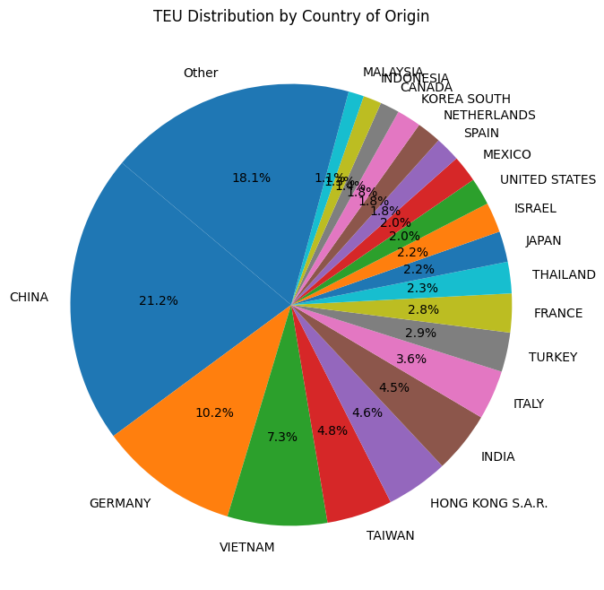
TEU Distribution by Country of Origin
China accounts > 20% of global TEU volume

Slide 8
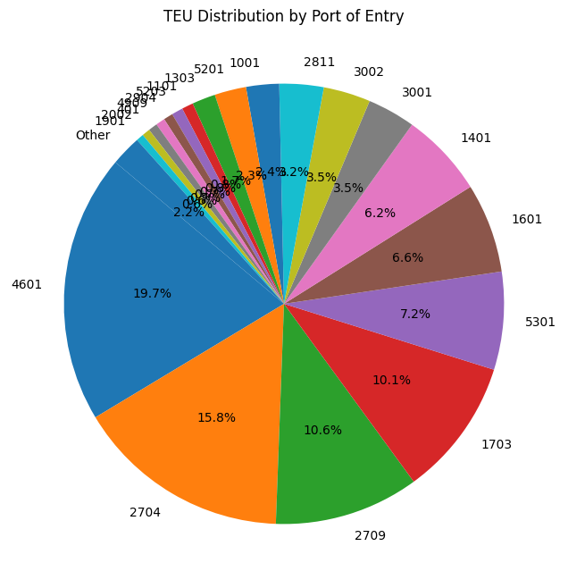
TEU Distribution by Port of Unlading
4601: New York/Newark accounts ~ 20% of entries (East Coast)
2704: Los Angeles, CA (West Coast)

Slide 9
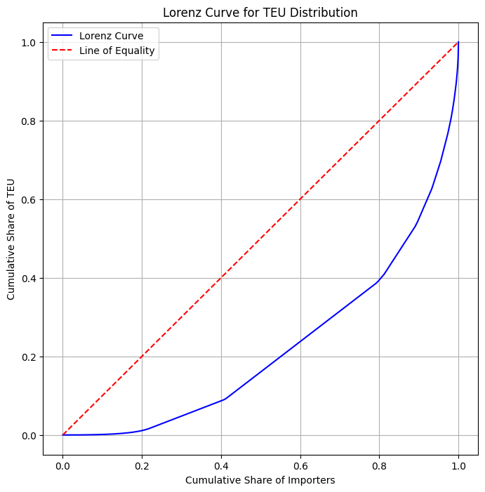
TEU Distribution Inequality by Volume
Gini coefficient: 0.5565
High inequality

Slide 10
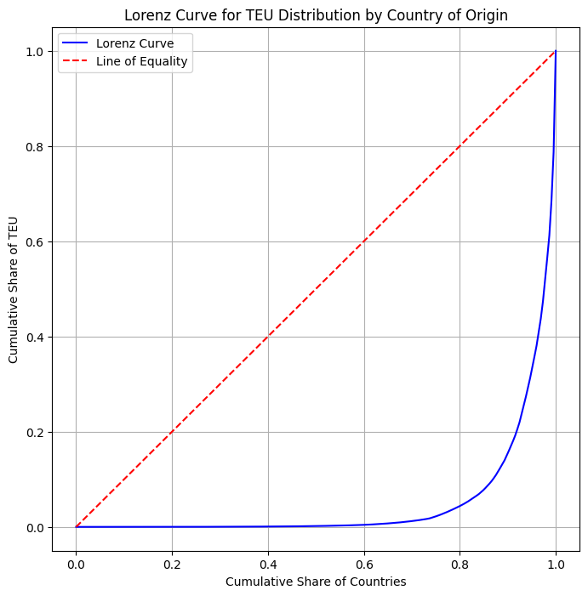
TEU Distribution Inequality by Country of Origin
Gini coefficient: 0.8995
Critically High inequality → vulnerability to geopolitical risk

Slide 11
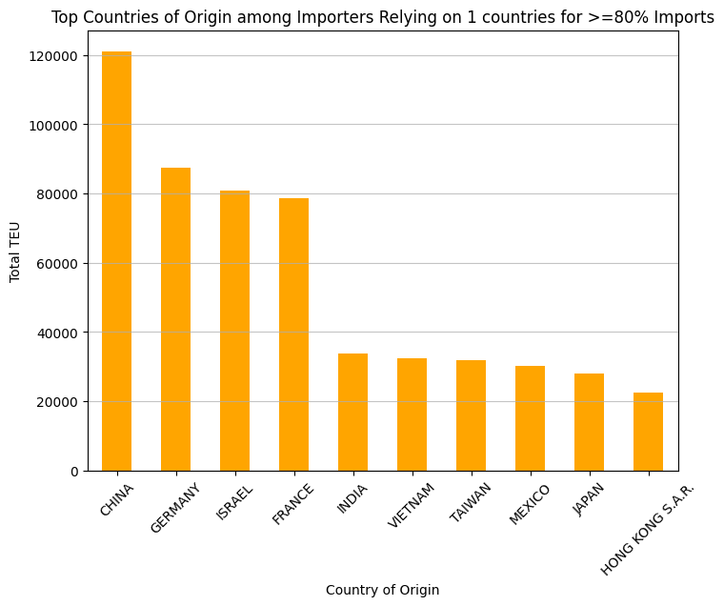
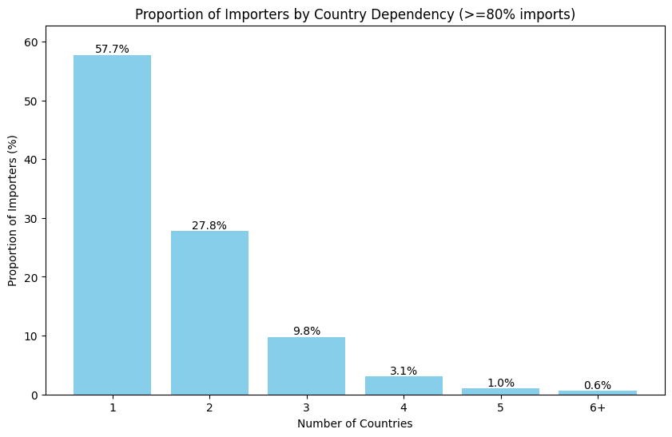
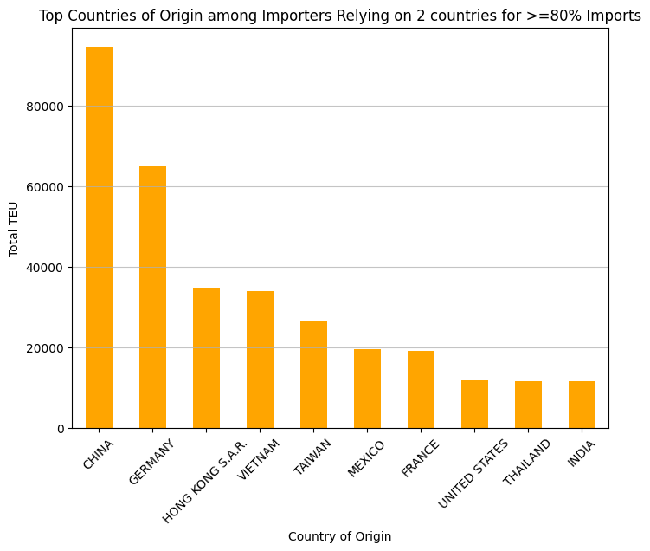
Proportion by Country Dependency
More than 80% of importers rely on at most 2 country sources
Prevalence of Low diversification

Slide 12
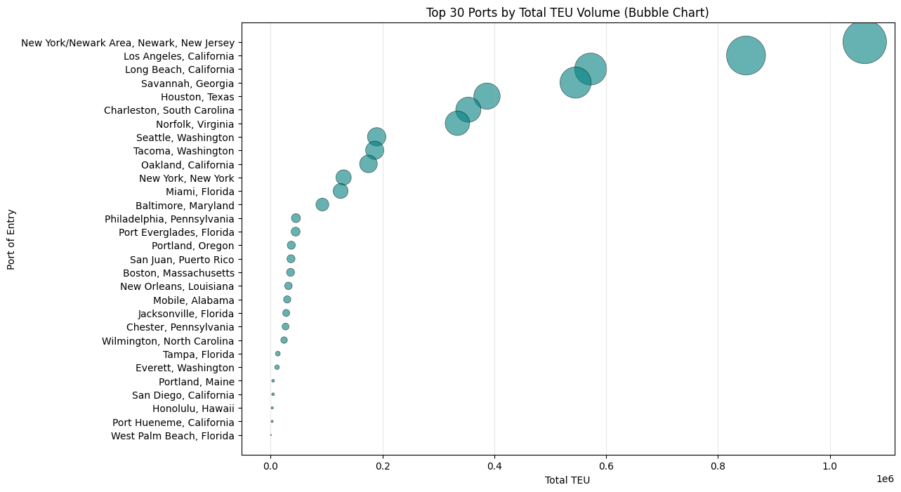
Ports and Logistics Analysis

Slide 13
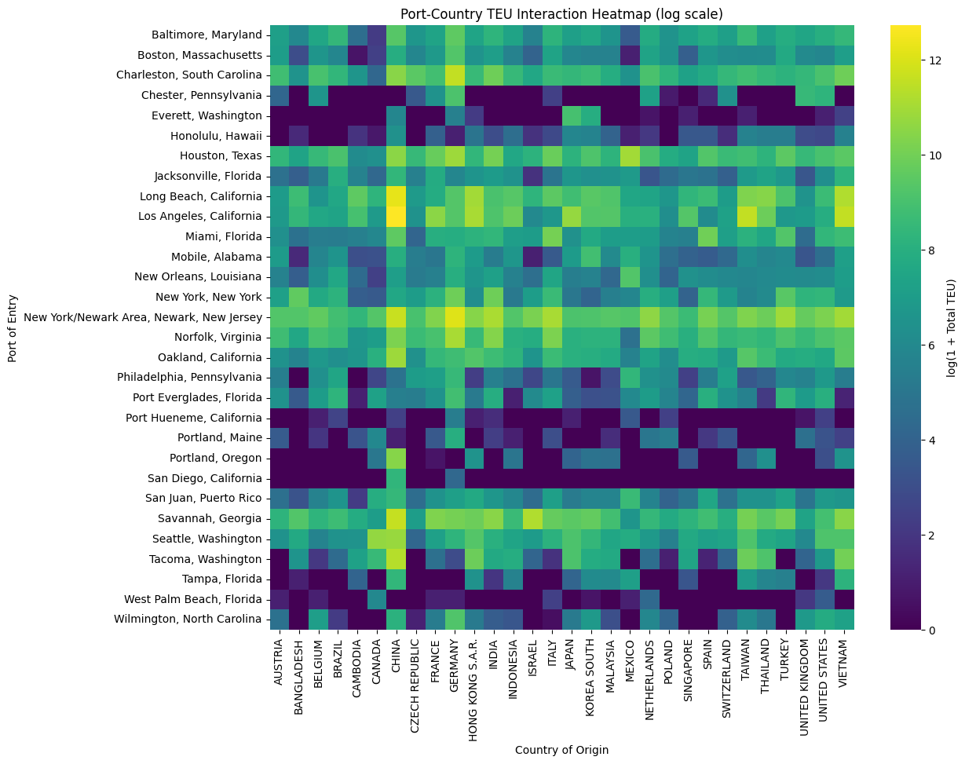
Ports and Logistics Analysis

Slide 14
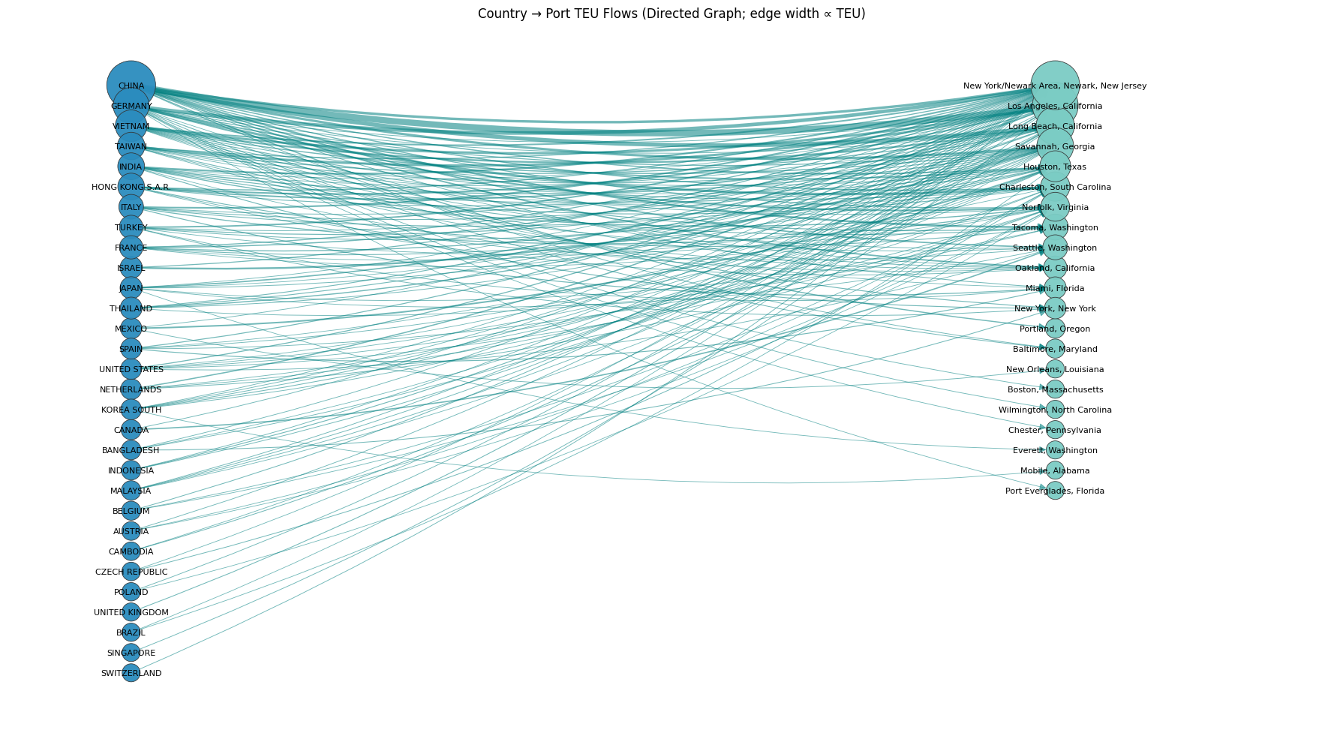
Country → Port TEU Flows
Trans-Pacific and Trans-Atlantic flows dominate
Aligning with China/Germany as top 2 sources

Slide 15
Segmentation
TEU cutoff = 200
Top-2 share cutoff = 80%

Slide 16
Importer Segments
Segment 1 (HVLD)
High-volume/Low-diversification (>=200 TEU; >=80%TEU, <=2 countries)
Segment 2 (HVHD)
High-volume/High-diversiication (>=200 TEU; >=80%TEU, >=3 countries )
Segment 3 (LVLD)
Low-volume/Low-diversification (<200 TEU; >=80%TEU, <=2 countries)
Segment 4 (LVHD)
Low-volume/High-diversification (<200 TEU; >=80%TEU, >=3 countries)

Slide 17
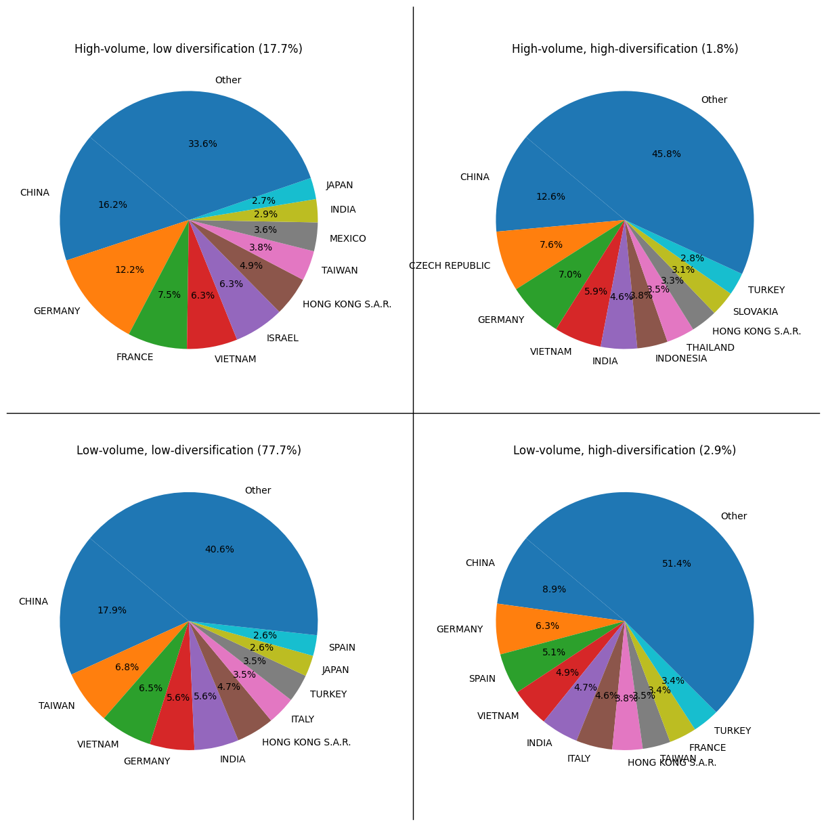
Importer Segments
Segment | Interpretation | Investment Lens
Segment 1 | Large but concentrated | Supply-chain risk
Segment 2 | Large and diversified | Resilient/best-in-class
Segment 3 | Small and concentrated | Fragile long tail
Segment 4 | Small but diversified | Promising growth segment
Segment 1
Segment 2
Segment 3
Segment 4

Slide 18
Predictive ML models
Early-Warning Classifier
Supply-Chain Risk Scoring
Growth/Segment-Upgrade Potential

Slide 19
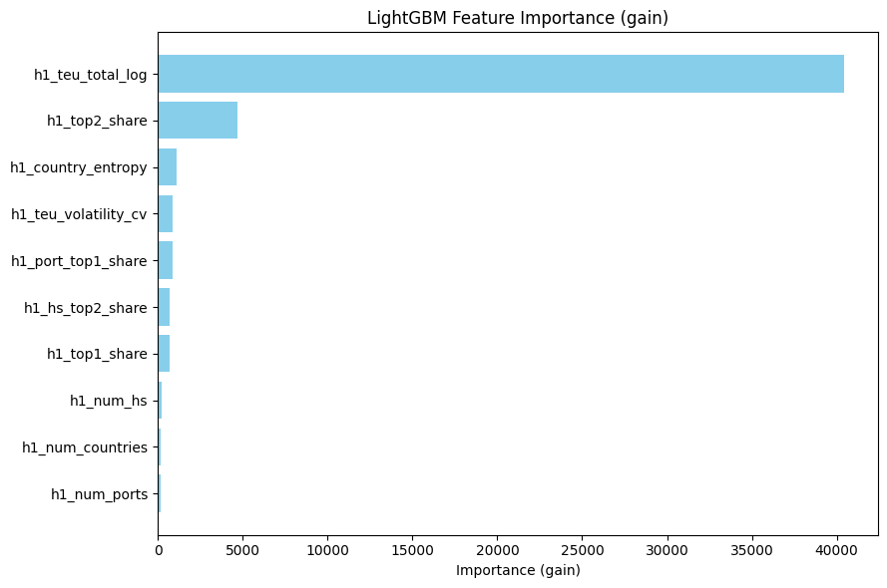
Early-Warning Classifier (Segment 1 Risk)
Binary LightGBM early-warning classifier that uses H1 (≤ June) importer signals to predict whether an importer will end the year as Segment 1:
Early-warning performance. Despite Segment 1 being a minority class (~15%), the LightGBM ranker shows strong discrimination (test ROC-AUC ≈ 0.95; PR-AUC ≈ 0.87). Using only ≤ June signals, it reliably surfaces a small watchlist (e.g., Top-50/100) of importers likely to end the year as high-volume, country-concentrated Segment 1. In practice, false positives can be controlled by selecting an operating point based on Top-K screening capacity rather than a fixed 0.5 threshold.

Slide 20
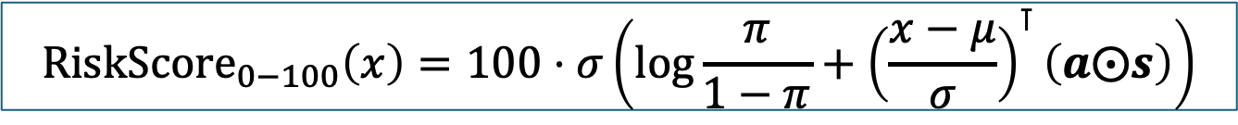
Supply-Chain Risk Scoring
Objective: Estimate the supply-chain fragility of US importers for
Investment screening
M&A due diligence
Scenario stress testing
Target: Continuous risk score (0-100) representing
Likelihood that company’s import operations are meaningfully disrupted by a country-level shock
$${\text{RiskScore}}_{0−100}\left(x\right)=100⋅σ\left(\log{\frac{π}{1−π}+{\left(\frac{x−μ}{σ}\right)}^{⊺}\left(a⨀s\right)}\right)$$

Slide 21
Supply-Chain Risk Scoring
Features
Feature | Derived from
Total annual TEU | Volume axis
% TEU from top 1 country | Concentration
% TEU from top 2 country | Concentration
Number of source countries | Diversification
Segment membership (1-4) | Structural context
Port concentration ratio | Logistics risk
HS code concentration | Product risk
Month-to-month TEU volatility | Stability

Slide 22
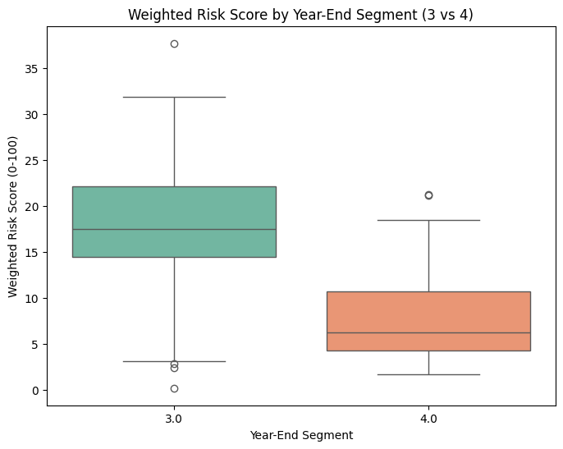
Impact of Diversification
Diversification alone meaningfully separates risk among low-volume importers. Even when TEU is constrained (<200), importers with concentrated sourcing (Segment 3) exhibit systematically higher and more volatile risk scores, while diversified importers (Segment 4) remain consistently low-risk.
Overlap between the two distributions is minimal, which validates that the weighted risk score is not noisy or arbitrary—it is capturing a real structural difference.
Mann-Whitney U test: Segment 3 > Segment 4
U statistic: 24489.0, p-value < 0.0001

Slide 23
Impact of Diversification
Implications for Investment Screening and M&A Due Diligence. By holding volume maximum constant (200 TEU), the Segment 3 vs Segment 4 analysis isolates supply-chain structure as a driver of risk. The clear separation and differential stress sensitivity allow Blume to distinguish between small importers that are fragile by design and those that are resilient by design—enabling faster screening, more targeted diligence, and better risk-adjusted investment decisions.
Mann-Whitney U test: Segment 3 > Segment 4
U statistic: 24489.0, p-value < 0.0001

Slide 24
Scenario Stress Testing
If conditions worsen, which segment becomes fragile faster?
Scenario | Avg Δ Risk (Seg 3) | Avg Δ Risk (Seg 4) | Mann-Whitney U (3>4)
+0.10 top-2 country share | +6.23 | +3.26 | 24489, p-value < 0.001
+50% TEU volume | +0.77 | +0.41 | 23608, p-value < 0.001
-0.5 country entropy | +0.42 | +0.21 | 24489, p-value < 0.001
+0.15 port top-1 share | 0.00 | 0.00 | 13968, p-value = 1.0
+0.2 TEU volatility (CV) | +1.14 | +0.58 | 24489, p-value < 0.001
Segment 3 importers are not only higher-risk at baseline, they are also systematically more sensitive to adverse changes in sourcing concentration and volatility. Segment 4 importers remain comparatively resilient under the same stress scenarios.

Slide 25
Growth/Segment-Upgrade Potential
Objective: Predict which TEU<200 importers are most likely to move into a higher-value segment if volume grows.
Operational details:
Build year-end labels for Segment 1, 2, and 3/4.
Train LightGBM “teacher” models
Distill each teacher into a linear weighted score

Slide 26
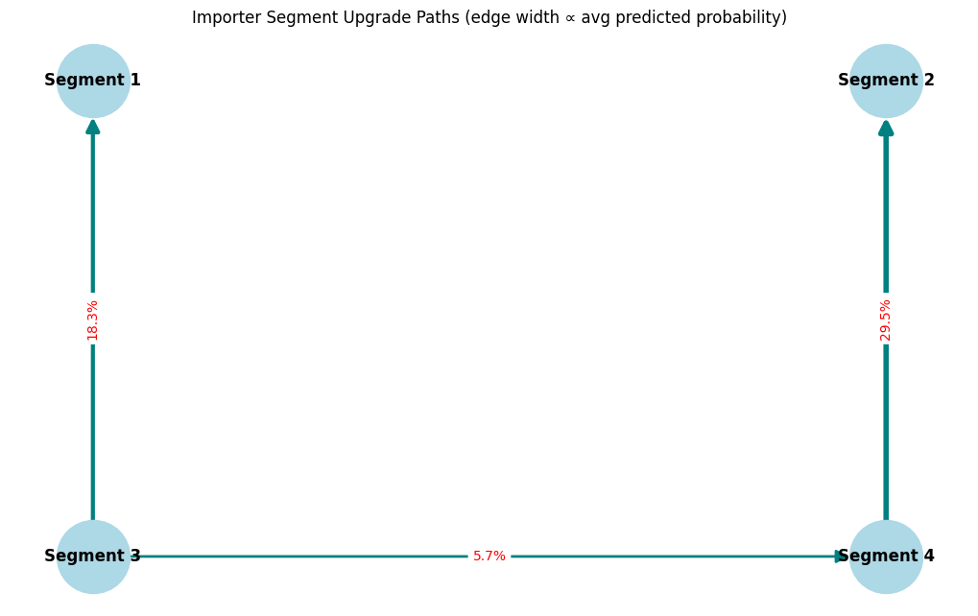
Upgrade Paths: Interpretation
3 → 1 (18.3%): Risk-accumulating growth
Default growth path for small, concentrated importers
Scale volume first, diversify later
4 → 2 (29.5%): Clean, resilient scaling
High-quality growth
Already behave like large, resilient importers—they are just smaller today
Diversification is structural, not accidental
3 → 4 (5.7%): Behavioral upgrade before scale
Rare, but meaningful transition
Operational maturity precedes growth
Changing how they source, not just how much they import
=== Bootstrap Summary of Upgrade Probabilities===
p_31: mean=0.1829, 95% CI=(0.1789, 0.1869)
p_34: mean=0.0573, 95% CI=(0.0528, 0.0622)
p_42: mean=0.2938, 95% CI=(0.2390, 0.3486)

Slide 27
Upgrade Paths: Meaning
3 → 1 (18.3%): Risk-accumulating growth
Likely future Segment 1 importers
Become economically important but structurally risky
Growth increases exposure rather than resilience
4 → 2 (29.5%): Clean, resilient scaling
Highest probability of becoming Seg 2
Scale without creating new fragility
Represent early-stage versions of best-in-class importers
3 → 4 (5.7%): Behavioral upgrade before scale
Watch-list cohort
Not yet attractive on scale
But showing early indicators of disciplined supply-chain design
=== Bootstrap Summary of Upgrade Probabilities===
p_31: mean=0.1829, 95% CI=(0.1789, 0.1869)
p_34: mean=0.0573, 95% CI=(0.0528, 0.0622)
p_42: mean=0.2938, 95% CI=(0.2390, 0.3486)

Slide 28
Upgrade Paths: Actionable Insight
3 → 1 (18.3%): Risk-accumulating growth
Flag these before they become large
Price in supply-chain risk early
Require diversification plans in diligence
Model downside scenarios (tariffs, country shocks)
4 → 2 (29.5%): Clean, resilient scaling
Growth equity
Platform acquisitions
Buy-and-build strategies
Long-term resilient portfolios
3 → 4 (5.7%): Behavioral upgrade before scale
Track these importers longitudinally
They are feeder pool for future Segment 4 winners
=== Bootstrap Summary of Upgrade Probabilities===
p_31: mean=0.1829, 95% CI=(0.1789, 0.1869)
p_34: mean=0.0573, 95% CI=(0.0528, 0.0622)
p_42: mean=0.2938, 95% CI=(0.2390, 0.3486)

