Slide 1
EMporium
Sales Performance report 2022-2025
Territory of Maine:

Slide 2

WHy include the online sales?
-Helps give a more complete revenue picture
Online sales
In- store sales

Slide 3
Northeast Region – Total revenue
$32,846,960.65
Maine's contribution to Northeast region revenue between 2022-2025
Maine – Total Revenue
$2,741,089.55

Slide 4
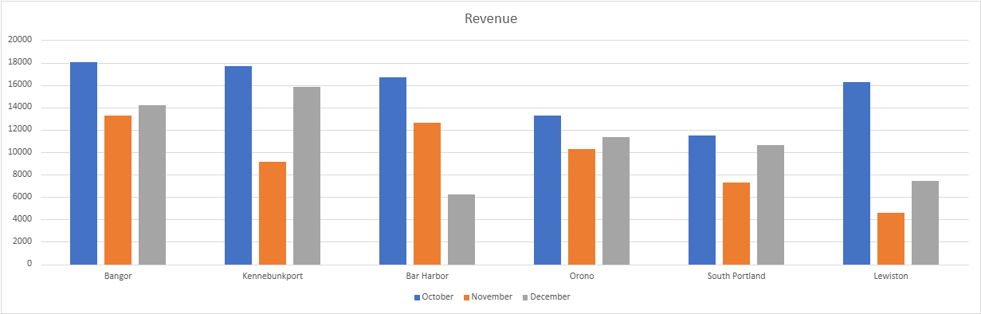
Maine store revenue comparison 2025 q4

Slide 5
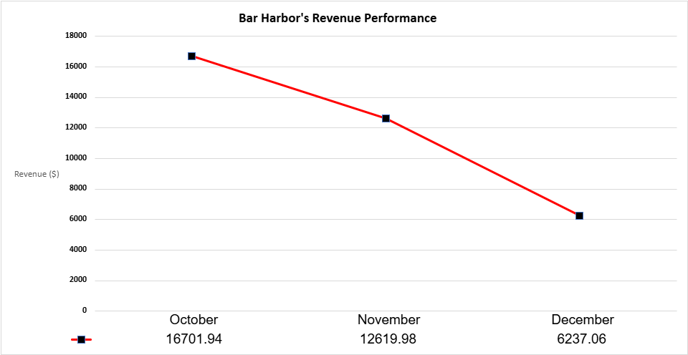
Overall, that's a 62.7% decrease in revenue from October to December.

Slide 6
Q1 2026 recommendations
Focus: Bar Harbor Store
Investigate revenue's decline: Identify potential causes behind the 62.7% decrease
Analyze transaction activity: Determine whether fewer purchases or lower transaction that causes the decline.

