Slide 1

ACLC Enrollment and Student Load Management System
Researchers
Earl Lawrence Llego
Harold Jake Patindol
Jimel Leones
Joelito Laurente
Degree:
Bachelor of Science in Information Technology
Adviser
Ms. Wilna Lynn Albarida

Slide 2
Background & The Problem
Heavy reliance on manual encoding and verification.
Excessive time consumption during peak enrollment seasons.
High risk of inaccurate records and misplaced physical data.
Delays caused by manual checking of financial documents (e.g., GCash receipts).

Slide 3
Project Objectives
General: Automate administrative enrollment workflows with a secure, cross-platform system.
Specifics:
Centralize student data securely.
Automate subject loading and schedule assignment instantly.
Generate official PDF Certificates of Registration (COR).

Slide 4
System Architecture
Frontend (Mobile): React Native with Expo.
Frontend (Web): HTML, CSS, JavaScript, PHP.
Backend (Cloud): Supabase (PostgreSQL).
Architecture: "Single Database Architecture" via IPv4 Session Pooler.

Slide 5
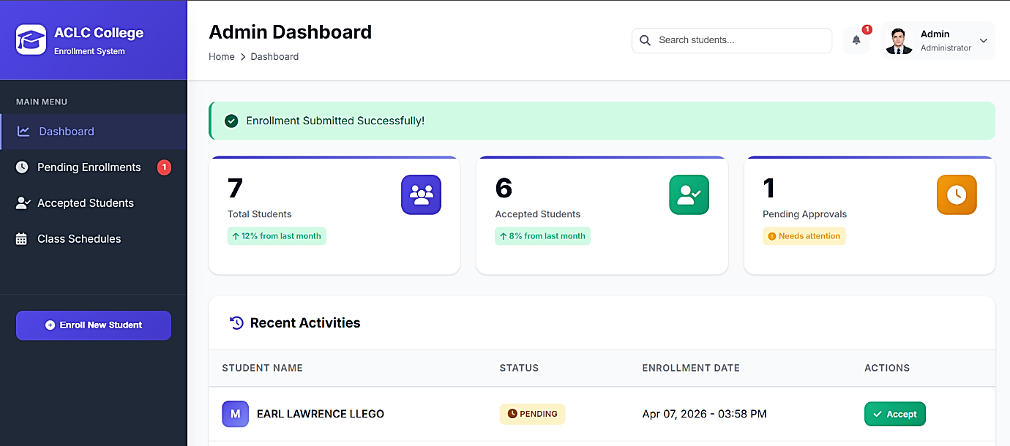
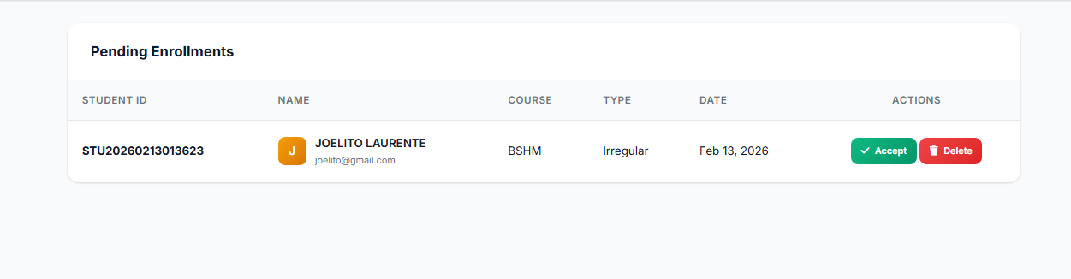
Key Features
Secure 2FA Admin Login via simulated OTP/Email.
Dual-Platform Dashboard (Web & Mobile).
One-Click Automated Subject Loading.
Real-time Cloud Syncing.

Slide 6
Scope and Limitations
Target Users: Administrative staff only (No Student Portal).
Payments: Manual Payment Verification (No live GCash API integration).
Schedules: Static Schedule Templates for subjects.
Data: Permanent deletion (No data recovery).

Slide 7
Thank You!
Researchers:
Earl Lawrence Llego
Harold Jake Patindol
Jimel Leones
Joelito Laurente

