Slide 1

iCFD
A Digital Formation Platform for Catholic Faith Defenders
Presented by Earlrodson Cariño Lead Software Architect / Engineering — Catholic Faith Defenders
iCFD · Board of Governors
1

Slide 2
INTRODUCTION
From Software Engineering to Catholic Apologetics
Almost 17 years in software engineering and architecture
Currently a Line Manager
Experience building software systems and platforms
Involved in CFD through a personal journey of rediscovering and defending the Catholic faith
iCFD · Board of Governors
2

Slide 3
MY JOURNEY
This Did Not Begin as a Software Project
Questions
Study
Apologetics
CFD
iCFD
iCFD · Board of Governors
3

Slide 4
THE PROBLEM
The Information Is There. The Connection Is Missing.
There is already a tremendous amount of Catholic information online:
Bible
Catechism
Church documents
Apologetics
Theology
Church Fathers
Articles and discussions
Where do I start?
What should I study next?
How are these sources connected?
Can I access them offline?
But information is often scattered across different sources.
iCFD · Board of Governors
4

Slide 5
THE PROBLEM WE ARE TRYING TO SOLVE
Five Problems iCFD Was Built to Address
Catholic teaching material is scattered across many disconnected sources — Bible, Catechism, Church documents, apologetics, theology, Church Fathers.
Members don't know where to start or what to study next — there is no guided path through the material.
There is no simple way to evaluate how well a member is actually learning — formation has no measurable feedback loop.
Educators and catechists lack a focused tool to guide members with good content — most teaching still depends on scattered personal effort.
Existing material isn't always available offline or in the member's own language (Cebuano, Tagalog).
iCFD · Board of Governors
5

Slide 6
THE MOMENT ICFD STARTED
It Started With 12 Questions
My wife gave me a list of 12 topics she wanted to understand, and asked me to write explanations so she could study them.
Because Cebuano was difficult for her, I initially created the material in Tagalog and English.
"Why stop at 12 articles when I can build something that can become a library?"
That became the beginning of iCFD.
iCFD · Board of Governors
6

Slide 7
FROM ARTICLES TO PLATFORM
The Idea Grew
12 Questions
↓
Apologetics Articles
↓
The goal evolved from simply providing answers to helping Catholics learn, practice, and defend the faith.
Centralized Catholic Resources
↓
Learning Paths
↓
Quizzes & Progress
↓
Formation Platform
iCFD · Board of Governors
7

Slide 8
VISION
iCFD
A Digital Apologetics and Formation Companion
Apologetics
Formation
Progress
Scripture · Catechism · Church Documents
Church Fathers · theological terminology
Structured learning · quizzes · certificates
Make Catholic formation easier to access, easier to study, easier to connect, and easier to continue.
iCFD · Board of Governors
8

Slide 9
Let Me Show You iCFD
Home
Learn
Search
References
Progress
Offline
The presenter will switch to the live application.
iCFD · Board of Governors
9

Slide 10
CONNECTED KNOWLEDGE
One Question, Many Connections
Apologetics Question
↓
Answer
↓
Scripture
↓
Catechism
↓
Church Fathers
↓
Church Documents
↓
Theological Terms
↓
Related Topics
Implemented — screenshot follows
iCFD · Board of Governors
10

Slide 11
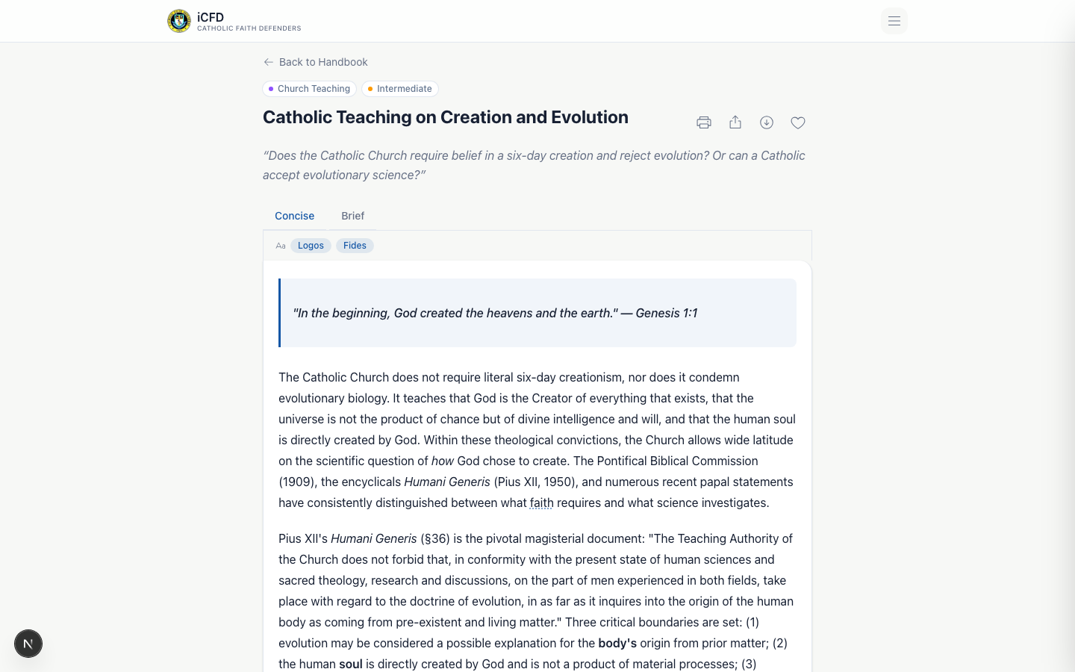
LIVE APPLICATION
A Real Topic Page — in Cebuano
iCFD · Board of Governors
10a

Slide 12
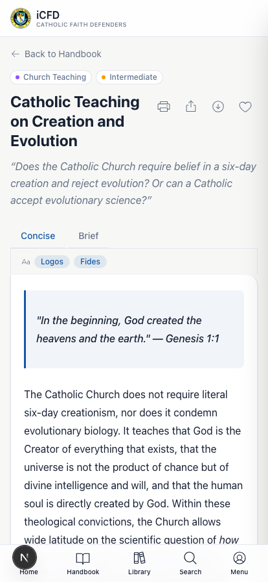
OFFLINE FIRST
Formation Should Not Depend on Internet Access
iCFD is built as a Progressive Web App (PWA) with real offline capability — service worker caching, installable icon set, offline content access.
Live demo:
Load content
Disable internet
Open previously downloaded content
Continue reading
Implemented
iCFD · Board of Governors
11

Slide 13
FROM READING TO LEARNING
Reading Is Not the Same as Formation
Learning Paths
Course progression
Topic completion
Quizzes
Passing thresholds
Progress tracking
Certificates
Read
Understand
Test
Progress
Complete
Certificate
Implemented end-to-end — quiz completion auto-issues a certificate
iCFD · Board of Governors
12

Slide 14
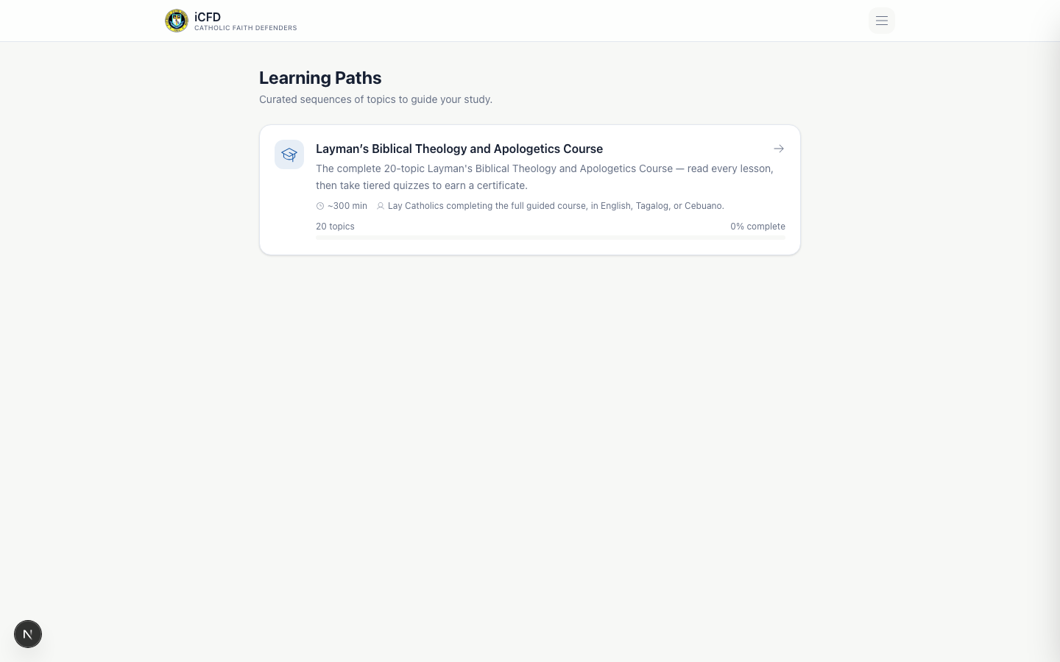
CFD FORMATION
Bringing CFD Formation Into a Digital Experience
The CFD Layman's Biblical Theology and Apologetics Course provides a structured formation framework with 20 themes/topics.
Course
↓
Topic
↓
Study Material
↓
Quiz
↓
Certificate
The complete question bank is still being developed. This course is live in the product, but not every topic yet has a full quiz bank.
iCFD · Board of Governors
13

Slide 15
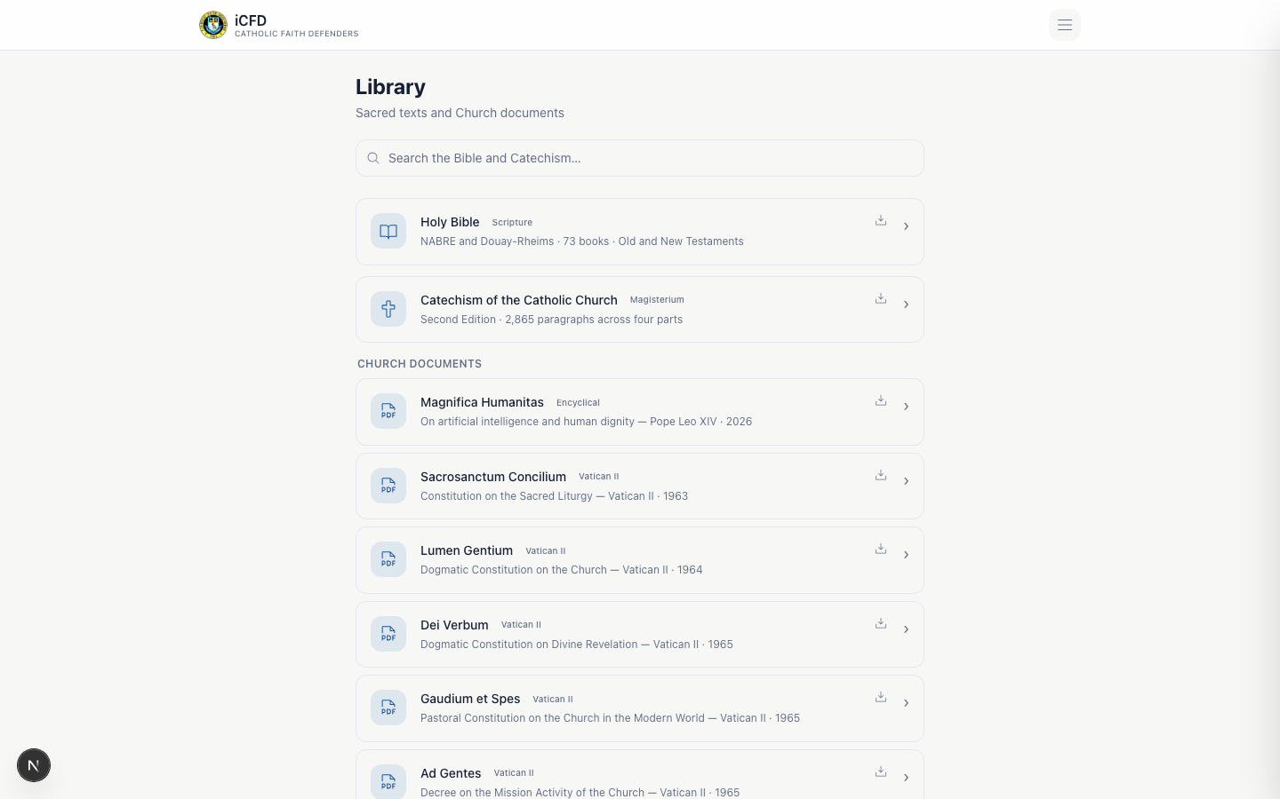
CATHOLIC REFERENCE LIBRARY
A Central Place to Find the Sources
Holy Bible — NABRE & Douay-Rheims
Catechism of the Catholic Church — 2,865 paragraphs
Church documents — Vatican II constitutions & encyclicals
General Instruction of the Roman Missal
Code of Canon Law
Church Fathers & apologetics topics
The goal is to connect sources to the topics being studied.
iCFD · Board of Governors
14

Slide 16
THEOLOGICAL ETYMOLOGY
Sometimes the Meaning Is in the Word
ekklesia
latria
dulia
Greek → assembly, called-out ones → "Church"
Worship due to God alone
Veneration given to saints
Theotokos
kecharitomene
"God-bearer" — title of Mary
"Full of grace" — Luke 1:28
The objective is to help the defender understand terminology behind theological arguments — not merely memorize conclusions.
iCFD · Board of Governors
15

Slide 17
CFD RESOURCES
From Personal Study to CFD Formation
CFD members & formation materials
Presentations & apologetics resources
Learning paths & certificates
User progress & administrative content management
Personal study tool
CFD formation infrastructure
Partially implemented — foundations built, org-wide rollout is a direction, not a current state
iCFD · Board of Governors
16

Slide 18
ADMINISTRATION & ANALYTICS
If We Care About Formation, We Need Visibility
User management
Topic & reference management
Learning paths & quiz management
Certificates
Presentations
Activity & learning analytics
What are members studying? Which topics are being completed? Where are learners struggling? Which materials are actually being used?
Implemented
Geo-analytics dashboard: in active development
The objective is formation insight, not surveillance.
iCFD · Board of Governors
17

Slide 19
CURRENT ARCHITECTURE
How iCFD Works
Users (web + installed PWA)
↓
iCFD Web App — Next.js, hosted on Vercel
↓
Backend — API routes on the same platform
↓
Supabase — Database, Authentication, Storage
Content domains stored in the database: Topics · Bible · Catechism · Canon Law · GIRM · Church Documents · Church Fathers · Learning Paths · Quizzes · Certificates · Users · Analytics.
iCFD · Board of Governors
18

Slide 20
WHY THIS ARCHITECTURE
Designed to Start Small and Scale With Evidence
Cloud-hosted, managed infrastructure — no servers to maintain ourselves
Progressive Web App — one codebase, works on any device, installable
Centralized database with authentication and file storage
Offline-capable client
Infrastructure that scales up only when usage requires it
Do not pay for capacity we do not yet need.
iCFD · Board of Governors
19

Slide 21
CURRENT INFRASTRUCTURE COST
What Does It Cost Today?
Service | Current Plan | Cost
Vercel (hosting) | Free tier | ₱0
Supabase (database, auth, storage) | Free tier | ₱0
Domain | [INSERT CURRENT DOMAIN COST] | [INSERT ₱/year]
Other services | [INSERT IF ANY] | [INSERT ₱]
Total recurring |  | [INSERT ₱X]
The current deployment intentionally operates within free-tier infrastructure, appropriate for the current pilot and user base.
iCFD · Board of Governors
20

Slide 22
WHEN DO WE UPGRADE?
We Upgrade Based on Usage — Not the Calendar
Capacity
Usage
Reliability
Database/storage limits · Bandwidth · Function limits
Growing users · Concurrent usage · Increasing traffic
Backup requirements · Monitoring · Availability
Product growth
Organization
Larger content library · Advanced analytics
Additional organizational features
Scale when the evidence says we need to scale.
iCFD · Board of Governors
21

Slide 23
FUTURE COST MODEL
Scaling the Platform
STAGE 1 — CURRENT
STAGE 2
STAGE 3
Pilot
CFD Davao
Organization-Wide
Free/low-cost infrastructure
Validate concept
Build content
Measure adoption
More users
More content
More learning activity
Paid infrastructure where required
Larger user base
Higher reliability requirements
More advanced administration
Infrastructure becomes an organizational investment
iCFD · Board of Governors
22

Slide 24
ROADMAP
Where iCFD Goes From Here
TODAY — Digital Library + Apologetics
↓
Guided Learning
↓
Quizzes + Certification
↓
CFD Chapter Formation Support
↓
Organization-Wide Formation Platform
Everything below "Today" is described as a planned direction, not an existing feature.
iCFD · Board of Governors
23

Slide 25
WHAT ICFD IS NOT
iCFD Does Not Replace the Church
It does not replace:
Priests
Catechists
CFD leaders
Personal formation
Parish communities
The Magisterium
Technology should serve formation — not replace it.
iCFD is a tool for formation and access to Catholic resources. It does not replace the teaching authority of the Church or formation provided by priests, catechists, and CFD leaders.
iCFD · Board of Governors
24

Slide 26
A Tool to Support Our Educators
iCFD gives our educators a focused way to bring good, guided content to CFD members — a new way of teaching, not a replacement for it. It also gives us something we've never had: a simple, data-driven way to see how well members are actually learning.
"I would now like to open the floor for questions, recommendations, and guidance from the Board."
iCFD · Board of Governors
25

