Slide 1

Beijing’s Atmosphere: A Multi-Site Air Quality Analysis (2013-2017)
Moving from Raw Sensor Data to Predictive Environmental Insights
Presenter: Earl Tavera

Slide 2
From Fragmented Files to a Continuous Timeline
Consolidation: Merged 12 separate station datasets into a single unified master file.
Imputation (Handling Missing Data): Utilized Forward Filling (ffill) to patch sensor downtimes.
Temporal Alignment: Engineered a unified datetime column from fragmented year/month/day/hour data.

Slide 3
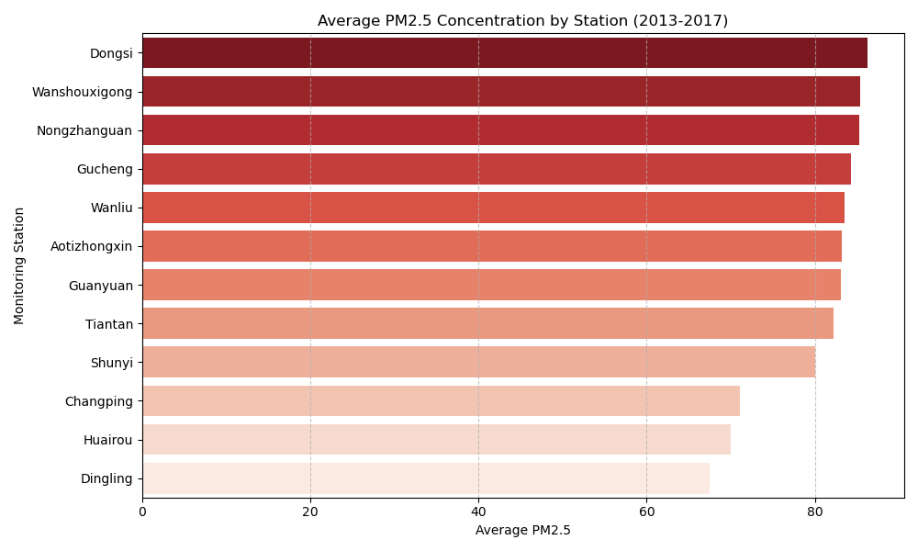
Identifying the Epicenter: Station Ranking by PM2.5
Methodology: Grouped the historical data by station and calculated the 4-year average PM2.5 concentration.
The Finding: Pollution is not uniformly distributed across Beijing.
The Target: Dongsi emerged as the station with the worst overall air quality.

Slide 4
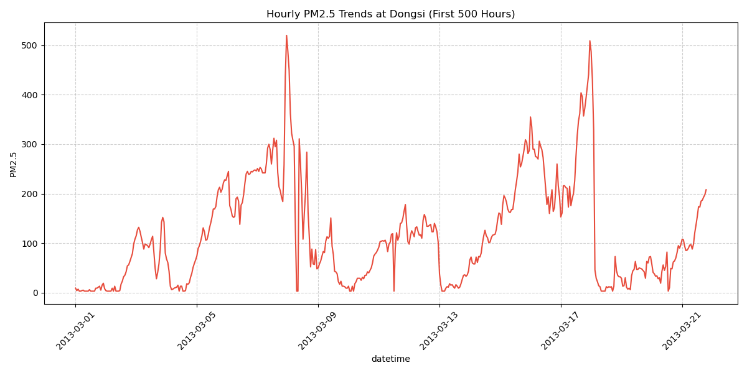
Acute Pollution Events: Hourly Trends at Dongsi
Observation Scale: The first 500 hours (~20 days) at the Dongsi station.
Trend Analysis: PM2.5 does not hover at a steady state; it features extreme, sudden spikes.
Health Implication: PM2.5 levels can jump from safe to hazardous (over 500) in a matter of hours.

Slide 5
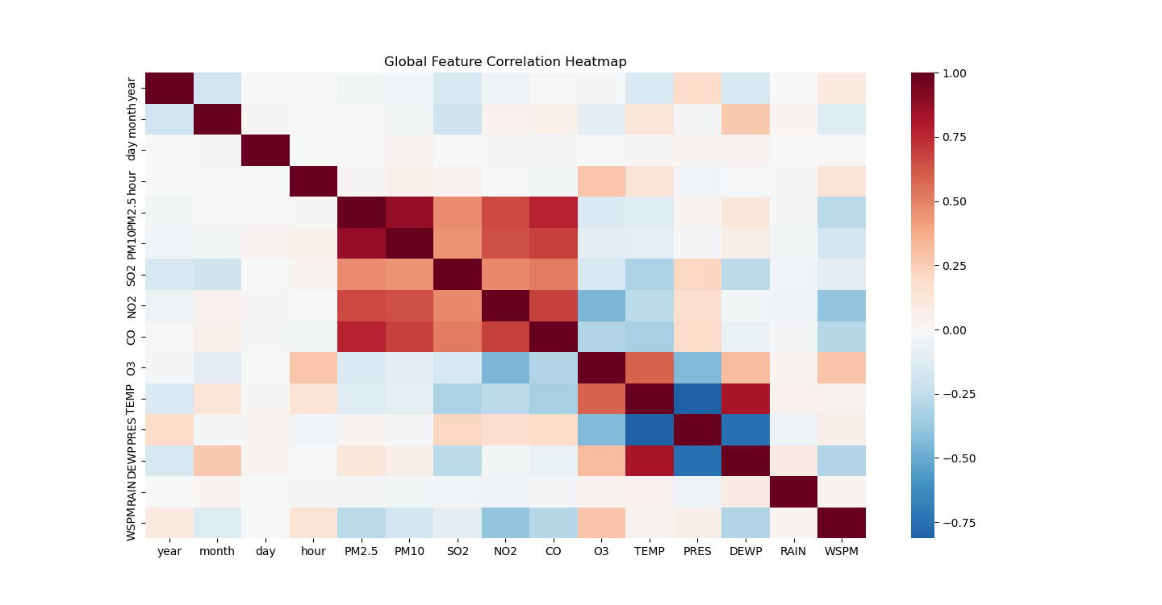
Correlation Matrix: What Controls the Air Quality?
The Matrix: A Pearson Correlation Heatmap showing the relationship between all variables.
Shared Sources (Dark Red): PM2.5 strongly correlates with PM10 and Carbon Monoxide (CO).
The Natural Cleanser (Dark Blue): PM2.5 has a strong negative correlation with Wind Speed (WSPM).

Slide 6

From Reactive Monitoring to Predictive Action
Meteorology over Emissions: Daily air quality is dictated just as much by wind patterns as it is by daily emissions.
Targeted Interventions: City planners must focus interventions on high-risk geographic pockets like Dongsi.
Future Potential: This data pipeline can serve as the foundation for Machine Learning models to forecast smog events days in advance.

