Slide 1
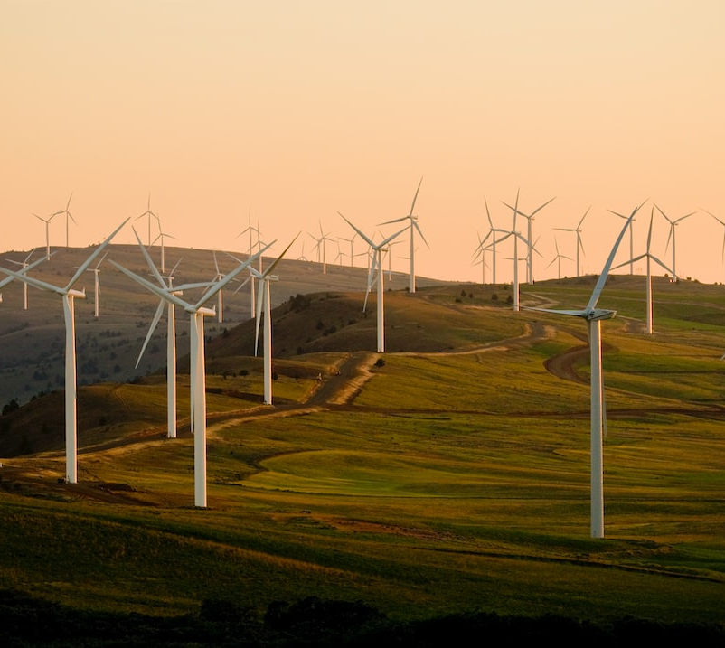
ECO-ANALYSIS
A GLOBAL LOOK AT CO2 EMISSIONS, GPD AND POPULATION
DANIELA CASTELLON
ERICA GRABOYES
HADDI FADIA
LACEY MORGAN

Slide 2

AGENDA
The data: sources, wrangling and modeling
Loading the database and building the API
Walkthrough of our interactive visualizations of our data - created using Apex charts
Questions

Slide 3

THE DATA
CO2 emissions by source, total and per capita data for ~200 countries: https://www.kaggle.com/datasets/thedevastator/global-fossil-co2-emissions-by-country-2002-2022
GDP and population data: https://databank.worldbank.org/reports.aspx?source=world-development-indicators#
Continent code data: https://datahub.io/core/continent-codes
Latitude/longitude for each country: https://public.opendatasoft.com

Slide 4

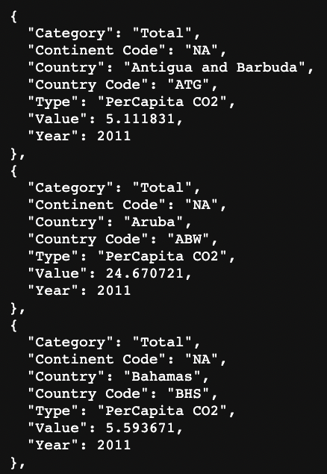

API
ENDPOINTS
/api/v1/countries?year=2011:
/api/v1/continent_per_capita/NA?year=2011
/api/v1/continent_totals/NA?year=2011
Powered by:

Slide 5

Questions?

Slide 6
THANK
YOU
DANIELA CASTELLON
ERICA GRABOYES
HADDI FADIA
LACEY MORGAN

