Slide 1
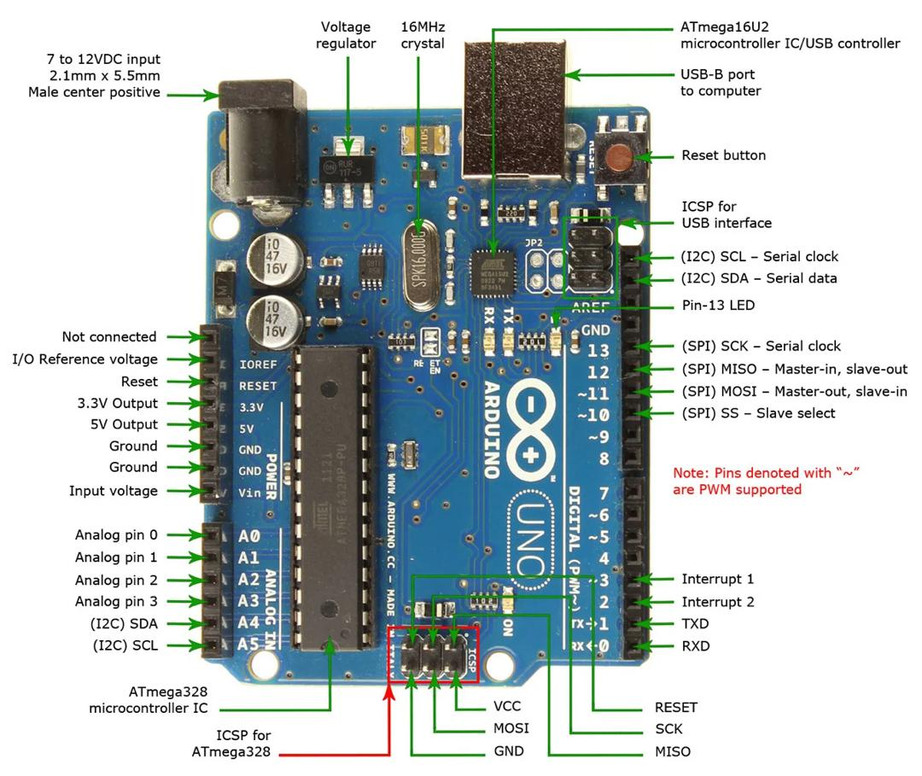
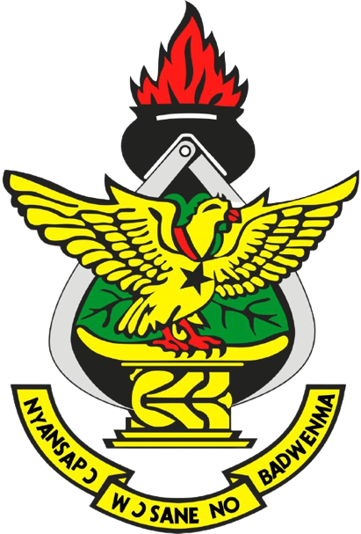
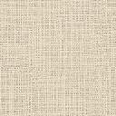

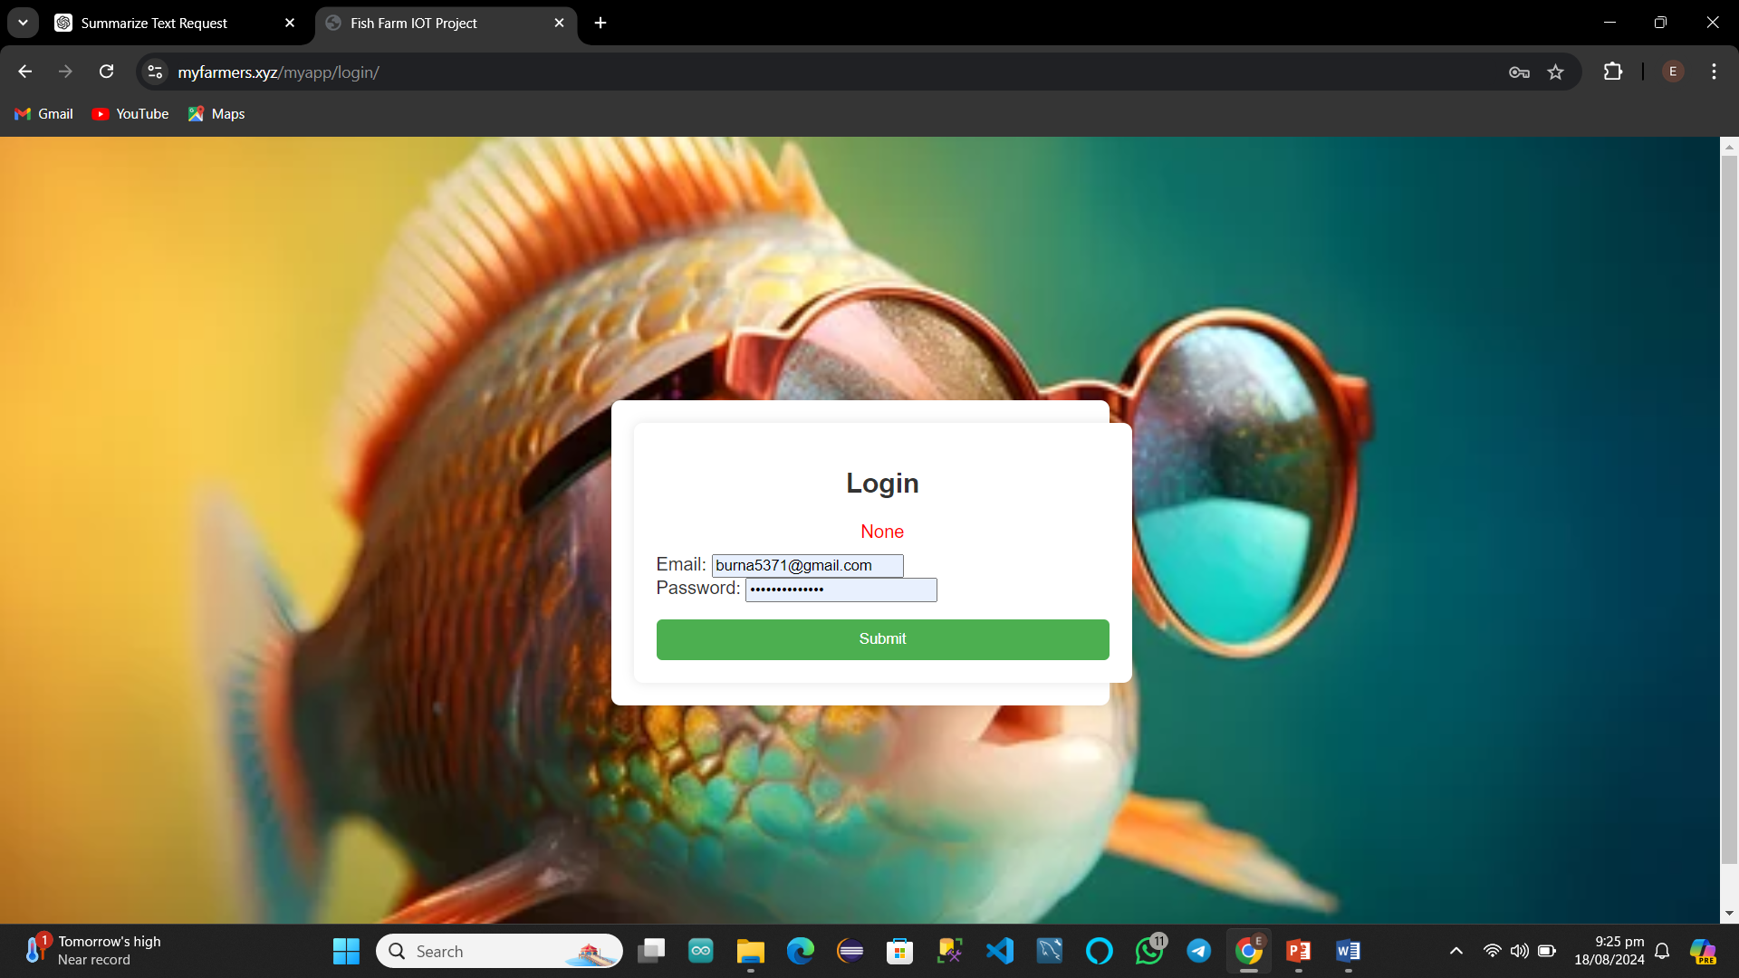
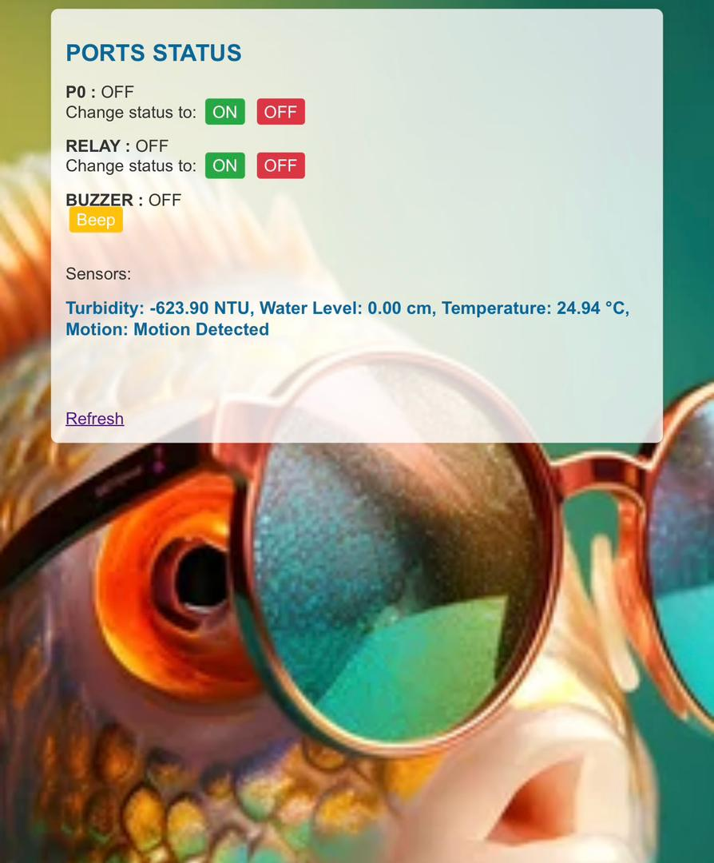
DESIGN AND IMPLEMENTATION OF IOT FOR MONITORING FISH FARM ACTIVITIES ON A FISH FARM AND SHARING STATISTICS
EMMANUEL ARMAH SAKYI AND ABDUL WAHAB BOAKYE
SUPERVISOR: DR. KWAME OFOSUHENE PEASAH
ABSTRACT
AIMS AND OBJECTIVES
RESULT ANALYSIS
Using the Internet of Things (IoT) to Share Statistics and Monitor Fish Farm Activities. Monitoring fish farm operations can be significantly improved by integrating the Internet of Things (IoT) into aquaculture. This project investigates the deployment of an Internet of Things (IoT)-based system intended to improve fish farming production and efficiency through real-time data processing and monitoring. The system continuously monitors important parameters such water temperature, Turbidity, water level, and motion detection near the fish farm using a variety of sensors and devices. These sensors send their collected data to a central computer, where it is processed and examined to produce insights that can be put to use.
To monitor water quality by regularly checking water temperature, water levels, turbidity and check motion.
To monitor water quality by regularly checking water temperature, water levels, turbidity and check motion.
To analyze data and provide useful insights and suggestions.
Enhanced User Experience: The web app offers interactive and responsive features, with quick feedback on user interactions and efficient data retrieval.
Scalability and Flexibility: The design ensures that buttons and icons are easy to use and adapt to various needs, providing a seamless experience.
Security: User data and app information are protected through the SSL certificates on the Google Cloud Server.
Reliable Communication: Secure real-time data exchange is ensured between the Arduino board and MQTT broker.
METHODOLOGY AND PROJECT TOOLS
The IoT-based fish farm monitoring system was developed by researching existing methods, selecting and testing sensors, and refining the design through prototyping. Automated controls like relays and buzzers were added for equipment management and alerts. A user-friendly interface was designed for easy monitoring and control. Feedback from testing improved the system, ensuring a reliable and effective solution for monitoring fish farms.
The project utilized various tools including the Arduino board for sensor integration, temperature, turbidity, water level, and motion sensors for data collection, and relays and buzzers for automated control and alerts. A user-friendly interface was developed for monitoring and managing the system
USER INTERFACE
INTRODUCTION
Fish farming, also known as aquaculture, plays a crucial role in meeting the global demand for seafood. However, traditional farming methods often lack real-time monitoring capabilities, leading to inefficiencies, increased operational costs, and environmental risks. The proposed project addresses these challenges by leveraging IoT and smart farming technology to monitor various parameters such as water quality, feeding behavior, and environmental conditions.
PROBLEM STATEMENT
INPLEMENTATION AND TESTING
Fish farming requires constant monitoring of water quality, fish health, and other environmental factors. Traditional methods of checking these conditions are often manual, time-consuming, and prone to mistakes. Without accurate and timely information, fish farmers can face issues like poor water quality, unhealthy fish, and even large-scale fish deaths. This can lead to financial losses and inefficiencies in the farming process. There is a need for an automated system that can continuously monitor the fish farm, provide real-time data, and help farmers make better decisions to ensure the health and productivity of their fish.
Hardware Setup: Connected sensors (temperature, turbidity, water level, motion) and controls (relays, buzzers) to the Arduino board.
Software Development: Programmed the Arduino to handle sensor data, control signals, and activate relays and buzzers. Created a simple interface for monitoring and control.
Integration: Combined hardware and software to ensure everything worked together smoothly.
Prototype Testing: Tested each component in a controlled setting to fix any issues with sensor readings or connections.
Field Testing: Deployed the system in an actual fish farm to check data accuracy and control functions. Ensured relays and buzzers worked as intended.
CONCLUSION
The system was developed to help fish farmers manage their farms better. Even though there were challenges during development, the project successfully met its goals. The system works as expected and will give farmers real-time monitoring and control once it's in use.

