Slide 1

Offline Reinforcement Learning Through Action Constraints

Slide 2
Project Team
Members: David Earnest
Advisor: Prof. Badri Vellambi

Slide 3
Goals
Goal 1: Develop a new approach for offline reinforcement learning that improves upon current approaches.
Goal 2: Avoid using “hacks” without theoretical grounding like artificially decrease the learned Q-values for out-of-distributions state, action pairs.
Goal 3: Ensure approach is simple and intuitive.

Slide 4
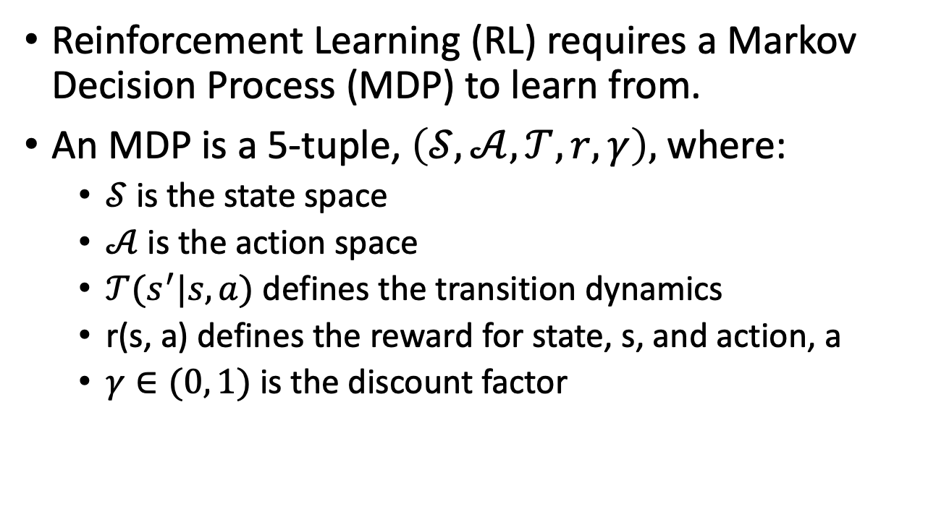
Background: Markov Decision Process
Reinforcement Learning (RL) requires a Markov Decision Process (MDP) to learn from.
An MDP is a 5-tuple, $\left(𝒮, 𝒜, 𝒯, r, γ\right),$ where:
$𝒮$ is the state space
$𝒜$ is the action space
$𝒯(s^{′}|s, a)$ defines the transition dynamics
r(s, a) defines the reward for state, s, and action, a
$γ∈(0, 1)$ is the discount factor

Slide 5
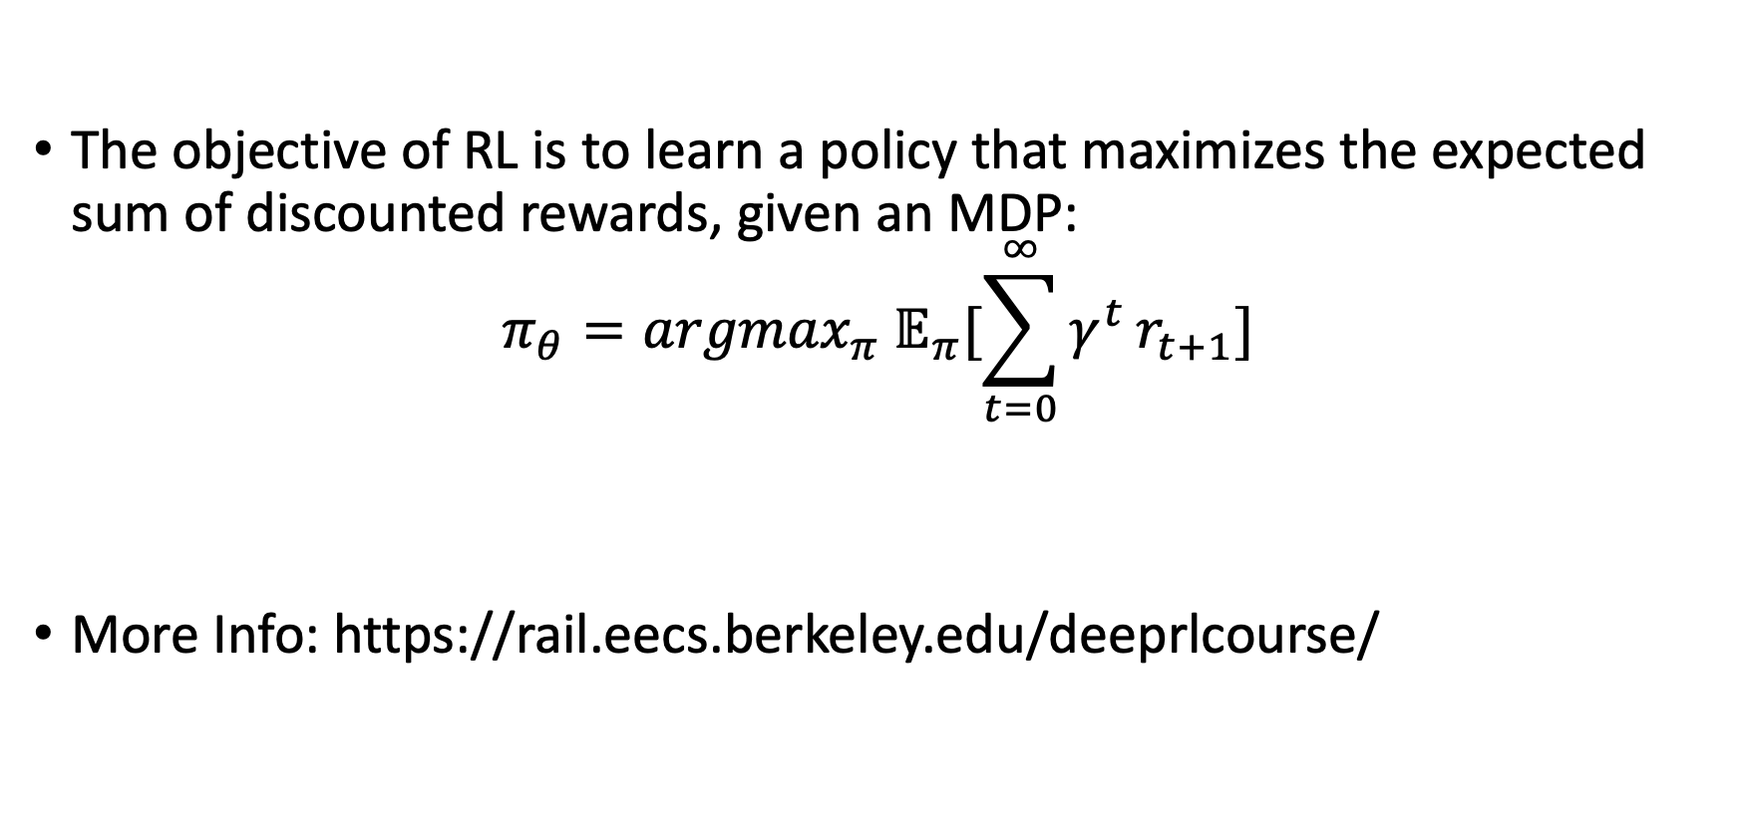
Background: Reinforcement Learning
The objective of RL is to learn a policy that maximizes the expected sum of discounted rewards, given an MDP:
$$π_{θ}={argmax}_{π} 𝔼_{π}[\sum_{t=0}^{∞}{γ^{t}}r_{t+1}]$$
More Info: https://rail.eecs.berkeley.edu/deeprlcourse/
Notes:
Expectation is over the policy
policy takes in a state and returns an action

Slide 6

Background: Online Reinforcement Learning
Traditional Online RL approaches learn by directly interacting with the environment.
The agent takes an action, and the MDP responds with a new state and reward.
The agent uses these rewards to learn.
Notes:
Expectation is over the policy
policy takes in a state and returns an action

Slide 7
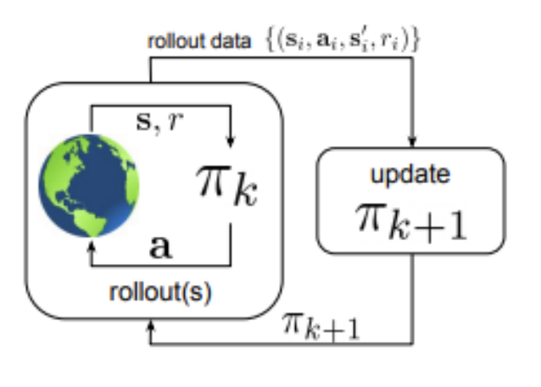
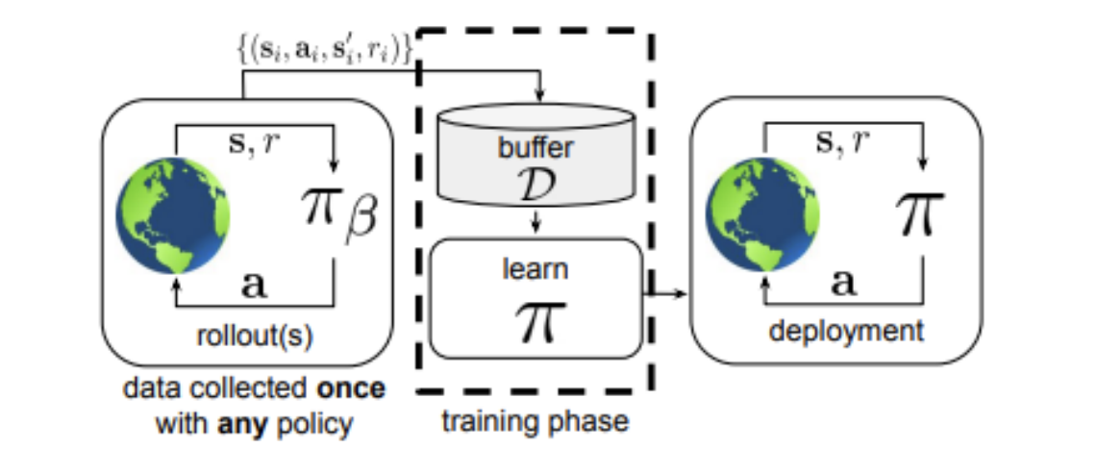

Background: Offline RL (Part 1)
Given a dataset $D=\{\left(s_{0}, a_{0}, r_{0}, {s′}_{0}\right), …,\left(s_{n}, a_{n}, r_{n}, {s′}_{n}\right)\}$ collected from some policy $π_{β}$
Learn the best policy supported by the dataset; never interact with the environment while training
Online RL
Offline RL
Notes:
Offline RL doesn't have to interact with the real-world while training.
Off-policy approaches work in theory, but run into issues with out of distirbution action

Slide 8
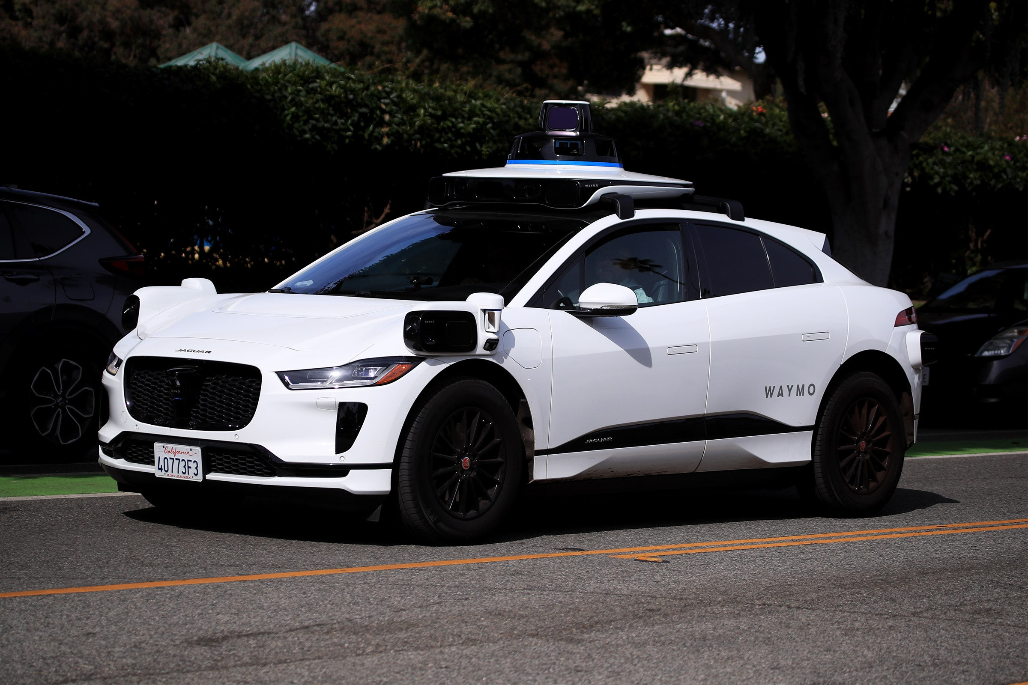
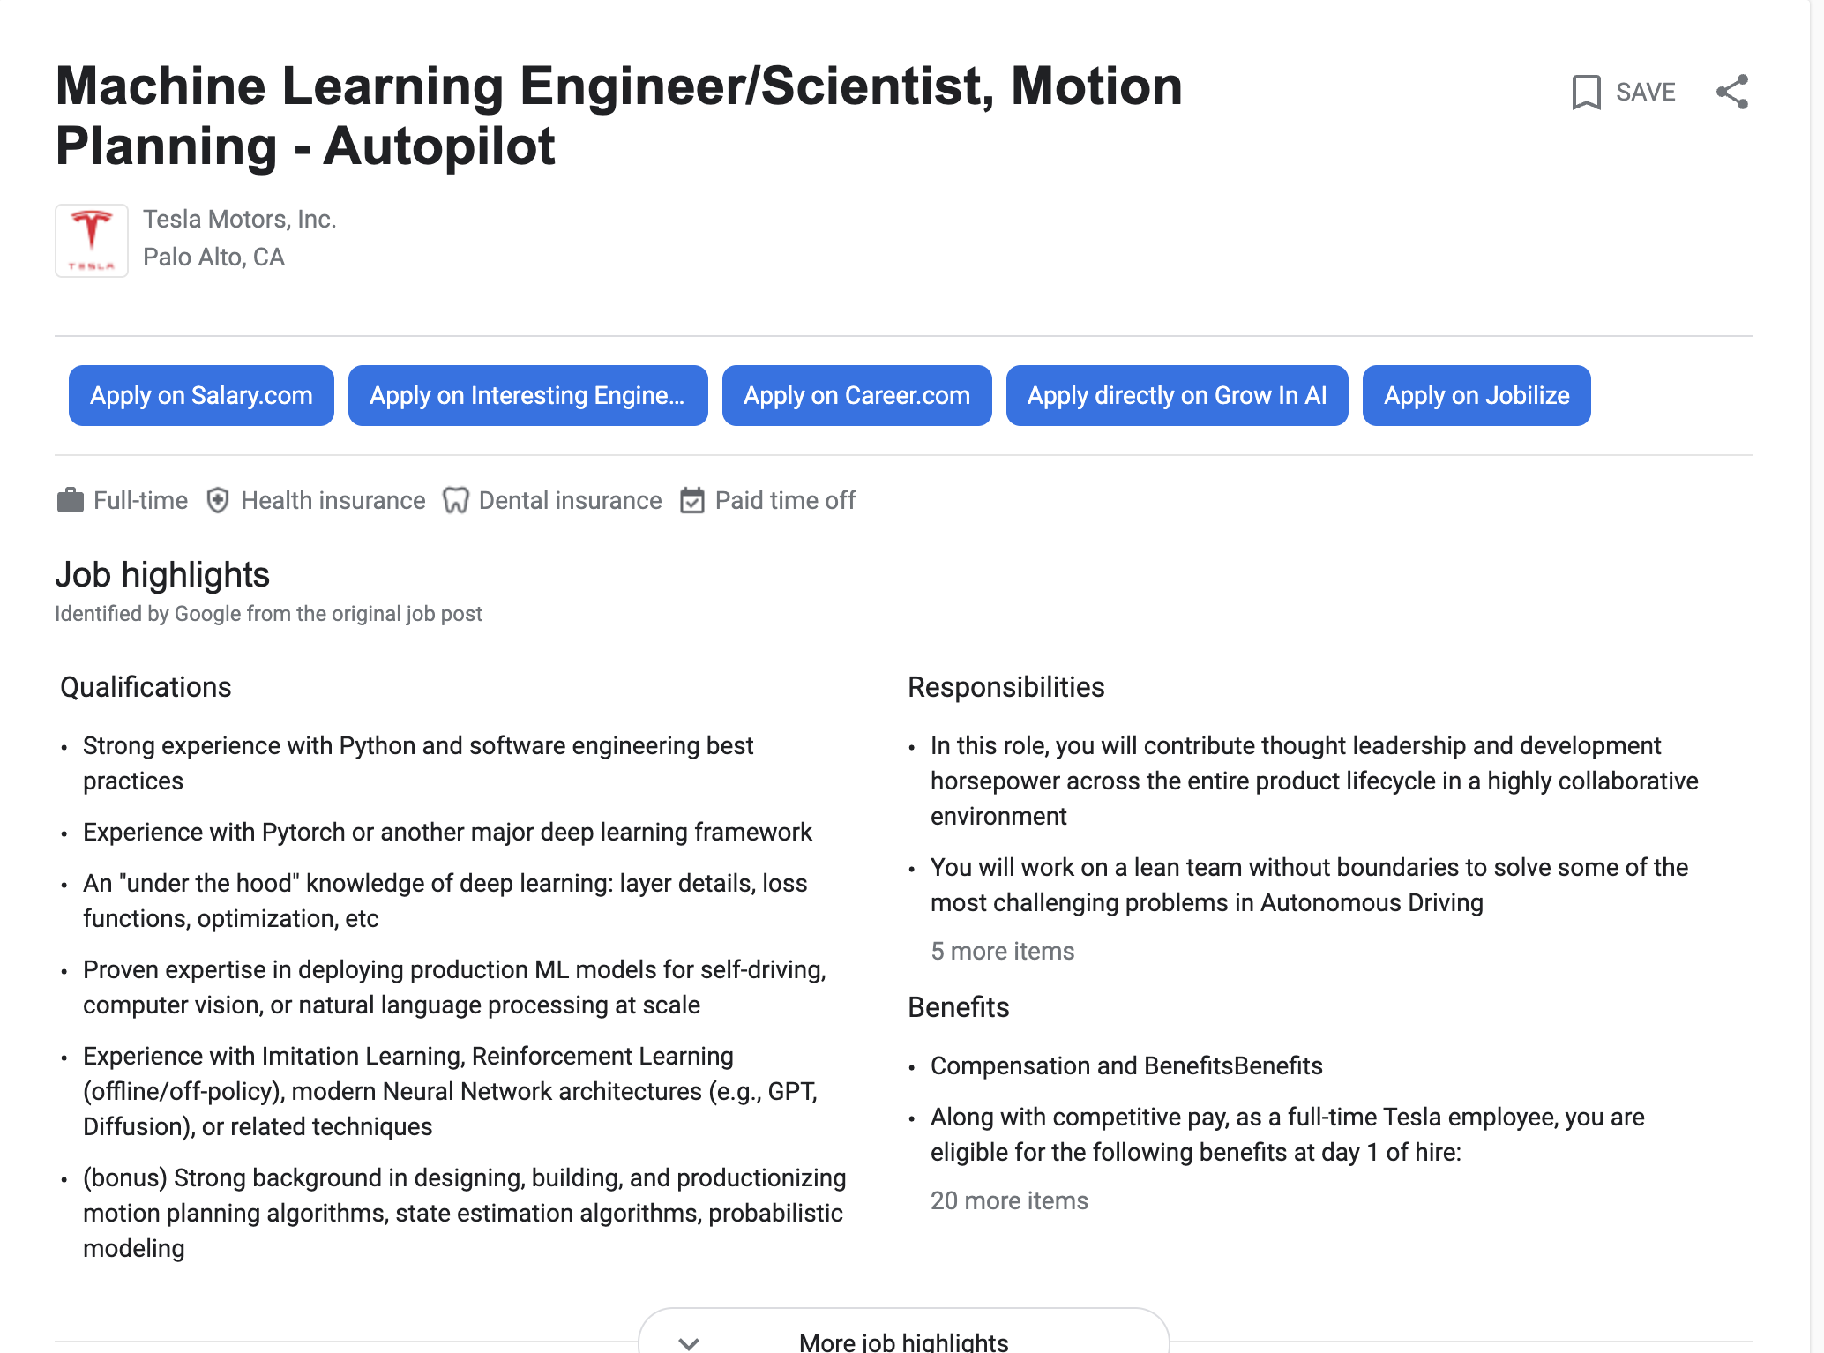
Background: Offline RL (Part 2)
Offline RL is used in situations where it is either too dangerous or costly to train the agent in the real world, but the situation is too varied or complicated for training in simulation to transfer.
Self-driving is one application in industry.

Slide 9
Intellectual Merits
Contributions: I created a new algorithm for offline RL that outperforms current state of the art approaches on the common Atari benchmark, while being simpler and more intuitive.
Methods: I compared my approach, ACORL, against Conservative Q-Learning (CQL) and Offline DQN on the Breakout and Pong Atari environments. To ensure a fair comparison each approach underwent hyperparameter tuning and the best hyperparameters were chosen. Results were averaged over ten runs. Training was done for 1-million timesteps on a dataset of 1-million transitions collected from a DDQN policy. I trained the DDQN policy for 1-million timesteps.

Slide 10
Broader Impacts
This has impacts for anyone trying to train an agent to interact with the real world.
It is particularly powerful for situations where it is too dangerous or costly to train the agent directly in the real world, but simulation is difficult to get to transfer because complexity or variety.
Self-driving is one application.
I used offline RL techniques in my co-ops for autonomous control of aircrafts.

Slide 11
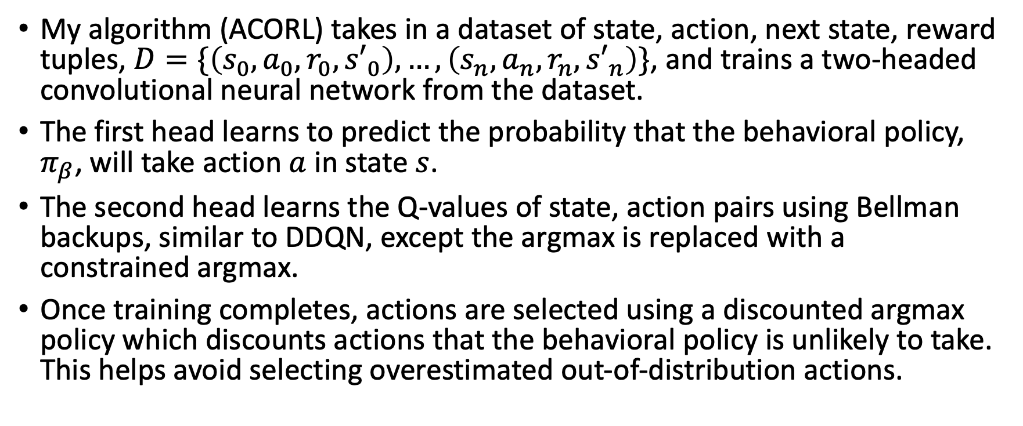
Design Specifications: Overview
My algorithm (ACORL) takes in a dataset of state, action, next state, reward tuples, $D=\{\left(s_{0}, a_{0}, r_{0}, {s′}_{0}\right), …,\left(s_{n}, a_{n}, r_{n}, {s′}_{n}\right)\}$, and trains a two-headed convolutional neural network from the dataset.
The first head learns to predict the probability that the behavioral policy, $π_{β}$, will take action $a$ in state $s$.
The second head learns the Q-values of state, action pairs using Bellman backups, similar to DDQN, except the argmax is replaced with a constrained argmax.
Once training completes, actions are selected using a discounted argmax policy which discounts actions that the behavioral policy is unlikely to take. This helps avoid selecting overestimated out-of-distribution actions.

Slide 12
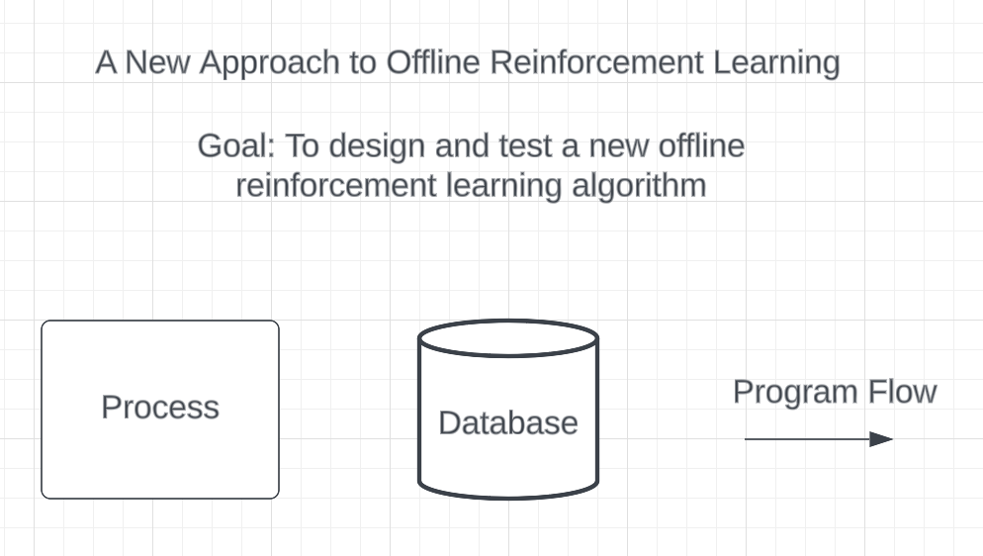
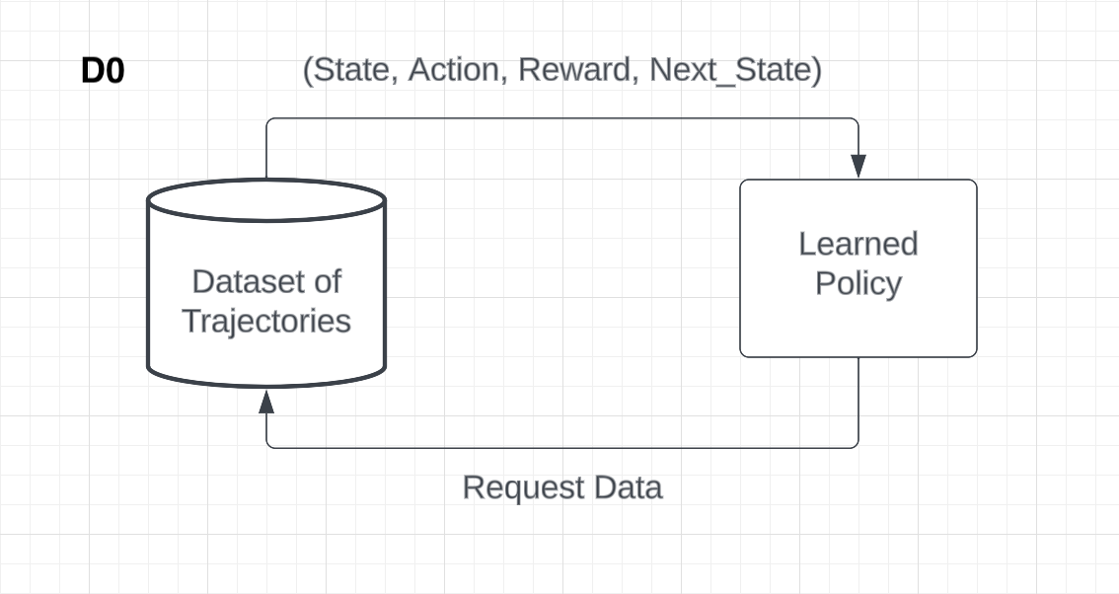
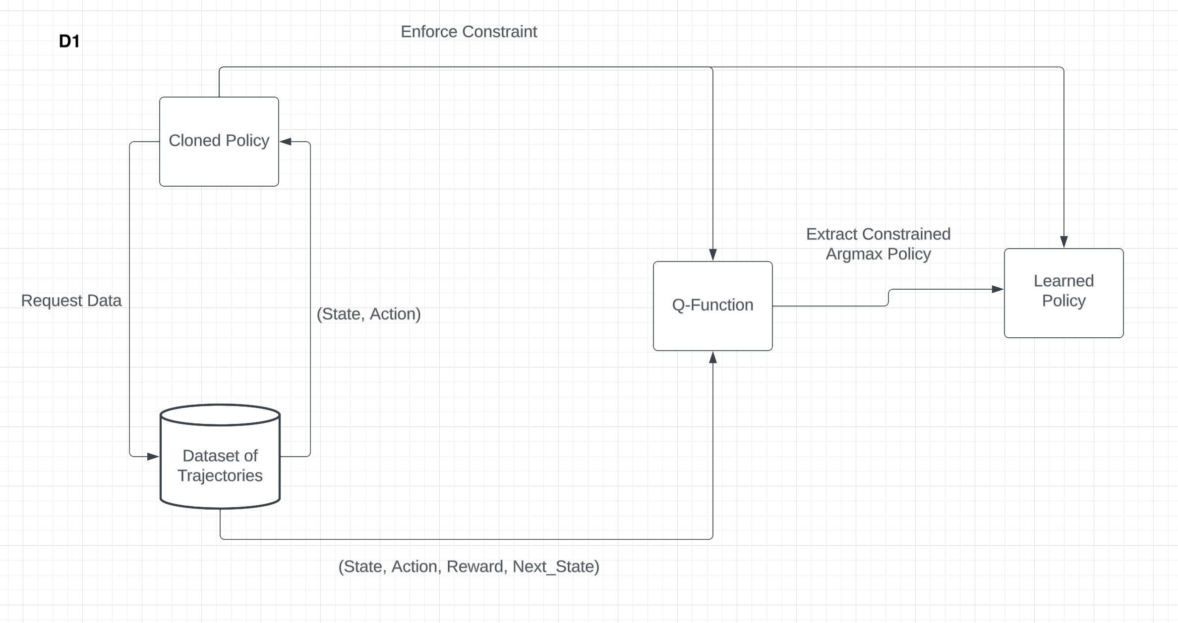
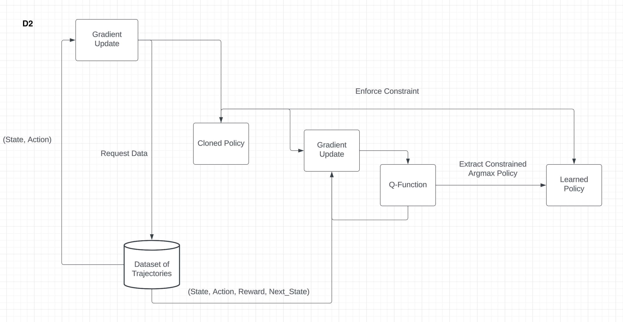
Design Specifications: Design Diagrams

Slide 13
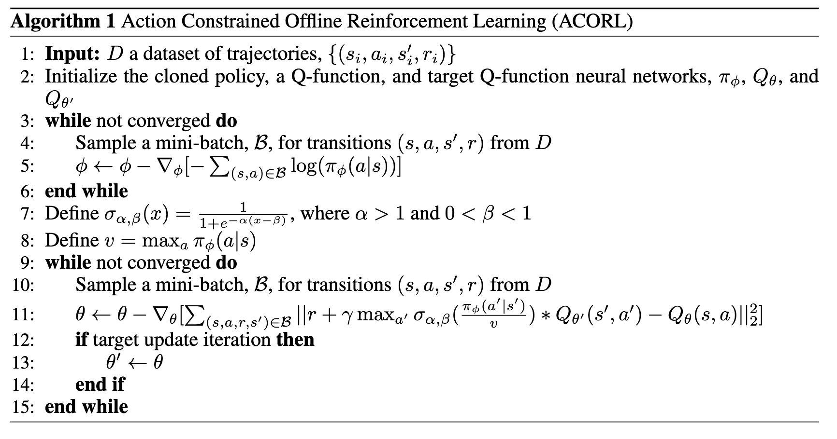
Design Specification: Algorithm

Slide 14
Technologies
Convolutional neural networks are used to learn Q-values and action probabilities.
Adam is used for optimization.
DDQN is used to collect the dataset.
CQL is used to compare against.
Fixed point iteration is used in training.
RL theory, i.e., convergence proofs, contractions, etc., are used to theoretically ground the algorithm in the tabular setting.

Slide 15
Milestones 1
9/1/23 – Project advisor is chosen.
9/10/23 – Project topic is finalized.
9/28/23 – Algorithm design is completed.
10/5/23 – Algorithm analysis is completed.
10/14/23 – Online DDQN agent is trained on Atari Breakout.
10/20/23 – Dataset is collected on Atari Breakout.
10/29/23 – Offline DQN baseline is trained on Atari Breakout.
11/5/23 – My algorithm, ACORL, is implemented in code.
11/29/23 – Hyperparameter tuning for ACORL is completed on Atari Breakout.

Slide 16
Milestones 2
12/22/23 – CQL is implemented in code.
1/20/24 – Hyperparameter tuning for CQL on Atari Breakout is completed.
1/31/24 – Online DDQN is trained on Atari Pong.
2/7/24 – Dataset of Atari Pong is collected.
2/15/24 – CQL is run on Atari Pong.

Slide 17
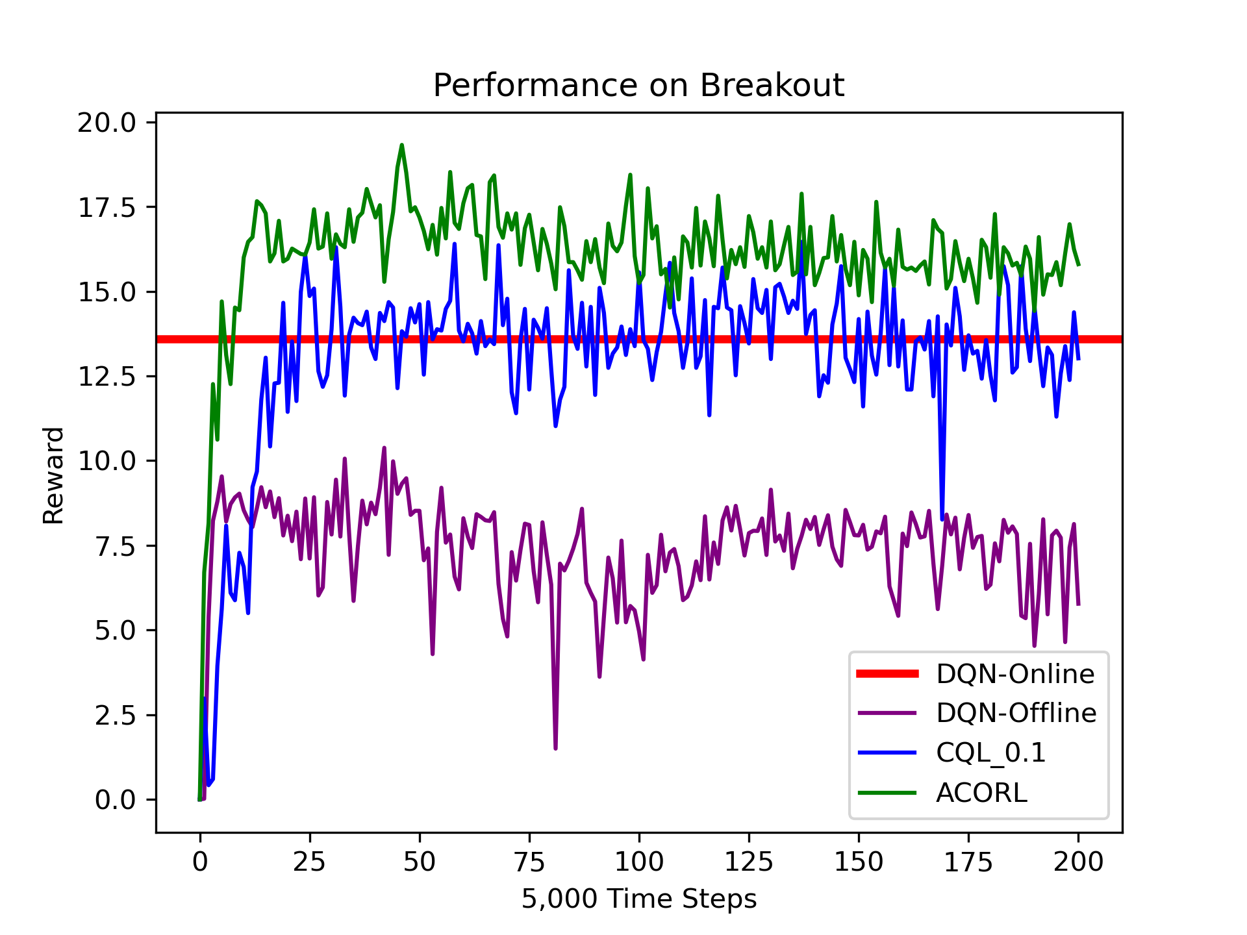
Results
I have completed the performance comparison on Atari Breakout and am about two thirds of the way through the comparison on Atari Pong.
Going forward I need to finish up the comparison on Atari Pong and then focus on my poster for the expo.

Slide 18
Challenges
The biggest challenge was computing limitations. I ran everything on a laptop and a single run took a little under a week. For each environment, I had to train the behavioral agent, collect the online dataset, run three offline algorithms, and tune hyperparameters. All of this added up to a little over two months of runtime per environment.
Additionally, RL algorithms can be difficult to debug, since they are so sensitive to hyperparameters. If the algorithm failed to learn, it was at times difficult to tell if the failure was the result of bad hyperparameters or a bug in the implementation.

