Slide 1
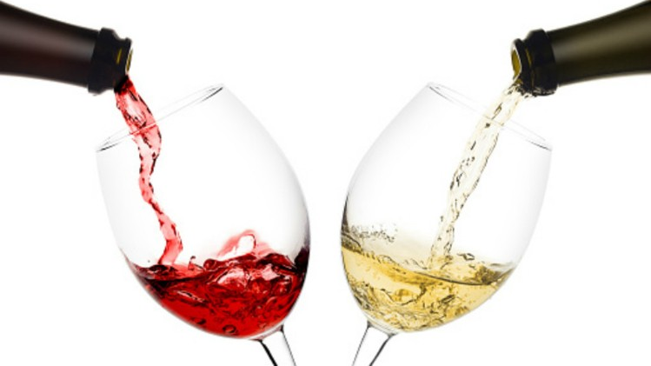
Classification and Resampling of Wine Quality on Imbalanced Data
Alison Kleffner, Sarah Aurit, and Emily Robinson

Slide 2
Introduction (Alison/Sarah?)
Marketing campaigns and sales of wine are linked to quality attributes, and the measurement of such is essential
Within the wine industry, there are two types of quality assessment: physiochemical and sensory tests.
Sensory tests require a human expert to assess the quality of wine based on visual, taste, and smell [Hu et al., 2016]
Unlike sensory tests, laboratory tests for measuring the physiochemical characteristics of wine such as acidity and alcohol content do not require a human expert.
Recently, research in the food industry has utilized statistical learning techniques to evaluate widely available characteristics of wine.
Classification can then be used as part of quality assessment process.

Slide 3
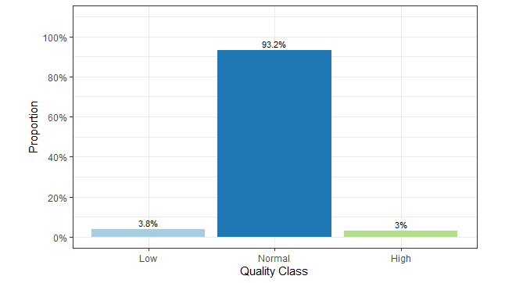
Goals/Problem (Alison)
Want to train a model that would work well to classify wines into three categories; low quality, normal quality and high quality.
Classification techniques:
eXtreme Gradient Boosting (XGBoost)
Random Forest
Additional challenge – Imbalanced Data Set
Evaluated different resampling techniques to see if this improves performance and to see which method is best.
Accuracy of each classification model applied in conjunction with each resampling method was compared.

Slide 4
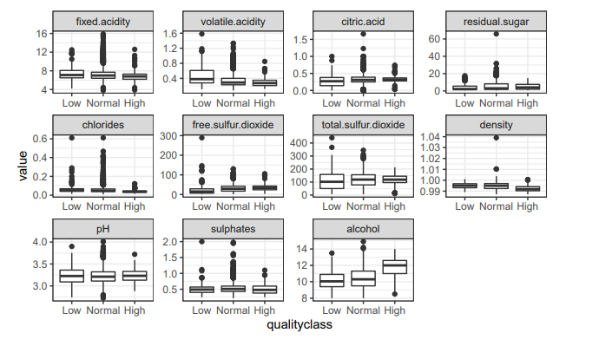
Data Exploration (Alison)
Data set: “Wine Quality Data Set” found on the UCI Data Repository [UCI].
Samples of Vinho Verde, which is a product from the northwest region of Portugal
For each of the wines in the dataset, 11 physiochemical measurements were taken on it
The response was initially measured as a quality rating where a 0 was considered very bad and a 10 was excellent Gupta [2018].
Following Hu et al. [2016], we separated the wine into three quality classes: Low Quality (≤ 4), Normal (5-7), and High quality (≥ 8)

Slide 5
Methodology: Resampling (Alison)
Typical classifier algorithms assume a relatively balanced distribution across the classes,
So, with imbalanced data there tends to be bias towards the majority class [Sun et al., 2009]
A method on how to lower the effects on working with an imbalanced data set is through resampling the original data set, by either
Oversampling the minority class
Undersampling the majority class
Our methods:
Original imbalanced data set to provide a baseline
Random Undersampling
SMOTE (Synthetic Minority Oversampling Technique

Slide 6
Accuracy & Cross-Validation (Emily)
Accuracy metrics
Overall correct classification rate
Individual group (low quality, normal quality, and high quality) correct classification rate
Monte Carlo Cross-Validation (MCMC)
B = 50 for model tuning; B = 100 for final model comparison
70% training; 30% testing
For each split, the final resampled training data set is used to build the model; then accuracy is evaluated on the corresponding testing data set.
The mean, 5th-quantile, and 95th-quantile of the correct classification rates are used to evaluate performance over the B splits.
Both classification methods were tuned by conducting a hyperparameter grid search with MCMC to minimize the overall accuracy.
The furrr package was used to minimize computing time [Vaughan and Dancho, 2021].

Slide 7
Random Forest (Emily)
randomForest package [Liaw and Wiener, 2002]
Generates many classification trees, which are each grown through recursive partitioning of independent variable space then aggregates the predictions made by each tree.
Growth:
Split points of variable space are investigated to maximize the reduction of heterogeneity, which is measured with the Gini impurity index.
Grown to a phase where node(s) represent a delineation of data per split point of each variable, and leaves are the terminal points that represent the final classification of data.
Pruning:
A leaf is potentially pruned back to a node to maximize the trade-off between complexity and rate of misclassification.
Hyperparameter grid search
Number of trees (ntrees: 200 – 800 by 200)
Number of variables to be randomly sampled from to generate a split point at each node (mtry: 2 – 10 by 2)

Slide 8
eXtreme Gradient Boosting (XGBoost)
xgboost package [Chen et al., 2021].
Objective Function: multiclass classification using the softmax objective function with three classes (low, normal, high quality)
Evaluation Metric: minimizes multiclass misclassfication error
Combines the tree-based model approach by implementing recursive partitioning and the boosting algorithm which repeatedly optimizes classification methods on the training set.
This process is repeated for a final boosted classifier given by the weighted sum of our weak classifiers.
Hyperparameter grid search
maximum tree depth (ntrees: 200 – 800 by 200)
step size shrinkage to prevent overfitting (eta: 0.05, 0.1, 0.25, 0.5, 0.75, 0.9, 0.95)
maximum number of boosting iterations (nround: 2 – 12 by 2)
number of threads used for parallel computing (nthread: 2 – 12 by 2)
Notes:
- In repeated optimization, a weak classifier is fit on the original data set with each observation having equal weight, the weight is then calculated for the current model based on the error rate and observations are assigned new weights used to fit the next weak classifier
- XGBoost allows for a variety of evaluation metrics providing a benefit over other boosting methods

Slide 9
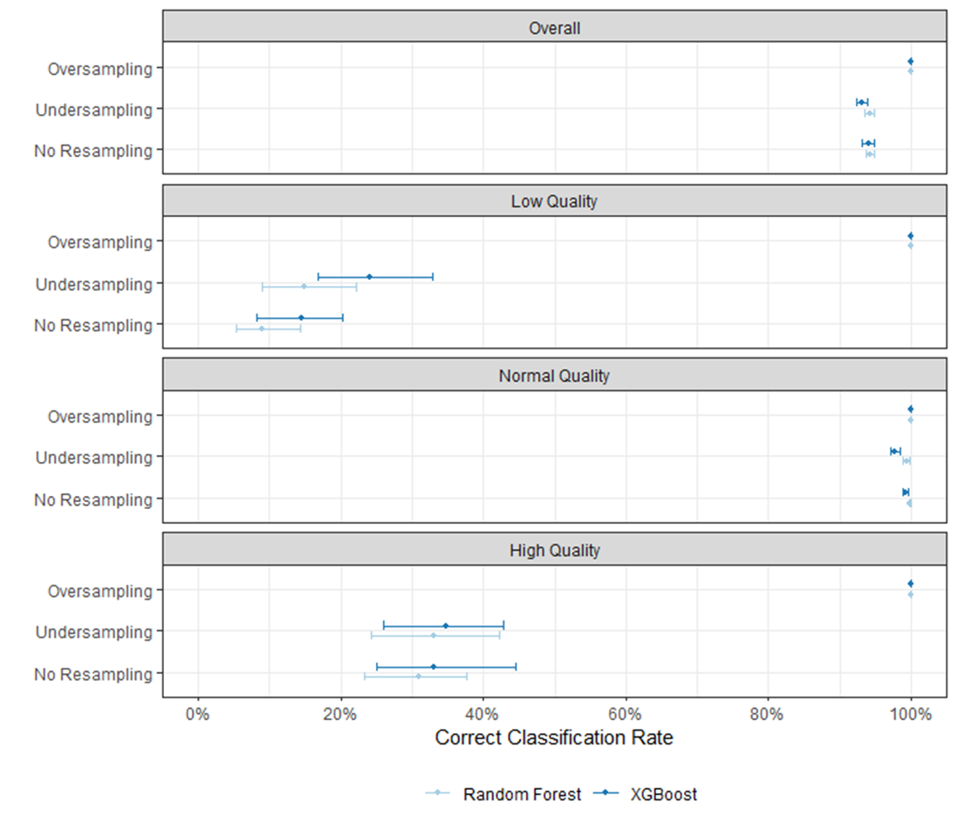
Results: Accuracy
For the overall data: all methods performed relatively well; oversampling had excellent results whereas undersampling did not
Per category of quality: low baseline rates of the rare classifications (low and high quality); undersampling had minimal improvement while oversampling had substantive improvement with small losses in normal category

Slide 10
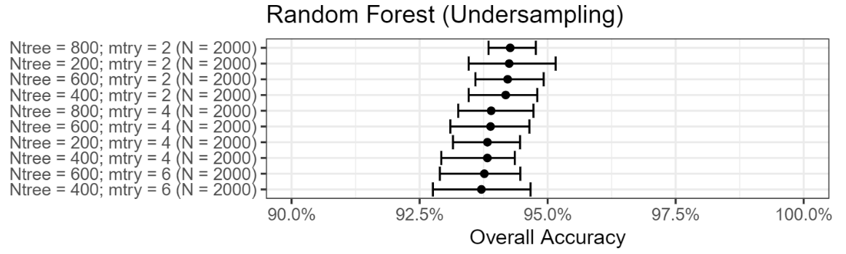
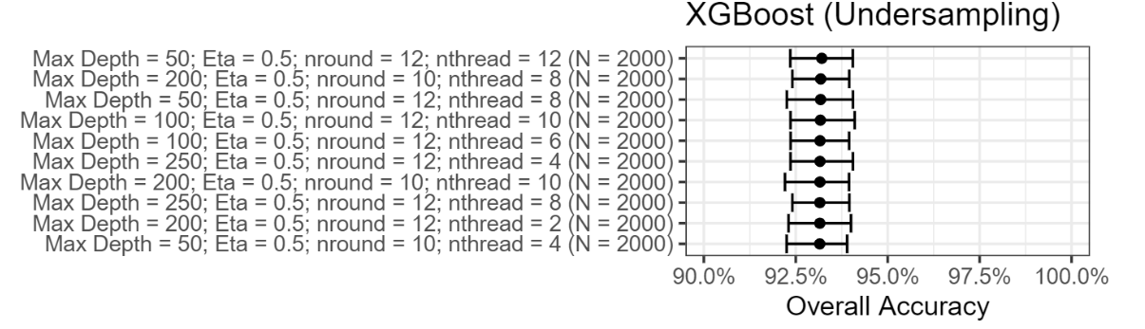
Results: Tuning Parameters
Notes:
Hyperparameter Grid Search of tuning parameters. We saw consistent results of 100% classification rates for oversampling in RFs and XGB for all combination of terms in grid search via MCMC methods (B=50). The two figures represent the ranking of best results from grid search for RF and XGB undersampling. RF had a maximal number of trees and small number of variables that were randomly selected. For XGB, the max depth was minimal and nround and nthread were maximal.

Slide 11
Discussion and Conclusion
Given the imbalanced nature of these data, we saw disparate accuracies when comparing the normal quality category to the rare (low, high) quality categories.
The SMOTE algorithm provided a methodology for undersampling and oversampling, which showed small improvement with undersampling and excellent improvement with oversampling
There was a small trade-off regarding accuracy of the normal quality wine with the improvement we saw in oversampling of the rare quality categories
Grid search of tuning parameters revealed the optimal combination of parameters
Future work consists of pursuing additional methodologies to improve the relative lack of performance with undersampling

Slide 12
References
Uci machine learning repository: Wine quality data set. URL https://archive.ics.uci.edu/ml/datasets/Wine+Qua lity
N. V. Chawla, K. W. Bowyer, L. O. Hall, and W. P. Kegelmeyer. Smote: synthetic minority over-sampling technique. Journal of artificial intelligence research, 16:321–357, 2002.
T. Chen, T. He, M. Benesty, V. Khotilovich, Y. Tang, H. Cho, K. Chen, R. Mitchell, I. Cano, T. Zhou, M. Li, J. Xie, M. Lin, Y. Geng, and Y. Li. xgboost: Extreme Gradient Boosting, 2021. URL https://CRAN.R-project.o rg/package=xgboost. R package version 1.3.2.1.
P. Cortez, J. Teixeira, A. Cerdeira, F. Almeida, T. Matos, and J. Reis. Using data mining for wine quality assessment. In International Conference on Discovery Science, pages 66–79. Springer, 2009.
Y. Gupta. Selection of important features and predicting wine quality using machine learning techniques. Procedia Computer Science, 125:305–312, 2018.
T. R. Hoens and N. V. Chawla. Imbalanced datasets: from sampling to classifiers. Imbalanced learning: Foundations, algorithms, and applications, pages 43–59, 2013.
G. Hu, T. Xi, F. Mohammed, and H. Miao. Classification of wine quality with imbalanced data. In 2016 IEEE International Conference on Industrial Technology (ICIT), pages 1712–1217. IEEE, 2016. 8A.
J. Luengo, A. Fernández, S. García, and F. Herrera. Addressing data complexity for imbalanced data sets: analysis of smote-based oversampling and evolutionary undersampling. Soft Computing, 15(10):1909–1936, 2011.
Y. Sun, A. K. Wong, and M. S. Kamel. Classification of imbalanced data: A review. International journal of pattern recognition and artificial intelligence, 23(04):687–719, 2009.
D. Vaughan and M. Dancho. furrr: Apply Mapping Functions in Parallel using Futures, 2021. URL https: //CRAN.R-project.org/package=furrr. R package version 0.2.2.

Slide 13
Final Tuning Parameters
 | Resampling | N. Trees | Mtry
Random Forest | No Resampling | 200 | 2
 | Undersampling (n = 2000) | 800 | 2
 | Oversampling (k = 3) | 200 | 2
 | Resampling | Max Depth | Eta | Rounds | Threads
XGBoost | No Resampling | 50 | 0.75 | 12 | 8
 | Undersampling (n = 2000) | 50 | 0.5 | 12 | 12
 | Oversampling (k = 3) | 50 | 0.5 | 10 | 2

