Slide 1
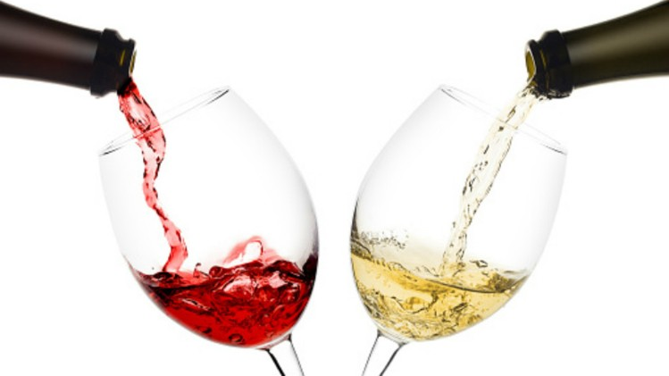
Classification and Resampling of Wine Quality on Imbalanced Data
Alison Kleffner, Sarah Aurit, and Emily Robinson

Slide 2
Introduction (Alison/Sarah?)
Marketing campaigns are linked to the communication of quality, so the measurement of this quality is essential
Within the wine industry, there are two types of quality assessment: physiochemical and sensory tests.
Sensory tests require a human expert to assess the quality of wine based on visual, taste, and smell [Hu et al., 2016]
Unlike sensory tests, laboratory tests for measuring the physiochemical characteristics of wine such as acidity and alcohol content do not require a human expert.
Recently, research in the food industry has utilized statistical learning techniques to evaluate widely available characteristics of wine.
Classification can then be used as part of quality assessment process.

Slide 3
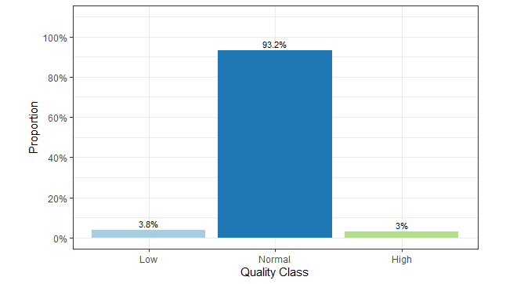
Goals/Problem (Alison)
Want to train a model that would work well to classify wines into three categories; low quality, normal quality and high quality.
Classification techniques:
eXtreme Gradient Boosting (XGBoost)
Random Forest
Additional challenge – Imbalanced Data Set
Evaluated different resampling techniques to see if this improves performance and to see which method is best.
Accuracy of each classification model applied in conjunction with each resampling method was compared.

Slide 4
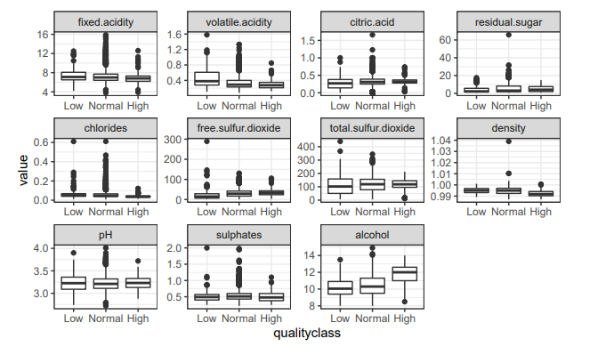
Data Exploration (Alison)
Data set: “Wine Quality Data Set” found on the UCI Data Repository [UCI].
Samples of Vinho Verde, which is a product from the northwest region of Portugal
For each of the wines in the dataset, 11 physiochemical measurements were taken on it
The response was initially measured as a quality rating where a 0 was considered very bad and a 10 was excellent Gupta [2018].
Following Hu et al. [2016], we separated the wine into three quality classes: Low Quality (≤ 4), Normal (5-7), and High quality (≥ 8)

Slide 5
Methodology: Resampling (Alison)
Typical classifier algorithms assume a relatively balanced distribution across the classes,
So, with imbalanced data there tends to be bias towards the majority class [Sun et al., 2009]
A method on how to lower the effects on working with an imbalanced data set is through resampling the original data set, by either
Oversampling the minority class
Undersampling the majority class
Our methods:
Original imbalanced data set to provide a baseline
Random Undersampling
SMOTE (Synthetic Minority Oversampling Technique

Slide 6
Methodology: Cross Validation (Emily)

Slide 7
Methodology: Random Forest (Emily)

Slide 8
Methodology: XGBoost (Emily)

Slide 9
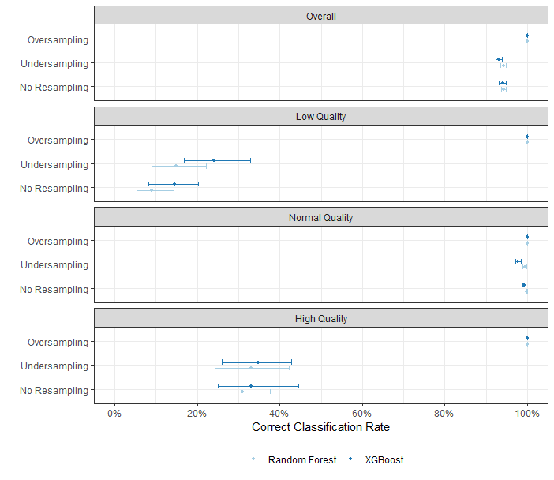
Results (Sarah)

Slide 10
Conclusion/Discussion (Sarah)

Slide 11
References
N. V. Chawla, K. W. Bowyer, L. O. Hall, and W. P. Kegelmeyer. Smote: synthetic minority over-sampling technique. Journal of artificial intelligence research, 16:321–357, 2002.
P. Cortez, J. Teixeira, A. Cerdeira, F. Almeida, T. Matos, and J. Reis. Using data mining for wine quality assessment. In International Conference on Discovery Science, pages 66–79. Springer, 2009.
Y. Gupta. Selection of important features and predicting wine quality using machine learning techniques. Procedia Computer Science, 125:305–312, 2018.
T. R. Hoens and N. V. Chawla. Imbalanced datasets: from sampling to classifiers. Imbalanced learning: Foundations, algorithms, and applications, pages 43–59, 2013.
G. Hu, T. Xi, F. Mohammed, and H. Miao. Classification of wine quality with imbalanced data. In 2016 IEEE International Conference on Industrial Technology (ICIT), pages 1712–1217. IEEE, 2016. 8A.
J. Luengo, A. Fernández, S. García, and F. Herrera. Addressing data complexity for imbalanced data sets: analysis of smote-based oversampling and evolutionary undersampling. Soft Computing, 15(10):1909–1936, 2011.
Y. Sun, A. K. Wong, and M. S. Kamel. Classification of imbalanced data: A review. International journal of pattern recognition and artificial intelligence, 23(04):687–719, 2009.

