Slide 1
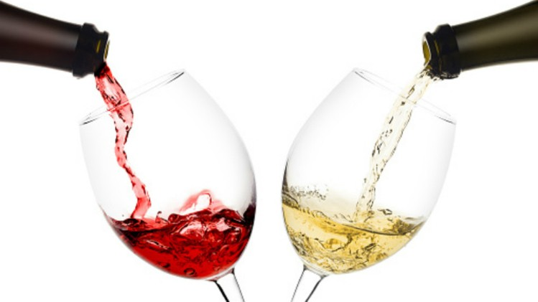
Classification and Resampling of Wine Quality on Imbalanced Data
Alison Kleffner, Sarah Aurit, and Emily Robinson

Slide 2
Introduction (Alison/Sarah?)

Slide 3
Data Exploration (Alison)

Slide 4
Goals/Problem (Alison)

Slide 5
Methodology: Resampling (Alison)

Slide 6
Methodology: Cross Validation (Emily)

Slide 7
Methodology: Random Forest (Emily)

Slide 8
Methodology: XGBoost (Emily)

Slide 9
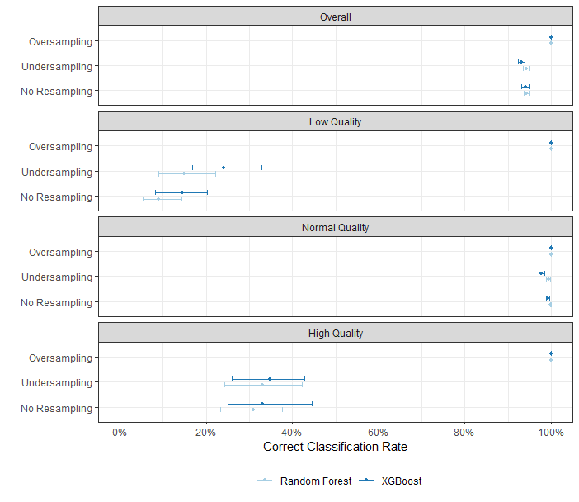
Results (Sarah)

Slide 10
Conclusion/Discussion (Sarah)

