Slide 1
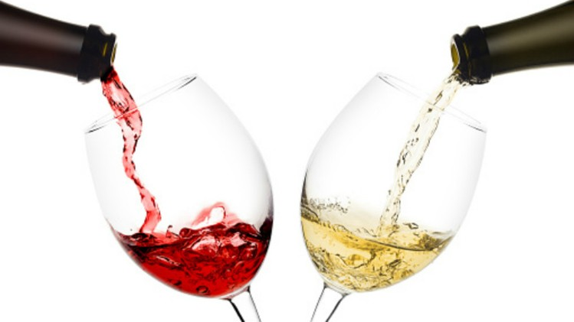
Classification and Resampling of Wine Quality on Imbalanced Data
Alison Kleffner, Sarah Aurit, and Emily Robinson

Slide 2
Introduction (Alison/Sarah?)
Successful marketing campaigns and productive selling strategies are directly linked to communication about key indicators of quality; hence, objective measurements of quality are essential
Within the wine industry, there are two types of quality assessment: physiochemical and sensory tests. Sensory tests require a human expert to assess the quality of wine based on visual, taste, and smell [Hu et al., 2016]
Unlike sensory tests, laboratory tests for measuring the physiochemical characteristics of wine such as acidity and alcohol content do not require a human expert. The relationship between physiochemcial and sensory analysis is not well understood. Recently, research in the food industry has utilized statistical learning techniques to evaluate widely available characteristics of wine.
Classification can then be used as part of quality assessment process.

Slide 3
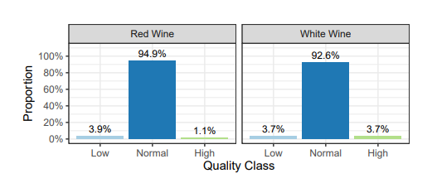
Data Exploration (Alison)
In this paper, we applied classification and resampling techniques to the “Wine Quality Data Set” found on the UCI Data Repository [UCI]. The data consist of information from samples of Vinho Verde, which is a product from the northwest region of Portugal
For each of the wines in the dataset, 11 physiochemical measurements were taken on it: fxed acidity, volatile acidity, citric acid, residual sugar, chlorides, free sulfur dioxide, total sulfur dioxide, density, pH, sulphates, and alcohol.
The response was measured as a quality rating based on a sensory test carried out by at least three sommeliers, where a 0 was considered very bad and a 10 was excellent Gupta [2018]. Following Hu et al. [2016], we separated the wine into three quality classes: Low Quality (≤ 4), Normal (5-7), and High quality (≥ 8)

Slide 4
Goals/Problem (Alison)
The goal of this paper, following Hu et al. [2016] is to train a model that would work well to classify wines into three categories, which are: low quality, normal quality and high quality.
We evaluated two classification techniques, eXtreme Gradient Boosting (XGBoost) and Random Forest
The quality categorization poses a challenge of working with imbalanced classes as there are many more normal quality wines than low or high quality wines [Figure 1].
To address this, we will evaluate different resampling techniques in order to determine if resampling improves performance and to identify which resampling method is best.
Accuracy of each classification model applied in conjunction with each resampling method was compared.
Initially, we first evaluated the classifier performance with no resampling

Slide 5
Methodology: Resampling (Alison)
Typical classifier algorithms assume a relatively balanced distribution across the classes, so with imbalanced data there tends to be bias towards the majority class [Sun et al., 2009]
Due to this imbalanced nature in the data, classifying algorithms will be biased towards classifying wines as “Normal,” causing poor predictions for the “Low” and “High” quality classes.
A method on how to lower the effects on working with an imbalanced data set is through resampling the original data set either by either oversampling the majority class, or undersampling the minority class. The goal with these methods is to create a data set that has close to a balanced class distribution, so the classifying algorithms will have better predictions due to being able to predict to the minority class more accurately [Hoens and Chawla, 2013].
We initially evaluated the classifier performance with the original imbalanced data set (without resampling), and hypothesized that it would be associated with low performance, however, we felt it provided an appropriate baseline
The undersampling method that we considered is random undersampling. In this method, instances of the majority class are discarded at random until reaches balanced with the minority class [Hoens and Chawla, 2013].
Next, we handled imbalanced data through resampling the original data set by oversampling the majority class using the SMOTE method, which is a technique that uses interpolation of the minority class to create synthetic data

Slide 6
Methodology: Cross Validation (Emily)

Slide 7
Methodology: Random Forest (Emily)

Slide 8
Methodology: XGBoost (Emily)

Slide 9
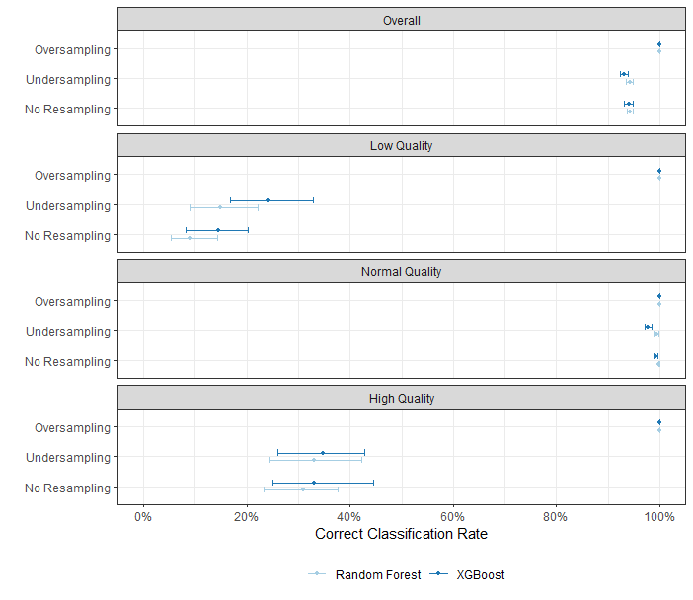
Results (Sarah)

Slide 10
Conclusion/Discussion (Sarah)

