Slide 1
India’s democratic experiment-II

Slide 2
Foundational Values
Changing Party System
Changing Federal System
Work in progress

Slide 3
Seamless Web
Democracy
Social and Economic Revolution
Unity and Integrity

Slide 4
Conflict between goals with the vision of social-economic transformation
Affirmative action vs Equality
Right to Property vs Equality
Conflict between Institutions
Judiciary vs Executive/legislature
Conflict between Centre and states

Slide 5
Political parties and Democracy
Modern democracy is unthinkable save in terms of the parties
Party government
Democracy core feature- governments are responsive to the preferences of the people
Political parties organize politics and it is through political parties that democracies are made to be responsive

Slide 6
What are Political Parties?
Key feature in representative liberal democracies
Organized group of people who
Share
Common goals
Common principles
Desire to control government
To carry out their policies and programmes

Slide 7
Features
Party of consensus
Parties of pressure
Function on the margins
Margin of pressure
Historical consensus to present consensus

Slide 8
Congress System
Faction_1
Pressure_1
Faction_2
Pressure_2
Faction_4
Pressure_4
Faction_3
Pressure_3
Margin of Pressure
Margin of pressure
Party of Consensus

Slide 9
Aggregation of State-level
INC, BJP, TDP, YSRCP, TRS, CPM, AITC, AIADMK
Andhra Pradesh
TDP, BJP, YSRCP, TRS
Punjab
SAD, BJP
West Bengal
CPM, AITC, BJP, INC
Tamil Nadu
AIADMK, BJP

Slide 10
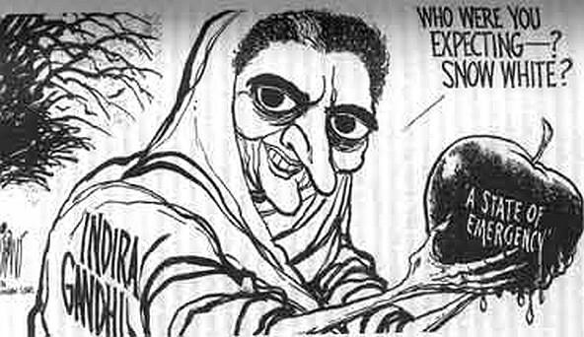

Slide 11
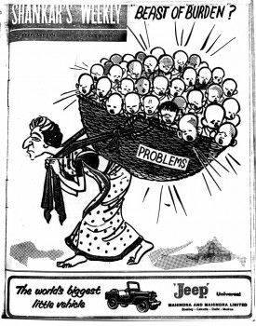

Slide 12
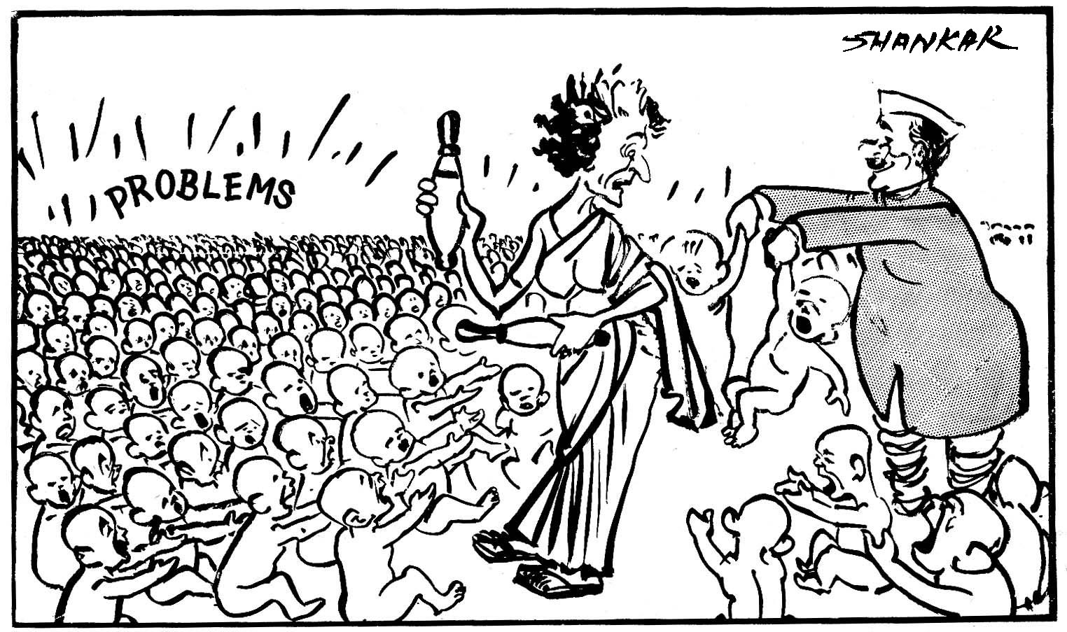

Slide 13
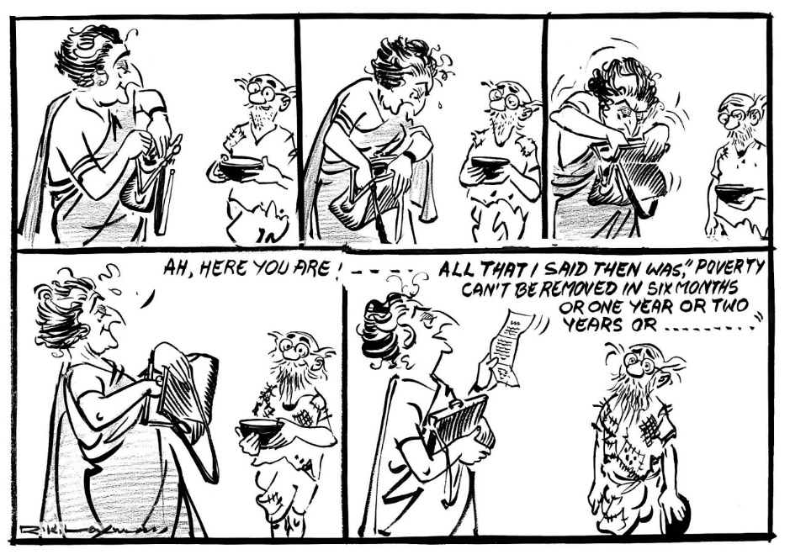

Slide 14
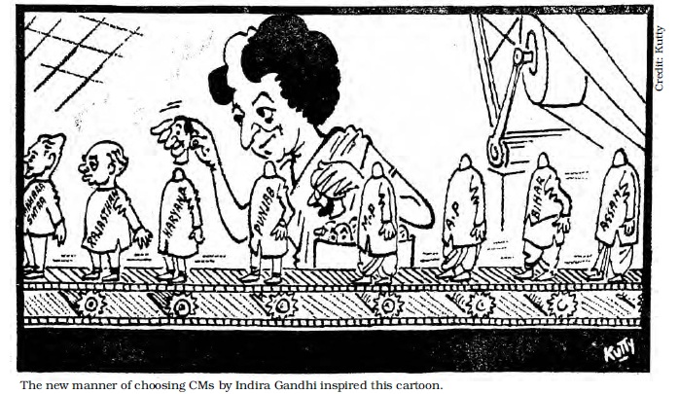

Slide 15
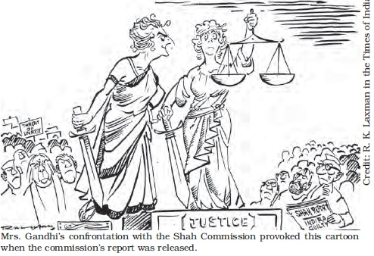

Slide 16
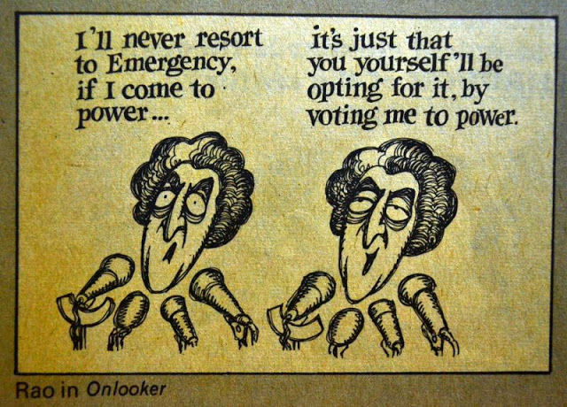

Slide 17
Multiple Levels of Government
Combines elements of shared-rule through common institutions and self-rule for the governments of the constituent units- at least two levels
Normative element
Linked to democracy, sharing, diversity and the maintenance of distinctive identities
Linking of individuals, groups, and polities in lasting but limited union in such a way as to allow for pursuit of common ends while maintaining the respective integrities of all groups

Slide 18
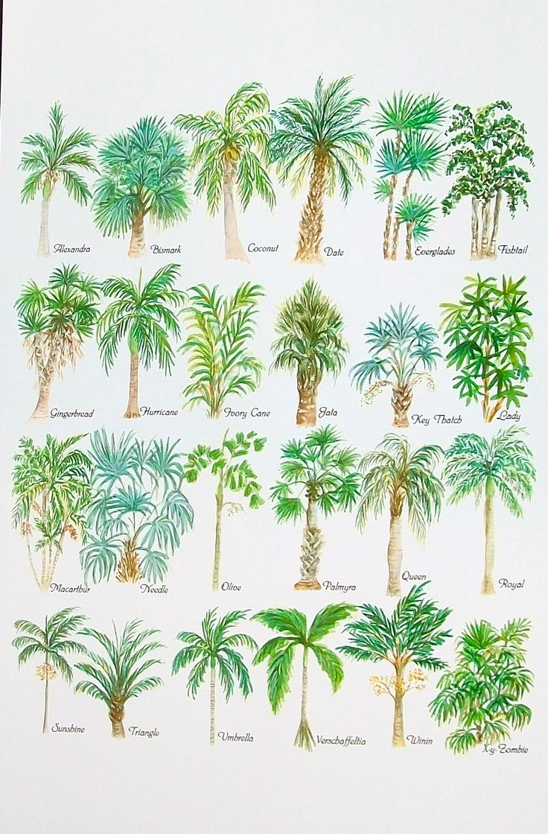
Varieties of Federations
Federal idea can take different forms
No one model of federalism
Depends on historical circumstances, emergent demands and needs of societies, nature of population, diversity and so on

Slide 19
Models of Federalism
Coming Together Model
where (more or less) sovereign states come together to create a common central government to which the states surrender some of their sovereignty
United States
Holding Together Model
A larger polity is subdivided into various sub-units that enjoy sovereignty over certain policy areas
Belgium, India
Putting Together Model
A large unit forcefully brings together previously independent units and takes away some of their sovereignty and allows some sovereignty in certain areas
Former USSR, Yugoslavia

Slide 20
Historical Background
Why
Fear of disunity
Strong-centre model of federation
Federalism to suit India’s needs and requirements
Powerful central government to lead from the front- economic, political, social
Protect India’s freedom
Partition and communal riots that followed
Migration and influx of millions of people
Invasion of Jammu and Kashmir
Problem of princely states
Danger of extremist violent groups

Slide 21
Other factors
Unification of Princely states
Goals of National Unity and Integrity, democracy and Social and Economic development
Balanced regional development
Congress everywhere- One-party dominant
Reinforced the centralizing component
Global circumstances

Slide 22
Economic Development
State- dominant role
Predominant economic philosophy- post second world war
Roots in the economic critique of colonialism
Post-colonial state was meant to be a more caring and concerned one compared to the colonial state

Slide 23
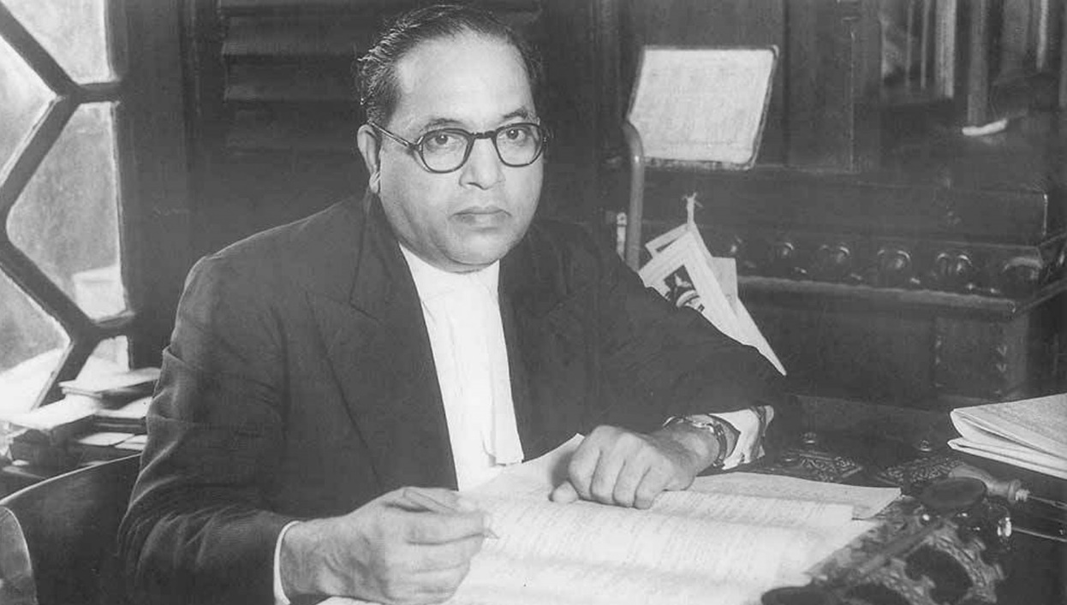
Holding Together: B R Ambedkar
The federation was not the result of an agreement by the States to join in a Federation and that the Federation not being the result of an agreement no State has the right to secede from it. The Federation is a Union because it is indestructible

Slide 24
Asymmetric Federalism
Constitutional recognition of inequality
Special status- Art 370 and Art 371
Protect diversity without sacrificing unity or imposing uniformity
Reflects a more participatory and responsive federal system
Meets specific needs and requirements
Sub-state autonomy and autonomous district councils

Slide 25
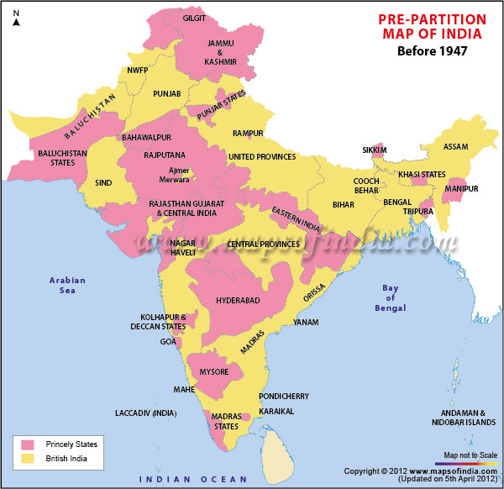
Pre-Partition

Slide 26
1951
Source: IBN Live

Slide 27
Issues for discussion
Main tension areas
President’s Rule
Role of Governor
Financial Issues
Greater say in National Level Decision making

Slide 28
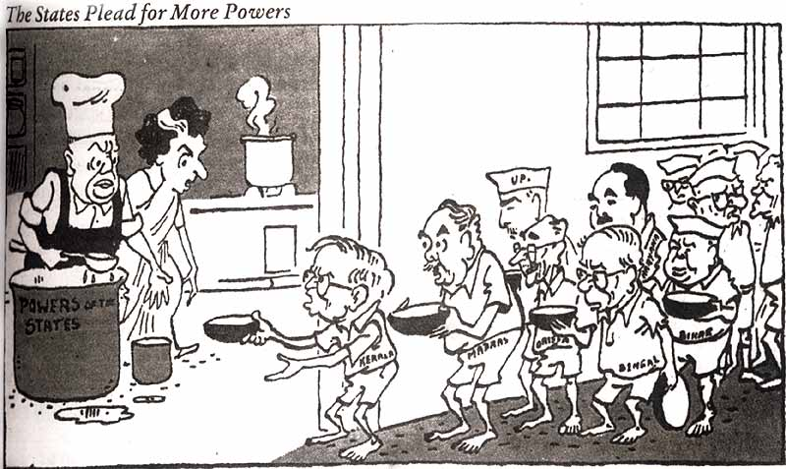

Slide 29
Why Tension?
Transformation from a one-party dominant system to a multi-party system
Federalism-centre-state relations intra-party affair
1967 elections- different parties in power at the state and centre

Slide 30
Failure of Constitutional Machinery
Political crisis
Internal subversion
Physical break-down
Non-compliance with constitutional directions of the Union Executive

Slide 31
Contemporary cases
Uttarakhand
Arunachal Pradesh

Slide 32
President’s Rule since Independence

Slide 33
Art 356: 1966-1984

Slide 34
Role of Governor
Major tension area in centre-state relations
Till 1967 no major issues
Discretionary powers more used after 1967
Governors failed to appear impartial
Not acted objectively-use of discretionary powers
Role as link between centre-states

Slide 35

Dependence on the centre
Led to progressive erosion of the
Jurisdiction
authority
initiative of the states even in own allocated areas
Proliferation of Centrally Sponsored Schemes

Slide 36
Main tensions
Centre know best attitude
Concerns of unity and integrity
Social and economic development
Balanced development

Slide 37
Bommai Judgement
Landmark Case in Centre-State Relations

Slide 38
Biggest Take Away
Substantial guarantee against abuse of power and for the maintenance of the federal structure of the Constitution

Slide 39
Background
Bommai: Chief Minister of Karnataka
Defection issues
CM offers to prove majority on the floor of the house
Governor declares that Chief Minister had lost the confidence of the majority in the House
Requests for action under Art. 356 (April 1989)
Meghalaya 1991
Nagaland 1988
Madhya Pradesh 1992
Himachal Pradesh 1992
Rajasthan 1992

Slide 40
Main issues
Whether Presidential Proclamation under Article 356 was justiciable and if so to what extent?
Whether the dissolved Legislature can be revived if the proclamation is set aside?
Whether the validity of the Proclamation can be challenged after it has been approved Parliament?
What relief can the Court grant?
Whether a president can dissolve the legislature without the approval of both the Houses?
Is secularism a basic feature of the Constitution?

Slide 41
Main Points
Whether conditions exist objectively which render it impossible to carry on the governance of the State in accordance with the provisions of the Constitution
Power must be used sparingly and so as not to disturb the federal balance of power between the Union and States since federalism is part of the basic structure

Slide 42
Assembly must not be dissolved before both Houses of Parliament have approved the proclamation
Courts can consider appropriateness even after approval- since Judicial review is also part of the basic structure of the constitution
Otherwise what is the purpose of JR?
Court can restore the government to office in case it finds the proclamation to be unconstitutional

Slide 43
The Courts have the Power
To requisition the records from the government containing the material on the basis of which the Council of Ministers advised President
To order an interim stay on the exercise of power under Article 356.
To order the revival of the dissolved State Assembly and restoration of the dismissed State government if the proclamation is struck down as unconstitutional

Slide 44
Political Factors
Transformation of Party System
The decline of the Congress Party’s dominance
Emergence of regional political parties
Single-Party to Coalition/Multi-party government
Rise of states
Judicial assertion- changing the balance of power between the executive and judiciary
Role of the President
K R Naryanan

Slide 45
Regional parties
Coalitions prior to the 90s- polity-wide party- national party- dominant actor
Regional parties- dominant actors in the 90s
every central government since the mid-1990s was formed and survived in office with the crucial support of regional parties
Brought a new perspective- a new political orientation- not there previously into the central government
Introduced internal and external constraints
check the arbitrary dismissal of state governments

Slide 46
Role of Regional Political Parties
Federal Coalitions- RPP present in federal cabinet and the Parliament
Checked the central government- cannot dismiss state governments- threat of withdrawal of support
Different political orientation- autonomy of states- since their basic interest lies there

Slide 47
Economic liberalization
NEP in 1991- Shift from Public-sector dominated economy to more market-friendly economy

Slide 48
New tension areas

Slide 49
National security- Internal security
2008 Mumbai attacks
Felt need for greater centralization
National Counter Terrorism Centre (NCTC)
States opposed
Other amendments
Railway Protection Force Act, 1957
Border Security Force Amendment Bill 2011
States opposed

