Slide 1


Let’s start with some practice dots!
Press to start the practice round!

Slide 2
Well done!
Press to start real adventure!
🎉
🎉
🎉
🎉
🎉
🎉
🎉
🎉
🎉

Slide 3
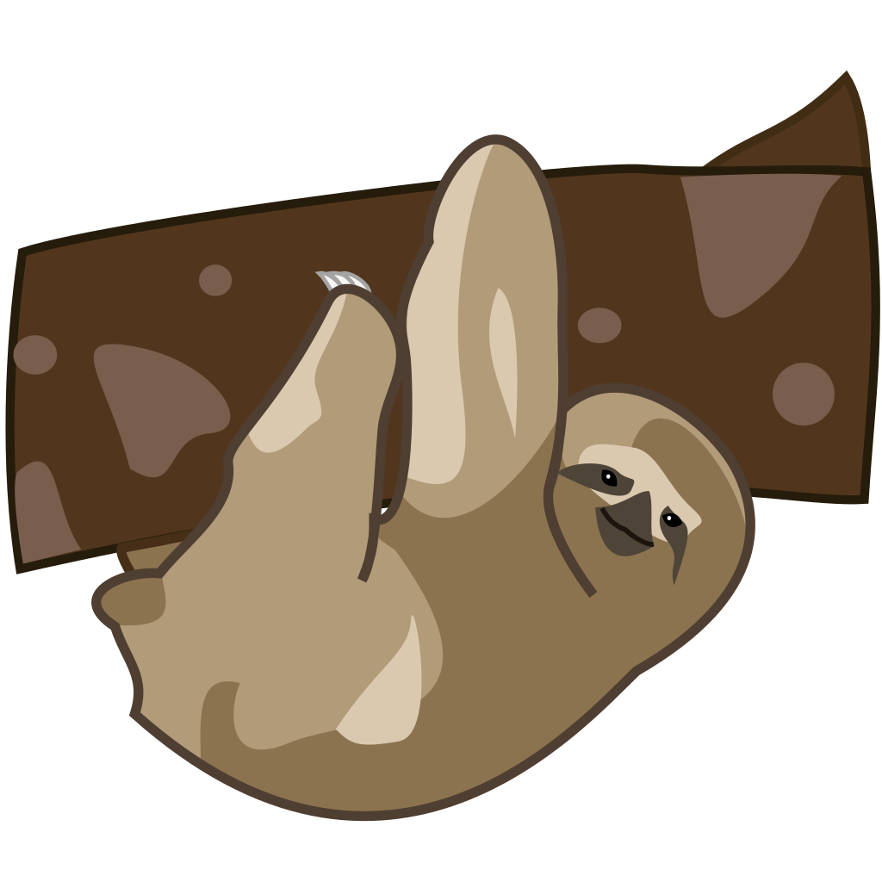
Nice work! We found the sleepy sloth!
Press to start the next adventure!

Slide 4

Nice work! Now let’s see who is at the math river! Here we will switch from dots to numbers
We’ll do some practice first.
Press to start the practice round!
🎉
🎉
🎉
🎉
🎉
🎉

Slide 5
Press to start the practice round!

Slide 6
Well done!
Press to start real adventure!
🎉
🎉
🎉
🎉
🎉
🎉
🎉
🎉
🎉

Slide 7

Nice work! We found the happy hippo!
Press to start the next adventure!

Slide 8

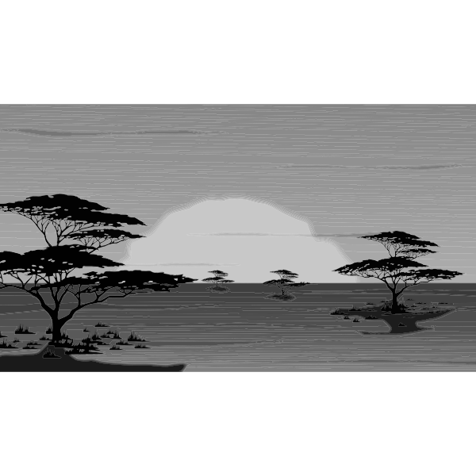

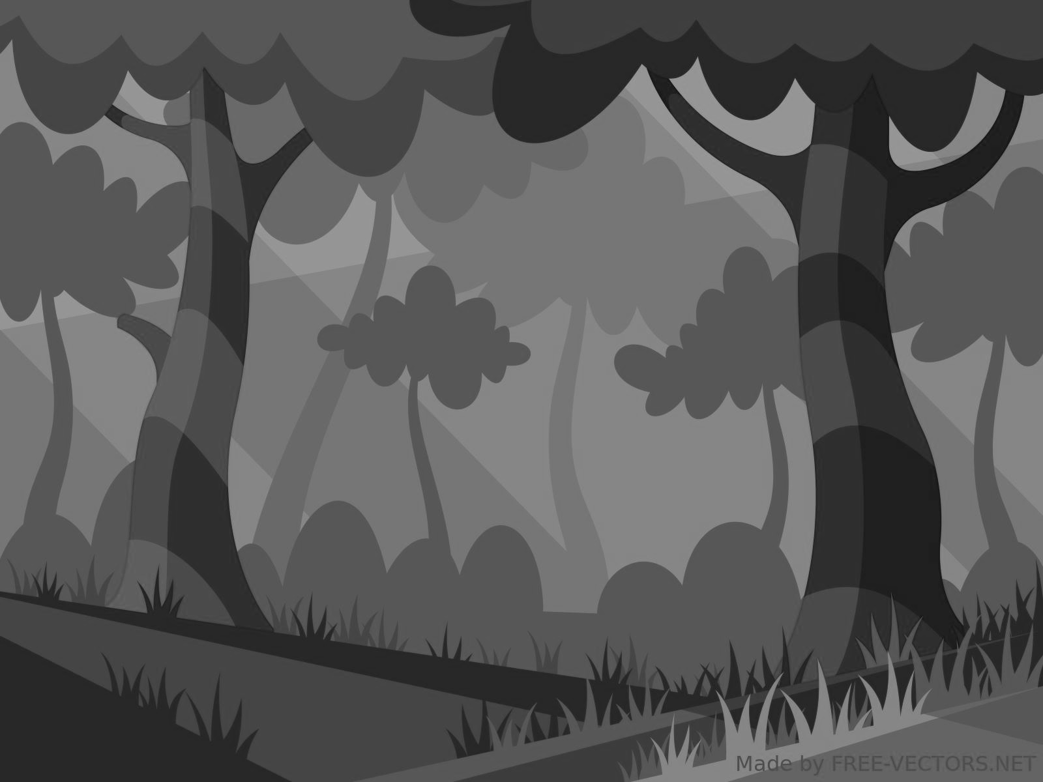
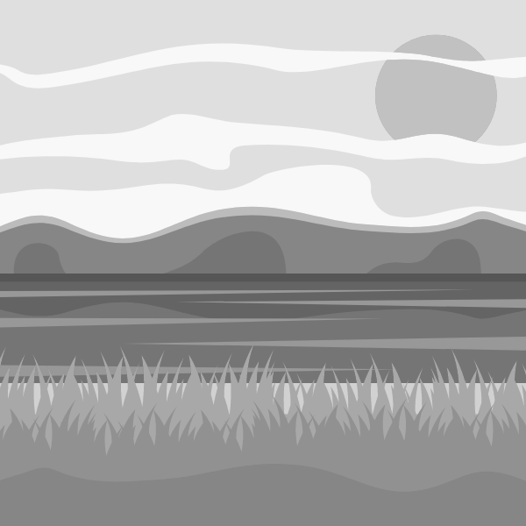
Next stop are the Math Mountains!
The rules here change a little so let’s learn them!

Slide 9

Well done!
Press practice!
🎉
🎉
🎉
🎉
🎉
🎉
🎉
🎉
🎉

Slide 10
Well done!
Press to start real adventure!
🎉
🎉
🎉
🎉
🎉
🎉
🎉
🎉
🎉

Slide 11

Nice work! Almost there! Let’s take a hot coco break
Press to keep going!

Slide 12

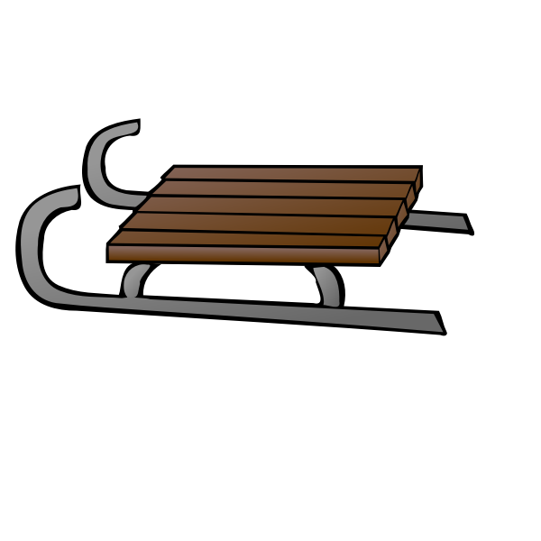
Nice work! We found the sledding snow leopard!
Press to start the next adventure!

Slide 13
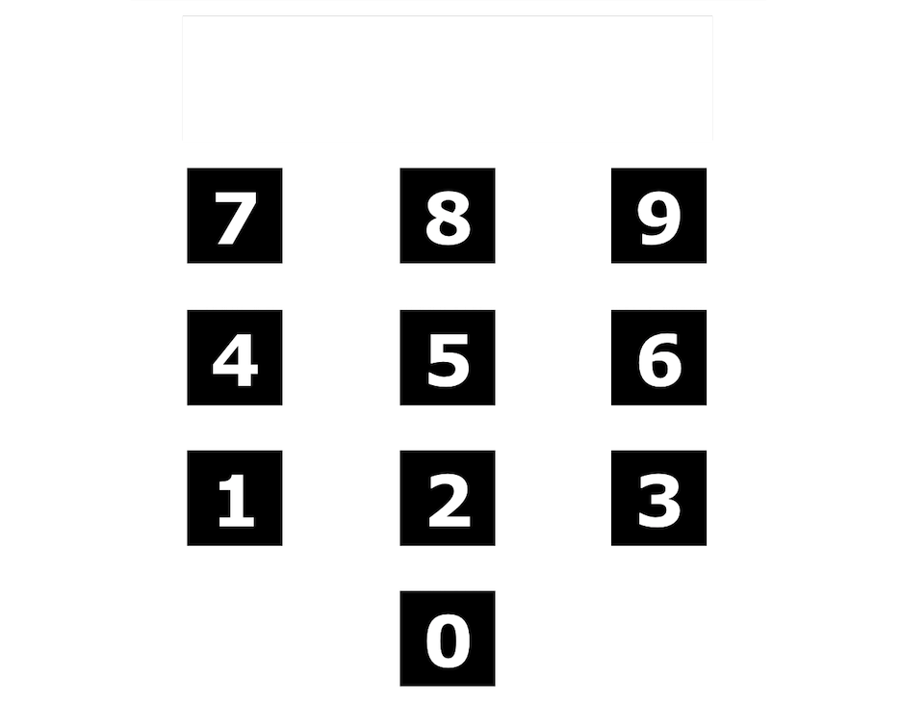



In the first game, we are going to figure out how many dots are on the screen!
Use the keypad to enter your answer.
If you want to change your answer, use the eraser button to change your answer.
When you know the answer, press the green check button
If you don’t know the answer and want to skip, press the ”Not Sure” button

Slide 14
Now we are going to switch from dots to numbers
and solve some math problems!
Use the keypad to enter your answer.
If you want to change your answer, use the eraser button to change your answer.
When you know the answer, press the green check button
If you don’t know the answer and want to skip, press the ”Not Sure” button

