Slide 1

Willson Financial Case Study Solution
Group Name: Alpha Team
Team Members:
Edgar Arroyo
Jordany Gonzalez
Andres Melendez
Jeffrey Reid

Slide 2
Group Introduction
Edgar Arroyo
Project Manager, Quality Assurance
Jordany Gonzalez
Product Owner, Developer
Andres Melendez
Co-Lead Developer, Business Analyst
Jeffrey Reid
Co-Lead Developer, Software Tester

Slide 3
Case Study Overview
Background: Jake and Ned Willson started Willson Financial to provide financial management and advising services in their town.
Objective: To step back and analyze the client list, their assets, and the billing process to ensure optimal service and business profitability.
Challenges: Tracking client growth, managing assets, and ensuring regulatory compliance.

Slide 4
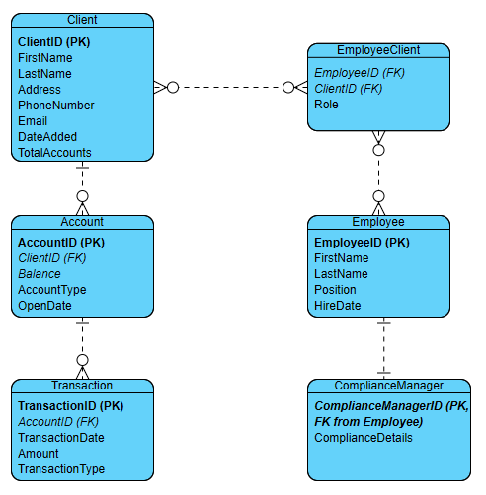
ERD
Client: Stores information about clients.
Account: Stores account information related to clients.
Transaction: Records all transactions related to accounts.
EmployeeClient: Maps employees to clients.
Employee: Stores information about employees.
ComplianceManager: Specific type of employee responsible for compliance.

Slide 5
Report Descriptions
Report 1: Number of Clients Added Per Month
Purpose: Track client growth over the past six months.
Query: Counts clients added each month.
Report 2: Average Amount of Assets for Clients
Purpose: Determine the average assets managed per client.
Query: Calculates the average balance across all accounts.
Report 3: High Transaction Clients
Purpose: Identify clients with a high number of transactions.
Query: Lists clients with more than ten transactions in the past month.

Slide 6
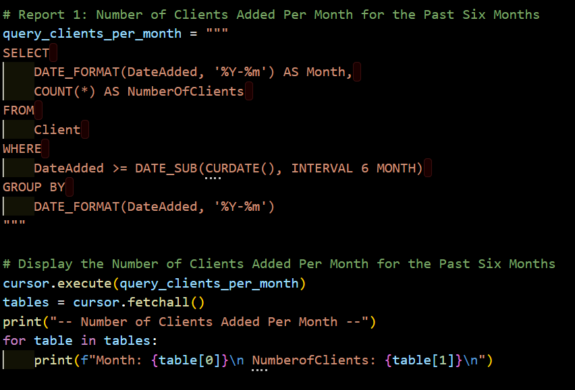
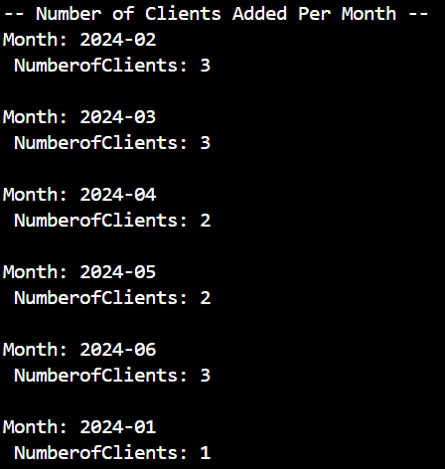
Report 1 - Number of Clients Added Per Month
Description: This report calculates the average amount of assets managed per client.
Python Script
Output
Description: This report tracks the number of new clients added each month for the past six months.

Slide 7
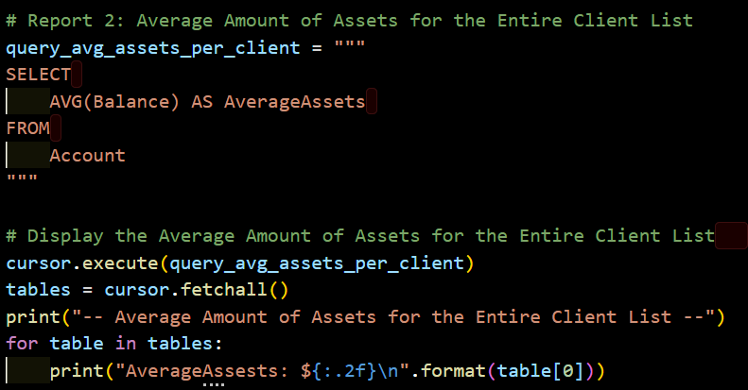

Report 2 - Average Amount of Assets
Description: This report calculates the average amount of assets managed per client.
Python Script
Description: This report calculates the average amount of assets managed per client.
Output

Slide 8
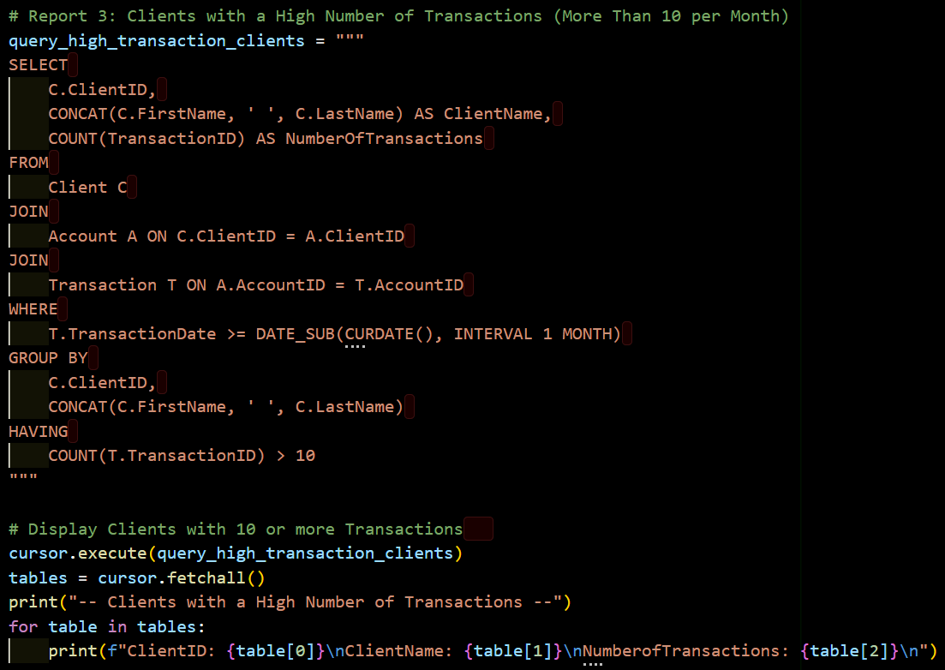
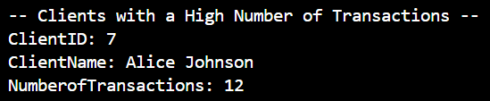
Report 3 - Clients with High Transactions
Python Script
Description: This report identifies clients with more than 10 transactions in the past month.
Output

Slide 9
Assumptions
Client Growth: Assumed clients are added consistently each month.
1
Transaction Frequency: Assumed some clients are highly active, leading to more than ten transactions per month.
2
Compliance: Assumed strict adherence to SEC regulations, necessitating dedicated compliance management.
3
Data Integrity: Ensured all foreign key relationships were maintained to avoid orphan records.
4

Slide 10

Conclusion
Summary:
Implemented a robust database design to support Willson Financials' operations.
Generated essential reports to aid in business decision-making.
Ensured compliance and data integrity throughout the process.

